Slide 1
Association Rules
MSCI:6070 Data Science

Slide 2
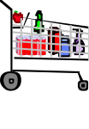
What are Association Rules?
Study of “what goes with what”, also called “market basket analysis” and “affinity analysis”
Originated with study of customer transactions databases to determine associations among items purchased
Extract information on purchasing behavior
Actionable information: can suggest
new store layouts
new product assortments
which products to put on promotion
Notes:
Open amazon.com

Slide 3
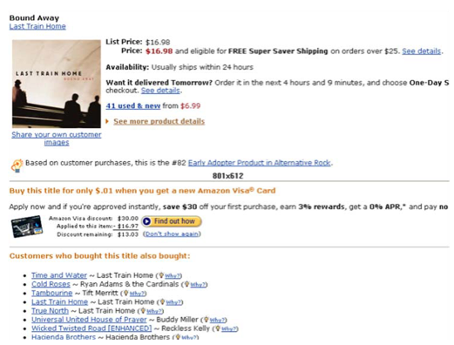
Example in recommender systems
Notes:
what does the data look like?

Slide 4
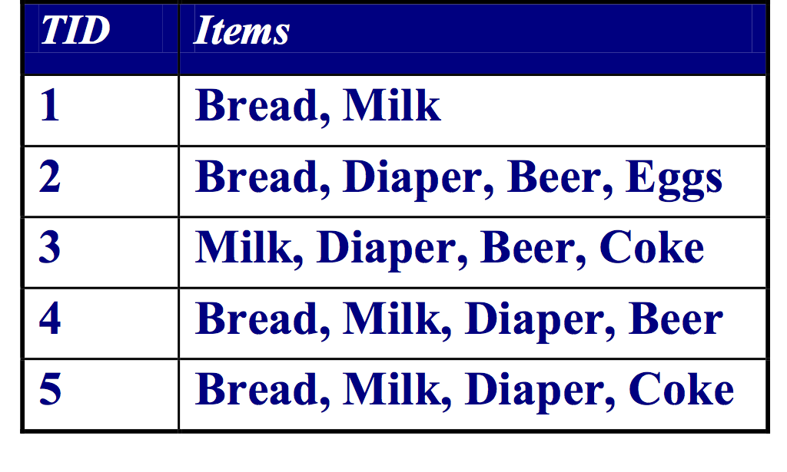
Frequent Itemset and Association Rules
Itemset
A collection of one of more items
Example: {Milk, Bread, Diaper}
A K-itemset is a set of K items
Association Rule
An implication expression of the form X → Y, where X and Y are non-overlapping itemsets
X: antecedent
Y: consequent
Example: {Milk, Diaper} → {Beer}
Market-Basket transactions
Co-occurrence is not causality!
Notes:
Relate to trees
Given a set of transactions, find rules that will predict the occurrence of an item based on the occurrences of other items in the transaction
“if a customer purchases three-way calling, then will also purchase call-waiting”
Does the rule look familiar to you?
Probability {milk, diaper, beer}
Support = 2/5 = .4
Minimum support should be determined on granularity of the rules (lower granularity lower support)

Slide 5
Discovering Rules from Itemsets
Let use consider the 3-itemset {I1, I2, I5}:
I1, I2 —> I5
I1, I5 —> I2
I2, I5 —> I1
I1—> I2, I5
I2—> I1, I5
I5—> I1, I2
Notes:
3 items
How many rules could we create?
2^3
K items
2^k

Slide 6
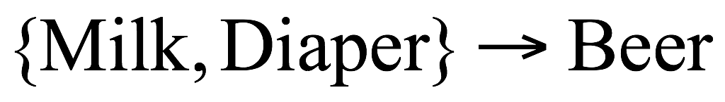
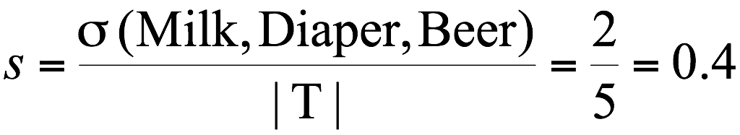
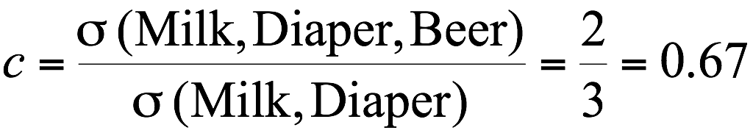
Rule Strength Measures I
Association Rule: X —> Y
Support (s)‏
Fraction of transactions that contain both X and Y
Confidence (c)‏
Measures how often Y appears in transactions containing X
Example:
count
What happens if we use a rule with low support to make a prediction?
what if we use a rule with low confidence?
Notes:
Confidence is a conditional probability (want this to be big, means info given improved chances)
If {Milk, Diaper} -> bread =
P(Bread | Milk & Diaper)
Translation: if I tell you it contains milk and diaper what is the probability that it contains bread
P(bread | milk & diaper) >> P(bread)
Ratio of the two: is lift
P(bread | milk & diaper) / P(bread) should be greater than 1 to be a good rule
Low confidence but high lift -> p(consequent | antecendent) is small but p(consequent) is much smaller gives you a high lift

Slide 7
Rule Strength Measures I
We should only consider rules derived from itemsets with high support, and that also have high confidence.
A rule with low support is likely to overfit
A rule with low confidence is not meaningful.
Rules don’t explain anything, they just point out hard facts in data volumes.
When we mine rules from data, we usually specify a minimum support (and a minimum confidence)

Slide 8
Rule Strength Measures II
Lift of rule r = confidence(r) / support of consequent
Lift > 1 indicates a rule that is useful in finding consequent items sets (i.e., more useful than just selecting transactions randomly)

Slide 9
Interpretation of Metrics
Lift ratio shows how effective the rule is in finding consequents (useful if finding particular consequents is important)
Confidence shows the rate at which consequents will be found (useful in learning costs of promotion)
Support measures overall impact

Slide 10
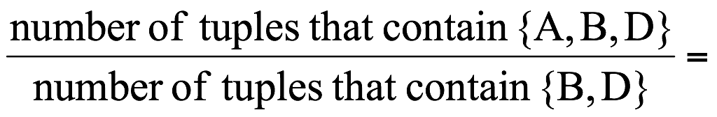
Example
TID date items_bought
100 10/10/99 {F,A,D,B}
200 15/10/99 {D,A,C,E,B}
300 19/10/99 {C,A,B,E}
400 20/10/99 {B,A,D}
What is the support and confidence of the rule: {B,D} → {A}
Support:
percentage of tuples that contain {A,B,D} =
75%
Confidence:
100%
Lift
= 1

Slide 11
Practice
Market-Basket transactions
{Milk, Beer} —> {Diaper} (s = 0.4, c = 1)
{Diaper, Beer} —> {Milk} (s = 0.4, c = 0.67)
{Beer} —> {Milk, Diaper} (s = 0.4, c = 0.67)
Notes:
if we only want highly confident rules but ignore

Slide 12
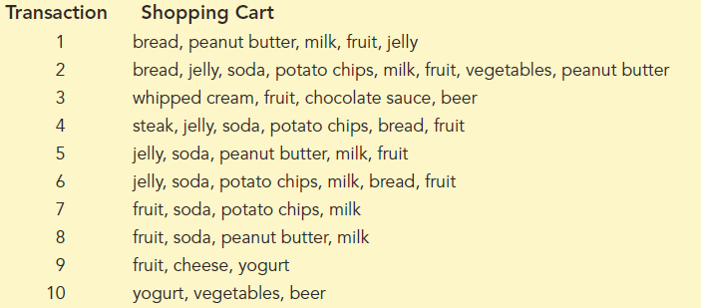
Another Example
Notes:
Compute confidence of If bread and fruit then jelly.
S = 4/10
C = 4/4 P{jelly | bread and fruit} how many transactions have bread and fruit and how many of these contain jelly
Lift = 1/ (5/10) P{jelly | bread and fruit} / P{jelly} = 2 (lift of 2 means 100% increase)
Compute confidence of If soda then milk
S = 5/10
C = 5/6
Lift = (5/6) / (6/10 ) = .83/.6 = or = .5 / (p{soda} x p{milk} this rule increase probability by 38% = .5 / (.6*.6)
6/10 is P(milk)
38% means that if you look in basket and see soda you at 38% greater to have milk as compared to not looking

Slide 13
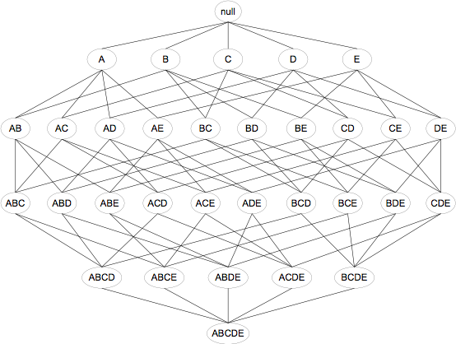
Brute-force Itemset Generation
Given d items, there are 2^{d} possible candidate itemsets

Slide 14
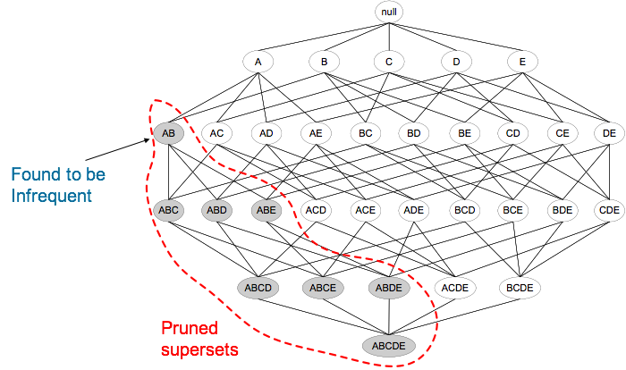
Association Rule Mining Task
Given a set of transactions D, the goal of association rule mining is to find all rules having
support ≥ minsup threshold
confidence ≥ minconf threshold
Rule Mining methods
Apriori, Eclat, FPgrowth, etc
Notes:
support and confidence

Slide 15
Apriori Algorithm
Most popular rule mining algorithm
Apriori pinciple:
Frequent Itemset Property:
Any subset of a frequent itemset is frequent.
Contrapositive:
If an itemset is not frequent, none of its supersets are frequent.
Support of an itemset never exceeds the support of its subsets
This is known as the anti-monotone property of support
e.g., If {Milk, Bread} has support 0.3 — 30% of transactions contain milk and bread, what is the support of {Milk} or {Bread}?
Transactions containing milk and bread are subsets of transactions containing milk
{Milk}
{Milk,Bread}
{Bread}

Slide 16
Apriori Algorithm
Method:
First Let k=1
Generate frequent itemsets of length 1
Repeat until no new frequent itemsets are identified
Generate length (k+1) candidate itemsets from length k frequent itemsets
Prune candidate itemsets containing subsets of length k that are infrequent
Count the support of each candidate by scanning the DB
Eliminate candidates that are infrequent, leaving only those that are frequent

Slide 17
The Apriori Algorithm
At step K:
assuming k = 3 (& k-itemsets lexicographically ordered)
{3,4,5}, {3,4,7}, {3,5,6}, {3,5,7}, {3,5,8}, {4,5,6}, {4,5,7}
generate all possible (k+1)-itemsets, by, for each to sets where we have
{a1,a2,..a(k-1),X} and {a1,a2,..a(k-1),Y}, results in candidate {a_1,a_2,...a_(k-1),X,Y}.
{3,4,5,7}, {3,4,5,6},{3,5,6,7}, {3,5,6,8}, {3,5,7,8}, {4,5,6,7}
prune all itemset candidates with non-frequent subsets. Like; {3,5,6,8} self never frequent since subset {5,6,8} is not frequent.
Actually, here, only one remaining candidate {3,4,5,7}
Last; after pruning, determine the support of the remaining itemsets, and check if they make the threshold.

Slide 18
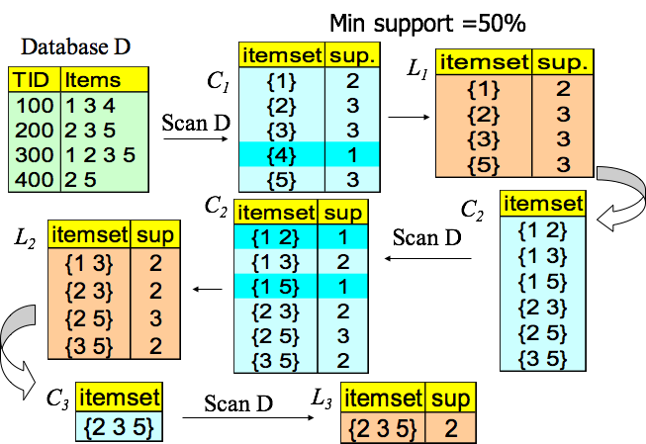
The Apriori Algorithm — Example

Slide 19
Issues with Association Rule Mining
Granularity of features will affect relations that can be identified
Need feature engineering (manually group features or create tags)
Transaction ID | Items
23435 | Yeast bread, 1% fat milk
342 | Flatbread, 2% fat milk
23159 | Pancake, whole milk
9865 | corn bread, whole milk, egg
7653 | wheat bread, skim milk
64219 | Crispy bread, avacado

Slide 20
Alternate data format - binary matrix
ID | Iterms | Booking?
1 | Finance, Cooking | Y
2 | Sports, Cooking | N
3 | Finance, Sports, Fashion | Y
4 | … | …
Association Rule: X —> Y (If X, then Y)
Which customers to send the advertisement?
ID | Finance | Sports | Fashion | Cooking | Booking?
1 | Y | N | N | Y | Y
2 | N | Y | N | Y | N
3 | Y | Y | Y | N | Y
4 | Y | Y | Y | Y | Y
5 | N | Y | N | Y | N
6 | N | N | Y | Y | N
7 | Y | N | Y | N | Y
ID | Iterms | Booking?
1 | Finance, No sports, No Fashion, Cooking | Y
2 | No finance, Sports, No fashion, Cooking | N
3 | Finance, Sports, Fashion, No cooking | Y
4 | … | …
Notes:
treat the dataset as a bag of words

Slide 21
Interesting/Useful Rules
Statistically, anything that is interesting is something that happens significantly more than you would expect by chance.
For example, basic statistical analysis of basket data may show that 10% of baskets contain beer, and 4% of baskets contain diaper. i.e: if you choose a basket at random:
There is a probability 0.1 that it contains beer.
There is a probability 0.04 that it contains diaper.
What is the probability of a basket containing both beer and diaper? The laws of probability say:
If these two things are independent, chance is 0.1 * 0.04 = 0.004
That is, we would expect 0.4% of baskets to contain both diaper and beer

Slide 22
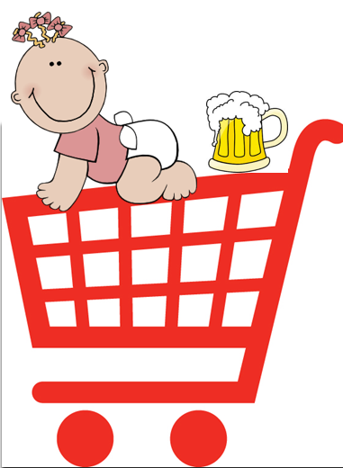
Interesting means surprising
We therefore have a prior expectation that just 4 in 1,000 baskets should contain both beer and diaper.
If we investigate, and discover that really it is 20 in 1,000 baskets, then we will be very surprised. It tells us that:
Something is going on in shoppers’ minds: beer and diaper are connected in some way.
There may be ways to exploit this discovery … put the beer and diaper at opposite ends of the supermarket?
See this post

Slide 23
Summary
Association rules (or affinity analysis, or market basket analysis) produce rules on associations between items from a database of transactions
Widely used in recommender systems
Most popular method is Apriori algorithm
To reduce computation, we consider only “frequent” item sets (=support)
Association rules can be used for classification
Association rules can be used to discover surprising relations from data

