Slide 1
Motivation
Get rid of selection bias from only using patients’ data with multiple visits.
Use hierarchical ontology of medical codes to be able to recommend less frequent medications from their related codes.

Slide 2
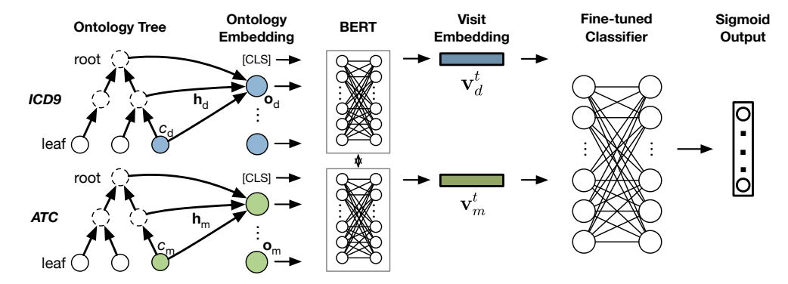
G-Bert Architecture
- Graph neural network to make embeddings of ontology
- Use transformer (BERT) to get visit embedding.
- Train on masked medications codes and diagnosis visit embeddings
- Fine tune using sequences of visit embeddings to predict current visit medication
https://arxiv.org/pdf/1906.00346.pdf

Slide 3
Implementation
Initial idea was to implement our own code.
Had to use Shang et al. Code for graph neural network.
Used author’s code for running tests

Slide 4
Graph Model Evaluation
Graph Model | Jaccard | F1 | PR-AUC
No | 0.4033 | 0.5640 | 0.6445
Yes | 0.3872 | 0.5495 | 0.6382

Slide 5
Hidden Size Ablation
Hidden Size | Parameters | Jaccard | F1 | PR-AUC | Time (hrs)
75 | 717655 | 0.3872 | 0.5495 | 0.6382 | 1.02
150 | 1632880 | 0.3939 | 0.5531 | 0.6387 | 1.95
225 | 2750605 | 0.3796 | 0.5409 | 0.6231 | 3.02
300 | 4215470 | 0.4386 | 0.599 | 0.6828 | 3.78
375 | 5593555 | 0.3684 | 0.5295 | 0.6126 | 5.05

Slide 6
Attention Head Ablation
Heads | Jaccard | F1 | PR-AUC | Time (hrs)
1 | 0.4132 | 0.5741 | 0.6522 | 3.57
2 | 0.4113 | 0.572 | 0.6566 | 3.67
3 | 0.4113 | 0.573 | 0.6559 | 3.75
4 | 0.4386 | 0.599 | 0.6828 | 3.78
5 | 0.3938 | 0.5537 | 0.6307 | 4.20

