Slide 1

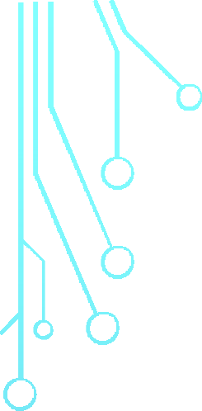







DIGITAL PORTFOLIO
STUDENT NAME: PAVITHRA.A
RESGITER NO : 24131030500122023
NMID: CD901081D2D238F904B49C83FDEB89AA DEPARTMENT: BCA-II Year
COLLEGE: GOVERNMENT ARTS COLLEGE,B.MUTLUR.
1

Slide 2
PROJECT TITTLE
Digital Portfolio
A Digital Portfolio is a personal website that displays an individual’s skills, education, projects, and achievements in a well-organized and attractive format.
It is designed using HTML, CSS, and optionally JavaScript to create a simple and responsive layout.

Slide 3
AGENDA
Problem Statement
Project Overview
End Users
Tools and Technologies
Portfolio design and Layout
Features and Functionality
Results and Screenshots
Conclusion
GitHub Link

Slide 4

PROBLEM STATEMENT
Problem statement
To design and develop a personal portfolio website for a BCA student that displays details such as profile, education, skills, and contact information in a simple and responsive manner.
The website should:
Provide smooth navigation across sections like Home, About, Skills, Education, and Contact.
Present information clearly with an attractive layout. Work on
4

Slide 5

PROJECT OVERVIEW
Project Overview – Digital Portfolio Website
Project Title:Personal Digital Portfolio PAVITHRA.A BCA Student
Objective: To design and develop a responsive portfolio website to showcase academic background, skills, and contact details professionally.
5

Slide 6
PROJECT OVERVIEW
3.Key Features
Navigation Bar – Links to Home, About, Skills, Education, and Contact sections.
Hero Section – Displays name, title, location, and social links.
About Section – Overview of education and career interests.
Skills Section – Programming skills in HTML, CSS & js.
Contact Form – Allows visitors to get in touch via email.
Responsive Design – Compatible with mobile and desktop devices
5

Slide 7

WHO ARE THE END USERS ?
Potential Employers / Recruiters
To review your skills, education, and contact information for internships or job opportunities.
College Faculty / Academic Evaluators
To assess your project work, presentation, and technical knowledge.
Peers / Collaborators
Fellow students, developers, or friends who may want to collaborate on projects.
General Visitors
Anyone interested in learning about your background, skills, and academic journey.
8

Slide 8

TOOLS AND TECHNIQUES
Tools Used
HTML5 – Structure and content of the website.
CSS3 – Styling, layout, and visual design.
Font Awesome – Icons for navigation and sections.
JavaScript – Interactivity (menu toggle,
form handling).
Code Editor(codepen/ easy coder web)–
For writing and edit Chrome code.
Web Browser(Chrome)– For testing and running the website.
9

Slide 9
PORTFOLIO DESIGN LAYOUT
Design
Minimal & Professional Look – Clean and simple interface with a focus on content.
Font Awesome Icons– For visual appeal and navigation clarity.
Color Scheme – Soft background with readable text contrast.
Typography – Clear headings and readable body text.
11

Slide 10
FEATURES AND FUNCTIONALITY
Functionality
Smooth Scrolling between sections using navigation links. Clickable Social Media Buttons to redirect to LinkedIn.
Form Submission to collect visitor messages (can be linked to email or database in future).
Mobile-Friendly Layout ensuring proper alignment across all devices.

Slide 11
RESULTS AND SCREENSHOT
A fully functional personal digital portfolio website was created.
Showcases profile, education, skills, and contact information in
an interactive layout.
Responsive design works seamlessly on desktop and
mobile devices.
Provides easy navigation and direct LinkedIn integration
.
3/21/2024
15

Slide 12
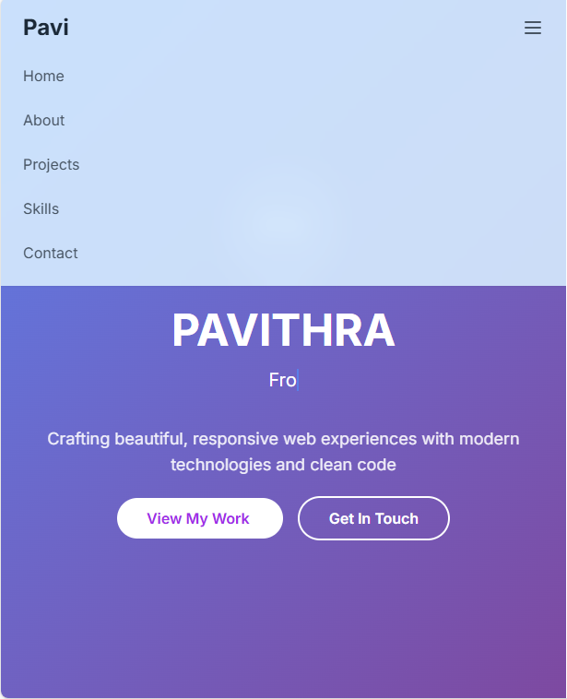
SCREENSHOT
Homepage– Showing name, title, and avatar.

Slide 13
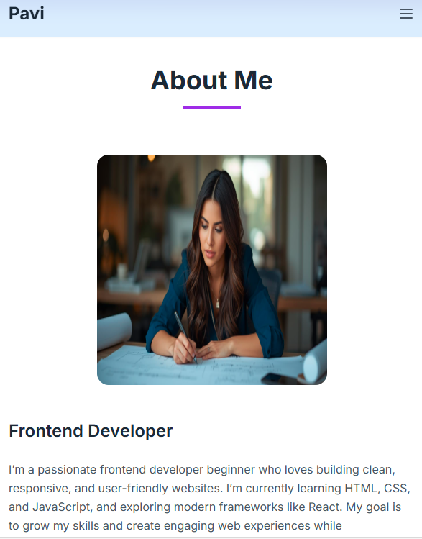
About Section – Displaying bio and highlights.

Slide 14
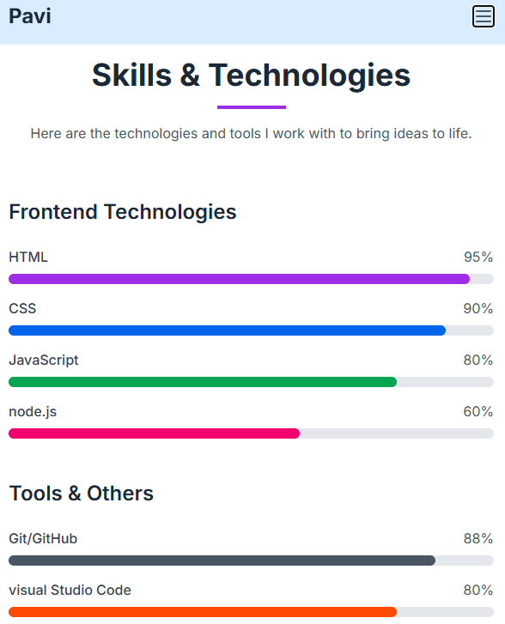
Skills Section – Listing programming languages.

Slide 15
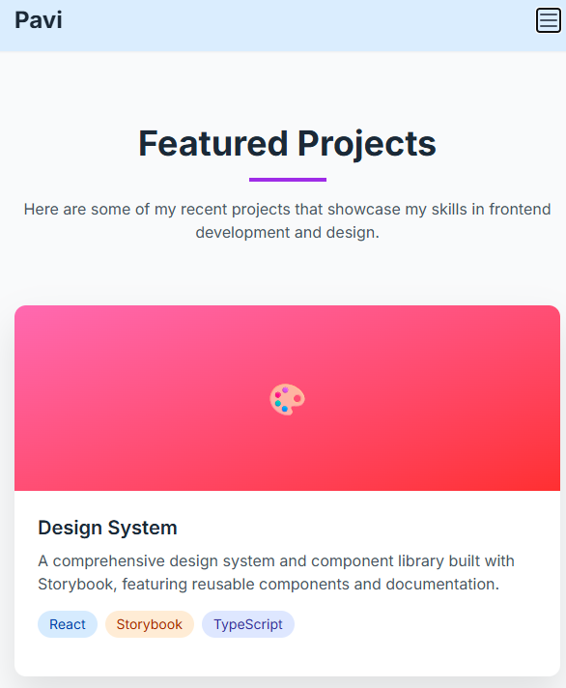
Project –design and working MS office.

Slide 16
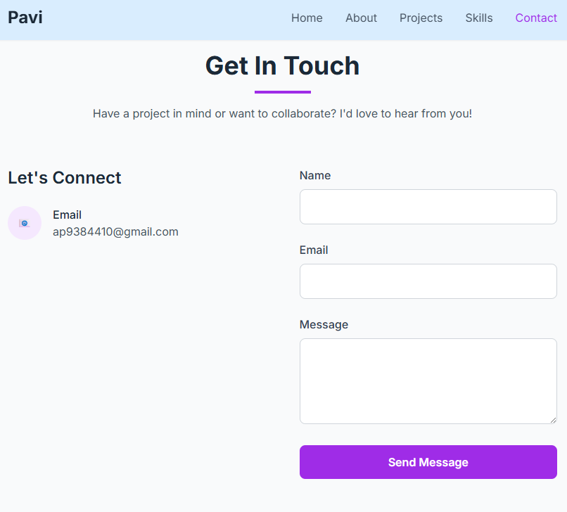
Contact Section – Email, LinkedIn, and contact form.

Slide 17
CONCLUSION
Conclusion for Digital Portfolio Project
“The Digital Portfolio effectively showcases my personal profile, academic background, technical skills, and career aspirations in an organized and visually appealing format. It serves as a professional platform for potential employers, faculty, and collaborators to learn about my abilities and achievements. The project demonstrates my knowledge of web development using HTML, CSS, and JavaScript and highlights my capability to create user-friendly and responsive designs.”
“THANK YOU”
21

