Slide 1
Saathi
साथी · companion
Personalised learning for every underserved learner.
An AI learning companion that knows exactly what a learner is studying, where they are stuck, and how to help without handing over the answer.
Live product · saathi-ap19.vercel.app
Buildathon MVP · August 2026 · Built by Akriti Panwar

Slide 2
01 · PROBLEM
Enrolment was solved. Learning was not.
Children move up a grade without mastering the last one
India put 248 million children in school. It did not put a tutor beside each one. Overcrowded classrooms mean a doubt raised on Monday is still a doubt in December — and Class 8 is built on Class 6.
Help exists, but it is priced out of reach
Private tuition is the default answer to falling behind, and it costs more than the families who need it most can pay. The learner who most needs personalised support is the one who structurally cannot buy it.
Parents want to help and have nothing to work with
They lack the time, the subject knowledge, and any visibility beyond an exam mark that arrives months too late. Wanting to support a child is not the same as being able to.
The learners furthest from support are overlooked first
Economically disadvantaged, disabled and neurodiverse learners are the ones a stretched system drops first — and the ones no product is designed around.
Existing products each solve one fragment.
Video platforms deliver content but cannot personalise teaching. Generic AI assistants answer questions but do not know the learner's curriculum or history. Practice apps assess without adapting instruction. Tutoring personalises but does not scale. Nobody joins them up.
Source: PRD §2 — Problem Statement. Enrolment figure: UDISE+ 2023-24.
Saathi · Personalised learning for every underserved learner
1

Slide 3
02 · SOLUTION
A companion that knows what you are learning.
Saathi is not a chatbot with a syllabus attached. It is a curriculum-aware learning journey — and the AI is grounded in the exact lesson on the learner's screen.
Chapter
›
Micro-lesson
›
AI Tutor
›
Guided practice
›
Chapter quiz
›
Mastery + insights
Grounded, not generic
Every tutor call carries the current lesson's text and that learner's concept mastery. It teaches inside the curriculum, and it hints before it answers — a learner handed the answer has learned nothing.
Adapts to the concept, not the score
Mastery is tracked per concept, not per chapter. Practice difficulty steps up and down on performance, and the next lesson is recommended from what is actually weak.
Hindi from day one
Full UI, curriculum content and AI tutor in Hindi and English. For a Hindi-medium learner, language is not a feature — it is the front door. Personalisation is worthless to someone who cannot read the lesson.
A parent loop that needs no parent
A weekly summary reaches a supporting adult through a link — no account, no app, no login. Because the adult who checks may be a grandmother, an older sister, or a teacher.
Built to keep someone coming back
A closable daily goal, a streak with a grace day, milestones. No hearts, no leaderboards, no guilt — mechanics that punish invert badly for a learner who is already behind.
A human when AI is not enough
Repeated struggle on one concept is detected, and the learner is offered a real person. Framed as an offer, never as a diagnosis.
Saathi · Personalised learning for every underserved learner
2

Slide 4
03 · MARKET VALIDATION
The phone is already in their hand.
The access problem is close to solved. The reason-to-open-it problem is wide open — and that is the one Saathi is built for.
~90%
of rural households with a child aged 14–16 own a smartphone
Device access is no longer the binding constraint.
57%
of those children used one for anything educational last week
76% used one for social media in the same week.
248M
students enrolled in Classes 1–12 — and the number is falling
26.4 crore average (2018–22) → 24.8 crore (2023-24).
The 33-point gap is the product thesis.
Nine in ten of these children can reach a learning app; barely half open one. Distribution here is not a hardware problem, it is a habit problem — which is why the daily goal, the streak and the weekly parent summary are MVP scope and not Phase 3 polish.
A buyer already exists, and it is mandated
Section 135 of the Companies Act requires qualifying companies to spend 2% of net profit on CSR. Education is the most-funded category. A per-learner programme is exactly the shape CSR budgets buy.
Learning outcomes lag enrolment, persistently
Foundational gaps compound: a learner who misses equivalent fractions in Class 6 fails algebra in Class 8 for a reason nobody diagnoses. Hence concept mastery as the unit, not syllabus completion.
Sources: ASER 2024 (National findings, rural, ages 14–16) · UDISE+ 2023-24 · Companies Act 2013, §135. Full derivation in docs/MARKET_AND_PRICING.md.
Saathi · Personalised learning for every underserved learner
3

Slide 5
04 · MARKET SIZE
₹1,500 Cr serviceable. 250,000 learners is the honest goal.
India only. ₹85 = $1. These are derived estimates from public data, not commissioned research — every input and its confidence level is published with the model.
TAM
~248M learners
₹12,400 Cr (~$1.46B)
Every school-going learner in India, Classes 1–12, at a ₹500/learner/year blended ARPU ceiling.
SAM
~30M learners
₹1,500 Cr (~$176M)
Classes 6–8 (~65M) × ~62% on NCERT or NCERT-aligned state curricula × ~75% with usable household smartphone access.
SOM
~250,000 learners
₹10–11 Cr (~$1.25M ARR)
Year 3, via 15–25 NGO/CSR partners (~150k), 2–3 district government pilots (~75k) and organic word of mouth (~25k). ≈0.8% of SAM.
The weakest input, named rather than buried
NCERT alignment at 62% is the least certain number in the model and swings SAM by roughly ±10 million learners. Verifying state-board textbook adoption is the first research task, not a footnote.
For a social-impact product, learners reached is the headline
Revenue is the sustainability constraint, not the goal. We lead with 250,000 learners and treat ₹10.6 Cr as what it costs to keep serving them.
Saathi · Personalised learning for every underserved learner
4

Slide 6

05 · PRIMARY PERSONA (MVP)
Aarav, 13. He is not bad at maths.
He is three weeks behind, and nobody noticed which three weeks.
The phone is his mother's. He gets it after dinner, sometimes, and there is one charger for the house.
When he puts his hand up in class, thirty-eight other children are also waiting. So mostly he does not put his hand up.
He has tried YouTube. YouTube is excellent and does not know that he never really got equivalent fractions, so it keeps explaining the wrong thing beautifully.
He has asked a chatbot too. It gave him the answer immediately. He copied it down, felt briefly clever, and could not do the next question either.
His mother asks how school is going. He says fine. It is the only answer he has, because nobody has ever shown either of them what he actually does and does not understand.
Age 13
WHAT HE ACTUALLY NEEDS
Class 7, government school
Someone who knows where he is
Hints, not answers
To feel like he is winning at something
Someone to notice
Curriculum NCERT Mathematics
Device his mother's Android
Language Hindi at home, English textbook
Composite persona from PRD §5. Illustrated rather than photographed — Aarav is a representative learner, not a real child.
Saathi · Personalised learning for every underserved learner
5

Slide 7
06 · PRODUCT
Eight features. One loop.
Everything below is live in the MVP at saathi-ap19.vercel.app — NCERT Mathematics, Classes 6–8, one chapter per grade, in Hindi and English.
Curriculum dashboard
Grade, chapters, lessons as a visible journey path, with a recommended next lesson and a closable daily goal.
Micro-lessons
One concept at a time, in the learner's language, with KaTeX-rendered maths and worked examples.
AI Tutor
Claude Sonnet 5, grounded in the current lesson text and the learner's concept mastery. Streams, hints first, refuses off-curriculum.
Guided practice
Adaptive difficulty, instant deterministic grading, a hint ladder from nudge to worked solution.
Chapter quiz
Mastery per concept, order varied per attempt, revision recommended from what was actually missed.
Progress, streaks, milestones
Personal progress only. No ranks, no leaderboards, no lives — a grace day so one bad evening costs nothing.
Parent companion
A weekly summary a supporting adult reads without an account. Tutor conversations are never in it.
Request a human mentor
Offered when repeated struggle is detected on one concept. An offer, never a diagnosis.
Also shipped, because they are not optional for this audience: WCAG 2.1 AA throughout · full keyboard navigation · 44px touch targets · prefers-reduced-motion honoured · installable PWA, no app store required · designed at 360px first
Saathi · Personalised learning for every underserved learner
6

Slide 8
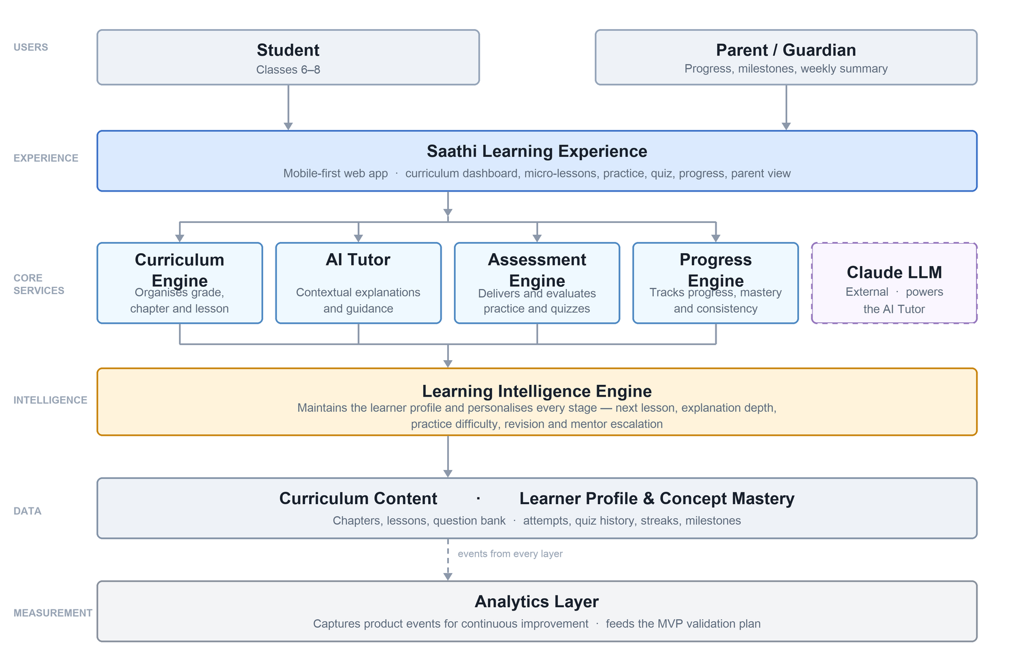
07 · HOW WE BUILT IT
Four days. Every constraint met as a decision.
STACK
Next.js 16 App Router (TypeScript), installable PWA on Vercel · Supabase Postgres, row-level security on every table · Claude Sonnet 5 for tutoring and hints, Haiku 4.5 for batch · KaTeX · Twilio WhatsApp behind a channel-agnostic adapter
Grading is code, never AI
A model asked "is this correct?" is wrong occasionally and silently, and the cost lands on a child who was right. Deterministic grading treats 1/2, 2/4 and 0.5 as one answer. AI writes hints and explanations only.
Answer keys never reach the browser
Learners read a view with no answer column; grading happens server-side. Three files in the whole repo may read the base table, and a test fails if that list grows.
The parent link needs no parent account
Requiring a login from the adult would have excluded the grandmother, the older sister and the teacher — often the adult who actually checks.
The full build story — architecture, the trade-offs made under a four-day clock, and everything left in the backlog with its reason — is the accompanying PDF.
github.com/ap9650/saathi
Saathi · Personalised learning for every underserved learner
7

Slide 9
08 · NEXT
The next 1–2 months, if the feedback says go.
Ordered by what real users have already told us, not by what is fun to build. The first three came out of testing this week.
01
Widen the question bank
A tester retook a quiz and got the same eight questions — because there are only eight per chapter. Order now varies per attempt; the real fix is 16 per chapter. ~6 hours, most of it verifying answer keys.
02
Teach on a rounded decimal instead of failing it
Grading demands six decimal places on a recurring answer, so 5/12 as 0.42 is marked wrong. It should say "very close — write it as a fraction". Correct arithmetic, useless pedagogy.
03
Make the adaptive ladder visible
Practice already steps difficulty up and down. The learner cannot see it. "Nice — let's try a harder one" on the way up, and silence on the way down, so nobody is told they are failing.
04
Let an adult see the practice
Questions attempted and what the learner answered. Deferred on purpose: showing the correct answer beside it needs a server-assembled payload, not a new permission on the answer key.
05
WhatsApp off the sandbox
The Twilio sandbox expires a parent's session after three days and cannot carry a weekly template. Moving to WhatsApp Business is Meta verification — paperwork, not engineering. The adapter is already written.
06
A tutor eval set with an LLM judge
20–30 real learner questions with a rubric. Until it exists, every prompt edit is an untested deploy — and the tutor is the differentiator.
07
Hindi authored natively, not translated
Today the Hindi is translated from English. A Hindi-medium learner deserves lessons written in Hindi, in the register a 12-year-old actually speaks.
08
A cohort dashboard
The unlock for the first NGO conversation. They will not buy a product they cannot report on.
Saathi · Personalised learning for every underserved learner
8

Slide 10
09 · ROADMAP
One subject proves it. The rest is authoring.
Curriculum is data — chapters, concepts, lessons and questions are rows, not code. Adding a subject is authoring, not rebuilding. That is a fact about the schema, not a promise.
Phase 1 — now
Validate the core loop
NCERT Mathematics, Classes 6–8 · AI Tutor · guided practice · chapter quiz · progress and streaks · parent summary · mentor request · Hindi and English. Free, deliberately — no pricing experiment runs until H1–H7 have data.
Phase 2 — expansion
Widen subjects, languages and stakeholders
Science and other subjects · more grades · Marathi, Tamil and Bengali (the storage model already supports them) · adaptive learning paths · teacher dashboard · NGO cohort dashboard · first paid CSR pilots.
Phase 3 — inclusive platform
The part of the vision the MVP could not reach
Learners with visual, hearing and speech impairments · neurodiverse learners (ADHD, dyslexia) · voice-first learning · offline learning · AI-powered accessibility · a verified mentor network.
WHO SAATHI IS FOR NEXT
Learners
Students with visual, hearing or speech impairments · neurodiverse learners · adult literacy learners
Institutions
Teachers · government schools · NGOs · CSR education programmes · volunteer mentors
Saathi · Personalised learning for every underserved learner
9

Slide 11
10 · ADOPTION
Reach learners through the adults who already have them.
Paid consumer acquisition contradicts the targeting: you cannot buy your way to users selected for being unable to pay. So distribution runs through people who already hold a cohort.
B2C · DIRECT, UNPAID
INSTITUTIONAL · WHERE THE VOLUME IS
Teachers are the highest-leverage channel
One teacher forwards a link to forty students in a single message. No app store, no install, no cost — Saathi is an installable web link. This is how the first testers were reached, and it is the lowest-CAC route in the model by an order of magnitude.
NGOs and CSR programmes — the volume
15–25 partner organisations at 6–10k learners each, ~150,000 by Year 3. They already run after-school education programmes and already report on them. Section 135 makes the budget mandatory; the cohort dashboard makes it buyable.
Families and word of mouth
An older sibling shows a younger one. A parent sends it to the WhatsApp group. Small, slow, real, and free — modelled at ~25,000 learners by Year 3 with zero acquisition spend.
Government school pilots
2–3 district-level pilots, ~75,000 learners. NCERT alignment is what makes this conversation possible at all — the content is the curriculum they already teach, not a parallel one.
What removes the friction, on every channel
It is a link, not an app store listing — installable, but nothing to download first. · Google Sign-In, because a shared Android phone is already signed in. · Hindi, so the front door is not English. · The parent summary needs no parent account, so an adult can be reached without onboarding them.
Saathi · Personalised learning for every underserved learner
10

Slide 12
11 · COMPETITION
Everyone solves a fragment. The gap is joining them up.
CATEGORY
WHO
WHAT THEY DO WELL, AND WHERE IT STOPS
THE GAP
Video platforms
YouTube, Khan Academy
Excellent content, genuinely free. But it cannot know that this learner never got equivalent fractions, so it explains the wrong thing well.
No model of the individual learner
Generic AI assistants
ChatGPT, Gemini
Strong at maths, and increasingly free. They do not know the learner's chapter, history or gaps — and they hand over the answer on request.
No curriculum, no memory, answers first
Answer-scanning apps
Photomath, Doubtnut
Photograph the question, receive the solution. Fast, and it removes the productive struggle that learning actually consists of.
Solves the homework, not the learner
Premium edtech
BYJU'S, Unacademy, Physics Wallah
Real personalisation and real teaching, sold at a price point and through a sales motion built for families who can already afford tuition.
Priced for families who can pay
Government platforms
DIKSHA, e-Pathshala
NCERT-aligned, free, at national scale. Built as content repositories — no adaptive tutor, no mastery model, no habit loop.
Content, not a companion
Saathi's position: curriculum-aware, mastery-driven, hints before answers, Hindi from day one, free at the core.
The defensible piece is not the model — anyone can call the same API. It is the learner state that grounds every call: which concept is weak, what was answered wrong last week, which lesson is open right now. That compounds with use and does not transfer.
Saathi · Personalised learning for every underserved learner
11

Slide 13
12 · PRICING
Learners never pay for the core. Institutions pay for reach.
The MVP is free, deliberately — a pricing experiment now would contaminate the activation and retention numbers that decide whether the product works at all. Free is a stage, not a missing model.
THE MISSION TIER
Saathi Free
₹0
Full curriculum, micro-lessons, practice, quizzes, progress, streaks, milestones and parent summaries. AI Tutor capped at 10 questions/day.
FAMILIES PAY FOR DEPTH
Saathi Plus
₹99/mo · ₹799/yr
Unlimited AI Tutor, deeper adaptive practice, revision plans, detailed parent insights.
SUPPLY-GATED
Saathi Mentor
+₹299/mo
Adds two human mentor sessions a month. Gated on verified mentor supply — never sold ahead of capacity.
THE REVENUE ENGINE
Saathi for Institutions
₹450–600 / learner / yr
NGO, CSR and government licences. Cohort dashboards, reporting, bulk onboarding.
₹370
per fully active learner per year — the floor
~₹330 AI inference (verified, with cached grounding and Haiku for batch) + ~₹40 infrastructure. No institutional licence is priced below it.
1–2%
assumed free-to-paid conversion
Duolingo converts 9.1% (12.5M paying of 137.8M) after four years of climbing from 5%, on a global and largely affluent base. Assuming that here would be fantasy.
₹10.6 Cr
Year-3 revenue at SOM (~$1.25M ARR)
225,000 institutional at ₹450 + ~4,000 Plus + ~600 Mentor. Margin is thin by design and improves as inference costs fall — not by raising the institutional price.
Sources: Duolingo investor materials (company strategy overview; Q3 FY2025 10-Q) — FY2025 revenue $1.04B, subscriptions 76% of revenue. Saathi unit costs: docs/DECISIONS.md D11, verified against Claude API pricing.
Saathi · Personalised learning for every underserved learner
12

Slide 14
13 · WHAT USERS SAID
Real feedback from real users.
Collected in-app from students, parents and teachers using Saathi on their own phones. Replace the placeholders below with actual quotes and the response count.
“
Quote goes here.
— Name, role
“
Quote goes here.
— Name, role
“
Quote goes here.
— Name, role
“
Quote goes here.
— Name, role
“
Quote goes here.
— Name, role
“
Quote goes here.
— Name, role
How the feedback was collected
A five-question form inside the app, shown after a lesson is completed. Three tap-only questions, two optional written ones. No email address leaves the database.
00
responses
00%
said it helped them understand
00%
would come back
Saathi · Personalised learning for every underserved learner
13

