Slide 1
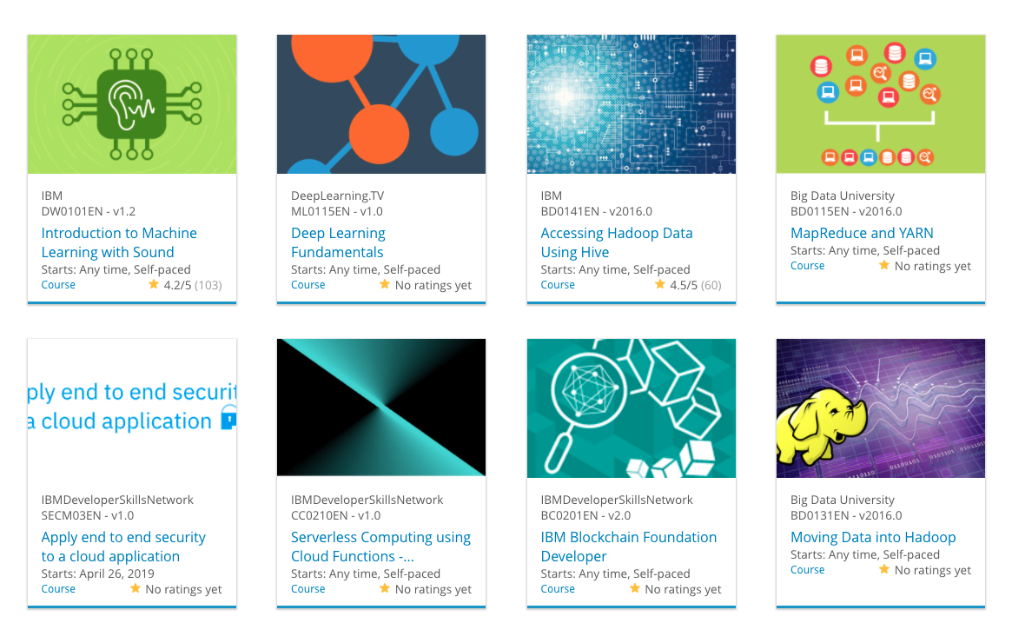

Build a Personalized Online Course Recommender System with Machine Learning
Andrea P.
2026-02-26

Slide 2

Outline
Introduction and Background
Exploratory Data Analysis
Content-based Recommender System using Unsupervised Learning
Collaborative-filtering based Recommender System using Supervised learning
Conclusion
Appendix

Slide 3
Introduction
Project background and context
The client aims to integrate Machine Learning into their services. Our goal is to build a recommendation system that suggests the best next courses for users. Two main recommendation approaches explored:
A) User-Based Approach – Uses behavior & ratings to recommend courses.
B) Content-Based Approach – Uses course content from previous enrollments.
The project explores multiple algorithms: Similarity measures, KNN, and Deep Learning models.
Problem states and hypotheses
Traditional course recommendation is static and lacks personalization.
Hypothesis: User-Based Filtering is more effective than Content-Based Filtering because:
Users with similar preferences make better recommendations than course metadata alone.
Behavioral patterns (ratings, enrollments) capture implicit user interest, improving predictions.
Content-based filtering struggles with cold-start issues (new users/courses).
Testing different approaches (KNN, Similarity, Deep Learning) to validate this hypothesis.

Slide 4
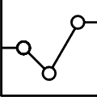
Exploratory Data Analysis

Slide 5
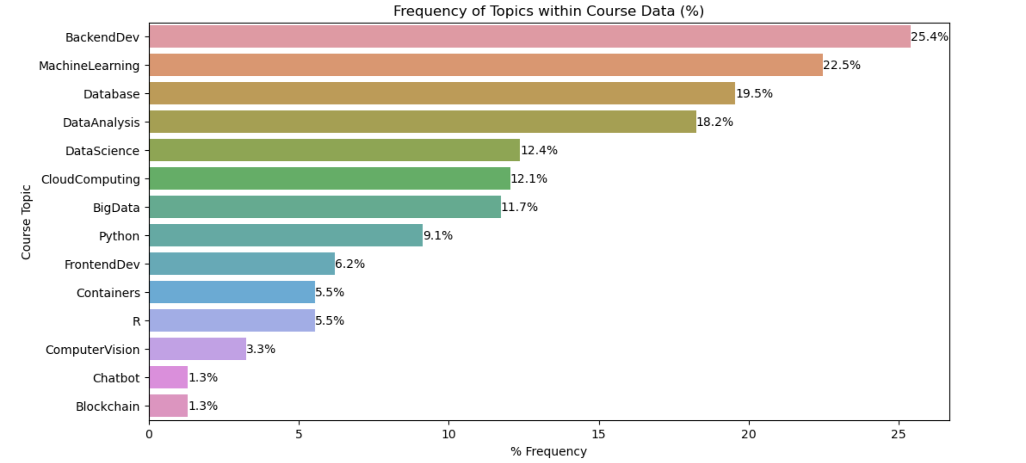
Frequency of courses per genre (topics)
Notes:
The chart is a horizontal bar plot showcasing the frequency of a topic, or a genre, within the dataset.
Based on my experience with clients, Iselected the relative count expressed in % rather than the count because it is more meaningful and resonates better with the audience. (results are same of the course count).
Reading:
“We can see that about 25% of the courses listed in the dataset is about Backend Development.”
“A course can be treating multiple topics, which is why the total of % won’t give us a 100%. So you can have a course that is about BackEnd Dev. But also about Machine Learning”.
Insights:
The 4 most popular topics are BackendDev, MachineLearning, Database, DataAnalysis.
If most frequent courses are also correlated, a content-based filtering approach may result biased.

Slide 6
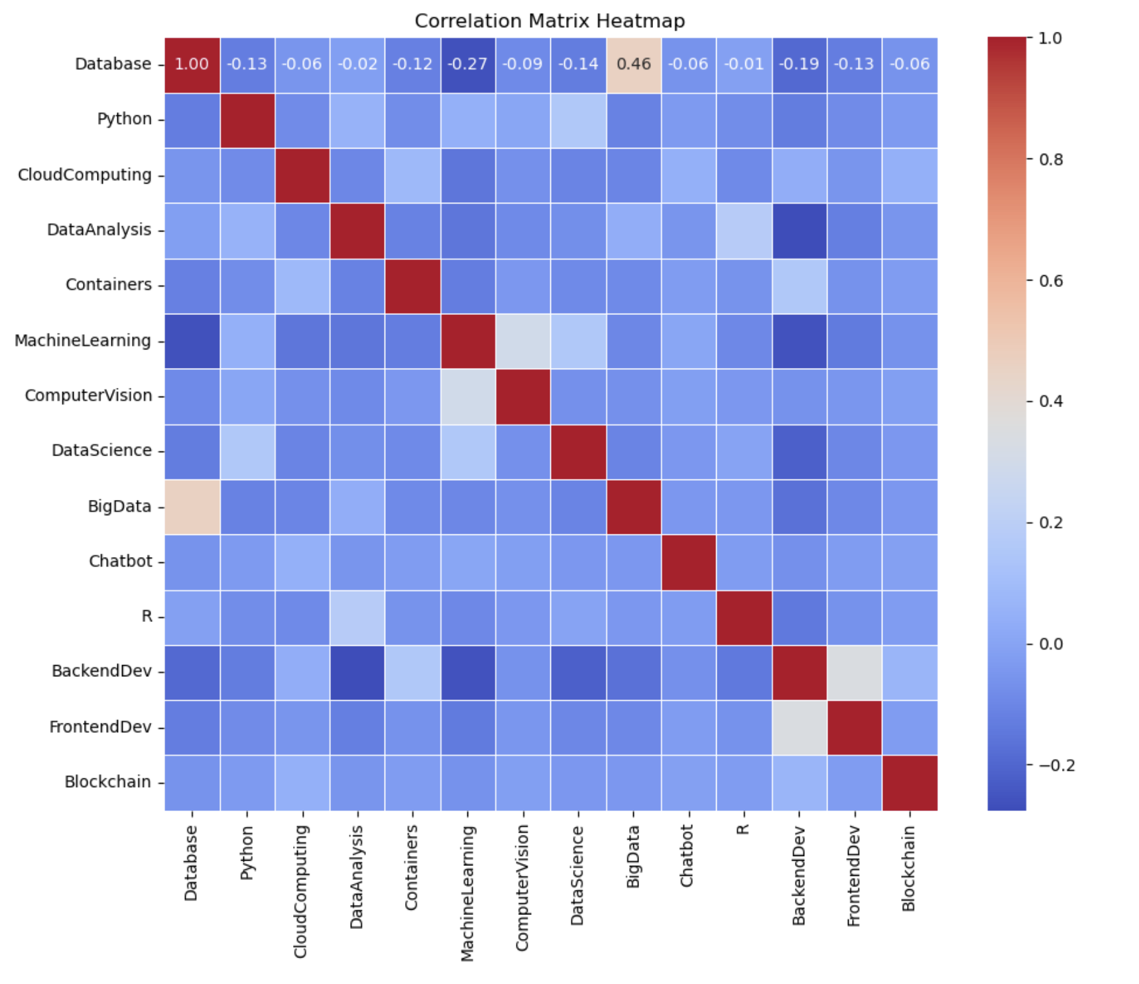
Correlation Matrix of Genres
Meaningful Correlations:
Database / Big Data (0.46)
Implies many database courses are about big data
Database / Machine Learning (-0.27)
Implies the two genres are slightly divergent
Notes:
The following heatmap display the correlation matrix of course genres.
Unfortunately I can’t get the annotations right, due to Seaborn versioning on the environment I am using, despite having upgraded to the most recent version.
Reading:
“This chart show us the correlation between different genres in the courses.
Positive values closer to 1 mean that two courses genres are frequently both present in a course. Negative values closer to -1 mean that two topics are rarely found together in a course.”
Insights:
No signs of significant autocorrelation or heteroschedasticity in the dataset however the correlation depends also by the actual presence of a course.
BackendDev is the most frequent genre yet has little correlations.

Slide 7
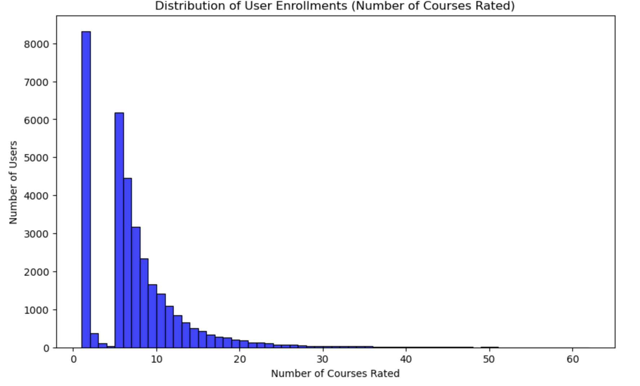
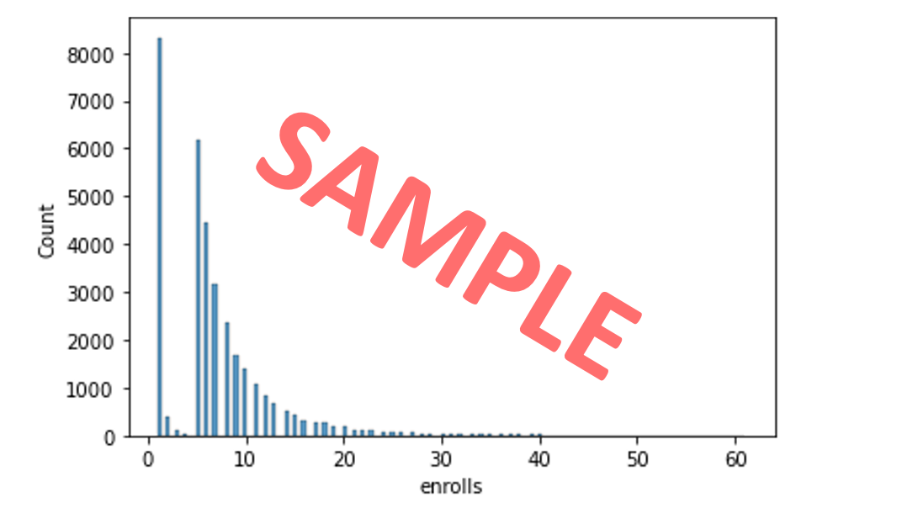
Course enrollment distribution
Notes:
This chart displays the distribution of user enrollements.
That is, how many courses each user has rated.
Most users rated between 0 and 10 courses. At the same time, not many users did take from 2 or 3 courses.
This suggests an underlying customer behavior:
The first rating includes new users and one-time users.
A few users rate 2, 3, 4 courses before not proceeding
All other users are very active past 4 courses in continuing their education.
However, only a small number of users rate more than 10 courses.
INSIGHTS
A lot of users are only engaging with a single course, and might not be exploring many others.
This could indicate low user engagement, as these users might not be returning or exploring more content.
Some users are more engaged with the platform, rating multiple courses.
This can show a segment of users that is highly active, possibly suggesting higher retention or a greater interest in the content.

Slide 8
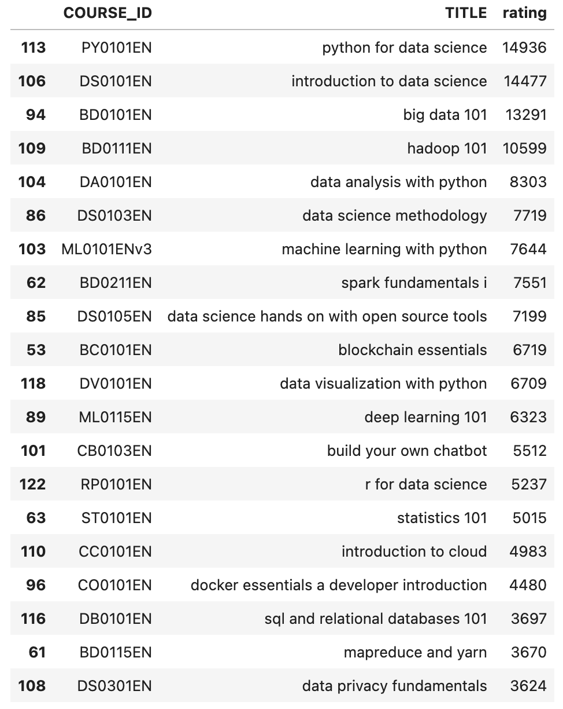
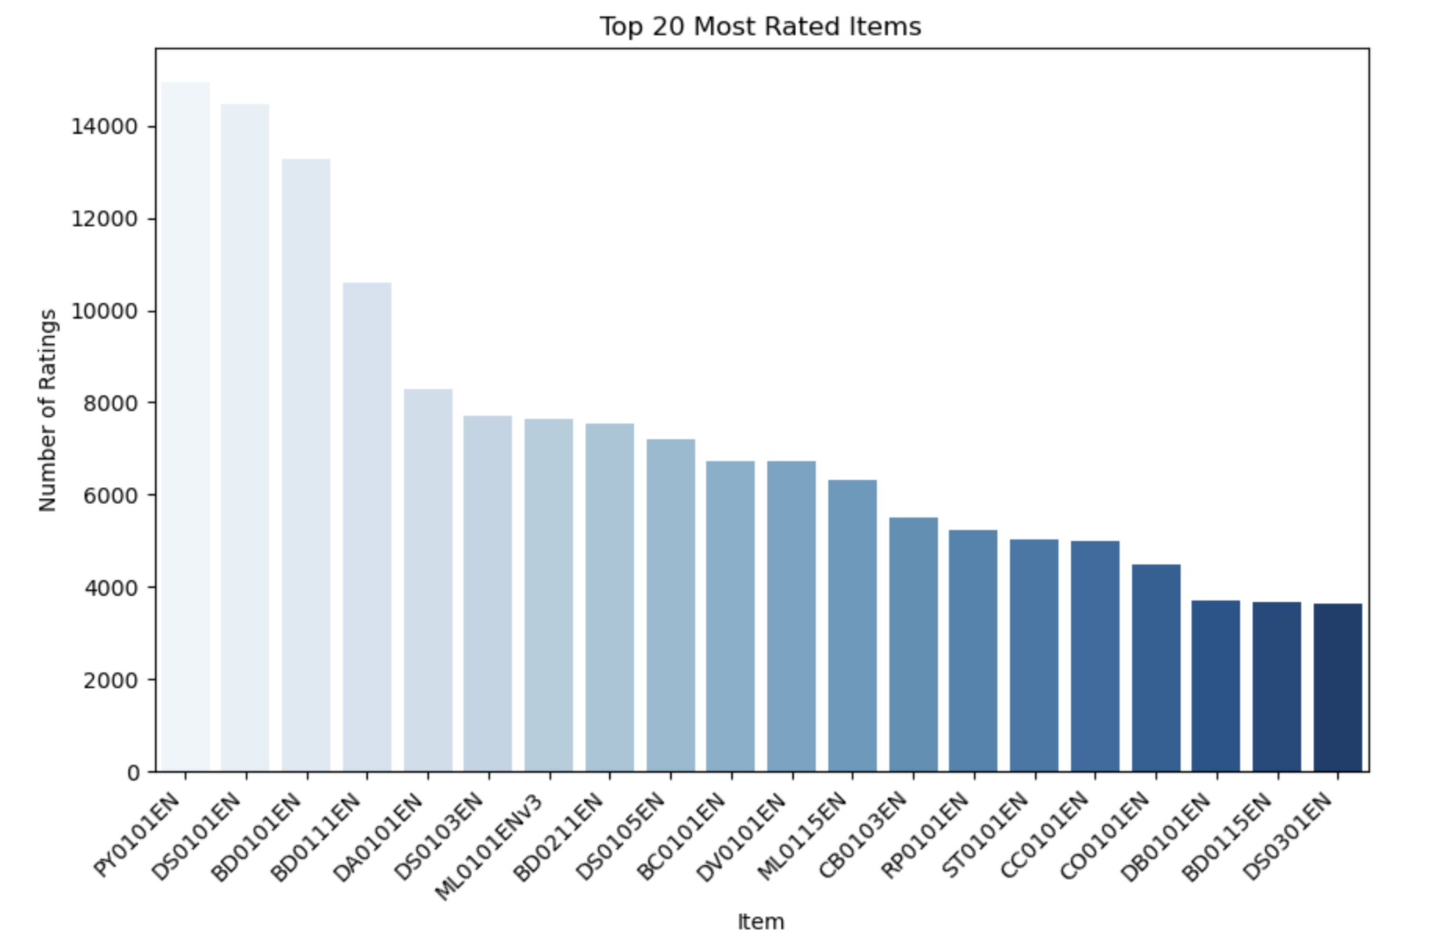
20 most popular courses
Notes:
The popularity of the courses is hereby presented in form of user ratings.
By aggregating the number of ratings provided by all users to each course, we are able to present the most popular 20 courses.
The table on the left showcases the list by the ID of the course, its title, and the number of ratings.
The bar chart on the right showcases the same but visually – by course id.
We can see that three courses in particular have higher ratings than all others – Python for Data Science; Introduction to Data Science; Big Data 101.
Overall this suggests that our users are especially interested into data science, big data, and python.

Slide 9
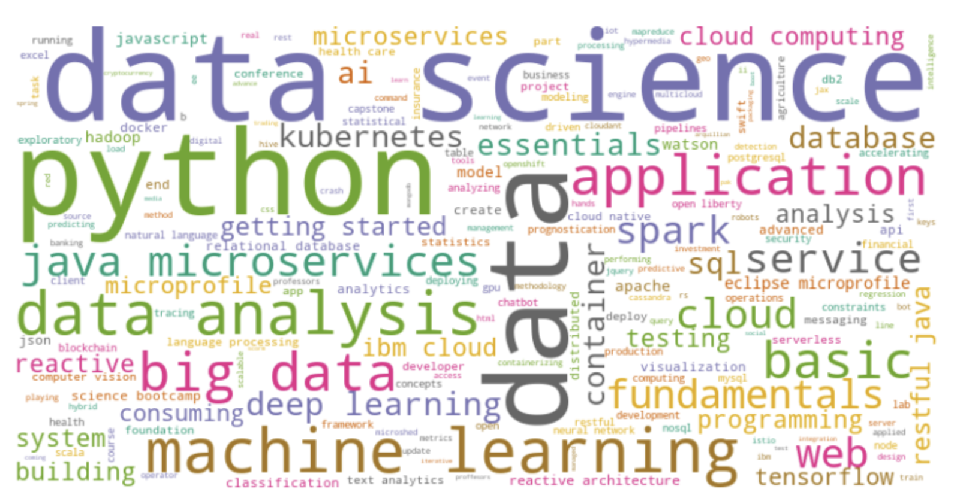
Word cloud of course titles
Notes:
The wordcloud tell us about the frequency of certain semantic patterns from the course titles.
The larger the word, the more frequent that topic is.
Also, More frequent words have a more prominent color (usually based on their frequency).
So, the more important words are those that are bigger and with a prominent color.
We can clearly see that based on the wordcloud, most courses title cite python, data, and data science.
Thus confirming that even if most courses are for BackendDev, those topics are treated in those courses as well.

Slide 10
Content-based Recommender System using Unsupervised Learning
Cluster2
Cluster1

Slide 11
Flowchart of content-based recommender system using user profile and course genres
User Profiles (Test Data)
User Ratings
Enrollments
(Popular Courses)
Similarity Score
Recommendations
User Profiles
Courses Profiles
Most Popular Courses
Notes:
We start from 2 datasets: the ratings provided by each user for each course they enrolled; and the genres or topics covered by a course.
From each dataset I was able to create user profiles based on their learning preferences.
I used the profiles together with the courses genres to create a profile matrix and I calculated the cosine similarity between each duplet of courses.
When similarity was above a threshold and the overall user ratings for a course was high enough, the course would be suggested.
The list of most popular courses was a byproduct of the recommendations.

Slide 12
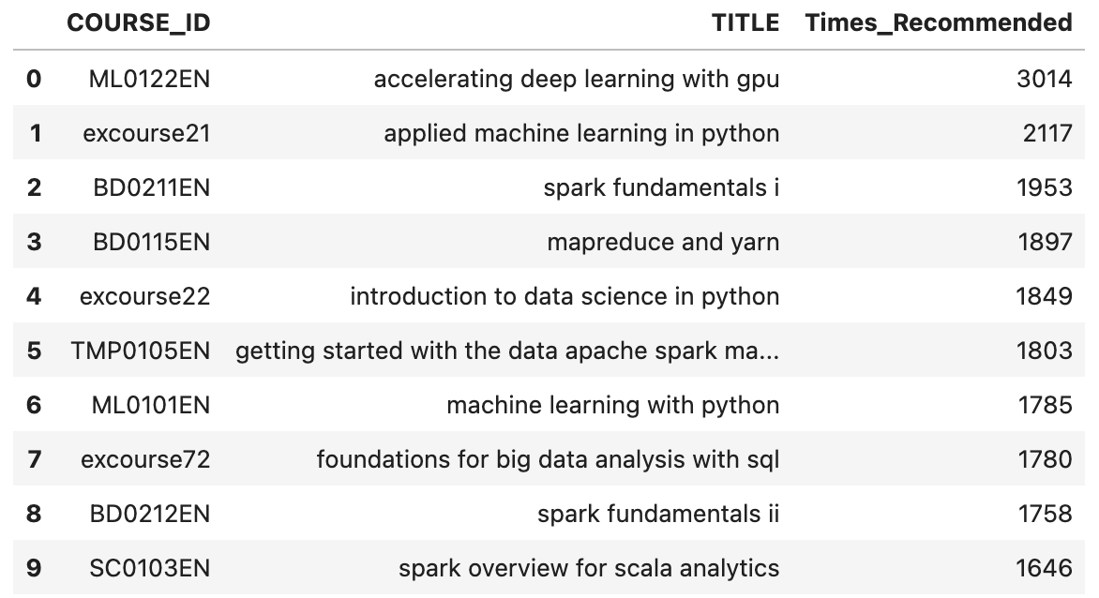
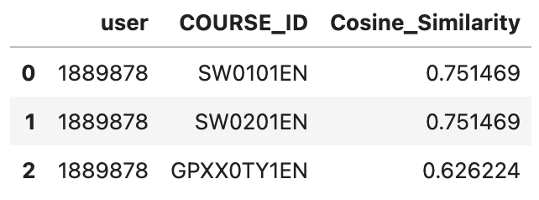
Evaluation results of user profile-based recommender system
Hyperparameters: n_recommendations; cosine_similarity; min_rating, threshold
On average, 1 to 3 courses are recommended per test user.
Only top recommendations by similarity score are returned.
If the number of recommendations exceed 3, those recommendations are not considered.
> Top-10 Recommended Courses:
Notes:
For this recommendation system I focused on the user ratings.
First, I defined the user profiles based on the topics their rated courses covered. I did this by generating a matrix of user ratings against course topics.
Then we calculated the similarity scores of each user against all courses. To do that I used cosine similarity.
Cosine similarity ranges from 0 to 1, where higher values imply high similarity among items.
I set a limit to 3 courses to be recommended with a threshold of 0.6 on similarity score, so only courses with high similarity would be recommended.
Finally, I repeated on a test set. Recommendations were done only for courses that received a rating of 4 or above by similar users.
In the first screenshot we can see how results are produced for a single user. We get the recommended course by COURSE_ID based on highest cosine similarity.
In the second screenshot we can see the top-10 recommended courses. It was sufficient to count how many times a course was recommended to the users population.

Slide 13
Flowchart of content-based recommender system using course similarity
TITLE BoW
Recommendation by Course Similarity
APPROACH 1
Course DF
Cos. Sim. Matrix
Course DF
Course Profiles
Similarity Matrix
Recommendation by Highest DotPr. Value + Rating Threshold
APPROACH 2
User Ratings
Dot Product
Notes:
We start from 2 datasets: the ratings provided by each user for each course they enrolled; and the genres or topics covered by a course.
I used two different content-based approaches.
In the first, I concentrated on course profiles alone, in particular on their title and their semantic association.
To do this, I extracted Bag Of Words and calculated the cosine similarity matrix based on the BoW.
In the second, I profiled the courses based on their genres and I helped myself with the user profiles to calculate similarity scores.
In this case I used a dot product (similarity of user rating x cosine similarity of courses).
In both cases I provided threshold for scoring to provide a certain number of recommendations.
When similarity was above a threshold and the overall user ratings for a course was high enough, the course would be suggested.
The list of most popular courses was a byproduct of the recommendations.

Slide 14
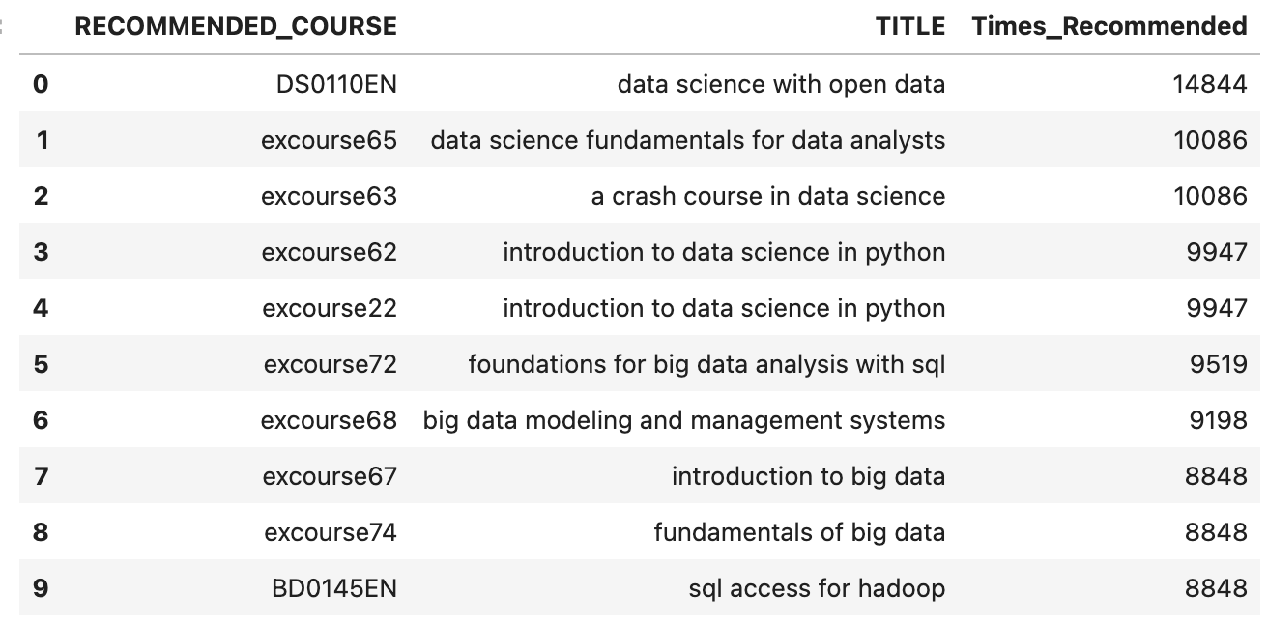
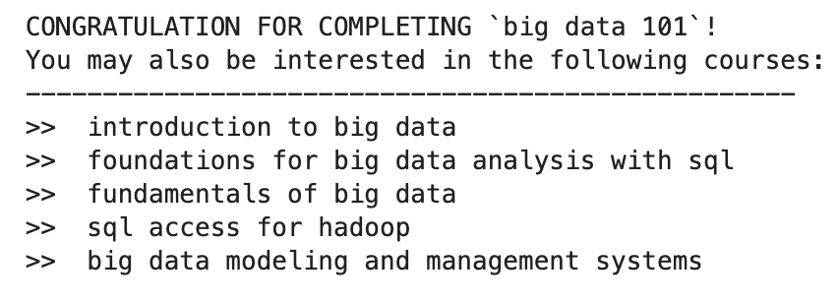
Evaluation results of course similarity based recommender system (BoW Similarity System)
APPROACH 1
Hyperparameters: cosine_similarity on BoW matrix; min_rating (user rating)
The system recommends on average 3 courses based on BoW similarity and previous user rating (>3).
Only courses with a high similarity score (>0.6) are recommended.
> Top-10 Recommended Courses:
Notes:
For this recommendation system I focused on the content of the course.
First, I extracted a Bag-of-Word dictionary from all course titles. By pivoting it, I created a BoW matrix .
Then I created a cosine similarity matrix of all the courses from the BoW matrix. This served me as courses profiling.
I filtered out all recommendations whose similarity matrix was below 0.6 – from this output I calculate that the average n. of recommended course is 3.
I merged those results with user ratings of the courses where ratings were 4 or above to produce personalized recommendations.
In the first screenshot we can see how results can be produced for a single user. This is an example of touchpoint that could be implemented on Streamlit applications.
In the second screenshot we can see the top-10 recommended courses. It was sufficient to count how many times a course was recommended to the users population.
The recommendations are here heavily influenced by semantic similarity between the courses. In another approach, we will use the course similarity by their topic (based on course profiles rather than BoW).

Slide 15
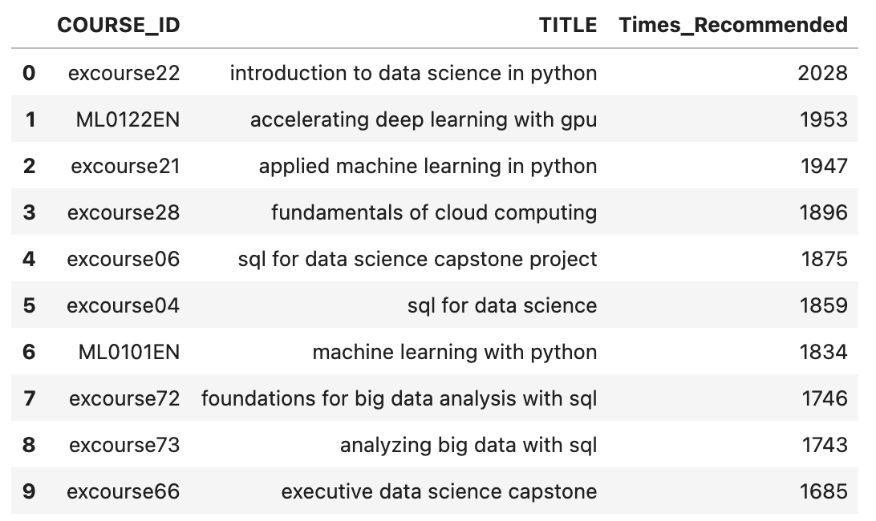
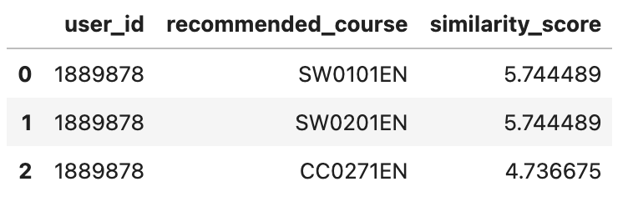
Evaluation results of course similarity based recommender system (Course Profiling System)
APPROACH 2
Hyperparameters: n_recommendations; dot_product (cosine similarity matrix); min_rating
On average, 3 to 5 courses are recommended per test user.
Only top-5 recommendations by similarity score are returned.
Results may be similar to user-based recommendation system, but overall top recommended course list is different.
> Top-10 Recommended Courses:
Notes:
For this recommendation system I focused on the content of the course.
First I created a cosine similarity matrix of all the courses. This served me as courses profiling.
Then we calculated the similarity scores of each user against all courses. To do that I used the dot product. Higher values of dot product mean higher similarity between two courses.
I set a limit to 5 courses to be recommended, so only courses with high similarity would be recommended.
Finally, I repeated on a test set.
In the first screenshot we can see how results are produced for a single user. We get the recommended course by COURSE_ID based on highest similarity score.
In the second screenshot we can see the top-10 recommended courses. It was sufficient to count how many times a course was recommended to the users population.
We can see that the results for the same user may be similar to that of a user-based recommender system.
However we will notice that the top-10 recommended courses are entirely different.
FUTURE APPROACH:
It would be interesting combining the two approaches together by calculating a mean similarity matrix
If the same course is recommended due to BoW similarity and profile similarity, this course would be more likely to be recommended
If the course is recommended by only one system, the recommendation would be influenced more by the user rating and its preference
This will however still be a content-based filtering since we use single users preferenes and not similarity between users.

Slide 16
Flowchart of clustering-based recommender system
Ratings DF
User Profiles Matrix (for ratings => 4)
Fit Model
Scaling
Decomposition
Courses DF
Notes:
We start from 2 datasets: the ratings provided by each user for each course they enrolled; and the genres or topics covered by a course.
We combine the 2 datasets Course ID.
We only keep entries where ratings are equal or higher than 4. This ensures recommendations are given only for high rated courses.
We aggregate the data by user, calculating the mean value for each genre. This way we obtain the user matrix.
Next we start preprocess data for modelling. Because of the high number of features, we opt for dimensionality reduction and so Principal Component Analysis.
Therefore, we must first scale the data. Because the rating system used was the same for all courses, we opted for StandardScaler.
Finally, we applied PCA for the best number of components (that we found with cross validation).
The decomposed data is then to fit the model.

Slide 17
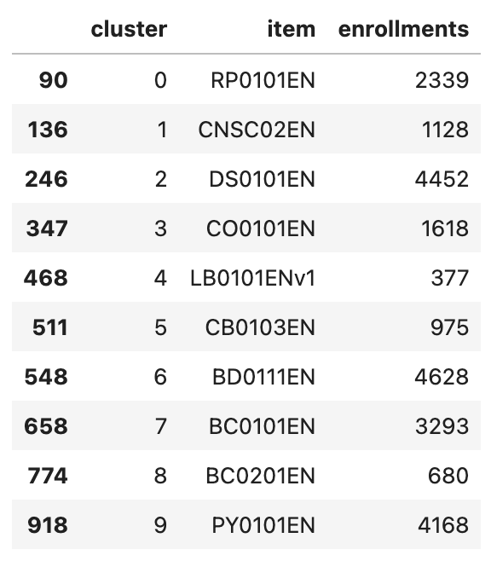
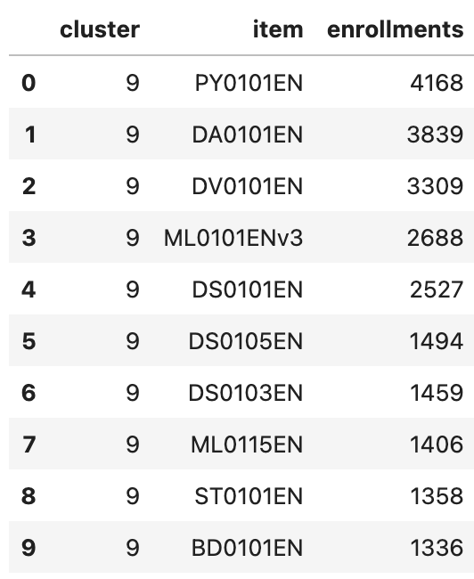
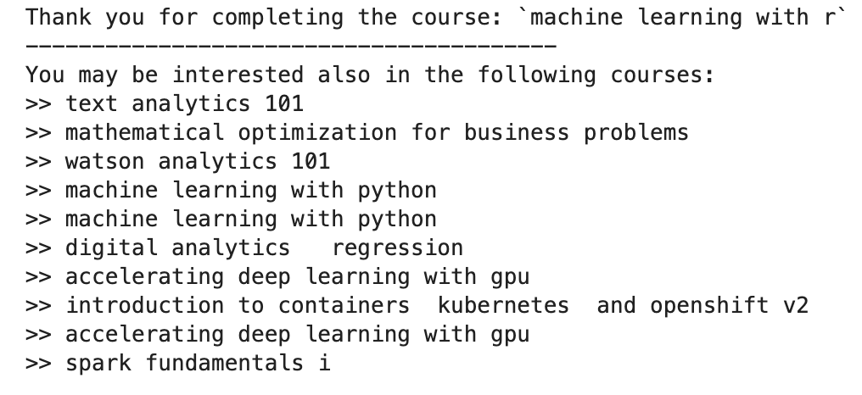
Evaluation results of clustering-based recommender system
MiniBatchKMeans(n_clusters=10, random_state=42, batch_size=int(len(pca_profiles)*0.05), n_init='auto')
Clusters are created based on user ratings and courses profiles.
Suggestions are returned for courses suggested within same cluster and for mean rating of 4 and above.
This system is not satisfactory as some clusters produce too many suggestions. Could be further improved using BoW or user similarity.
Top Course in each Cluster
By Enrollments
Top 10 Suggestions in User’s Cluster
By Enrollments
Notes:
To develop this model, I tried different methods: AgglomerativeClustering, DBSCAN, Kmeans.
Due to limitations of environment, I could not execute fully AgglomerativeClustering and DBSCAN, so I was limited to Kmeans.
I performed tests on K-Means++ and MiniBatch K-Means, for both I studied elbow method (inertia + silhouette score) and selected the best n cluster based on:
point(s) were inertia stabilizes
Point where silhouette score is higher
MiniBatchKMeans proved to be more stable, especially when batch_size was equivalent of 5% of training dataset.
To train the models I performed:
Scaling
PCA and selection of best number of components (=10)
After training the selected model with courses profiles by users enrollments, I assigned the clusters to each user and their ratings.
I then aggregated the enrollments by course id and cluster to retrieve the list of courses that may be recommended.
If the average rating of a course for that cluster is 4 or above, the course is then recommended.
I consider this model flawed, because it assumes that users in the same group will enjoy the same courses if those are rated higher.
However, this has an implicit bias that privileges high rated courses in spite of the others.
That creates a “best seller” scenario where the most popular course keeps being more popular because first suggestion on the list.
Hence, another improvement on outputs should be the randomization of recommendations.
Despite all this, K-Means does not seem to be the best clustering option for recommendations.

Slide 18
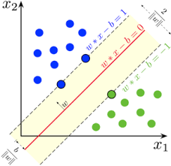
Collaborative-filtering Recommender System using Supervised Learning

Slide 19
Flowchart of KNN and NMF based recommender system
Raw data
Surprise Reader
Train-Test Split
Model Training
Notes:
For KNN and NMF I used a simpler datastream which involved the surprise library.
I only used the user ratings of the course for those trials.
The data was stored locally, then reloaded using the surprise reader, which converts data in a surprise data object.
Here I used train-test split for validation (I did not use a separate test dataset). The training data was used to fit the model.

Slide 20
Flowchart of Neural Network Embedding based recommender system
NN Fit
Raw data
Replace ID with Indices
Shuffle
Scaling
Users & Courses ID to Indices
Convert Ratings
Extract Features
Train-Test Split
Notes:
For the Neural Network approach we had to use a different system to work with data.
The user IDs and item IDs in the data are not in a format that’s easy to use for machine learning.
So, we assign a unique index to each user and item.
This makes it much easier for the model to understand the relationships between users, items, and ratings.
We create two dictionaries, one for user IDs and one for item IDs, that map the original IDs to these new indices.
Then we go through the dataset and swap out the original IDs for the indices we’ve just created, ensuring everything is in the right format.
We also make sure the ratings are converted into integers as they should be just a value between 3, 4 or 5.
Then we start to prepare the data for training.
Firt we shuffle the data so that the model doesn’t get biased by the order in which the data was collected.
We then separate the features (user-item pairs) from the ratings, ensuring the model has the right input to make predictions.
If we want the model to focus on the relative ratings rather than absolute values, we can scale the ratings between 0 and 1, making everything easier to compare.
At this point we split the data into training, testing and validation set. 80% is used for training. 10% for testing. 10% for validation.

Slide 21
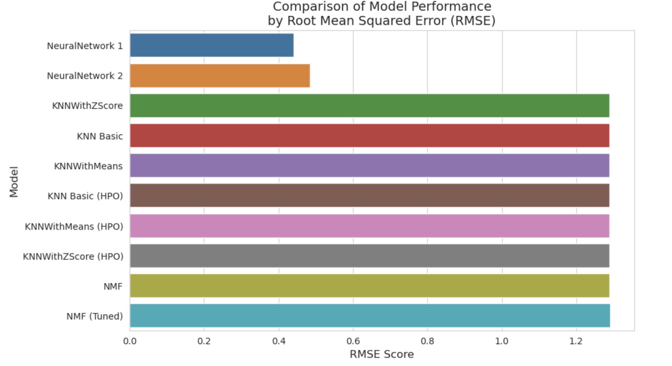
Compare the performance of collaborative-filtering models
Notes:
RMSE (Root Mean Squared Error) is a metric used to measure the average magnitude of error between predicted and actual values.
A RMSE closer to 0 means the model's predictions are very close to the actual values, indicating better performance. Larger values indicating poorer model performance.
RMSE is used instead of MSE because it gives an error in the same units as the original data, making it easier to understand.
Our results show that Neural Networks outperforms other models. This however comes with a few caveats.
Neural Network 1 is a baseline model (like that provided in the labs). Neural Network 2 introduces higher dropout, L2 Regularization for Dense Layer, early stopping, and overall should handle better non-linear patterns.
Both Neural Networks seem suffering from overfitting. More epochs in training did not help improve model performance. Other tests with higher embedding sizes only introduced overparametrization.
Hyper-Parameter Optimization did not significantly increase the performance of KNN and NMFmodels.
However specifically for KNN models it was impossible to perform HPO on user-based models (environment kept failing).
Overall, it should be possible to improve the performance of Neural Networks 1, 2. It is also possible that data is not sufficient to train those complex models (overkill).

Slide 22
Conclusion
User-Based Filtering is more effective than Content-Based Filtering
User-Based system were easier to interpret, provided less recommendations (3 to 5 max) compared to content-based approach
When Content-Based systems were used, course profile alone did not prove enough - even in this case was good to introduce another element (either BoW or user ratings)
User-Based Filtering would also benefit from Content-Based Filtering
Content-Based filtering uses semantic similarity to find other recommendations based on patterns
A hybrid approach could provide a feeling of “novelty” to the user based on content alone, not on ratings
Likewise, it would prevent churn from courses that are rated 3 and below, mitigating inherent bias
No Model Was a Perfect Fit - at best it overfits ☺
More data may be needed for optimal results
More time is needed to properly tune each model and try other approaches

Slide 23
Appendix
Github Repo (Proof of Work)
https://github.com/apa017/CourseraRepo/tree/main/capstone

