Slide 1



Managing your dependencies with
http://incubator.apache.org/ivy/
Xavier Hanin

Slide 2
Topics
What is Ivy?
Why Ivy?
A little bit of history
First contact
Where do those files come from?
Modular development with Ivy
Ivy’s spirit
Q/A

Slide 3
What is Ivy?
A tool for managing project dependencies
    recording reporting
    resolving publishing
Focus on flexibility and configurability
Ensure build reproducibility
Support large dependencies graph
Strong conflict management engine
Tight integration with Apache Ant
Compatible with Maven 2 repositories

Slide 4
Why Ivy?
Don’t reinvent the wheel: reuse
Modular systems are easier to develop and maintain
More and more complex components
Agile methodologies
=> Manage your dependencies
Notes:
Modern software development tries to divide complex challenges in the integration of small sub systems.
It’s getting harder and harder to maintain complex eco systems of small modules, especially with agile methodologies, where you need to integrate frequently.
That’s where a tool like Ivy can be of great help: you master your module dependencies, know exactly why each module is required, and can integrate more frequently and more easily.

Slide 5
A little bit of history
Created for the internal needs of Jayasoft
First release
1.0
Join Apache Incubator
sponsored by Apache Ant
1.2
1.3.1
2004
2005
2006
2007
1.4.1
1.1
1.3
1.4
First open source
version (0.5)
1.5-beta1-incubating ?
Notes:
Ivy is now more than 2 years old, and even if it entered Apache incubation only a few years ago, it can already be considered of production quality, and is already used by large companies on complex systems with 150+ modules and 100+ third party dependencies.
Prior to joining Apache, there were more than 500 hundred registered users on the forum and more than 10,000 downloads.

Slide 6
First contact
No complex install, bootstrap!
<target name="install-ivy" description="--> install ivy">
<mkdir dir="${ivy.jar.dir}"/>
<get src="${ivy.jar.url}"
dest="${ivy.jar.dir}/ivy.jar" usetimestamp="true"/>
<path id="ivy.lib.path">
<fileset dir="${ivy.jar.dir}" includes="*.jar"/>
</path>
<taskdef resource="org/apache/ivy/ant/antlib.xml"
uri="antlib:org.apache.ivy.ant"
classpathref="ivy.lib.path"/>
</target>
Notes:
Properties:
ivy.jar.url: URL to ivy.jar
ivy.jar.dir: Where to install ivy
Check https://svn.apache.org/repos/asf/incubator/ivy/core/trunk/doc/presentations/apache-con-2007/demo/1/build.xml for example of values for those properties
Note: Ivy can be used with its jar only, and that’s what is done in this example. But if you need optional dependencies (like commons-vfs for webdav repository for example), put them in the ivy.jar.dir too.

Slide 7
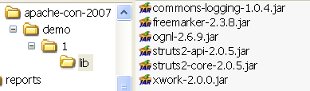
First contact
Get your first dependency
<ivy:retrieve organisation="org.apache.struts"
module="struts2-core"
revision="2.0.5"
inline="true"/>
Notes:
Notice the inline=« true » attribute, which tells Ivy that dependency is declared directly in the task. This is not the most common way to use Ivy (see second example), but it’s the easiest.
When you launch this task, Ivy look for the dependency declared in maven 2 repository (http://repo1.maven.org/maven2) and uses maven 2 poms to get dependency metadata and get transitive dependencies.

Slide 8

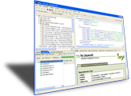
Demo
Notes:
Demo files can be downloaded here:
https://svn.apache.org/repos/asf/incubator/ivy/core/trunk/doc/presentations/apache-con-2007/demo/1
The first demo is very simple, and only shows what has been explained in the previous slides.

Slide 9
First contact
Introducing ivy files
  because one dependency is not enough
  because dependencies declaration should not be part of the build.xml
  because transitive dependencies require module metadata

Slide 10
Ivy files
<ivy-module version="1.5">
<info organisation="org.apache.ivy"
module="ivy-demo-2" />
<configurations>
<conf name="runtime"/>
<conf name="test"/>
</configurations>
<dependencies>
<dependency org="org.apache.struts"
name="struts2-core" rev="2.0.5"
conf="runtime->default"/>
<dependency org="junit"
name="junit" rev="3.8.1"
conf="test->*"/>
</dependencies>
</ivy-module>
Notes:
The concept of configurations is a core concept unique to Ivy, which provides a lot of flexibility.
You can define as many configurations as you want in your module, and compose those configurations with different dependencies and different configurations of those dependencies, with what is called configuration mapping.

Slide 11

Resolve dependencies
<ivy:retrieve
pattern="lib/[conf]/[artifact]-[revision].[ext]"/>
Notes:
Compared to previous retrieve example, here we do not define the dependencies we want to retrieve, because they are defined in the ivy.xml file.
OTOH, we use a custom pattern, to separate retrieved dependencies per configuration (using the [conf] token in the pattern).
This concept of patterns and tokens is used extensively in Ivy, and provides very flexible and easy configuration.

Slide 12
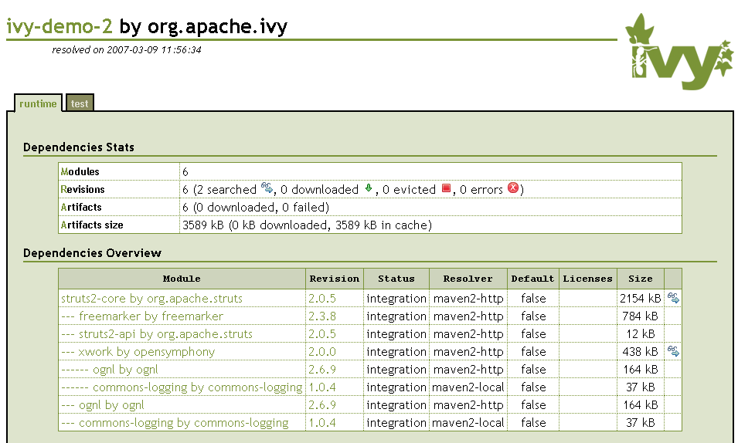
Understanding your dependencies
<ivy:report todir="report"/>
Notes:
Reports are presented by configuration, with easy switching between configurations.
You get very useful information, such as the dependency tree, and details for each dependency, such as callers and direct dependencies.
You can also quickly see how big is your total ecosystem of dependencies, and track the results of conflict management (evicted modules and reason).

Slide 13
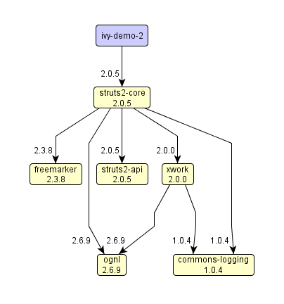
Understanding your dependencies
Notes:
Graph reports are also available, here we use the yEd free editor of graphml to do the layout of the graph. Ivy also provides dot format for autolayout using graphviz tools.
See http://incubator.apache.org/ivy/doc/use/report.html for details.

Slide 14
Where do those files come from?
Notion of repository
  stores modules artifacts and metadata
  very flexible
    anything can be a repository!
    possible to split modules across repositories
      ex: metadata in one place and artifacts in another
      ex: thirdparty modules on one server and internal on another
    possible to split versions across repositories
      example: one repository for integration builds, one for releases, one for archive, …
Notes:
Examples of repositories supported out of the box:
filesystem
maven 1 and 2 repositories
url based (http, ftp, …)
ssh based
webdav
svn (through http or webdav)
Splitting modules across repositories in Ivy is efficient, because you can specify which repository to use for which module (using exact names or patterns).
This can be very useful for distributed repositories: each project or organisation can provide its own repository!

Slide 15
Where do those files come from?
Insert here an example of ivyconf.xml

Slide 16
Demo
Notes:
Demo files can be downloaded here:
https://svn.apache.org/repos/asf/incubator/ivy/core/trunk/doc/presentations/apache-con-2007/demo/2

Slide 17







Modular development with Ivy
Ivy helps resolve third party dependencies, but it’s even more useful for internal dependencies changing frequently
project A
local repository
project B
shared repository

Slide 18
Ivy file
<ivy-module version="1.5">
<info organisation="org.apache.ivy"
module="ivy-demo-3-B" />
<configurations>
<conf name="runtime"/>
<conf name="test"/>
</configurations>
<dependencies>
<dependency org="org.apache.struts"
name="struts2-core" rev="2.0.5"
conf="runtime->default"/>
<dependency name="ivy-demo-3-A" rev="latest.integration" />
</dependencies>
</ivy-module>
Notes:
The only change in the ivy file compared to previous example is the use of « latest.integration » version constraint, instead of a static revision.
Many version constraints can be used out of the box with Ivy, like 1+ to get the latest version starting with 1, or version ranges, following the same notation as maven 2 one.
See http://incubator.apache.org/ivy/doc/ivyfile/dependency.html for details.

Slide 19
Settings
Insert here appropriate settings

Slide 20
Demo

Slide 21
Ivy’s spirit: flexibility
Adapt to your environment and requirements
Many things are configurable and pluggable
Large choice of repositories, with very flexible layout
Wide set of flexible ant tasks

Slide 22
Ivy’s spirit: flexibility
Some examples of pluggability
  pluggable module descriptor format,
    support Ivy files and maven 2 pom out of the box
  pluggable versioning scheme,
    define which version is greater than another
    define your own version constraints
  pluggable conflict managers
  plug into the engine with triggers

Slide 23
Ivy’s spirit: flexibility
Some examples of tasks
  use artifacts directly from Ivy cache
  or copy them to your lib directory
  reuse dependency resolution result
  generate numerous reports
  install modules and their dependencies from one repository to another one

Slide 24
Ivy’s spirit: flexibility
Some examples in Ivy files
  define as many module configurations as you need
  use powerful configurations mapping to suit your specific cases, and define your own defaults
  embed your configurations declaration or define them in separate files
  declare as many artifacts per module as you want
  create your own extra attributes with no complex settings

Slide 25
Ivy / Maven2 comparison
Better compare Ant+Ivy vs Maven
Ant+Ivy Pros
  Flexible
  Better control
  No « magic »
  Easier migration (if you already use Ant)
Maven Pros
  out of the box feature rich build system
  reusable experience
  better maven 2 compatibility
Notes:
Excuse this slide if it isn’t fair enough, it’s hard to be objective!
To go further, some blog entries:
Sylvain: http://bluxte.net/blog/2006-09/17-52-51.html
Carlos: http://jroller.com/page/carlossg?entry=the_black_magic_inside_maven
Steve: http://www.1060.org/blogxter/entry?publicid=FAA51080D35EFFA3709C5329B534DB67
Stephane: http://www.bearaway.org/wp/?p=518
And page on Ivy site:
http://incubator.apache.org/ivy/doc/m2comparison.html

Slide 26
Future
Release 1.5
Recruit contributors / committers
Graduate
We need your help!

Slide 27
Links
Ivy web site:
  http://incubator.apache.org/ivy/
Download:
  http://incubator.apache.org/ivy/download
Mailing lists:
  ivy-user@incubator.apache.org
  ivy-dev@incubator.apache.org
Issue tracking:
  http://issues.apache.org/jira/browse/IVY
These slides:
  http://incubator.apache.org/ivy/presentations/apache-con-2007/slides.ppt

Slide 28


Questions
and (hopefully) Answers

