Slide 1
Brpc external work practice treasure
jiangrujie@baidu.com
蒋如杰

Slide 2


What is RPC
When will the new version of nutron go live?
Test tomorrow, go live the day after tomorrow
Peng brother
Jade emperor

Slide 3
What is RPC
There will be a regular meeting at 10 o'clock tomorrow morning
？？ Did you get it?
Peng brother
Jade emperor
You don't have to come tomorrow

Slide 4
What is RPC
Request
Response
Client
Server
RPC（Remote Procedure Call），It likens network interactions to "functions on client access servers" Since RPC waits for the features of reponse, it is easy to know whether the server is handled successfully on the client side, ensuring that the upper logic is correct and reliable

Slide 5

RPC features - data format
name: Jade Emperor age：26 weight：100 Message: Is the goddess free at night?
Jade emperor
goddess

Slide 6
Non-self-describing structure
struct HelloRequest {
char name[16];
int age;
int weight;
char message[256];
int salary;
};
Message: Who are you, bother me again?
Jade emperor
goddess

Slide 7
Self-describing structure - JSON
{ "name": "Jade Emperor", “age”: 26, “salary”: xx, "Message": "Is the Goddess Free at Night" }
{ "Message": "Ready to sleep" }
Jade emperor
goddess

Slide 8
Semi-self-describing format - protobuf
message HelloRequest {
required string name = 1;
optional int32 age = 2;
optional int32 salary = 3;
optional string message = 4;
}
message HelloResponse {
required message = 1;
}
req.set_name ("Jade Emperor"); req.set_age(26); …
res.set_message ("Do you clatter");
Jade emperor
goddess

Slide 9
Introduction to Protobuf
message [message name] {
[field rule] [field type] [field name] = [tag];
}
field rule := required | optional | repeated
filed type := int32 | int64 | uint32 | uint64 | double
| bool | string | bytes
Tag can not be repeated, once fixed can not be arbitrarily modified Field type can be a defined message Other files can be referenced by import xx.proto

Slide 10
Introduction to Protobuf
// hello.proto
message HelloRequest {
optional string name = 1;
repeated int32 id = 2;
}
// hello.pb.h
class HelloRequest {
public:
const string& name() const;
bool has_name() const;
void set_message(const string&);
size_t id_size() const;
int id(int index) const;
void add_id(int id);
}

Slide 11
Introduction to Protobuf
// hello.proto
option cc_generic_services = true;
service HelloService {
rpc Hello(HelloRequest) returns (HelloResponse);
}
// hello.pb.h
class HelloService {
public:
virtual void Hello(Controller*, HelloRequest*,
HelloResponse*, Closure*) = 0;
}
class HelloService_Stub: public HelloService {
public:
HelloService_Stub(Channel*);
void Hello(Controller*, HelloRequest*,
HelloResponse*, Closure*);
}

Slide 12
RPC Elements - Protocol
// hello.proto
message HelloRequest { … }
message HelloResponse { … }
service HelloService {
rpc Hello(HelloRequest) returns (HelloResponse);
}
If you send the entire HelloRequest directly to the peer, then:
How do I identify the size of a request? If you add a Goodbye method, how do you distinguish? Request/return needs compression if informed?

Slide 13
RPC Elements - Protocol
In addition to requesting data, additional information is required for easy tracking control, commonly referred to as meta The RPC protocol defines what parts of a complete packet contain and how it is assembled, for example
Different protocols have different metas, formats, specifications, and several RPC protocols that are common within the company:
RPC Meta
Request Body
HTTP(s): Universal, text protocol nshead: Baidu's earliest RPC protocol, fixed format baidu_std: ANF developed an RPC standard in 2014

Slide 14
RPC Features - Network connection
With a complete request packet, you can send data by establishing tCP connections, so how are those connections managed? What is the relationship with the request? In general, there are three ways to connect:
Short connection: Create a new connection before each request and close it when you're done Connection pool: Get a new connection frompool before each request and return it at the end Single connection: All requests/returns to the same address, sharing the same connection
Half-duplex
Full duplex

Slide 15
Synchronized access
HelloRequest
HelloResponse
Jade emperor
goddess
Ah, forget to look
Alarm online It's a thing
Peng brother

Slide 16
Asynchronous access
HelloRequest
HelloResponse
Jade emperor
goddess
Processed
Alarm online It's a thing
Peng brother

Slide 17

A complete RPC framework
Easy-to-use data formats and interfaces Support for a variety of RPC protocols Connection management and adaptation Asynchronous, time-out mechanism Name service, load balancing, combined access
Is it so hard to communicate with goddesses?

Slide 18
brpc
The RPC framework based on the protobuf interface also provides support for other data formats such as json Include all RPC protocols within Baidu and support a variety of third-party agreements Modular design, clear hierarchy, easy to add custom protocols Comprehensive service discovery, load balancing, and combined access support Visualization of built-in services and debugging tools Lead all other RPC products today in performance

Slide 19
brpc - frame
Client
Server
Mechanism
Selective
Channel
Parallel
Channel
Partition
Channel
Policy
Channel
Naming
RPC Method
Implementation
BNS
List
Load Balancer
Built-in Services
RR
Hash
Protocol
Format
http
nshead
Compression
snappy
gzip
Authentication
Giano
SSL
Socket

Slide 20
brpc 72 stunt
Supported protocols:
baidu_std (default) Hulu-pbrpc protocol nova-pbrpc protocol Public/pbrpc protocol sofa-pbrpc protocol UB protocol ubrpc protocol HTTP protocol HTTPS protocol Phoenix Nest ITP Protocol Memcache Protocol Redis protocol Mongo protocol Hadoop rpc protocol
Supported connection methods:
Single connection Connect the pool Short connection Supported name service List File BNS DNS Supported load balancing Round-Robin Consistency hash random Locality Aware

Slide 21
Baidu-rpc 72 stunt
Combined access:
Parallel Channel: Broadcast Access Selective Channel: Channel Cascade Partition Channel: Branch access DynamicPartition Channel: Dynamic Sub-library
Advanced features:
backup request RPC cancellation Data compression, encryption Built-in service RPC dump & replay

Slide 22
Client end of the battle
// #include <brpc/channel.h>
brpc::Channel channel;
brpc::ChannelOptions options;
options.timeout_ms = 100;
channel.Init(“10.92.34.89:8888”, &options);
HelloService_Stub stub(&channel);
HelloRequest request;
HelloResponse response;
brpc::Controller controller;
stub.Hello(&controller, &request, &response, NULL);
if (controller.Failed()) {
LOG(INFO) << controller.ErrorText();
} else {
LOG(INFO) << response.message();
}

Slide 23
Client end of the battle
channel.Init(“file://server.list”, “rr”, &options);
bns://BNS-TAG random
list://ip:port,ip:port c_murmurhash
void hello_callback(Controller, HelloResponse*);
stub.Hello(&controller, &request, &response,
google::protobuf::NewCallback(
hello_callback, &controller, &response));
brpc::CallId cid = controller->call_id();
stub.Hello(…);
brpc::Join(cid);

Slide 24
Server side real combat
// #include “hello.pb.h”;
HelloServiceImpl: public HelloService {
public:
void Hello(Controller*, HelloRequest* request,
HelloResponse* response, Closure* done) {
brpc::ClosureGuard done_guard(done);
response->set_message(request->message());
done->Run();
}
}

Slide 25
Server side real combat
// #include <brpc/server.h>
brpc::Server server;
brpc::ServerOptions options;
options.num_threads = 30;
HelloServiceImpl hservice;
server.AddService(&hservice,
baidu::rpc::SERVER_DOESNT_OWN_SERVICE);
server.Start(8888, &options);
server.Join();
server.RunUntilAskedToQuit();

Slide 26
HTTP Live - Client Side
brpc::Channel channel;
brpc::ChannelOptions options;
options.protocol = “http”;
channel.Init(“www.baidu.com”, &options);
brpc::Controller controller;
controller.http_request().uri() = “www.baidu.com/index.html”;
channel.CallMethod(NULL, &controller, NULL, NULL, NULL);
if (controller.Failed()) {
LOG(INFO) << controller.ErrorText();
} else {
LOG(INFO) << response.message();
}

Slide 27
HTTP Live - Client Side
{ “name”: “Jade emperor”, “age”: 26 }
message HttpRequest {
optional string name = 1;
optional int32 age = 2;
}
brpc::Controller controller;
controller.http_request().SetHeader(“x-bce-request-id”,
“123456789-abcdef”);
controller.http_request().set_method(
brpc::HTTP_METHOD_POST);
HttpRequest request;
HttpResponse response;
channel.CallMethod(NULL, &controller,
&request, &response, NULL);
controller.http_response().status_code();
controller.http_response().GetHeader(“log-id”);

Slide 28
HTTP Live - Server Side
message HttpRequest { … }
message HttpResponse { … }
service HttpService {
rpc Call(HttpRequest) returns (HttpResponse);
}
// Access URI is /HttpService/Call server.AddService(&hservice,
brpc::SERVER_DOESNT_OWN_SERVICE);
class HttpServiceImpl: public HttpService {
public:
void Call(…) {
controller->http_request().uri().GetQuery(“device_id”);
controller->http_response().set_content_type(“text/plain”);
…
}
};

Slide 29
HTTP Live - Server Side
service HttpService {
rpc default_method(HttpRequest) returns (HttpResponse);
}
// Access URI is /HttpService/
server.AddService(&hservice,
brpc::SERVER_DOESNT_OWN_SERVICE);
class HttpServiceImpl: public HttpService {
public:
void Call(…) {
controller->http_request().unresolved_path();
…
}
};

Slide 30
HTTP Live - Server Side
service HttpService {
rpc create(CreateRequest) returns (CreateResponse);
rpc delete(DeleteRequest) returns (DeleteResponse);
rpc show(ShowRequest) returns (ShowService);
}
server.AddService(&hservice,
brpc::SERVER_DOESNT_OWN_SERVICE,
“/v1/network/create => create”
“/v1/network/*/delete => delete”
“/v1/network/show/* => show”);
…
void show(…) {
int id = atoi(controller->http_request()
.unresolved_path().c_str());
…
}

Slide 31

Powerful built-in services
Any process that uses brpc::Server can access the server's own port directly in HTTP, returning content for a variety of built-in services. Direct access to the graphical interface through the browser is more intuitive;
It's time to witness the miracle!

Slide 32
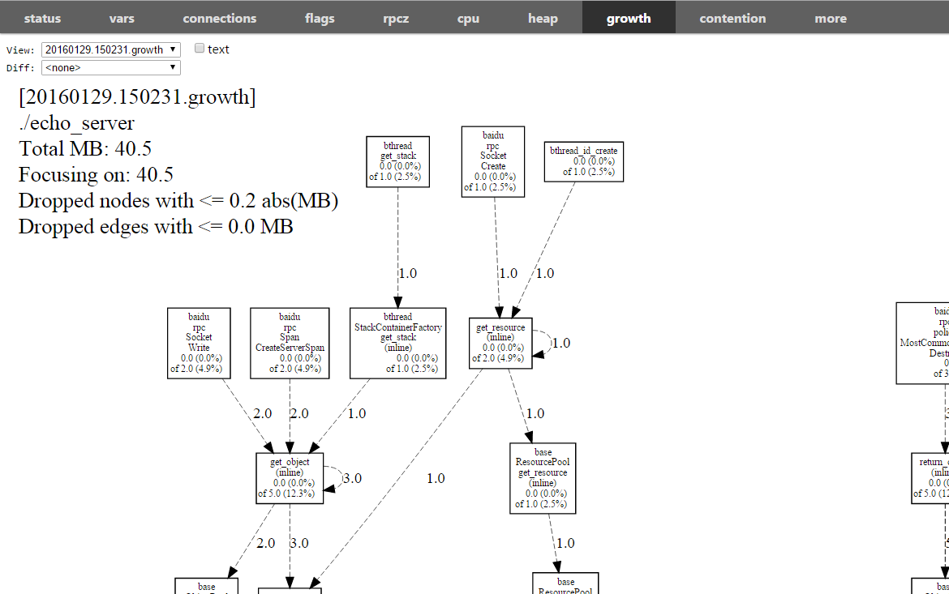
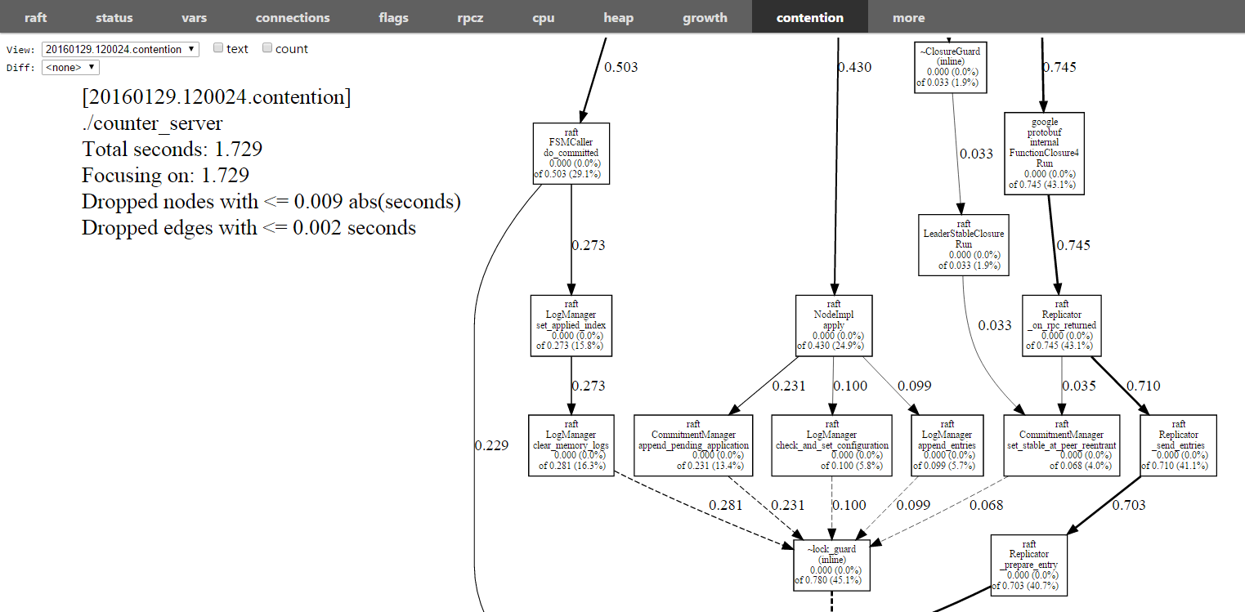
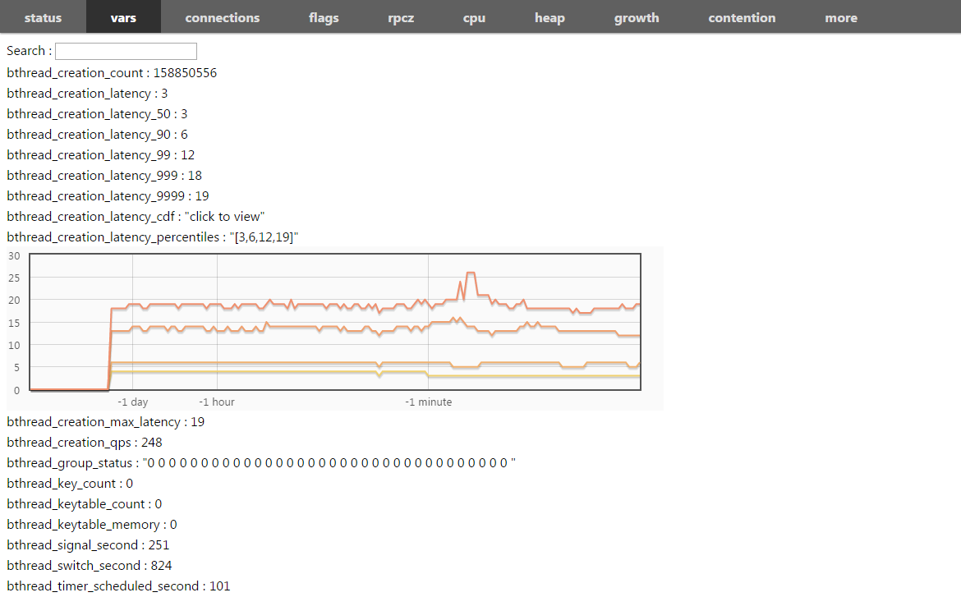
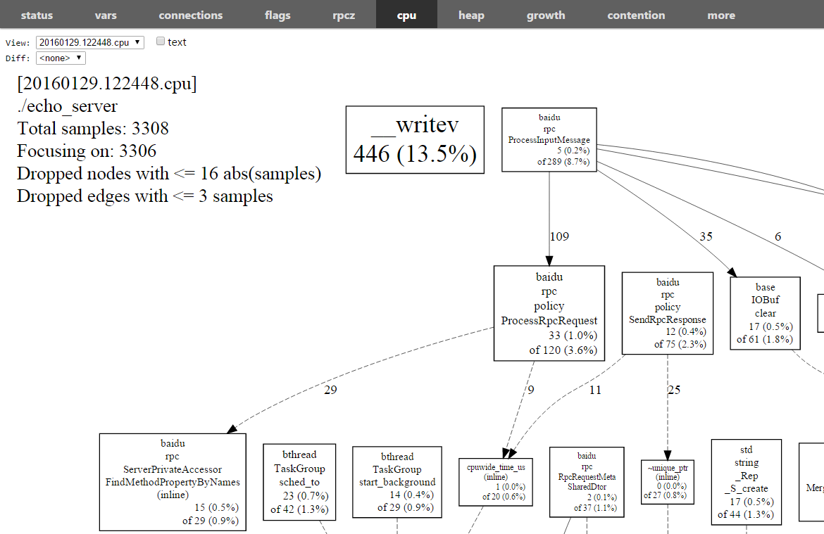
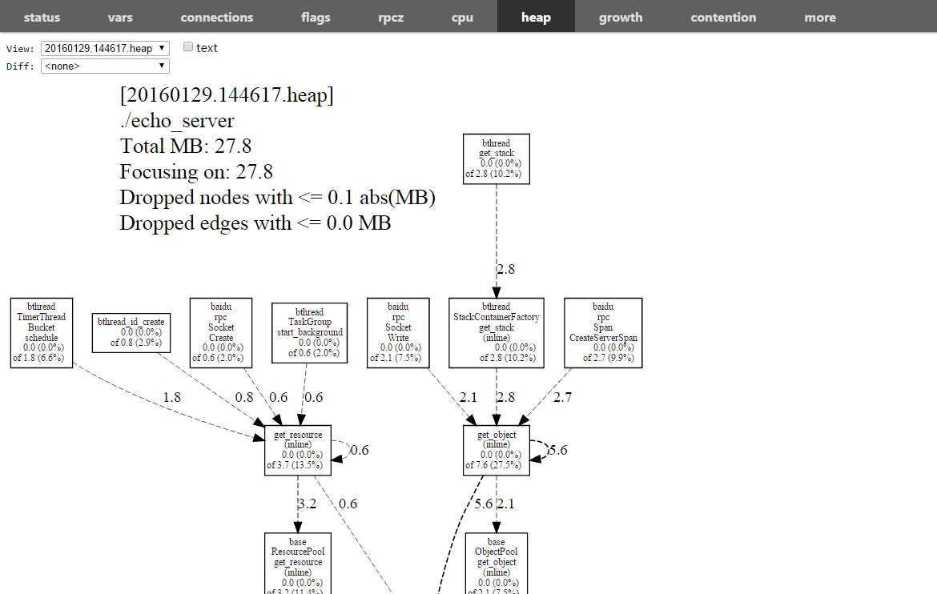
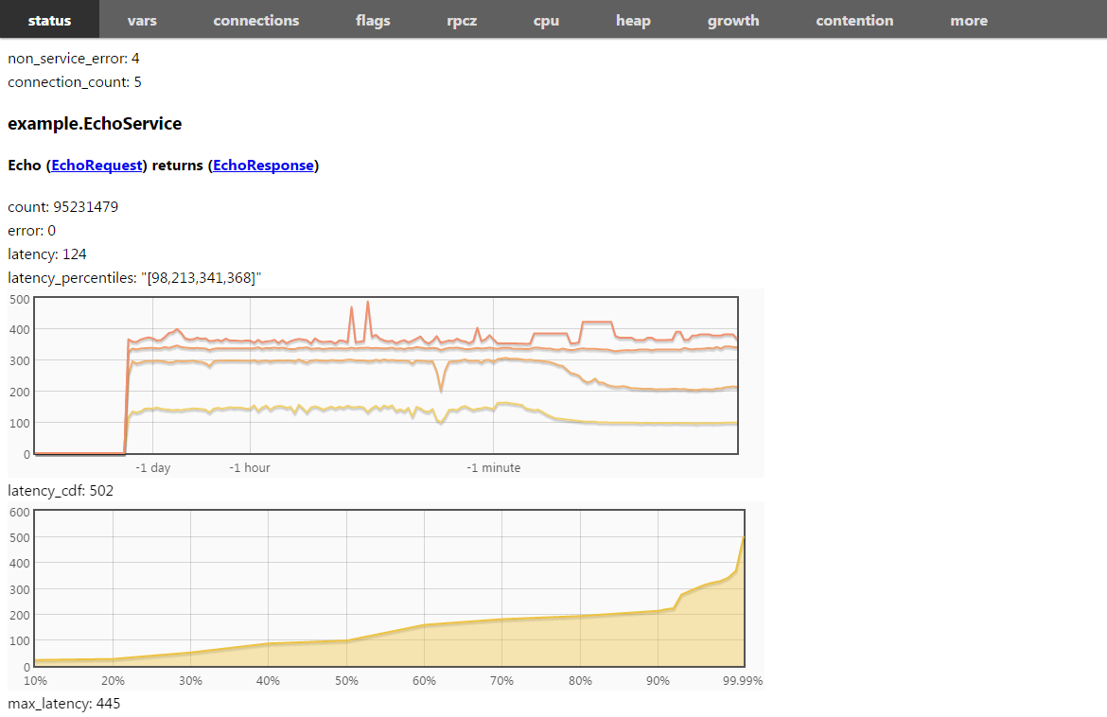
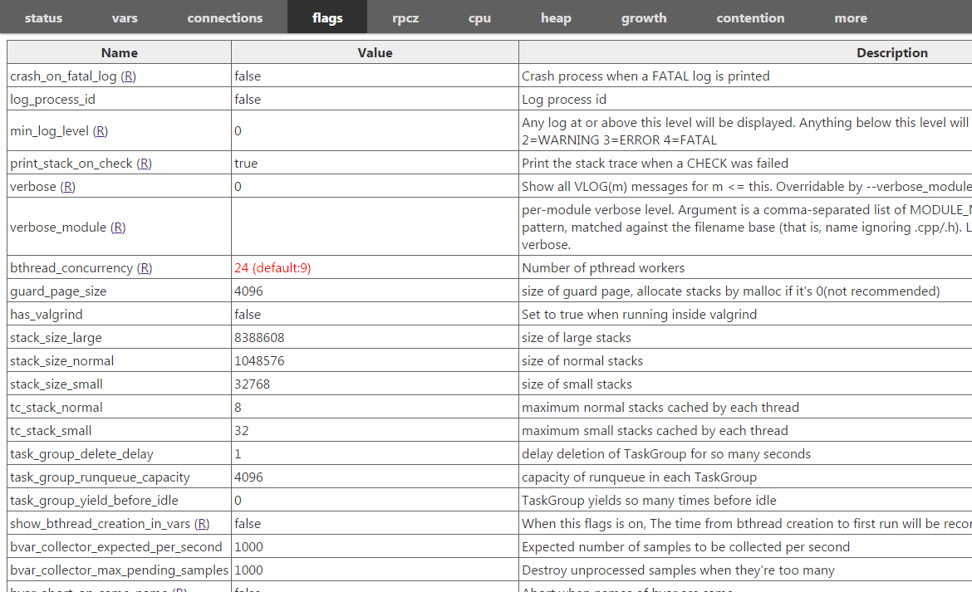
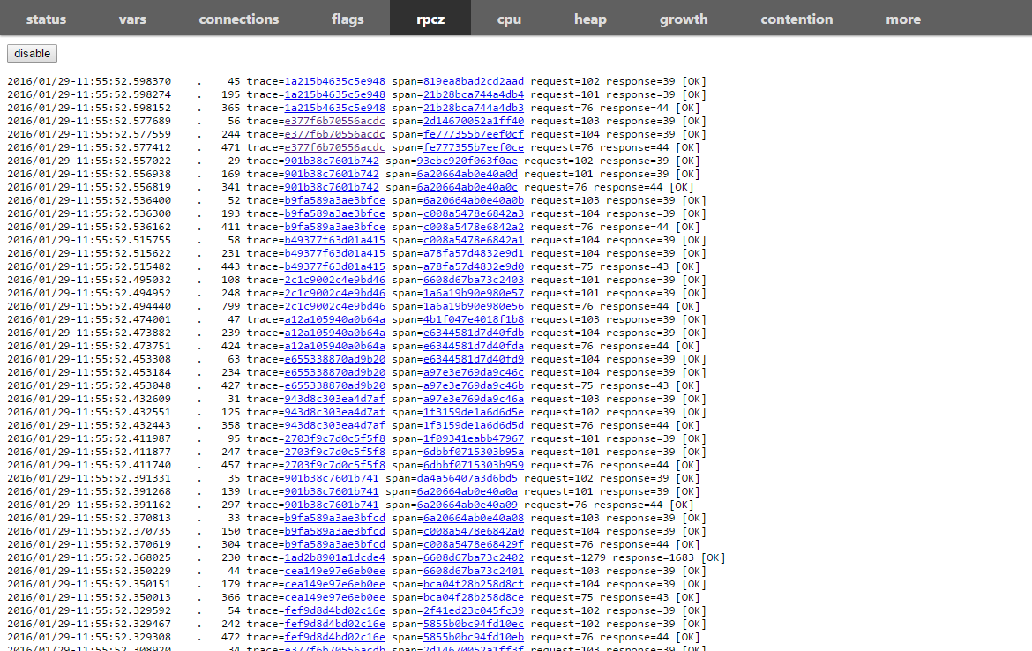
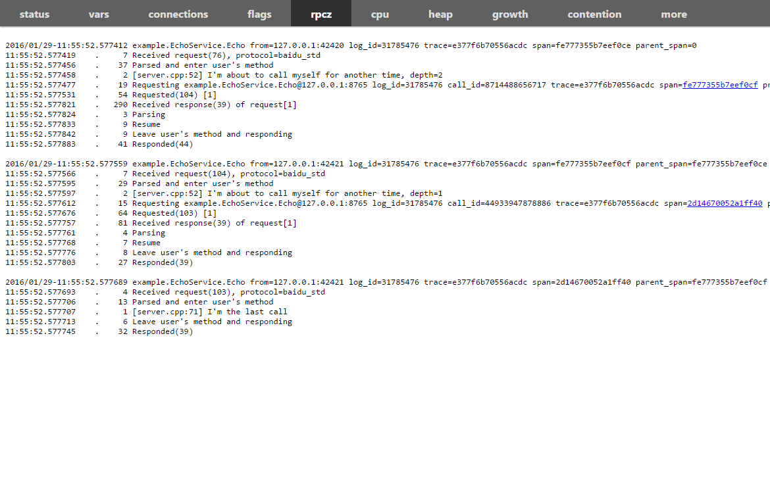
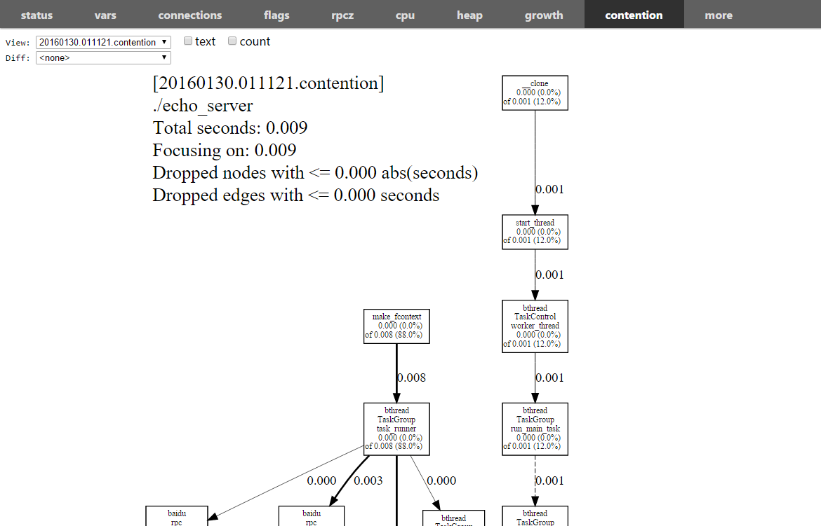
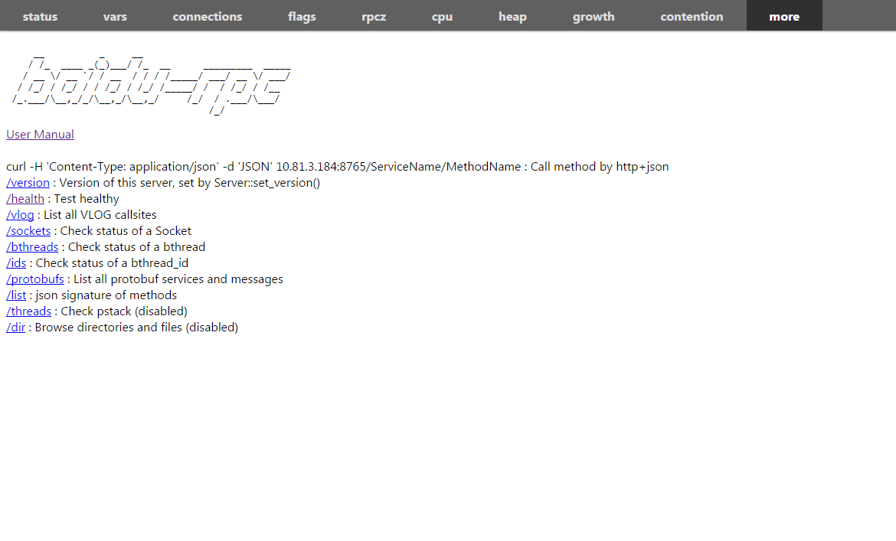
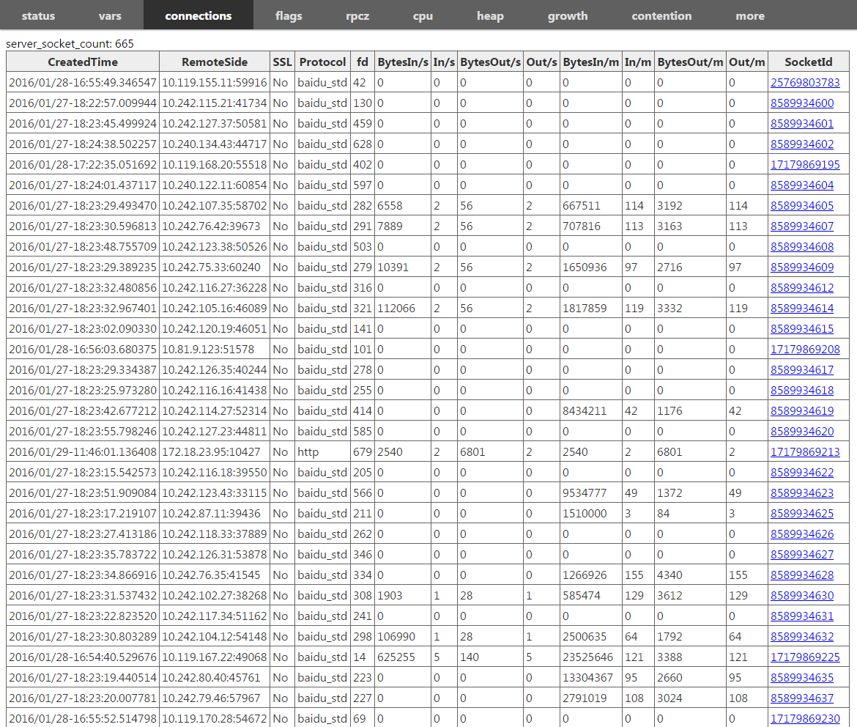
The built-in services

Slide 33

Brpc Novices FAQ
What to do if access fails, online, etc
Print controller. ErrorText(), to see the specific error Ensure that the underlying network is connected The built-in service allows you to see if the process state is healthy and where the request is blocked Add logs for further troubleshooting analysis Add a retry mechanism, which automatically retrys by default for disconnected connections and does not retry for timeouts

Slide 34
Links commonly used by brpc
General introduction: https://github.com/brpc/brpc Client：https://github.com/brpc/brpc/blob/master/docs/cn/client.md Server：https://github.com/brpc/brpc/blob/master/docs/cn/server.md Built-in service: https://github.com/brpc/brpc/blob/master/docs/cn/builtin_service.md protobuf：https://developers.google.com/protocol-buffers/ For specific interface usage, look more at header files, svn directory also has example https://github.com/brpc/brpc/tree/master/example

