Slide 1

Build and Deploy Cloud Native Camel Quarkus Routes With Tekton and Knative
Omar Al-Safi
APACHECON @HOME
Spt, 29th – Oct. 1st
2020

Slide 2

About
Omar Al-Safi
Open Source Software Engineer at Talend
Apache Camel PMC and Commiter
Based in Germany
Twitter: @omarsmak Github: omarsmak

Slide 3
Agenda
What is Cloud Native?
Introduction to GraalVM Native Image.
Introduction to Camel Quarkus.
Introduction to Knative.
Introduction to Tekton.
Put it all together with a Demo.
Notes:
Cloud Native ~ 2min
GraalVM ~ 6min -> 8min
Camel Quarkus ~ 6min -> 14min
Knative ~ 6min -> 20min
Tekton ~ 6min -> 26min
Demo ~ 8min -> 34min
Q&A ~ 5min -> 39min

Slide 4
What is Cloud Native?
Notes:
So first before we get into our topics for this talk, let’s take a look on Cloud native definition, for me personally I was always confused about this meaning.

Slide 5
What is Cloud Native?
Open source stack.
Notes:
The applications that we have in cloud native landscape are open source

Slide 6
What is Cloud Native?
Open source stack.
Microservices in containers.
Notes:
They are small microservices that run in containers, different from the traditional monolith

Slide 7
What is Cloud Native?
Open source stack.
Microservices in containers.
Dynamically ocheratsted.
Notes:
They are dynamically ocherasted, meanting that we shouln’t care on which nodes we should deploy as long we have such ocheration in place

Slide 8
What is Cloud Native?
Open source stack.
Microservices in containers.
Dynamically ocheratsted.
Optimized resource utilization.
Notes:
And of course, they should be optimzed to ultlze resources effifcently

Slide 9
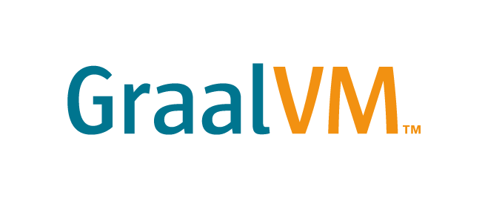
Introduction To
Native Image
Notes:
Now we look at the first introduction into our cloud native stack for this talk which GraalVM Native image

Slide 10
What is GraalVM

Slide 11
What is GraalVM
Java VM based on HotSpot/OpenJDK.

Slide 12
What is GraalVM
Java VM based on HotSpot/OpenJDK.
High performance runtime.

Slide 13
What is GraalVM
Java VM based on HotSpot/OpenJDK.
High performance runtime.
Ahead-of-time (AOT) compilation through Native Image.

Slide 14
What is GraalVM
Java VM based on HotSpot/OpenJDK.
High performance runtime.
Ahead-of-time (AOT) compilation through Native Image.
Ideal for Microservices and Cloud Native applications.

Slide 15
What is GraalVM
Java VM based on HotSpot/OpenJDK.
High performance runtime.
Ahead-of-time (AOT) compilation through Native Image.
Ideal for Microservices and Cloud Native applications.
Multiple languages interoperability.

Slide 16
What is GraalVM
Java VM based on HotSpot/OpenJDK.
High performance runtime.
Ahead-of-time (AOT) compilation through Native Image.
Ideal for Microservices and Cloud Native applications.
Multiple languages interoperability.
Includes as well a Just-in-time (JIT) mode.

Slide 17
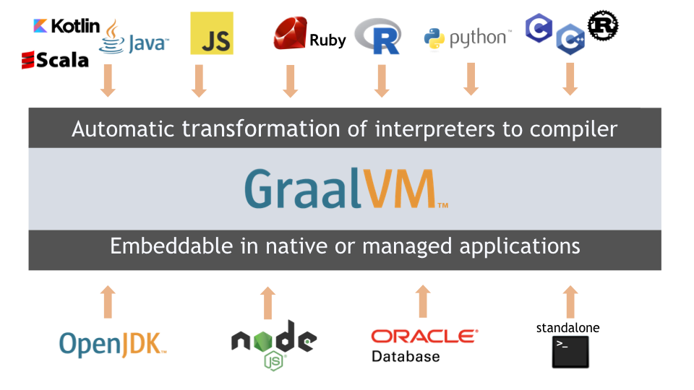
GraalVM Architecture

Slide 18
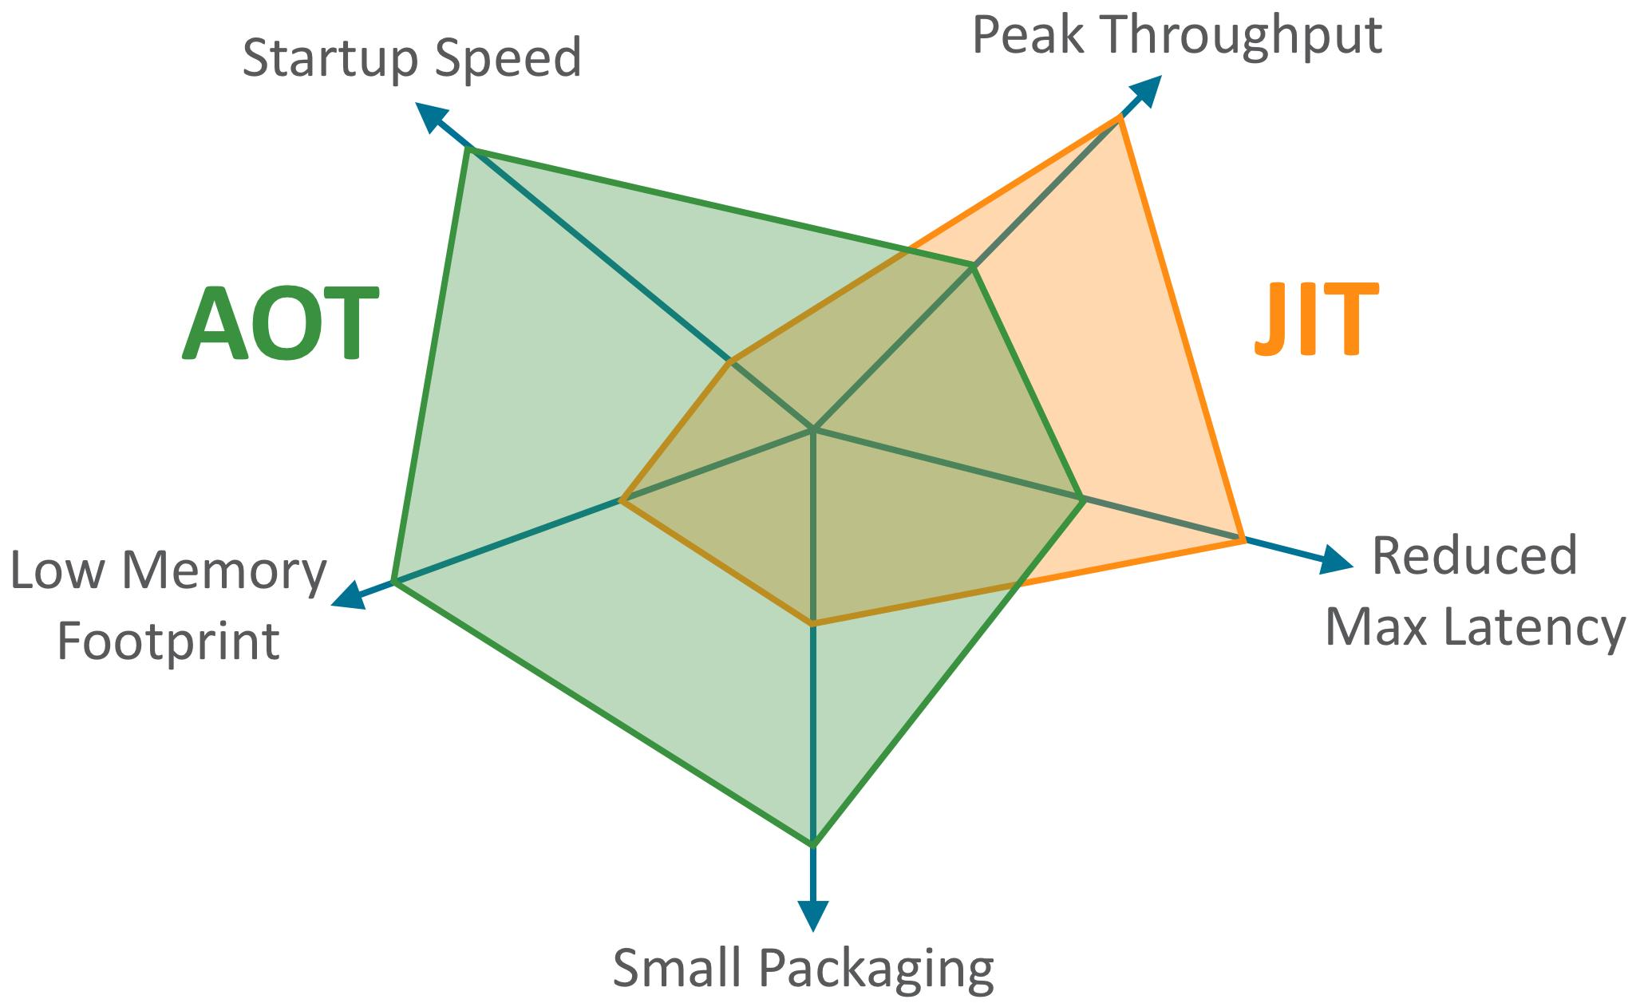
AOT vs JIT
* From: Thomas Wuerthinger performance benchmarks https://twitter.com/thomaswue/status/1145603781108928513
Notes:
JIT is very good at the Peak Throughput on how much it can handle, the Peak through of JIT gets faster with more requests because it has better view of the system at the runtime but that doesn’t come for free, to achieve such results, we may need to warm up our application until JIT takes over, because of that, we will need to bring the compalier with the packages application which will introduce more memory overhead and large packaging opposed to native application where everything is natively compiled.

Slide 19
GraalVM Native Image Utility
Input
Output
Application
Point-to Analysis
Run Initializations
Heap Snapshotting
Ahead-of-Time
Compilation
Native executable
Libraries
JDK
Image Heap
Writing
Substrate VM
Notes:
The way graalvm native image works is, first it takes your application, libraries, JDK .. etc and then, it runs analysis, it needs to know if this methods, classes .. etc is reachable or even called, then these objects will initialized and then the heap will be snapshotted and will be written to written to executable. With plus substrate VM will be wrapped as native application.

Slide 20


Introduction To

Slide 21
Java Density Problem
Node
Node
Node
Traditional Cloud-Native Java Stack
NodeJS
Go
Go
Go
NodeJS
Go
Go
Go
Traditional Cloud-Native Java Stack
NodeJS
Go
Go
Go
NodeJS
Go
Go
Go
Traditional Cloud-Native Java Stack
NodeJS
Go
Go
Go
Traditional Cloud-Native Java Stack
NodeJS
Go
Go
Go
NodeJS
Go
Go
Go
CONTAINER ORCHESTRATION
* From Apache Camel 3: the next generation of enterprise integration by Claus Ibsen & Andrea Cosentino
Notes:
we have here java desnity problem, if you recall previsouly the slide of AOT vs JIT, that in tradtional JIT will have more memry overhead and packageing issue, opposed for example something like Go which is optimzed in resulres that a node can take more pods than it is in tradtyional Java for example.

Slide 22



Java Fast Scaling Problem
SCALE-UP
SCALE-DOWN
SCALE-TO- ZERO
* From Apache Camel 3: the next generation of enterprise integration by Claus Ibsen & Andrea Cosentino
Notes:
And also, related to AOT vs JIT slide, if you have a tradional JIT, we saw that startup time will take longer and that is not what we need in clooud native world whereby we want to our service to rapidly scale down and up based on the needs very fast

Slide 23
What is Quarkus

Slide 24
What is Quarkus
Kubernetes-native full stack Java framework.
Notes:
So quarkus is built that cloud naitve and k8s in mind from the beginning, meaning that optimizations were already there since the beginning

Slide 25
What is Quarkus
Kubernetes-native full stack Java framework.
Container first.
Notes:
As a result, container support is a first class citizen in Quarkus world

Slide 26
What is Quarkus
Kubernetes-native full stack Java framework.
Container first.
Besides OpenJDK HotSpot, utilizes GraalVM Native Image very efficiently.
Notes:
Remember we talked about the benefits of AOT in comparison of JIT. It doesn’t mean any application you’d run today can be complied natively as optimzations need to be in place. Quarkus solves this as extensions in Quarkus need to be natively compiled to make sure we can benefit from AOT in GraalVM native image

Slide 27
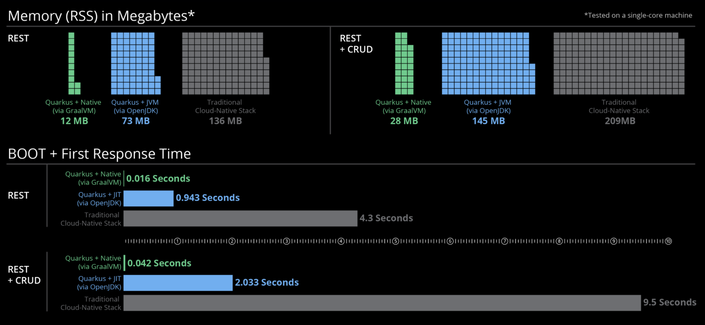
Quarkus Performance
Notes:
As we can see here, RSS memory is very low, even with OpenJDK mode, the same goes for the response time

Slide 28
What is Camel Quarkus?

Slide 29
What is Camel Quarkus?
A runtime to run Apache Camel components on top of Quarkus.

Slide 30
What is Camel Quarkus?
A runtime to run Apache Camel components on top of Quarkus.
Utilizes all performance optimizations brought by Quarkus.

Slide 31
What is Camel Quarkus?
A runtime to run Apache Camel components on top of Quarkus.
Utilizes all performance optimizations brought by Quarkus.
Allows Camel routes to be compiled natively using GraalVM Native Image.

Slide 32
Performance Comparison
from(timer("foo").period(1000))
.log("Hello World From ApacheCon");

Slide 33


Performance Comparison
Camel SpringBoot
Memory used (RSS) ~400MB
Startup time ~ 3s

Slide 34

Performance Comparison
Camel SpringBoot
Camel Quarkus
Memory used (RSS) ~400MB
Startup time ~ 3s
Memory used (RSS) ~200MB
Startup time ~ 0.9s

Slide 35

Performance Comparison
Camel SpringBoot
Camel Quarkus
Camel Quarkus Native
Memory used (RSS) ~400MB
Startup time ~ 3s
Memory used (RSS) ~200MB
Startup time ~ 0.9s
Memory used (RSS) ~30MB
Startup time ~ 0.3s

Slide 36
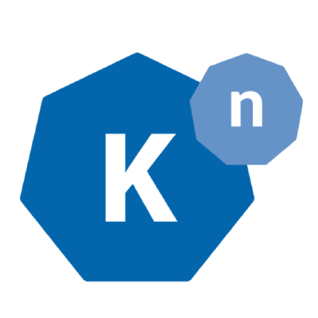
Introduction To
Knative

Slide 37
What is Knative?

Slide 38
What is Knative?
A simplified set of tools to manage containers on Kubernetes.
Notes:
Is a set of tools, that makes managing container in K8s easier for developers

Slide 39
What is Knative?
A simplified set of tools to manage containers on Kubernetes.
Allows developers to focus on coding.
Notes:
Personally I used to hate the complexy that I need to create config templates, manage the network ,,etc whereby my time on coding was getting less, so knative allows to automate managing all these things and we as develppers, focus less on K8s configs

Slide 40
What is Knative?
A simplified set of tools to manage containers on Kubernetes.
Allows developers to focus on coding.
Built as Kubernetes extension with CRD.
Utilizes Kubernetes goodies.
Integrates with other non-Knative services.
Notes:
Built as CRD, CRD custom resource definition, is a way to extend K8s and have operators to react on these resources. meaning that it still K8s native service that should natively interact with other non-knative services.

Slide 41
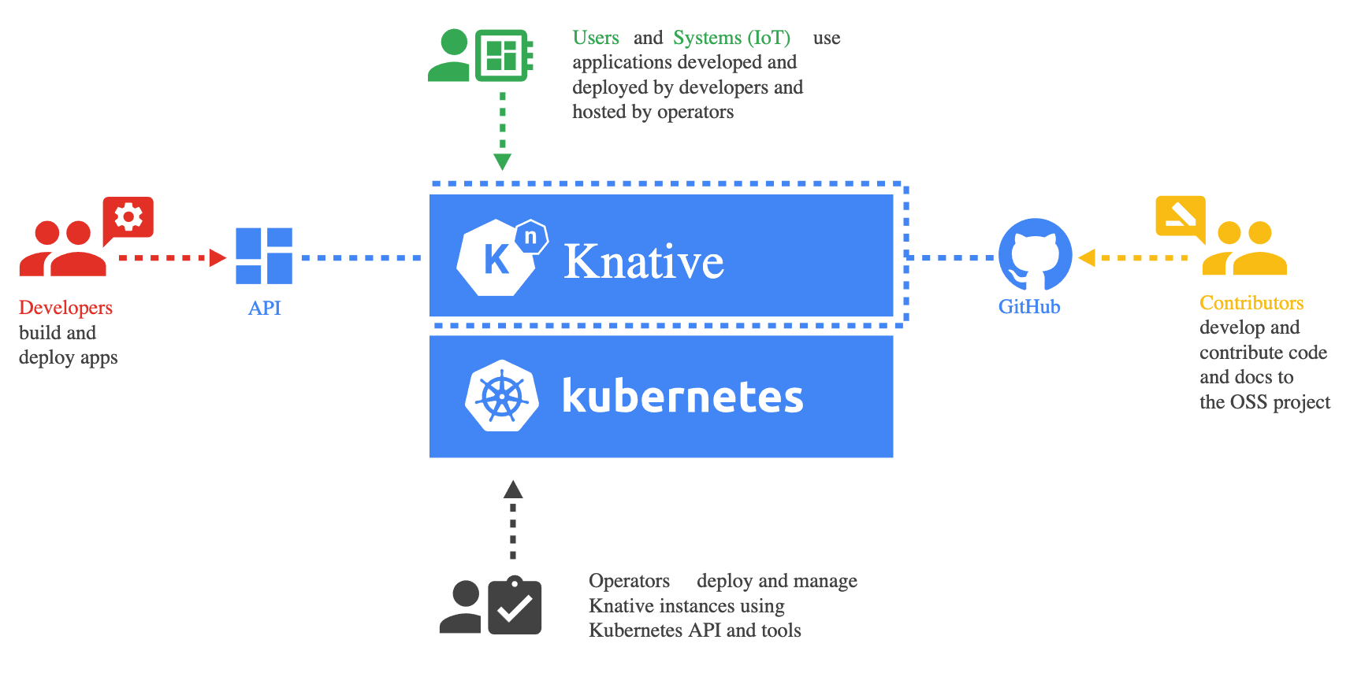
What is Knative?

Slide 42

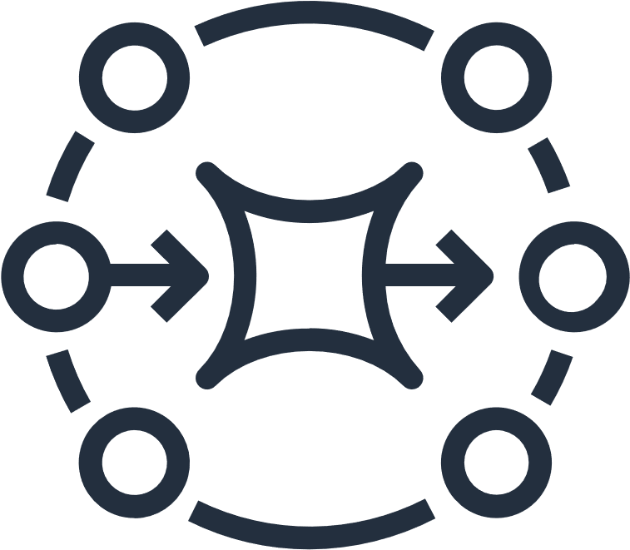
Knative Components
Serving
Deploy your application to K8s
Eventing
Common events infrastructure between services
Notes:
Serving is basically the most important component where it allows you to deploy your application to K8s and automate that.
Eventing is a common events infrastructure framework to unify all events between services through CloudEvent specs

Slide 43
Knative Serving
Knative Service
Revision 1
Config
Deploy app as pod with revision
Notes:
We deploy our application with revison, this simple configs in knative CRD

Slide 44
Knative Serving
Knative Service
Route
Revision 1
Config
Deploy app as pod with revision.
Network auto-setup.
User
Notes:
Since we deployed it our revision, the network will be auto-setup for us, of course we need to setup things like DNS routing to ingress gateway but still not that hard to do

Slide 45
Knative Serving
Knative Service
Revision 1
Route
Revision 1
Config
Deploy app as pod with revision.
Network auto-setup.
Revision are scaled up/down
Based on load
Down to zero
User
Notes:
Our revision can be scaled up/down even to zero. Of course we define such rules in the knative CRD once we deploy our application or define these globally with configmaps

Slide 46
Knative Serving
Knative Service
Revision 1
Route
Revision 1
Config
Deploy app as pod with revision.
Network auto-setup.
Revision are scaled up/down
Based on load
Down to zero
Create revisions and auto migrate
User
Revision 1
Revision 2
Config
Notes:
We deploy a second revision. now the route will be automatically migrated to the new revision

Slide 47
Knative Serving
Knative Service
Revision 1
Route
90%
Revision 1
Config
Deploy app as pod with revision.
Network auto-setup.
Revision are scaled up/down
Based on load
Down to zero
Create revisions and auto migrate
Traffic splitting
User
10%
Revision 1
Revision 2
Config
Notes:
However it maybe the case that, we want to split our traffic to allow something like A/B testing with randomized traffic

Slide 48
Knative Serving
Knative Service
Revision 1
Route
90%
Revision 1
Config
Deploy app as pod with revision.
Network auto-setup.
Revision are scaled up/down
Based on load
Down to zero
Create revisions and auto migrate
Traffic splitting
Dedicated URLs to Revisions which allows other uses cases like blue/green deployment.
User
10%
Revision 1
Revision 2
Config
Revision 1
Route
Tag
Revision 3
Config
Tester
* From Stop Calling Knative Serverless! - Doug Davis, IBM
Notes:
Or we can have a blue/green deployment, for example a third revision needs to be tested first before it goes live, we can tag this and kantive will give us a dedicated URLs for these tagges services

Slide 49
Knative Eventing
Event Source
publish
Event Source
Event Source is K8s resource producing events as CloudEvent via HTTP POST.
Notes:
As we mentioned before, knative eventing meant to unity the evening infracture in our services, it has an event source that publishes events as CloudEvent via HTTP POST

Slide 50
Knative Eventing
Event Source
publish
Adapter
Event Source
Event Source is K8s resource producing events as CloudEvent via HTTP POST.
Adapter often used to convert events into CloudEvents.
Notes:
Or we can have an adapter that converts these events to CloudEvent specs before publishing these events to the broker

Slide 51
Knative Eventing
Event Source
Broker
publish
Adapter
Event Source
Event Source is K8s resource producing events as CloudEvent via HTTP POST.
Adapter often used to convert events into CloudEvents.
Broker is central events hub, e.g: Kafka.
Notes:
Of course we will need to have a broker, could be a distributed log like Kafka or queue

Slide 52
Knative Eventing
ingress
Trigger
Event Source
Broker
ingress
Trigger
publish
Adapter
Event Source
Event Source is K8s resource producing events as CloudEvent via HTTP POST.
Adapter often used to convert events into CloudEvents.
Broker is central events hub, e.g: Kafka.
Trigger subscribe events from a Broker.
Notes:
And then we have trigger that subscribe the events from the broker

Slide 53
Knative Eventing
filter=
ingress
Trigger
Event Source
Broker
ingress
Trigger
publish
Adapter
filter=
Event Source
Event Source is K8s resource producing events as CloudEvent via HTTP POST.
Adapter often used to convert events into CloudEvents.
Broker is central events hub, e.g: Kafka.
Trigger subscribe events from a Broker.
Filter for specific events.
Notes:
Also filleting which events we need for our service

Slide 54
Knative Eventing
filter=
subscribe
ingress
Trigger
Event Source
Service
subscribe
Broker
ingress
Trigger
Service
publish
Adapter
filter=
Event Source
Event Source is K8s resource producing events as CloudEvent via HTTP POST.
Adapter often used to convert events into CloudEvents.
Broker is central events hub, e.g: Kafka.
Trigger subscribe events from a Broker.
Filter for specific events.
Send events to Service as CloudEvent via HTTP POST.
Notes:
and then push these events to our service in a form or CloudEvent as HTTP POST

Slide 55

Introduction To

Slide 56
What is Tekton?

Slide 57
What is Tekton?
A Kubernetes native framework for creating creating continuous integration and delivery (CI/CD) pipelines.
Notes:
Tekton is basically a CI/CD but in different to traditional CI/CD, runs on your K8s cluster natively, meaning that it utlizes all knativre resources. You may wonder why do I need it? But in case, you have a full fledged K8s cluster and you have all your infrastructure these for example monitoring, logging … etc and you just don’t want to maintain a separate monolith infrastructure for your CI/CD

Slide 58
What is Tekton?
A Kubernetes native framework for creating creating continuous integration and delivery (CI/CD) pipelines.
It used to be part of Knative tools.
Notes:
For historical reasons that I have no idea about

Slide 59
What is Tekton?
A Kubernetes native framework for creating creating continuous integration and delivery (CI/CD) pipelines.
It used to be part of Knative tools.
Just like Knative, built as Kubernetes extension with Custom Resource Definition (CRD).
Notes:
It also built as CRD like knative, meaning that it can utlize all K8s resources.

Slide 60

Tekton Building Blocks
Step is the smallest block, contains images, commands, arguments and corresponds to a K8s container.
Step
Container
Notes:
Step is the smallest block, that has for example the command to run on a image, like running unit tests .. etc. This represents a container

Slide 61
Tekton Building Blocks
Task
Step is the smallest block, contains images, commands, arguments and corresponds to a K8s container.
Task is a sequence of steps that run in sequential order and on the same node.
Node
Step
Container
.
.
.
Step
Notes:
Task represents a sequence of steps that has to run sequentially, for example a first task to build the application, second task to run the the unit tests

Slide 62
Tekton Building Blocks
Pipeline
Task
Step is the smallest block, contains images, commands, arguments and corresponds to a K8s container.
Task is a sequence of steps that run in sequential order and on the same node.
Pipeline contains multiple tasks, sequential or parallel. Executes tasks on different nodes.
Node
Step
Container
.
.
.
Step
.
.
.
Task
* From Next Generation CI/CD with GKE and Tekton (Cloud Next '19)
Notes:
And then finally we have Pipeline, which contains multiple tasks that can run sequential or parallel. For example a Task that could build the image and run tests and second task that need to setup the integration tests env or end-to-end tests environment, that can run in parallel on different nodes

Slide 63
Put it all together with a
Demo
Notes:
So now since we have gave an intro on same interesting technologies on the cloud native scale, for example GraaVM and Quarkus together to improve our resource utilization Knatrive and tekton to simplify our container orchestration. We can utilize these into an example to deploy a simple Camel rouute

Slide 64
Demo Overview
Camel route with REST component on top of Camel Quarkus runtime.
Trigger the Tekton pipeline using an EventListener.
Build the Camel route natively using GraalVM Native Image in Tekton using Kaniko.
Deploy the route from Tekton pipeline as Knative Service.
The route is accessible through HTTP/GET.
Notes:
So we have a Camel route that has a REST component built on top of Camel Quarkus that can be natively compiled.
Then we have an EventListenr which is Tekton CRD type that is an HTTP sink that listens to HTTP and request and trigger the pipeline based on that, for example github webhook
Then we build our route in tekton natively in the a container
Deploy the route from Tekton to Knative and have it accessible through HTTP

Slide 65
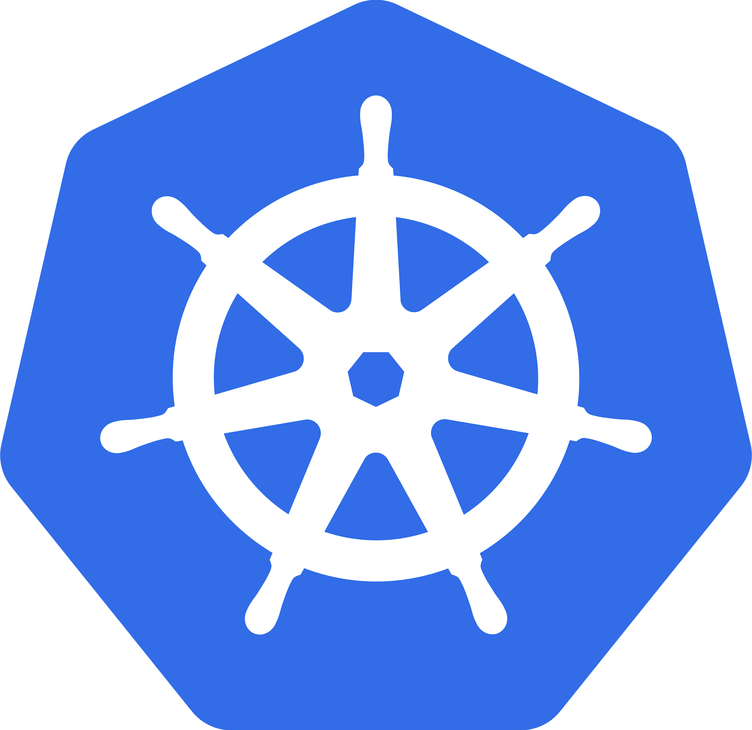




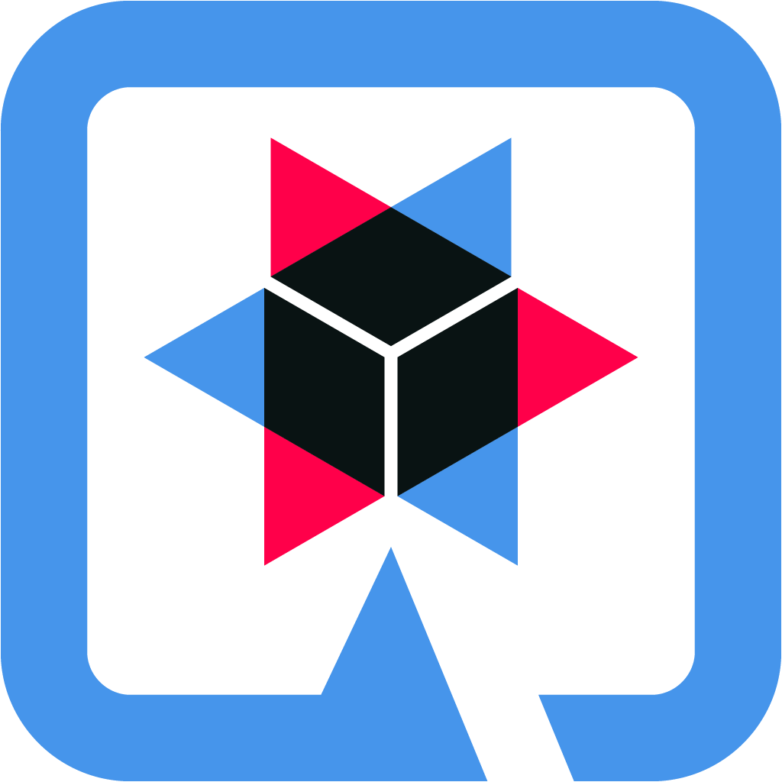
Demo Overview
Pipeline
Build image from git source
trigger
EventListener
Camel Quarkus Rest Kn Service
HTTP GET /hello?q=
Deploy service to Knative
User
Notes:
So here is the trigger. however I had to mok the trigger since the eventlistenr need to be exposed in order for github to send the events, since I don’t have the infrastructure to do this We have a two tasks in pipeline that one build imge and second deploy the service
and then we have our camel route in knative deployed

Slide 67
Any Questions ?
Demo project: https://github.com/omarsmak/camel-talk-examples/tree/master/camel-quarkus-rest

