Slide 1

CAPI Light Apache Camel API Gateway
Rodrigo Coelho

Slide 2



About me
Rodrigo Coelho
linked in
github
CAPI - Light Apache Camel API Gateway

Slide 3
Not on this talk
Apache Camel
Kafka
- Docker
- Kubernetes
Helm
Scaling up monitoring
CAPI - Light Apache Camel API Gateway

Slide 4


Key message
CAPI - Light Apache Camel API Gateway

Slide 5





Key message
CAPI - Light Apache Camel API Gateway

Slide 6
Features
- Light API Gateway powered by Apache Camel dynamics routes.
- Customizable processors
- Easy deployment of Swagger and Open API endpoints.
- Keycloak integration, for API Manager and Deployed API's
- REST endpoint to manage your API's.
- Distributed tracing system (Zipkin)
- Metrics (Prometheus)
- Hawtio (JVM management console)
- API Subscription Engine (Keycloak)
- Traffic management (Apache Camel Kafka [component])
- Analytics for the metrics (Grafana)
Error/Blocking strategies (customizable Error Endpoint).
Load balancing
Soon available:
- Angular API Manager Interface. (Demo version available for Helm users) - Web Socket Gateway
CAPI - Light Apache Camel API Gateway

Slide 7
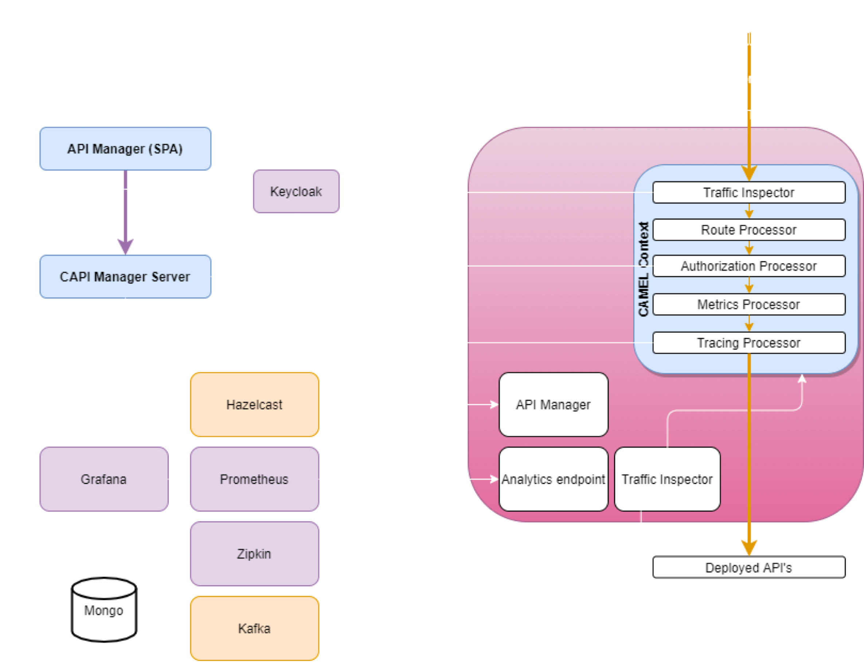
Architecture
CAPI - Light Apache Camel API Gateway

Slide 8

Architecture
CAPI - Light Apache Camel API Gateway

Slide 9
Architecture
CAPI - Light Apache Camel API Gateway

Slide 10

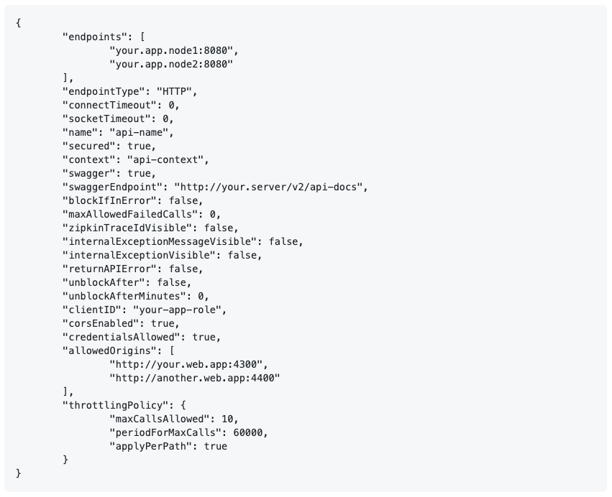
API Model
CAPI - Light Apache Camel API Gateway

Slide 11

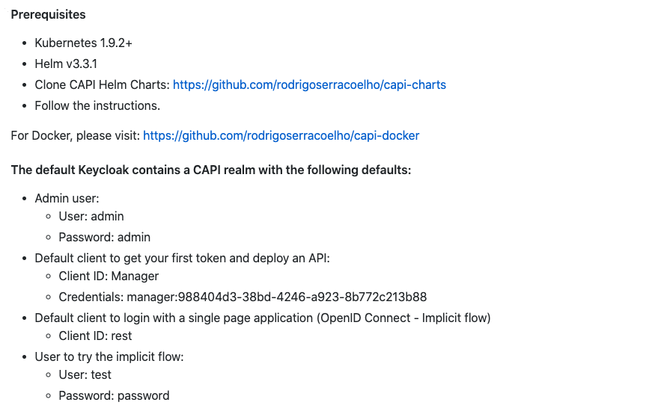
Demo Time
CAPI - Light Apache Camel API Gateway

Slide 12
Demo Time
Start 2 remote services. (deployed on AWS)
Request the first access token.
Deploy the first API: License Service. (unprotected)
Call the API without a bearer token.
Call the API from our demo web application. (CORS)
Edit the API to play with CORS configuration.
Deploy the second API: Quote Service (protected and restricted)
Call the API without a bearer token
Request an access token
Call the API with a bearer token
CAPI - Light Apache Camel API Gateway

Slide 13
Demo Time
Create the role and add the role to the client ID
Request a new access token
Call the API with a bearer token
Call the API more than 10X minute
Observe the API being blocked
Check Zipkin
Check Prometheus
Check Grafana
CAPI - Light Apache Camel API Gateway

Slide 14
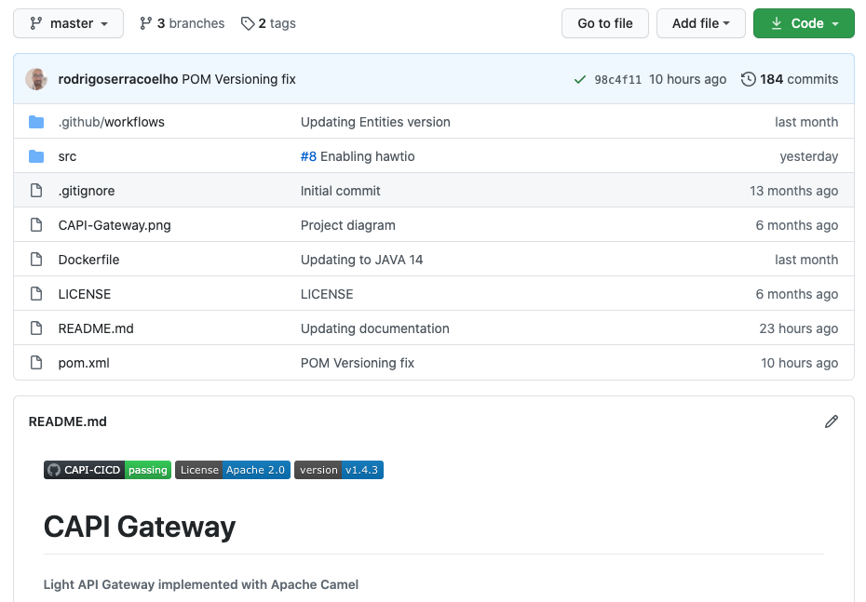
Github
> git clone https://github.com/rodrigoserracoelho/capi-gateway.git
CAPI - Light Apache Camel API Gateway

Slide 15
Questions
CAPI - Light Apache Camel API Gateway

