Slide 1
Enhancing Apache Ignite 3.0 with the Power of Open Source
Stanislav Lukyanov
Director of Product @ GridGain
Oct 9, 2023

Slide 2

About Me
Speaker: Stanislav Lukyanov
Product @ GridGain, original creators of Apache Ignite
Ex-Oracle Java geek
5+ years contributor to Apache Ignite
Distributed systems and collocated computing advocate

Slide 3
Agenda
What is Apache Ignite (3.0)
Using OSS Components in Apache Ignite 3.0
Open-Source vs DIY

Slide 4
What is Apache Ignite (3.0)

Slide 5

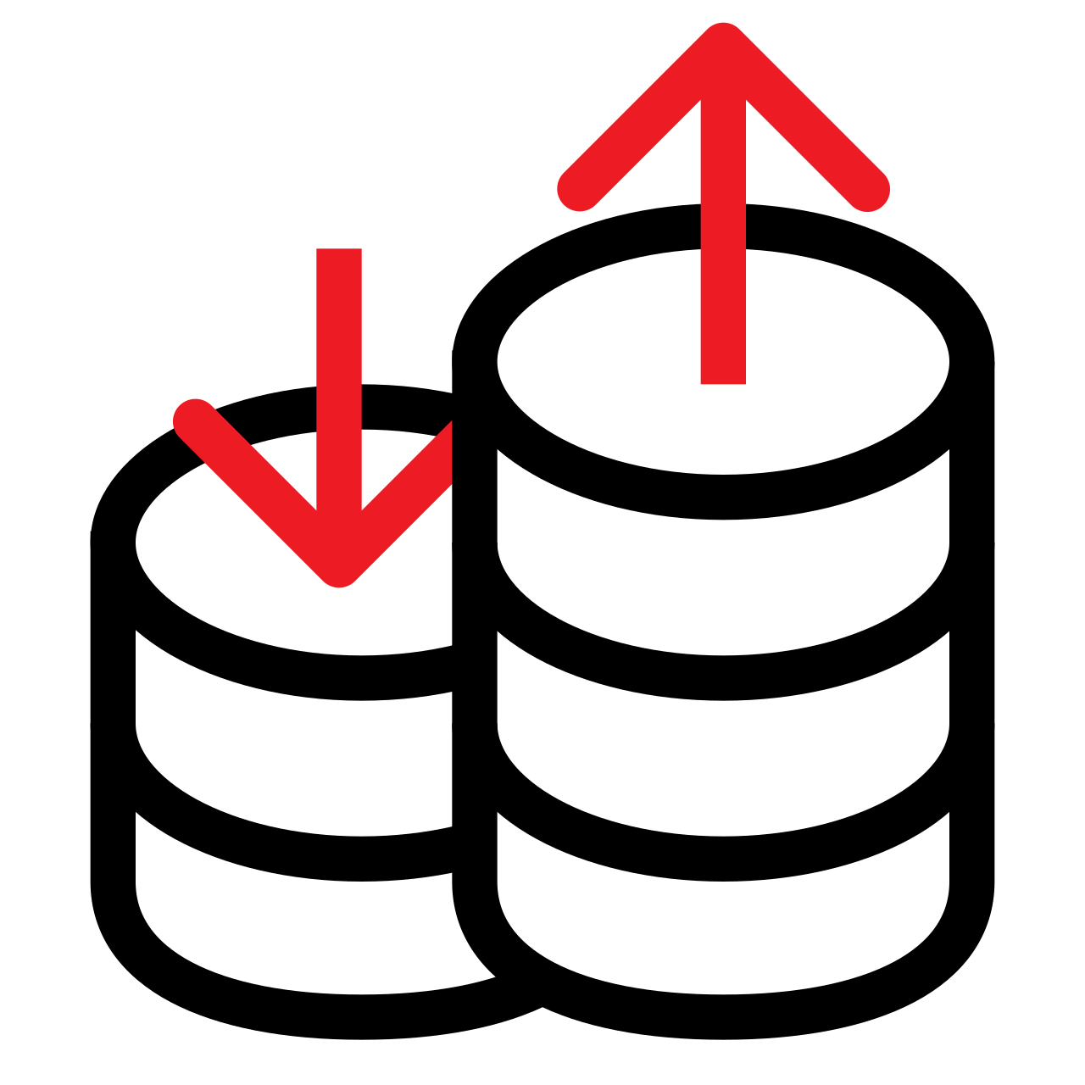
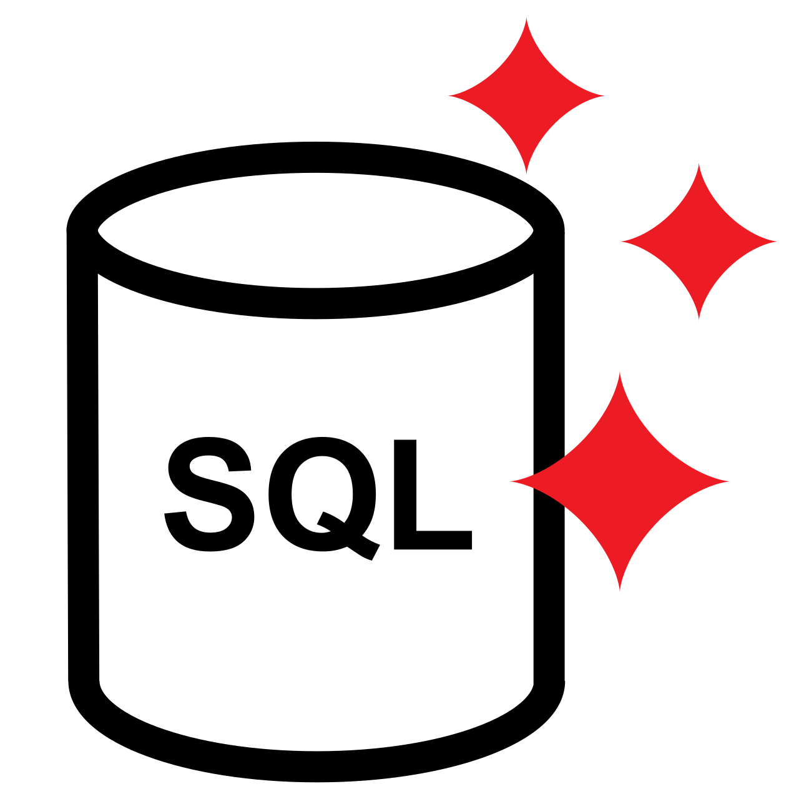
What is Apache Ignite?
Apache Ignite is a distributed database management system for high-performance computing and can be used as a cache or a memory-centric database. It offers SQL, key-value API, ACID transactions, and colocated compute processing data in RAM or in disk-based persistent store.
Apache Ignite can help to:
Build real-time and event-driven solutions that process data with in-memory speed
Scale up and out across available memory and disk capacity
Take advantage of built-in SQL, high-performance computing and real-time processing APIs
Notes:
Ignite is a distributed database management system designed for high-performance computing but also used to underpin enterprise applications.
Apache Ignite can be used to power in-memory apps, as a cache, or an in-memory database, or datagrid sitting between an application and third-party databases however. It uses hardware RAM as a caching and storage layer, allowing it to ingest and process complex datasets in parallel and at faster speeds than traditional databases supported by only disk storage.
It offers very low latency and very fast read performance – up to 1000x better than disk-based systems (although Ignite has native persistence, and can use disk storage, particularly for large datasets which don’t fit in memory). It can also scale indefinitely, meaning Ignite can handle extremely large datasets, and can be extremely resilient and fault-tolerant. Ignite offers integration with existing databases and data stores, along with SQL and ACID transactions – with some limitations.

Slide 6
Apache Ignite 3.0
Goals: Modernization and Usability
Project status: in Beta
Modernize APIs and DX
Rework legacy APIs
Improve configuration usability
Address common pitfalls
Modernize internals
Solve architectural pain points
Upgrade to modern protocols
Future-proof as possible
A lot of DIY components and algorithms in Ignite 2.x
Consider replacing in 3.0

Slide 7
Using Open-Source in Apache Ignite 3.0

Slide 8
Apache Ignite Key Components
Connect with apps
APIs and Standards
Process data
Key-Value
SQL
Compute
Ensure consistency
Transactions
Replication
Get nodes talking
Network
Clustering
Store data on each node
Storage

Slide 9

Storage
2.x: DIY
APIs and Standards
3.0: DIY + OSS
Compute
Key-Value
SQL
Transactions
Replication
Page Memory
Custom B+ Tree implementation
In-memory and persistence
Universally good for reads and writes
Not as good for writes as LSM-Tree
Network
Clustering
Page Memory (Decoupled)
No other widely used OSS B+ Tree
Keep and decouple
Allow to add more storages in future
RocksDB
OSS LSM-Tree by Meta
De-facto standard for DB persistence
Storage

Slide 10

Network
2.x: DIY
APIs and Standards
3.0: OSS
Compute
Key-Value
SQL
Transactions
Replication
Communication
Java NIO-based networking
Peer-to-peer communication
Custom TCP-based protocol
Complex to maintain
Network
Clustering
Netty
De-facto standard for fast networking
Java NIO-based
Many protocols, TLS, and other goodness out-of-the-box
Storage

Slide 11

Clustering
2.x: DIY
APIs and Standards
3.0: OSS
Compute
Key-Value
SQL
Transactions
Replication
Discovery
Custom service discovery and cluster membership
Custom protocol for connection, failure detection, metadata propagation, etc.
Ring topology -> scalability bottleneck
Network
Clustering
ScaleCube
SWIM protocol implementation
Scalable membership and failure detection
Storage

Slide 12

Transactions & Replication
2.x: DIY
APIs and Standards
3.0: DIY + OSS
Compute
Key-Value
SQL
Transactions
Replication
ATOMIC and TRANSACTIONAL Protocols
Two semi-dependent protocols for consistent data updates
Custom, not based on popular papers
Complex to maintain
No split-brain protection OOTB and other fundamental limitations
Failed to add MVCC support to the existing protocols
Network
Clustering
Transaction Protocol (IEP-91)
Backbone of Ignite 3.0
MVCC-based
SOFAJRaft
Raft protocol implementation
Part of SOFAStack
Forked and customized
Storage

Slide 13

SQL Engine
2.x: OSS
APIs and Standards
3.0: OSS
Compute
Key-Value
SQL
Transactions
Replication
H2 Engine
Single-node embedded SQL DB for Java
Customized to support SQL queries
Very hard to customize
Often inefficient
Not built for distributed execution
Network
Clustering
Apache Calcite
Framework for building SQL databases
Very customizable
Great for distributed query planning
A lot of OOTB features
Storage

Slide 14
APIs and Standards
2.x
APIs and Standards
3.0
Compute
Key-Value
SQL
Transactions
Replication
Native Clients
Custom thin client protocol
Java, .NET, C++, Python, etc.
JCache 1.1 (JSR 107)
SQL
ANSI SQL 99
JDBC
ODBC
Network
Clustering
Native Clients
Custom thin client protocol
Java, .NET, C++, Python, etc.
JCache 1.1 (JSR 107)
SQL
ANSI SQL 2016
JDBC
ODBC
Storage

Slide 15


APIs and Standards
2.x
APIs and Standards
3.0
Compute
Key-Value
SQL
Transactions
Replication
REST
Based on Jetty
Not fully RESTful
Network
Clustering
REST
Based on Micronaut
Fully RESTful
Open API spec out-of-the-box
Storage

Slide 16

APIs and Standards
2.x
APIs and Standards
3.0
Compute
Key-Value
SQL
Transactions
Replication
CLI
Multiple scripts and tools written from scratch
SQLLine for SQL execution
Some REPL, some not
No single convention for options
Network
Clustering
CLI
Based on Picocli
All tools combined
Syntax highlighting
Autocomplete
Interactive mode (REPL)
Storage

Slide 17
Apache Ignite 3.0 Enhanced with Open Source
APIs and Standards
Key-Value
SQL
Compute
Transactions
Replication
Network
Clustering
Storage

Slide 18
DIY vs Open-Source: Opinionated Guidelines

Slide 19
Should We Write Things From Scratch?
Do-It-Yourself
Use a 3rd Party Dependency
Pros
Fine tune for what you need
Less dependencies
It’s fun! ☺
Pros
Less work (usually)
Benefit from new changes
Help other communities
It’s focused fun! ☺
What is your project’s raison d’être (”reason to be”)?

Slide 20
Should We Invent Our Own APIs?
What Open Standards to Support?
Is standard familiar to users?
Can you implement it fully?
Does it open a new ecosystem?
Does it help to design the product?
Does it limit the design?

Slide 21
Summary
Don’t boil the ocean
Focus on your project’s mission
Help other communities – provide feedback and contribute
Choose wisely

Slide 22

Reach Out
Check out these useful resources:
Free Apache Ignite Training
Ignite Summit – Virtual Community Conference
Product Demo: The GridGain Unified Real-Time Data Platform
Apache Ignite Community
E-mail: stan@gridgain.com

