Slide 1
Helping Your Clients Make The Move to eCommerce

Slide 2
The positions we hold often give the unsuspecting Internet entrepreneur the idea that we are the best initial contact when considering the world of eCommerce. They focus their thoughts on shopping carts, HTML code and Service Level Agreements. Our NEW job is to inform them that they need to first consider marketing, financing, staffing and order fulfillment before worrying about their Internet interface. Knowing the other factors they needs to consider and helping them arrange all aspects of their new venture presents an amazing opportunity for you to move into this market and provide a service that will be very valuable (to you and your client).

Slide 3
eBusiness
Activities carried over
computer-mediated
channels

Slide 4
eCommerce
Transactions carried over
computer-mediated channels that
comprise the transfer of ownership or
the entitlement to use tangible or
intangible assets

Slide 5
I can’t participate in eCommerce because I do not know how to create a web site!
Well…did the owner of the corner store do his own plumbing & electrical work?

Slide 6
There is very little difference between starting-up a physical retail location and an e-commerce retail operation

Slide 7
Business Plan
Expense Forecast
Revenue Forecast
Employee Requirements
Market Research
Financing

Slide 8
Setting Up Partner Arrangements
Advertising Channels
Banking Arrangements
Credit Card Merchant Services
Gov’t Registration
Marketing
“Landlord” Host for Web Site (ISP)
Suppliers for stock and supplies
Shipping
Broker Service (customs, etc)

Slide 9
“If you take the “e” out of eCommerce and eBusiness we are left with what the concept is really about”

Slide 10
So…who’s out there?

Slide 11
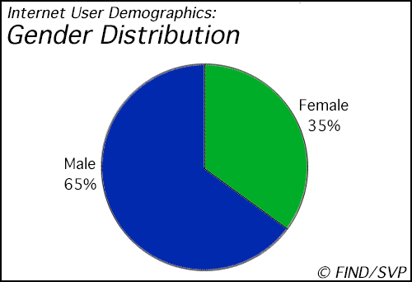

Slide 12
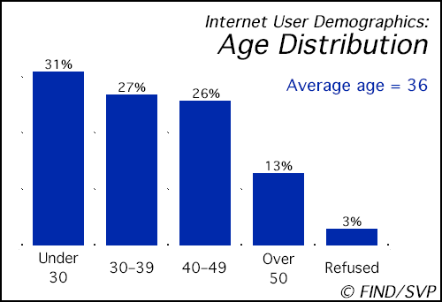

Slide 13
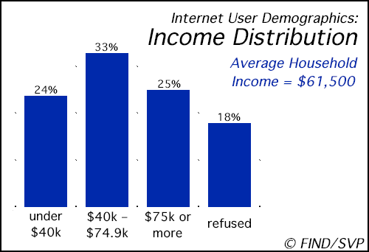

Slide 14
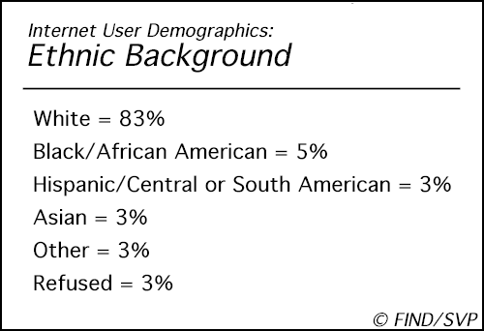

Slide 15
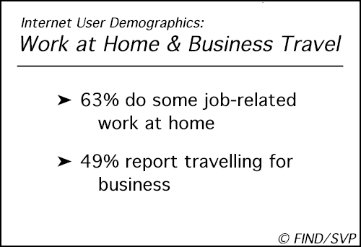

Slide 16
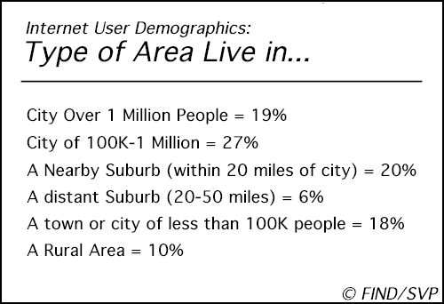

Slide 17
As the Internet becomes standard
for transactions, dollar volume will
increase dramatically, growing
from $2.6 billion in 1996 to $220
billion by 2001

Slide 18
Considerations for an eCommerce Internet Site

Slide 19
Product Offering
Can product be sold remotely?
Can it be shipped internationally?
After adding shipping, is price still competitive?
Is it easily “shippable”?

Slide 20
Financial Transactions
What type of payment options will you accept?
Does your Credit Card merchant agreement allow non-signature payments?
Do they require a security deposit from you?
Can your website accept payments?
Will you authorize payment immediately on-line?

Slide 21
Marketing
Marketing budget?
Search engines will NOT do the job alone!
Click-thru banners OK, but expensive and not worth money
Conventional marketing still the best way to spread the word about web site
Consult a professional marketing firm

Slide 22
Order Fulfillment!
The biggest stumbling block
and #1 reason for failure
in eCommerce

Slide 23
Order Fulfillment
Dependable Suppliers
Solid shipping arrangements
Solid arrangements with Customs
Guaranteed order turnaround
Quick reply to email requests
Fast and effective return policy

Slide 24
Selecting an Internet Host
Dependable and established hosting service
Able to satisfy SSL requirements
Use Apache! :-)
Knowledgeable staff
System accessible to you and your webmaster
Can they handle the potential traffic?

Slide 25
Web Store (Shopping Cart)
Ensure that vendor is established and reputable (ask around)
Compatible with credit card interface and web server
Easily maintained
Flexible

Slide 26
Example of Costs
Secure Certificate $250.00
Shopping Cart Software $200.00-$500.00
Basic Web Hosting and access $20.00/month
Secure Server Access $20.00/month
Domain Hosting (www.company.com) $10.00/month
PLUS credit card fees, banking charges, etc

Slide 27
There is money to be
made! So….go make it!

Slide 28
Some e-stores to visit
www.amazon.com
www.chapters.com
www.iaw.com/ss
Shopping cart sites have sample stores

Slide 29
Resources for Shopping Carts
Quik Store www.quikstore.com
Shop Site www.openmarket.com/shopsite/
Mercantec www.mercantec.com

Slide 30
Credit Card Authorization Sites
YOUR BANK!
www.internetsecure.com
www.touch.com
www.lend.org
www.cybercash.com

Slide 31
Other Resources
e-com.ic.gc.ca
www.ecc.ca
www.nua.ie/surveys
www.nua.ie/clickonomist/current.html
cyberatlas.internet.com
www.isp-resource.com/incogNETo/0000006.shtml
www.isp-resource.com/incogNETo/0000013.shtml
www.iaw.com/99006.pdf
http://www.emarketer.com/estats/welcome.html

Slide 32
Frank DeChellis
President
Internet Access Worldwide
6 King Street
Welland, Ontario
L3B 3H9
905-714-1400 frankd@iaw.com www.iaw.com

