Slide 1


Enterprise LDAP
and
Apache Directory
Server
Emmanuel Lécharny
Iktek
<elecharny@iktek.com>

Slide 2
Agenda
  1- Introduction
  2- LDAP Today
  3- Future evolutions
  4- Introduction to ADS
  5- Conclusion...
  6- Q&A

Slide 3
Introduction
  First there was X.500
  X500 was all about directories. First published in 1990. Based on OSI networking stack
  LDAP as an alternative
  Lightweight, over TCP. Back in 1993
  15 years later
  Time for the next step, and massive enterprise adoption, not only for White Pages.

Slide 4
LDAP today (1)
  White pages
  NIS
  PAM extensions
  Security, PKI
  applications ?

Slide 5
LDAP today (2)
  Complexity has slowed down its adoption
  No real leader :
  Netscape, OpenLdap, SunDS, IDS, OID, ...
  Almost no evolution since 1993

Slide 6
LDAP today (3)
  Still LDAP V3 from 1995
  New RFCs has been issued last year
  This was only about clarifying old RFCs

Slide 7
LDAP today (4)
  Archaic
  complex to implement
  inconsistent
  under utilized
  no traction from the market

Slide 8
LDAP today (5)
  No tools, or outdated tools (Ldap browsers, schema editors)‏
  No skills, compared to RDBMS
  RDBMs are studied in university, not LDAP
  API is a problem (JNDI or jLDAP ?)‏

Slide 9
LDAP today (6)
  Microsoft introduced AD
  - Managing domains needs it
  - Better replication
  - Allows distributed systems
  Identity Management suddenly became mainstream
  Increased integration problems

Slide 10
LDAP future (1)‏
RDBMs vs LDAP : a new choice
Better tooling
Better API (JNDI is being redesigned)‏
Better integration

Slide 11
LDAP future (2)‏
Virtual directories
Views, triggers, stored procs
Queues
Notifications
Having E/R tools for LDAP

Slide 12
LDAP future (3)‏
Persistence layer
DAS
Hibernate's like persistence layer
Graphical tree management
Graphical replication management
ChangeLogs/Snapshoting

Slide 13
LDAP future (4)‏
New LDAP client API
JSR just started
Will be available for Java 7
Apache is part of it

Slide 14
LDAP future (5)‏
LDAP server should be transparent
It's a major component of IT now, and will be more essential in the next few years
Integration is the key

Slide 15
ADS to the rescue
  a compliant LDAP Server
  written in Java(tm)‏
  embeddable
  extensible
  tooling (LdapStudio)‏
  and more ...

Slide 16
What is ADS ?
  Originally designed to increase the uptake of LDAP by the enterprise
  Makes the users more confortable with LDAP concepts
  Lower the price and the barrier for LDAP enabled applications

Slide 17

Ldap Compliant
  Compliance validated by OpenGroup
LDAP Certified V2
Company Name: Apache Software Foundation
Product Name: Apache Directory Server 1.0
Environment: Java 2 Standard Edition 1.5.0 (5.0)‏
Registered on: 27-Sep-2006
Display a copy of the Brand Certificate in PDF
Search the Conformance Statements database for all LDAP Certified V2 registrations
See all the registered products for the LDAP Certified V2 Product Standard
See more information about the LDAP Certified V2 Product Standard

Slide 18

Writen in Java
  Ubiquitous langage
  Wide community
  Performant
  Improving year after year
  Lot of available tools
  GUI capable, lots of libraries
Notes:
I have nothing against Ruby (the last buzzword IMHO), but keep in mind that Ruby and java were released the same year : 1995

Slide 19
Embeddable
  Apache Directory Server has been designed to be embeddable
  This is useful for many applications
  It eases packaging
  Better performances ( no more network costs )‏
  Easier to unit test

Slide 20
Extensible
  Apache Directory Server has been designed to be extensible
  Not only with new controls of extended operations
  Interceptors (filters equivalent)‏
  Partitions
  Stored procedures
  Triggers
  ACI support

Slide 21

Possible extensions
  Virtual Directory
  Proxy
  e-provisioning
  Identity management (TripleSec)‏
  and more ...

Slide 22
e-provisioning
  ADS has Stored Procedure and triggers built-in
  This is the best solution for e-provisioning
  One can add some new SPs for specific components
  We have a scheduler inside ADS (Quartz)‏

Slide 23
Ldap proxy
  Allows to dispatch requests to many servers
  Filters requests based on rules
  Can be used to log data

Slide 24
Identity Management
  Triplesec : A complete solution for IdM
  Guardian is the associated API to be used by application
  Centralized system
  « Keep it simple, keep it safe »
  See Alex Karasulu presentation

Slide 25
LdapStudio (1)
  LdapStudio is the platform for the next generation of LDAP tools.
  Plugins architecture (Eclipse)‏
  RCP application
  Not only for ADS, but leverage ADS and work better with ADS

Slide 26
LdapStudio (2) :
Functionalities
  what's into the box ?
  LdapBrowser
  Schema editor
  ADS administrator
  ACI editor
  soon a Triplesec admin plugin

Slide 27
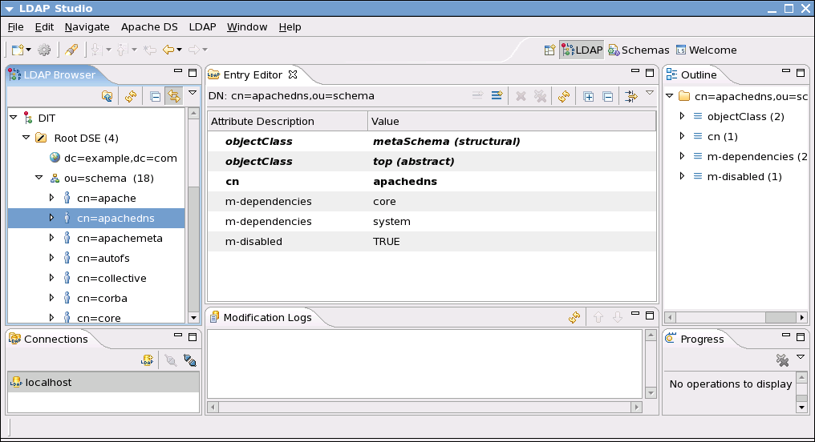
LdapStudio (3) : ldap browser
  It's not only about search and read.
  You can modify data.
  And it works
  with any Ldap
  server !

Slide 28
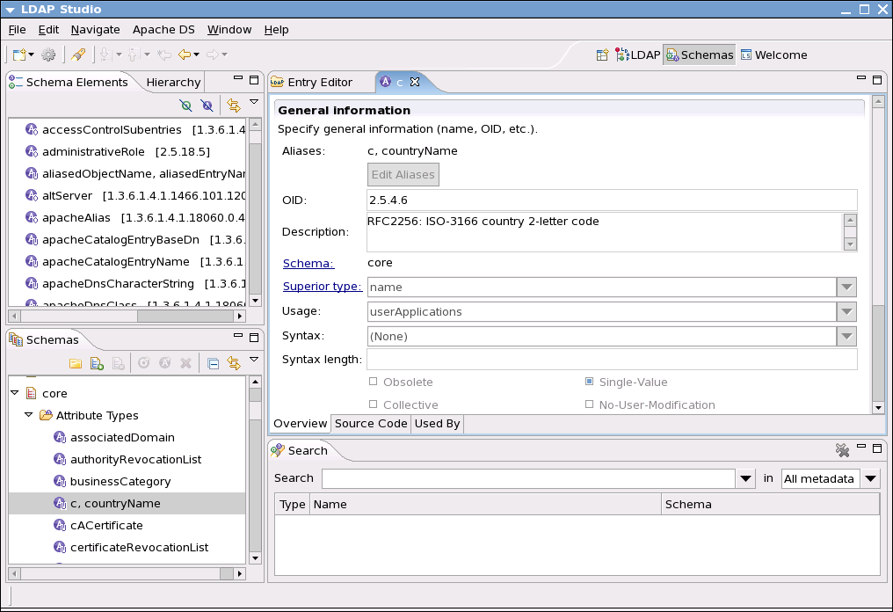
LdapStudio (4) :
Schema Editor
  You can edit Ldap schema (OpenLdap format).
  Soon, you will be able to update the server (ADS only)‏

Slide 29
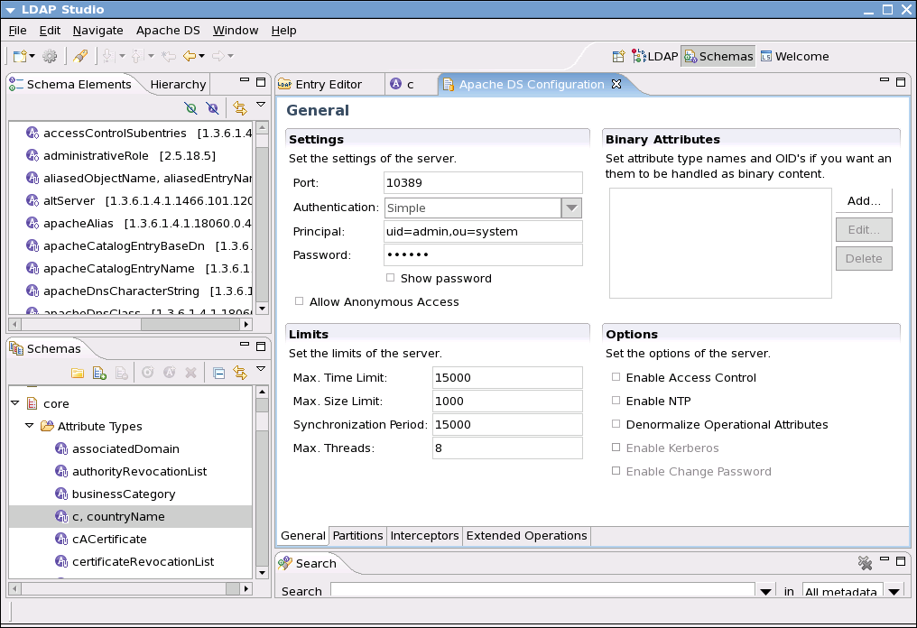
LdapStudio (5) :
ADS configuration
  Manage ADS configuration :
  interceptors
  basic configuration
  attributes
  indices and cache
  partitions

Slide 30
What's next ?
  Stored procedure management plugin
  Triggers management plugin
  TripleSec plugin
  Replication management plugin
  LDAP E/R plugin
  LDAP Hibernate plugin

Slide 31
Conclusion
  Apache DS
  has the potential to increase LDAP adoption at a higher level of usage besides simple white pages

Slide 32
Q&A
  From
  (&(dc=questions)(desc=*))‏
  to
  Any Question ?
  with ADS

Slide 33
Thanks !
  To the team:
  Ersin Er, Alex Karasulu, Christine Koppelt, Trustin Lee, Pierre-Arnaud Marcelot, Enrique Rodriguez, Stefan Seelmann, Stefan Szörner, the whole MINA team, and to many other peeps at
  Apache !

