Slide 1
HiveServer2 HA/Rolling Upgrade
Vaibhav Gumashta
vgumashta@hortonworks.com
@vaibhavgumashta
April 2015

Slide 2
HiveServer2 < Hive 14
No out of box HA
Using external load balancer.
No Rolling Upgrade
Upgrade downtime.

Slide 3
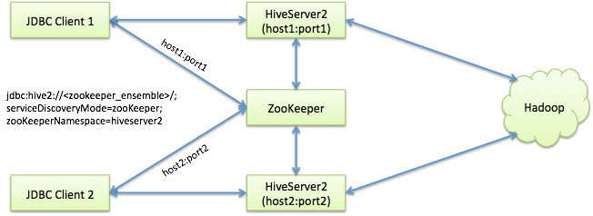
HIVE-8376 : Dynamic service discovery
HiveServer2 instances create persistent ephemeral node (thanks Apache Curator!) on ZooKeeper under a configurable namespace.
JDBC driver randomly picks an HS2 instance from ZK & opens a sticky session.
Security note: on secure cluster, namespace & nodes owned by user running HS2 process (HS2 – ZK kerberized); JDBC only has read access.

Slide 4
HA : Server Settings
Bring up ZK and set the following:
hive.server2.support.dynamic.service.discovery : true.
hive.zookeeper.quorum : <host1:port1, host2:port2, host3:port3> (comma separated list of ZK host:port).
hive.server2.zookeeper.namespace : <namespace>. Each HS2 instance that comes up will create a znode under this namespace (default : hiveserver2).
hive.zookeeper.session.timeout : <timeout> (default : 600s).

Slide 5
HA : JDBC Settings
JDBC url:
jdbc:hive2://<zk_ensemble>/;serviceDiscoveryMode=zooKeeper;zooKeeperNamespace=<hs2_zk_namespace>.
JDBC driver connects to ZK, & selects an HS2 instance at random. Creates a sticky session to the server instance.

Slide 6
Rolling Upgrade
Ensure settings are in place as shown before.
Start HS2 instances of version1.
When upgrading, start instances of version2.
Now run:
hive –service hiveserver2 –deregister version1
(version1 servers will shut down when they don’t have active sessions anymore).
New JDBC clients will now pick up the new versions from ZK.

Slide 7
Current limitations
Doesn’t support non-sticky sessions.

Slide 8
Thank You!
Questions & Answers

