Slide 1
New Metrics in Hive

Slide 2
Motivation
Enhanced Supportability
Limited number of current metrics
HMS Performance Metrics: Average time spent and number of invocations of individual HMS calls

Slide 3
Dropwizard / “codahale” toolkit
Dropwizard toolkit based metrics support added in HIVE-10761
Built-in support for several outputs
JMX, HTTP, stdout, CSV, SLF4J, Ganglia, Graphite, etc.

Slide 4
Dropwizard / “codahale” toolkit
Gauge Instantaneous measurement.
Counter Gauge with increment/decrement operations.
Meter Rate of events over time (mean qps, 15-minute moving average)
Histogram distribution of values (mean, median, 90th percentile, etc.)
Timer Rate and distribution of duration
Health Check

Slide 5
New Metrics
Open Connections - Number of open incoming connections to HS2/HMS
Open Operations in HS2
JVM Metrics
JVM Pause Info - Number of extra seconds spent in sleep
Other Metrics – GC count, GC time, Threads count, memory breakdown, etc.
HS2 Metrics
Duration of queries
Number of Queued queries
Number of Running queries
HMS Metrics
Number of tables, partitions
PerfLogger

Slide 6
Adding a metric
Metrics metrics = MetricsFactory.getInstance();
metrics.incrementCounter(MetricsConstant.OPEN_CONNECTIONS);
Metrics metrics = MetricsFactory.getInstance();
metrics.addGauge(MetricsConstant.JDO_ACTIVE_TRANSACTIONS, new MetricsVariable() { @Override public Object getValue() { return openTrasactionCalls; } });

Slide 7
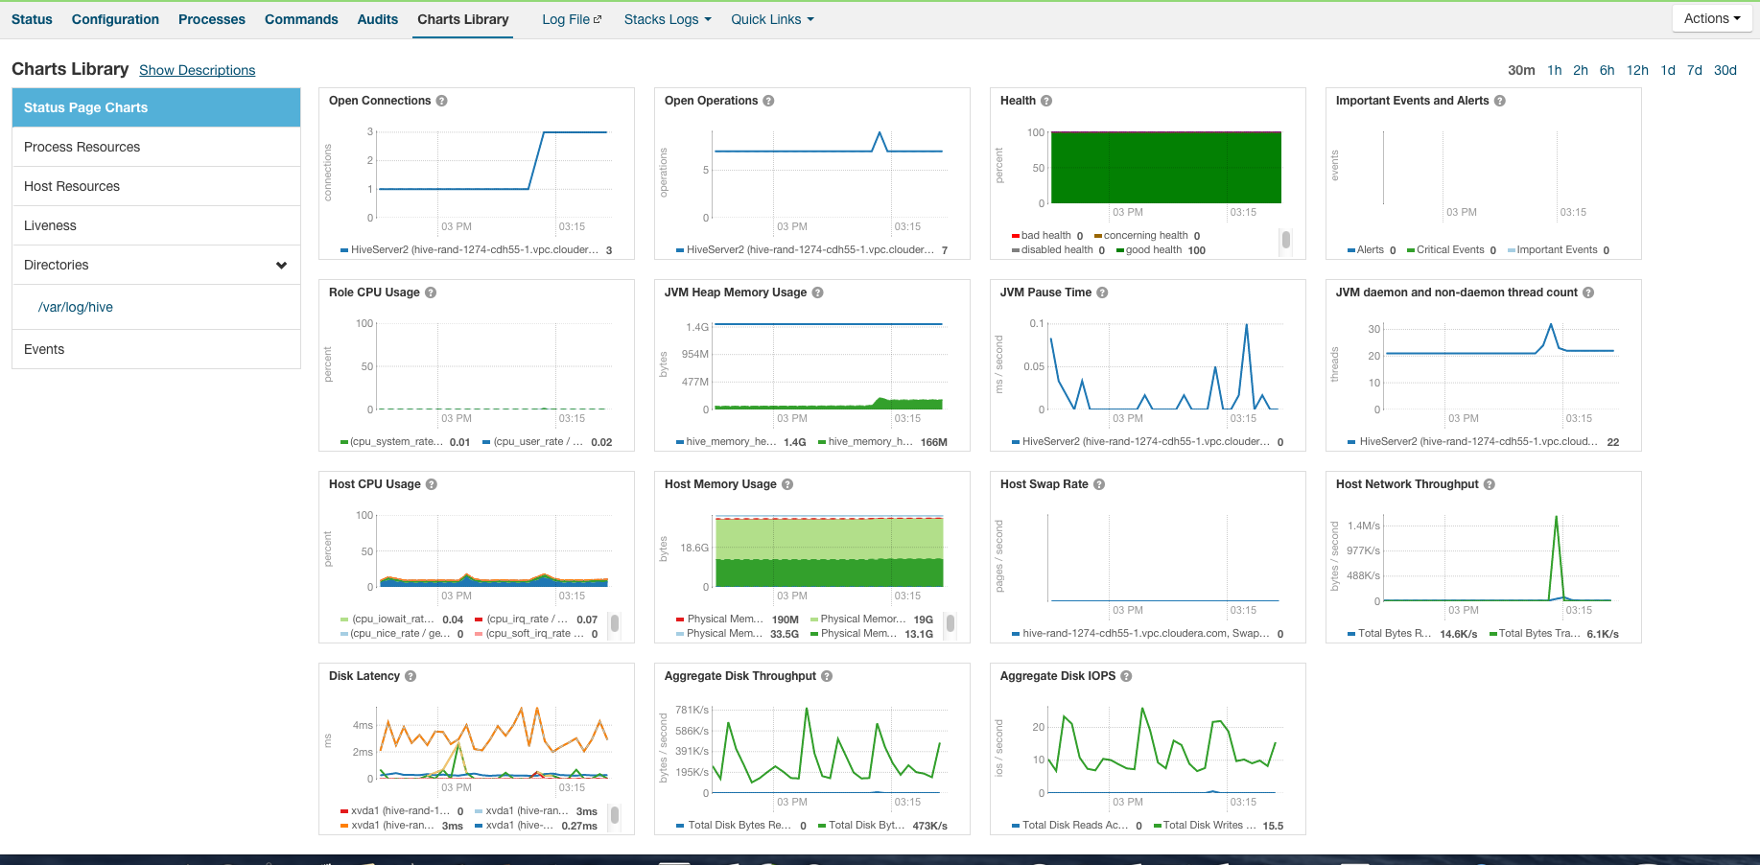
HS2 Status

Slide 8
Web UI for HS2/HMS – HIVE-12338
Active Sessions
Ongoing Operations
Metrics
TBD
Ideas?
Configs, Thread dumps, Catalog contents, Locks
Please update HIVE-12338

Slide 9
Thank you.

