Slide 1

Hive @ Uber
Mohammad Islam
D A T A

Slide 2
Data @ Uber
Kafka
Ingestion Layer
HDFS
Sharded MySQL
DB

Slide 3
Data @ Uber
Specialty in Uber data
Out of order data arrival
Duplicate records - machine failure/replay
Highly nested structure
Geo information
Notes:
Introduce Hive and our work

Slide 4
hDrone: Data registration service
Registration includes
Create new table
Add a new partition
Schema evolution
Registration backfill
Pros
Central control
Data producer does not need to handle the details
Cons
Yet another service to manage

Slide 5
hDrone: Data registration service
hDrone
INotify
Hive
Hive Registration Task
HDFS
ThreadPool
catchUp
Notes:
Introduce next slide/Janus

Slide 6
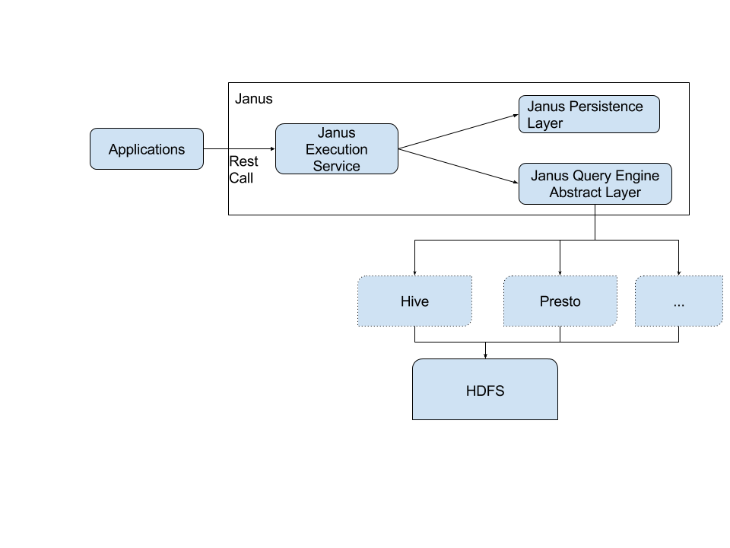
Janus
Janus: Unified query execution service
Notes:
Introduce expected feature

Slide 7
Expected Feature : Transaction
Hive transaction support
Update/delete/insert
Required for incremental ingestion
Issue: ORC only supports it!

Slide 8
Expected Feature : Geo
Geo/spatial query support
Uber business is inherently geo-aware
City OPS may not be a techy (SQL experience)
Esri library can be a good start but may need more

Slide 9
Hive (auto) Tuning
Hive has bunch of knobs for better performance
Not easy to remember for everybody
Excellent if hive execution/planner engine can auto-set the best configurations

Slide 10
More..
HS2 stability
Column-level security (for non-Hive App)
Parquet performance
Notes:
Locking
Memory
HA

Slide 11
Q & A

