Slide 1
Hardening Hive John Pullokkaran 11/16/2015

Slide 2
Safe Harbor Statement
Sentiments and opinions expressed here is to be purely used as discussion points and doesn’t anyway convey presenter’s lack of confidence in Hive community. Remember presenter is your friend. Incase you decide to shoot the presenter, give him one minute warning.

Slide 3
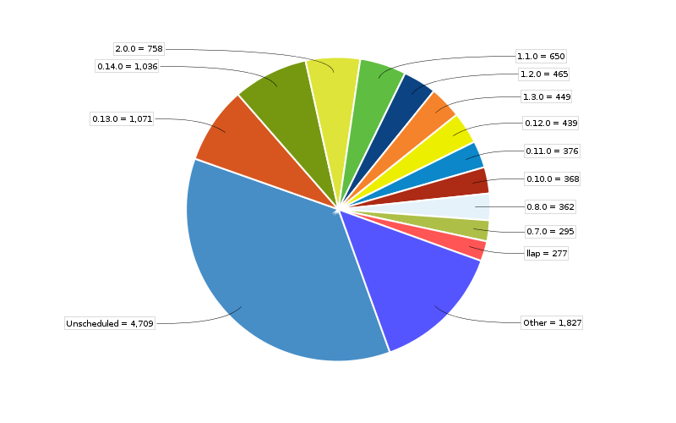
Houston We Have a Problem – Do We? Release Breakup

Slide 4
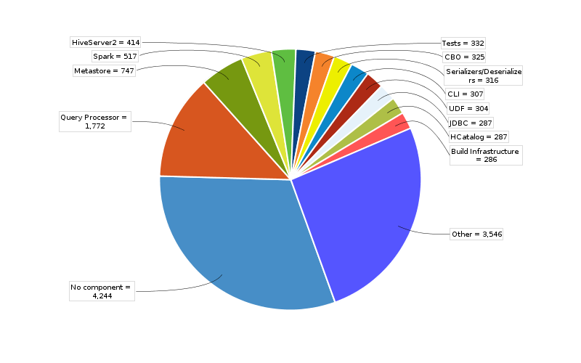
Houston We Have a Problem – Do We? Component Breakup

Slide 5
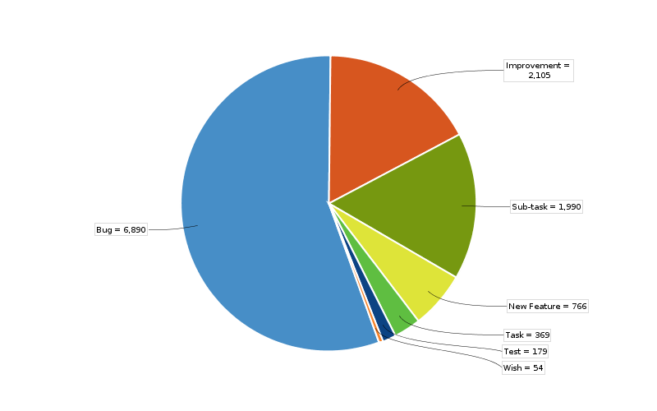
Houston We Have a Problem – Do We? Feature vs. Bug

Slide 6
Houston We Have a Problem – So Do We?
We really don’t have data
Anecdotal evidence suggests at least 10 % of all bugs are data correctness bugs.

Slide 7
What explains the growth curve?
Rate of innovation: TEZ, Spark, ORC, CBO, ACID, HS2, Vectorization, Security
Increased User Adoption
Poor Design/Code Review
Brittle Architecture
Suboptimal Code Engineering
Incomplete test coverage

Slide 8
Multiple code paths
Relaxed Parser/Resolver
Syntax/Semantic Info Tree
Calcite Gen Plan
Hive Gen Plan
Calcite Optimizer
Hive Optimizer
MR Compiler
TEZ Compiler
Spark Compiler
MR Executor
TEZ Executor
Spark Executor
ORC
Parquet
…

Slide 9
Could we do better?
Better Metrics: Correctness, Sub Component, Code Coverage numbers
Better Design/Code Reviews
Reuse existing infrastructure
Test cases that covers more of the code paths

Slide 10
Could we improve Design/Code Reviews?
?

Slide 11
Could we improve Design/Code Reviews? Suggestions
Reviewer should able to defend design/code engineering choices
Include more than one developer for large patches
Do design reviews for feature work
Reviewer should also look at q.out changes

Slide 12
Epilogue
I am still your friend.

