Slide 1
What's new in Hive 2.0
Sergey Shelukhin

Slide 2
What is Hive 2.0?
Split in 2015
Hive 1.* is the "more stable" line
    Receives the bugfixes, some features and improvements
    Keeps everything backward compatible
Hive 2.* is the "more ambitious" line
    Receives the bugfixes and improvements
    Also receives all the major new features
    Deprecates the support for some older features
Doesn't mean Hive 2 is unstable
Where is Hive 1.3?!!

Slide 3
When is Hive 2.0 coming?
The original plan was Dec 2015
    Unrealistic – too many blockers, too many features wanting to get in
2016-01-21
    1 blocker left (hello Eugene ☺)!
    Some features and improvements about to get in
    RC 0 expected this week

Slide 4
Hive 2.0 at a (rather blurry) glance
project = HIVE AND fixVersion in (2.0.0, llap, spark-branch, hbase-metastore-branch) AND fixVersion not in (1.3.0, 1.2.2, 1.2.1, 1.0.1, 1.1.1, 1.2.0, 1.1.0) AND resolution = Fixed
    764 tickets (Hive 2.0 only)
      333 Sub-tasks (remember all those new features?)
      313 bugs (but we mark everything as Bug)
      99 Improvements and Tasks
project = HIVE AND fixVersion in (2.0.0, llap, spark-branch, hbase-metastore-branch) AND fixVersion not in (1.2.1, 1.0.1, 1.1.1, 1.2.0, 1.1.0) AND resolution = Fixed
    1193 tickets (Hive 2.0 + future Hive 1.3/1.2.2)

Slide 5
Upgraded versions
Upgraded versions
    Log4j 1 -> Slf4j/log4j 2 (perf gain – logging doesn't block the thread!)
    Calcite 1.2 -> 1.5 (new features for CBO)
    Tez 0.5 -> 0.8.2 (perf gains, new features, plugins)
    Spark 1.3.1 -> 1.5 (perf gains, new features) (also in Hive 1.3)
    DataNucleus 3 -> 4, Kryo 2 -> 3, Hbase 0.98 -> 1.1
    Parquet 1.6 -> 1.8 (1.7 is also in Hive 1.3)
    Thrift 0.9.2 -> 0.9.3, Avro 1.7.5 -> 1.7.7 (also in 1.3), etc.

Slide 6
Breaking things
    Java 6 no longer supported
    Hadoop 1 no longer supported on Hive 2 line (is it older than Java 6?)
    MR is deprecated, but still supported (use Spark or Tez!)
    Better defaults (enforce.bucketing, metastore schema verification, etc. on by default)
    Tightened safety settings (fails on some unsafe casts, etc.)

Slide 7
New features #1
HPLSQL
LLAP (beta)
HBase metastore (alpha)
Improvements to Hive-on-Spark
Improvements to CBO

Slide 8
New features #2
SQL Standard Auth is the default authorization (actually works)
CLI mode for beeline (WIP to replace and deprecate CLI in Hive 2.*)
Codahale-based metrics (also in 1.3)
HS2 Web UI
Stability Improvements and bugfixes for ACID (almost production ready now)
Native vectorized mapjoin, vectorized reducesink, improved vectorized GBY, etc.
Improvements to Parquet performance (PPD, memory manager, etc.)
ORC schema evolution (beta)
Improvement to windowing functions, refactoring ORC before split, SIMD optimizations, new LIMIT syntax, parallel compilation in HS2, improvements to Tez session management, many more
Did I forget something?

Slide 9
HPLSQL
HPL/SQL is a hybrid and heterogeneous language that understands syntaxes and semantics of almost any existing procedural SQL dialect
    Compatible with Oracle PL/SQL, ANSI/ISO SQL/PSM (IBM DB2, MySQL, Teradata etc.), PostgreSQL PL/pgSQL (Netezza), Transact-SQL (Microsoft SQL Server and Sybase)
Key SQL features
    Flow of Control Statements
    Built-in Functions
    Stored Procedures, Functions and Packages
    Exception and Condition Handling
Merged into Hive as hplsql module
See hplsql command, docs at http://www.hplsql.org/doc

Slide 10
LLAP (beta in 2.0)
Sub-second query execution in Hive via persistent daemons
    Parallel execution and IO optimizations, JIT, etc.
    Reduces fixed costs like container scheduling
    Data caching
Some limitations in 2.0 (mostly worked around gracefully)
    Not tested well in secure clusters
    Tez only (API and Spark integration in progress)
User guide shortly after release
Demo (in 25 seconds at the end)

Slide 11
HBase metastore (alpha in 2.0)
Getting rid of DataNucleus/RDBMS
    Writes that actually scale!
    Reads that actually scale without "direct SQL"!
    No more bizarre errors from 10000 different RDBMSes and 10000 different JDBC drivers!
    No need for separate backup solution for metadata
    No need to maintain 10000 upgrade scripts in future
New features in progress
    File metadata cache in HBase with PPD inside HBase, etc.
Limitations on 2.0 – rough around the edges
    Major limitation - no cross-entity transactions (future work with Omid)
See https://cwiki.apache.org/confluence/display/Hive/HBaseMetastoreDevelopmentGuide

Slide 12
Hive-on-Spark improvements
Dynamic partition pruning
Make use of spark persistence for self-join union
Vectorized mapjoin and other mapjoin improvements
Parallel order by
Container pre-warm
Did I miss anything?

Slide 13
CBO
New optimizations
    More join improvements
    LIMIT pushdown
CBO now supplants many native Hive optimizers
    PPD, constant propagation, etc.
Performance improvements
Calcite return path – avoid repeated op tree conversions (alpha)

Slide 14
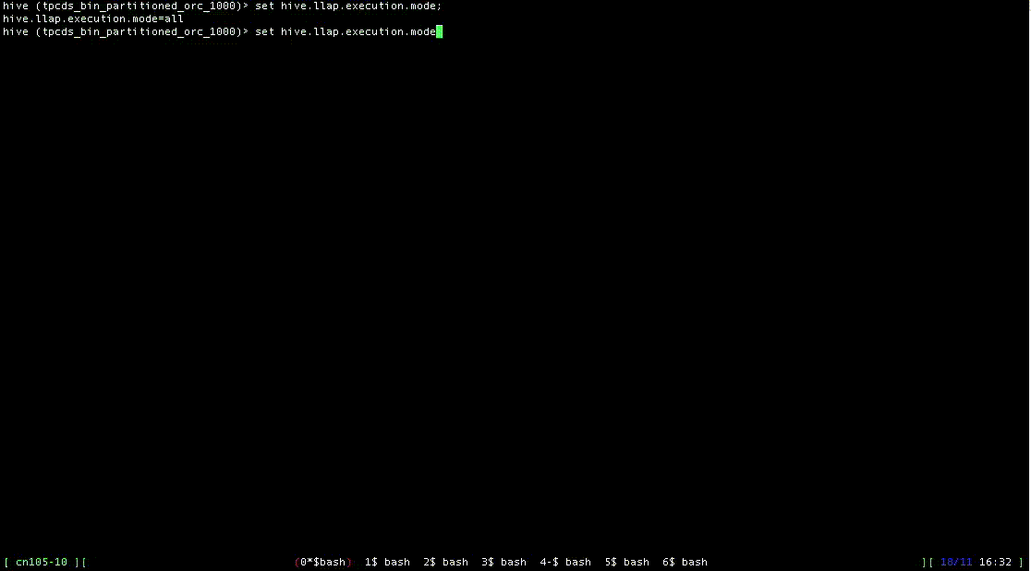
30-second demo (in case you missed the previous meetup)

Slide 15
Questions?

