Slide 1
Adding ACID Updates to Hive
Owen O’Malley
owen@hortonworks.com
@owen_omalley
October 2013

Slide 2
Who Am I?
Was working in Yahoo Search in Jan 2006, when we decided to work on Hadoop.
My first patch went in before it was Hadoop.
Was the first committer added to the project.
Was the tech lead for:
MapReduce
Security
Co-founded Hortonworks
Working on Hive

Slide 3
A Data Flood
A customer has 3TB/day of new data
Rate is growing 3x year over year
They have 10 years of data
Requirement to update lots of old data
Need high bandwidth scans and edits
Updates come in hourly dumps
New data is always coming in
Need repeatable and predictable reads

Slide 4
Use Cases
Update dimension tables (customer, inventory)
Batch update four times an hour
Streaming input coming from Storm or Flume
Low latency (15 seconds)
Delete old records for compliance
Batch update once a day
Update to fact tables (sales)
Batch update once on hour
All with consistent, repeatable reads

Slide 5
Delete, Update, and Insert in Hive
We’ve been making Hive’s SQL more standard
New types and commands
Continuing that trend
INSERT INTO table SELECT …
INSERT INTO table VALUES …
UPDATE table SET … WHERE …
DELETE FROM table WHERE …
MERGE INTO table …
BEGIN / END TRANSACTION

Slide 6
Design
HDFS doesn’t allow random writes
Store base files and delta files
Merge them in the client
All writes have a transaction id
Sequentially assigned by Metastore
Read queries get list of committed txn ids
Provides snapshot consistency
Snapshot at the start of the query

Slide 7
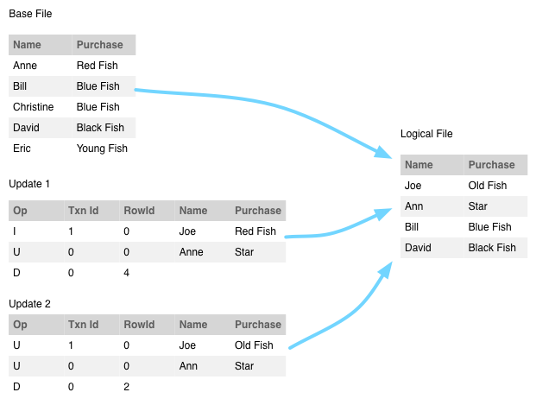
Stitching Buckets Together

Slide 8
HDFS Layout
Partition directory structure is the same
Replace list of files like 000000_0
Base directory base_$tid
Delta directory delta_$btid_$etid
Each directory has bucket files

Slide 9
Compaction
Compaction doesn’t require a lock
Metastore will schedule compactions
Major compaction
Merge deltas into base
Run when more than 10% in delta
Minor compaction
Merge deltas together
Run when more than 10 deltas

Slide 10
Limitations
Only suitable for batch, not real-time
Requires new active components
Minor and major compactions
Garbage collections
Base and delta files must be:
Sorted the same way
Bucketed the same way

Slide 11
Phases of Development
Initial
Will require ORC for file format
No multi-statement transactions
Write commands get write lock
Reads never block
Second
Multi-statement transactions
Tools for listing and cancelling transactions

Slide 12
Why not HBase?
Good
Handles compaction for us
Bad
No cross-row transactions
HFile is row-based instead of columnar
All columns read when just 2 needed
Point lookups instead of scans
HBase has only a single sorted key

Slide 13
Conclusion
Filed jira as HIVE-5317
Adds ACID semantics to Hive
Use SQL standard commands for
Delete, Update, Insert
Provides scalable read and write access.
Customer has their solution in production

Slide 14
Thank You!
Questions & Answers

