Slide 1
Bay Area Hive Contributor Meetup
LLAP: Live Long and Process!
16-Nov-2015

Slide 2

Sub-Second Hive with LLAP
Sub Second:
  LLAP: Persistent server to instantly execute SQL queries.
  Caches hottest data in RAM.
  Overcomes latencies associated with Hive on Tez or Hive on Spark.
SQL Compatibility:
  100% Compatible with SQL.
  Compatible with existing tools (BI, ETL, etc.)
Security:
  Security via HiveServer2.
  Integrates with Apache Ranger.
Hive SQL
Hive
Sever2
LLAP
Server
LLAP
Server
LLAP
Server
Vector Cache
Vector Cache
Vector Cache
LLAP Servers
(1 Per Hadoop Node)
Hadoop
Node
Hadoop
Node
Hadoop
Node

Slide 3
LLAP
Failure Tolerance
Concurrency & Pre-emption
ACID Transactions
No MPP Hotspots
Data overflow to disk
Elastic scale up/down
YARN native application
Hive SQL
Hive
Sever2
LLAP
Server
LLAP
Server
LLAP
Server
Vector Cache
Vector Cache
Vector Cache
LLAP Servers
(1 Per Hadoop Node)
Hadoop
Node
Hadoop
Node
Hadoop
Node

Slide 4
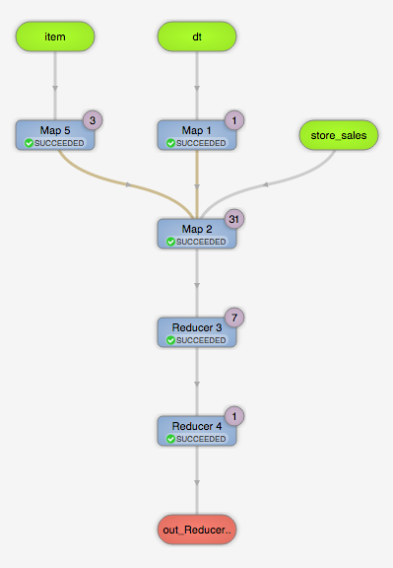
TPC-DS Query55
-- monthly sales by brand manager
select i_brand_id brand_id, i_brand brand,
sum(ss_ext_sales_price) ext_price
from date_dim, store_sales, item
where date_dim.d_date_sk = store_sales.ss_sold_date_sk
and store_sales.ss_item_sk = item.i_item_sk
and i_manager_id=${RANDOM_MANAGER}
and d_moy=${RANDOM_MONTH}
and d_year=${RANDOM_YEAR}
group by i_brand, i_brand_id
order by ext_price desc, i_brand_id
limit 100 ;

Slide 5
LLAP demo!

Slide 6
