Slide 1
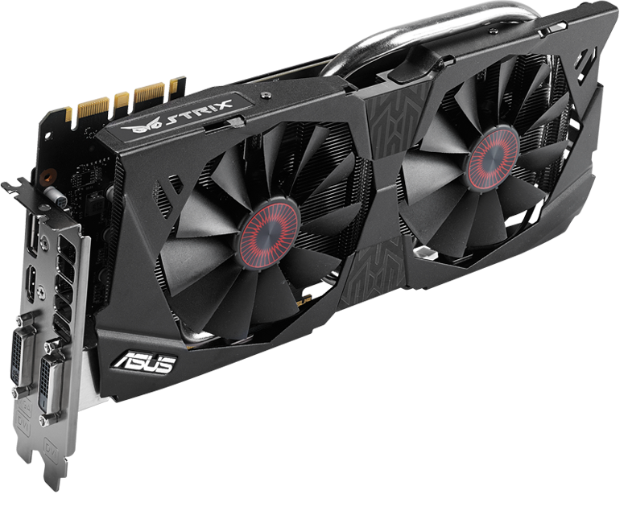
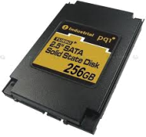
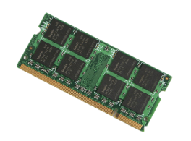
Data Processing Framework
Spark / Flink / Storm /...
Shuffle
Broadcast
/Tmp
Crail Store
High-performance network
GPU
Flash
DRAM

Slide 2
Data Processing Framework
Spark / Flink / Storm /...
Shuffle
Broadcast
/Tmp
Crail Store
User-level APIs (RDMA, NVMf, DPDK, SPDK...)
High-performance network
GPU
Flash
DRAM

Slide 3
Data Processing Framework
Spark / Flink / Storm /...
Shuffle
Broadcast
/Tmp
Crail Store
User-level APIs
(RDMA, NVMf, DPDK, SPDK, etc)
High-performance network
GPU
Flash
DRAM

Slide 4
Data Processing Framework
Spark / Flink / Storm /...
Shuffle
Broadcast
/Tmp
Crail Store
User-level APIs
(RDMA, NVMf, DPDK, SPDK, etc)
High-performance network
GPU
Flash
DRAM

Slide 5
Data Processing Framework
Spark / Flink / Storm /...
Shuffle
Broadcast
/Tmp
Crail Store
User-level APIs
(RDMA, NVMf, DPDK, SPDK, etc)
High-performance network
GPU
Flash
DRAM

Slide 6
Data Processing Framework
Spark / Flink / Storm /...
Shuffle
Broadcast
/Tmp
Crail Store
User-level APIs
(RDMA, NVMf, DPDK, SPDK, etc)
High-performance network
GPU
Flash
DRAM

Slide 7

Solr
Storm
Flink
Spark
buf
buf
CrailHDFS
CrailSparkIO
HDFS
Crail Store
zero copy
DRAM
Flash

Slide 8

“/”
“tmp”
“shuffle”
file
High-performance RDMA cluster
Memory blocks
Storage nodes
Flash blocks

Slide 9
CrailDirectory
CrailMultiFile
CrailDirectory
“/”
CrailTable
CrailKeyValue
“tmp”
“shuffle”
“table0”
“table1”
“sql”
“ml”
CrailFile
User-level Network/Storage APIs
High-performance Network
Memory blocks
Storage
nodes
Flash blocks

Slide 10
CrailMultiFile
CrailDirectory
“/”
CrailTable
CrailKeyValue
“tmp”
“shuffle”
“table1”
“sql”
“ml”
CrailFile
User-level Network/Storage APIs
High-performance Network
Memory blocks
Storage
nodes
Flash blocks

Slide 11
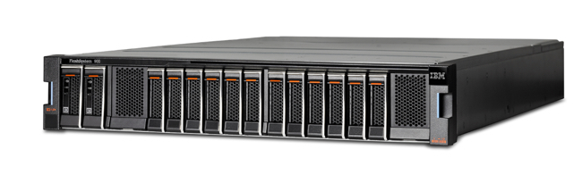
Data Processing
Compute
Crail Store (Core)
DRAM
BlkDv
NVMef
GPU
BlkDev
NVMef
RDMA
read/write
RDMA
fabrics
GPU
direct
iSCSI
RDMA
I/O
Storage

Slide 12
Data Processing
Compute
Crail Store (Core)
DRAM
BlkDv
NVMef
GPU
BlkDev
NVMef
RDMA
read/write
RDMA
fabrics
GPU
direct
iSCSI
RDMA
I/O
Storage

Slide 13
TeraSort
SQL
ML
Spark (core)
Ser
Ser
Sor
CrailBroadcast
CrailShuffle
Crail Store

Slide 14

Cores
Map
Crail
Reduce
Task
File
Directory
Sorted key range

Slide 15
Input
Cores
Map
Reduce
Output
Net
Ser
Sort
Net
Ser
Sort
Net
Ser
Sort
read & classify
shuffle
store

Slide 16
How Important is the Network?
Network gains are shadowed by the CPU
Gains from the networks are shadowed by the high CPU footprint

Slide 17
Map
Reduce
Output
Net
Ser
Sort
Net
Ser
Sort
Net
Ser
Sort

Slide 18
Cores
Crail Files
Spark buffer
RDMA
zero-copy
deserialization + sorting

Slide 19
Spark TeraSort Performance
Runtime (secs)
6x
Spark/Crail is 6x faster than vanilla Spark in sorting 12.8 TB on 128 nodes

Slide 20
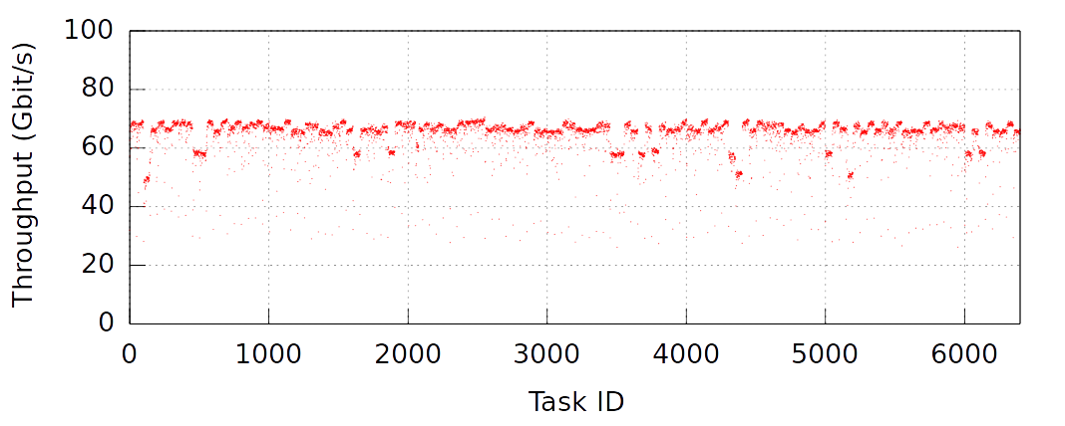
SparkCrail: Network Usage per Task
Spark/Crail shuffle delivers 70Gbit/s all-to-all network throughput

