Slide 1
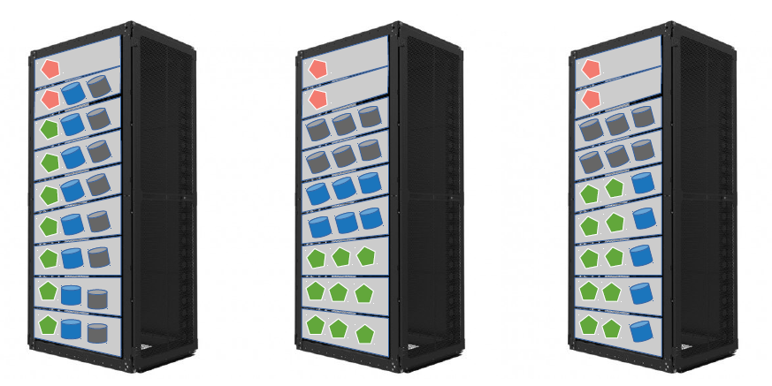
Crail Store: Deployment Modes
Metadata server
Flash storage server
DRAM storage server
Application compute
compute/storage
co-located
compute/storage
disaggregated
flash storage
disaggregation

Slide 2
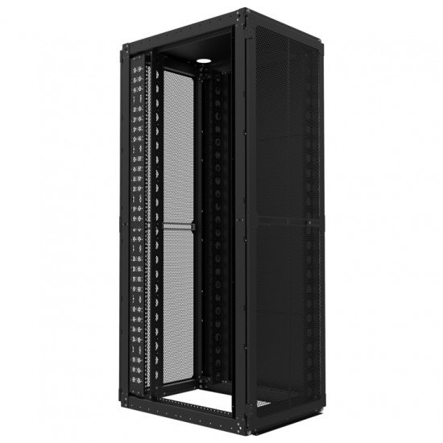
Metadata server
Disaggregated flash tier (class 2)
Local flash tier (class 1)
DRAM storage tier (class 0)
Application compute

Slide 4
Disaggregated flash tier
Local flash tier
DRAM storage tier

Slide 5
time
W-A W-B W-C W-D W-E D-A D-B W-F
Disaggregated flash tier
Local flash tier
DRAM storage tier

Slide 6
time
t0 t1 t10 t11 t12 t13 t14 t15
W-A W-B W-C W-D W-E D-A D-B W-F
Disaggregated flash tier
Local flash tier
DRAM storage tier

Slide 7
Disaggregated flash tier
Local flash tier
time
DRAM storage tier
W-A W-B W-C W-D W-E D-A D-B W-F

Slide 9
capacity
demand
disaggregated
flash tier
local
flash tier
local
DRAM tier

Slide 10
Metadata server
Flash storage server
DRAM storage server
Application compute
compute/storage
co-located
DRAM & flash
disaggregation
flash storage
disaggregation

Slide 11

Metadata server
Flash storage server
DRAM storage server
Application compute
compute/storage
co-located
DRAM & flash
disaggregation
flash storage
disaggregation

Slide 12
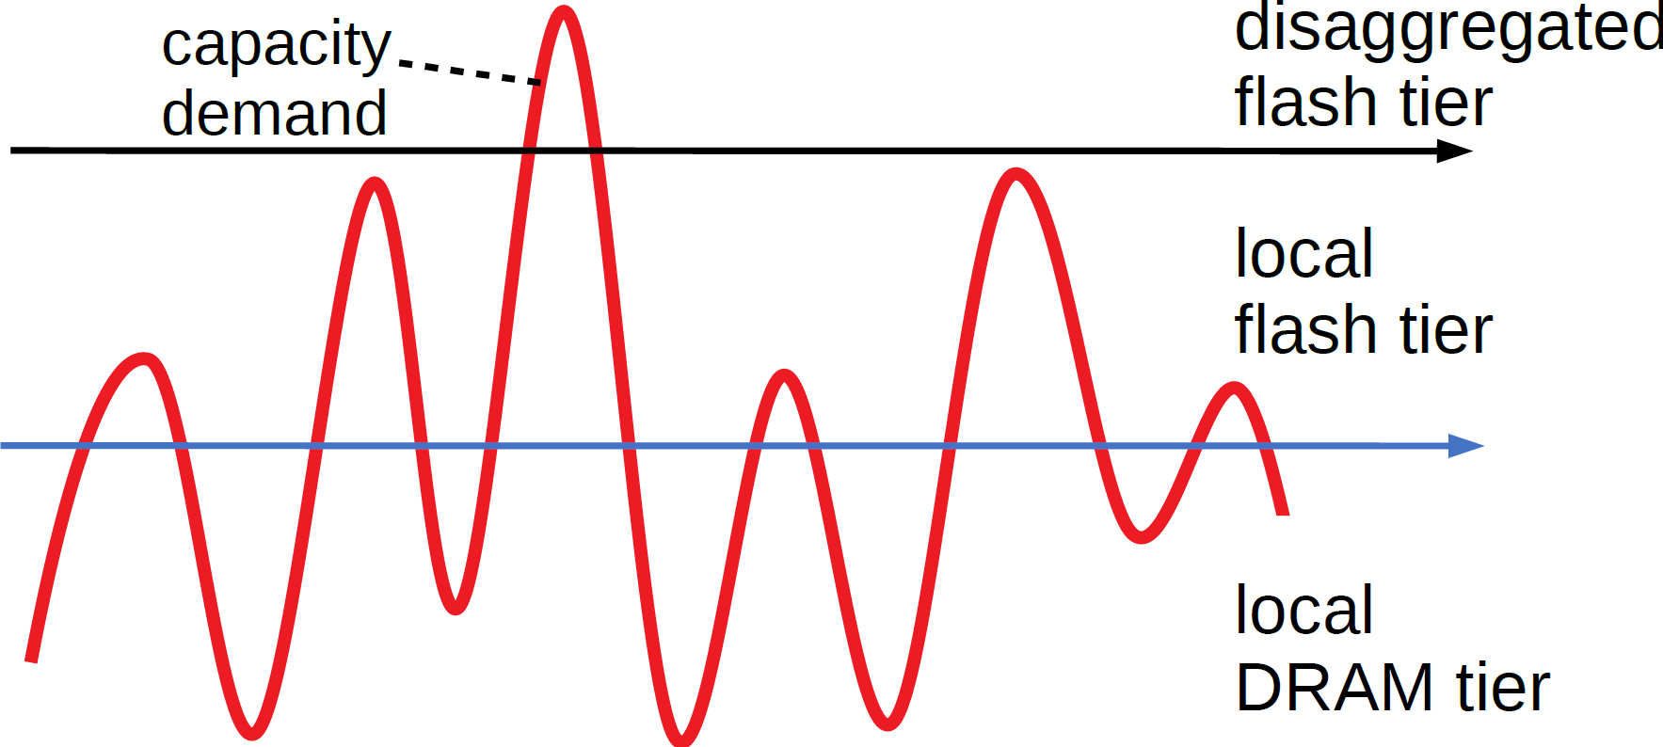
Local flash tier
DRAM storage tier
Metadata server
Application compute
Disaggregated flash tier

Slide 13
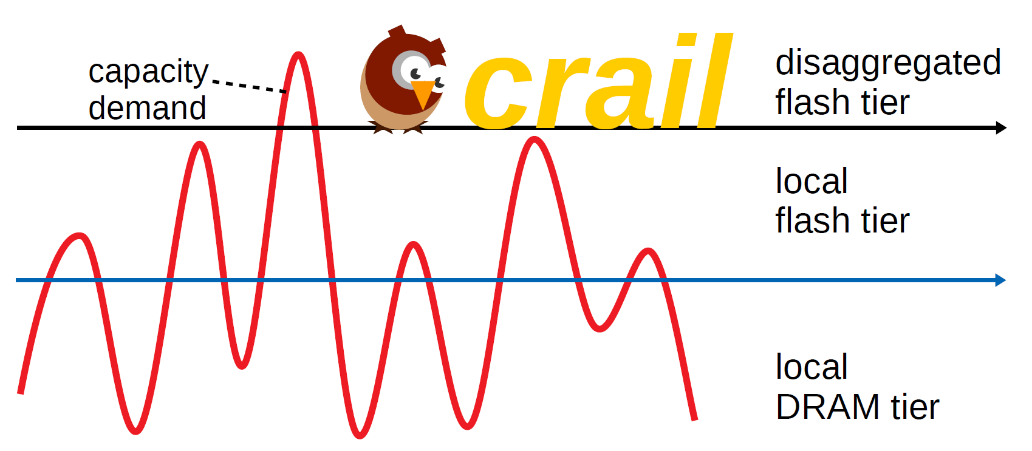
Local flash tier
DRAM storage tier
Metadata server
Application compute
Disaggregated flash tier

Slide 14

crail

Slide 16
crail
capacity
demand
disaggregated
flash tier
local
flash tier
local
DRAM tier

