Slide 1
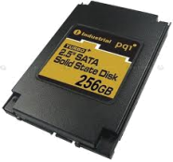
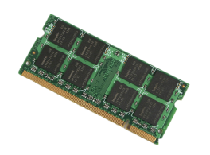
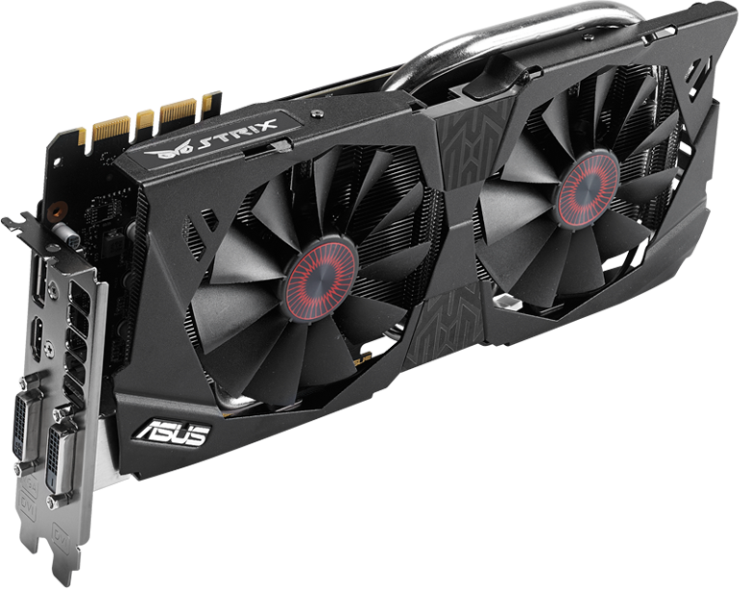
Solr
Storm
Flink
Spark
CrailHDFS
SparkCrail
Crail File System
Flash
DRAM
High-performance RDMA cluster
GPU

Slide 2

Solr
Storm
Flink
Spark
buf
buf
CrailHDFS
SparkCrail
HDFS
Crail File System
zero copy
DRAM
Flash

Slide 3
Spark (Core)
SparkCrail
Shuffle
Broadcast
Crail File System

Slide 4
Spark (Core)
SparkCrail
Shuffle
Broadcast
Crail File System

Slide 5
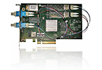
“/”
“tmp”
“shuffle”
file
High-performance RDMA cluster
Memory blocks
Storage nodes
Flash blocks

Slide 6

Data Processing
Compute
Crail File System (Core)
DRAM
BlkDv
NVMef
GPU
BlkDev
NVMef
RDMA
read/write
RDMA
fabrics
GPU
direct
iSCSI
RDMA
I/O
Storage

Slide 7
Application
Spark (core)
Ser
Sort
CrailShuffle
Crail File System

Slide 8
TeraSort
SQL
ML
Spark (core)
Ser
Ser
Sor
CrailBroadcast
CrailShuffle
Crail File System

Slide 9

Cores
Map
Crail
Reduce
Task
File
Directory
Sorted key range

Slide 10
Cores
Map
Reduce
Sorted key range

