Slide 1
Blog

Slide 2
Dir
“/”
list
Table
Dir
“/tab1”
list
“/dir1”
list
KV
KV
KV
File
File
value
value
value
data
data
“/tab1/key1”
“/tab1/key2”
“/tab1/keyn”
“/dir1/file1”
“/dir1/file2”

Slide 3
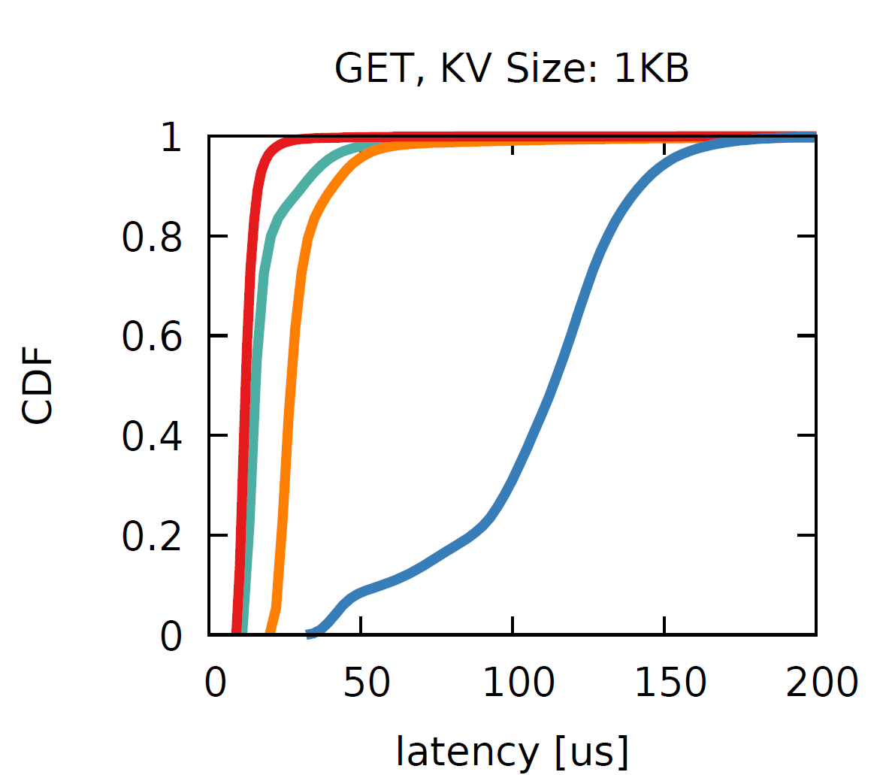
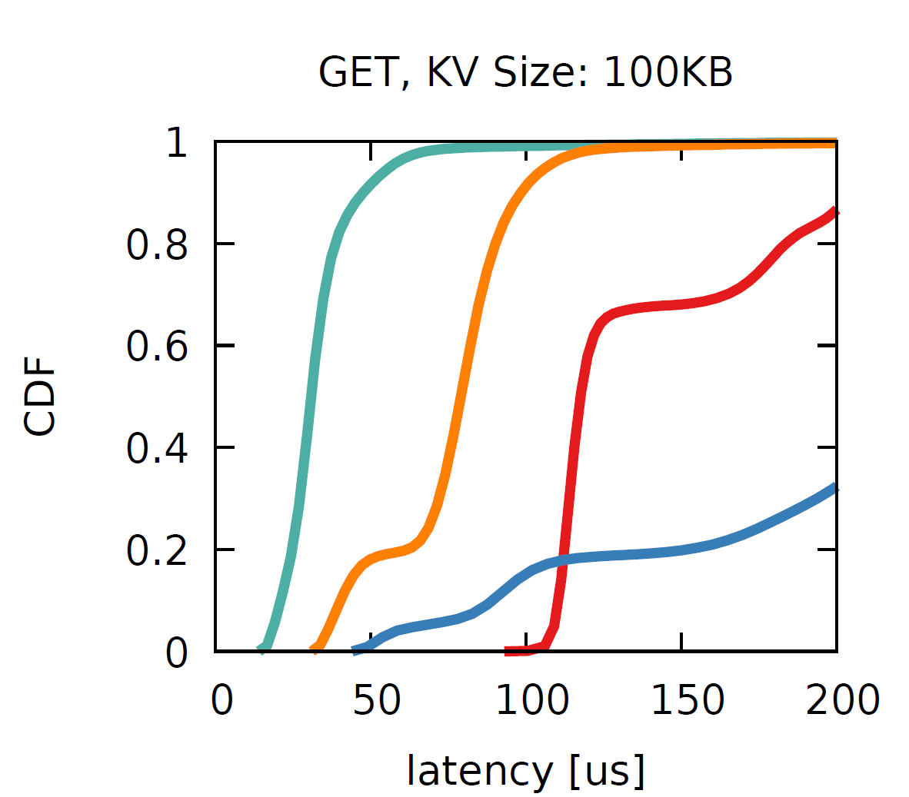
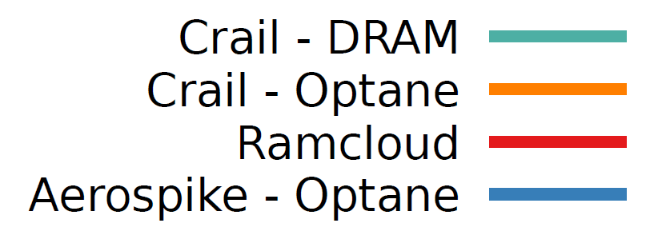

Slide 4
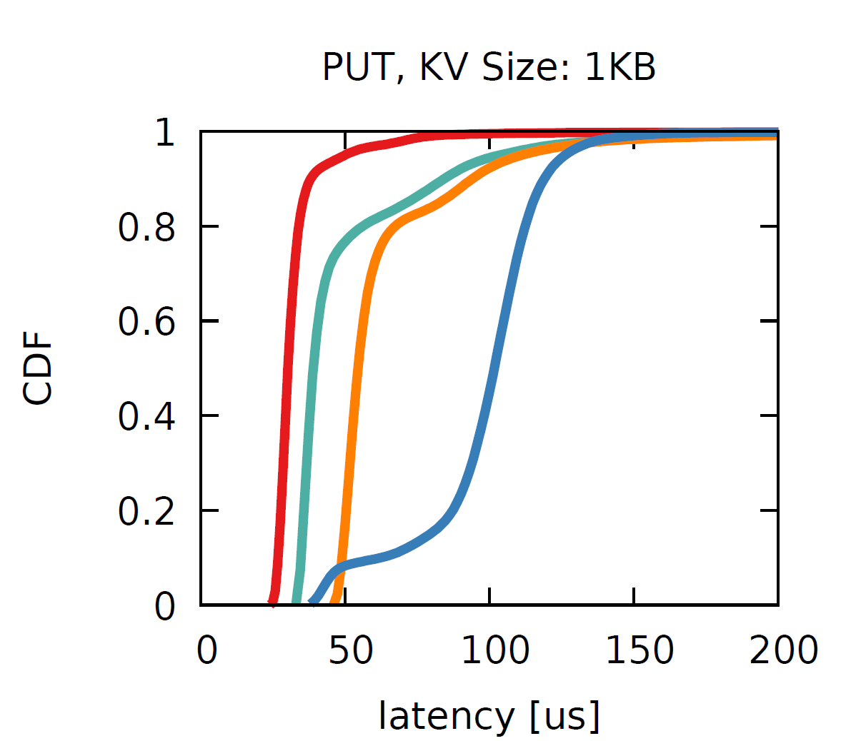
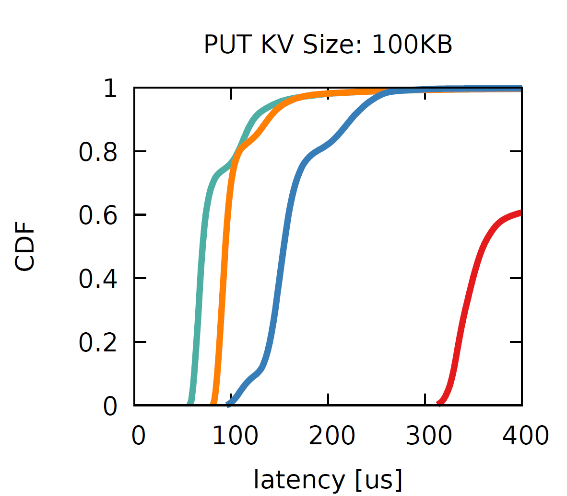

Slide 5
Metadata
Servers
Storage
Servers
client
buffer
KV
Server
Client
Client
create
create()
data write
PUT
getblock
tiering
decision,
load
balancing
append()
DRAM block
ack
ack
close
close()
Crail
Traditional KV Store
Notes:
As a downside, however, we also need an extra roundtrip, two extra roundtrips as we need to communicate the final size of the data to the mdata server after writing.
That is two roundtrips more than a key value put operation in a traditional distributed key value store.
The key underlying assumption in NodeKernel, however, is that with current and future low-latency network fabrics, such a metadata roundtrip can be implemented at a latency overhead of only a few microseconds.

Slide 6
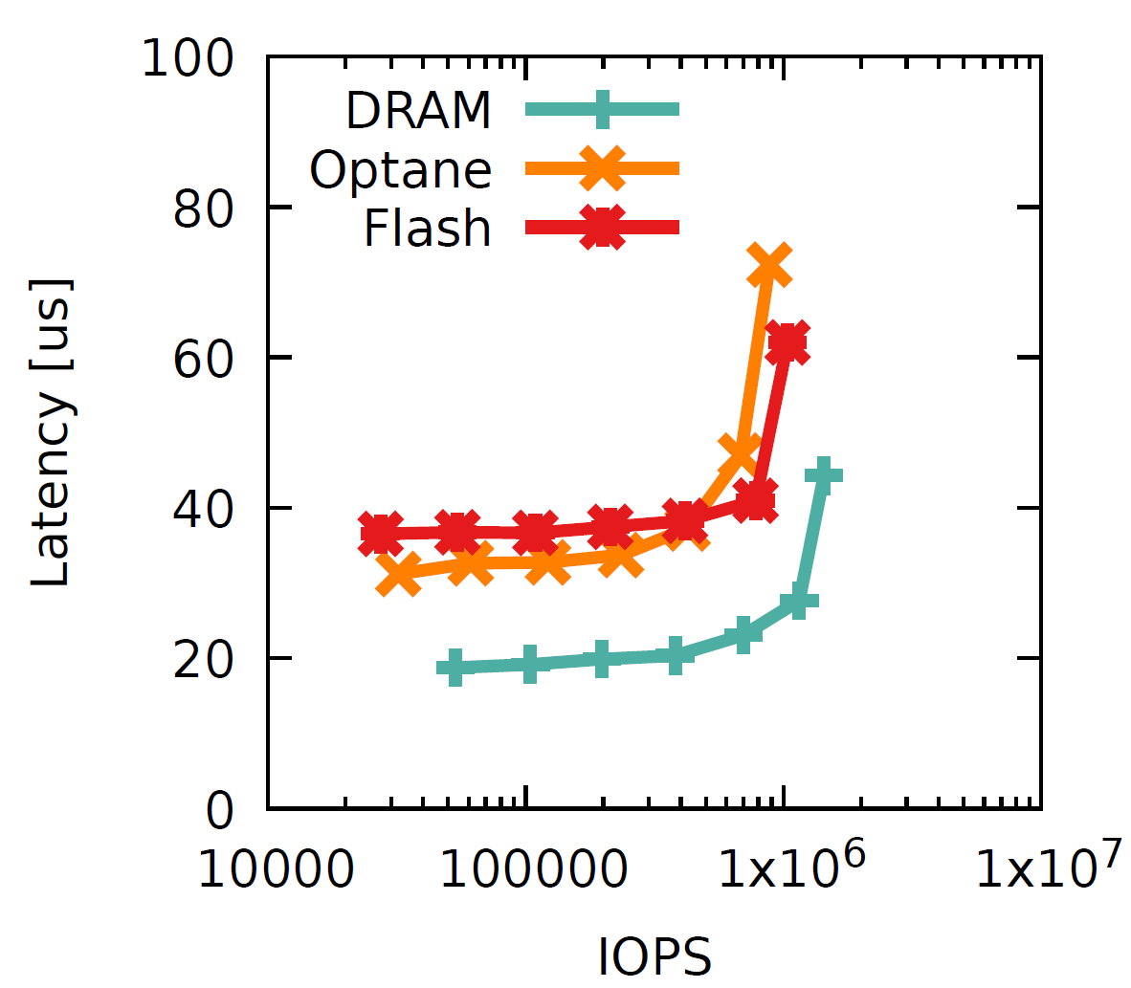
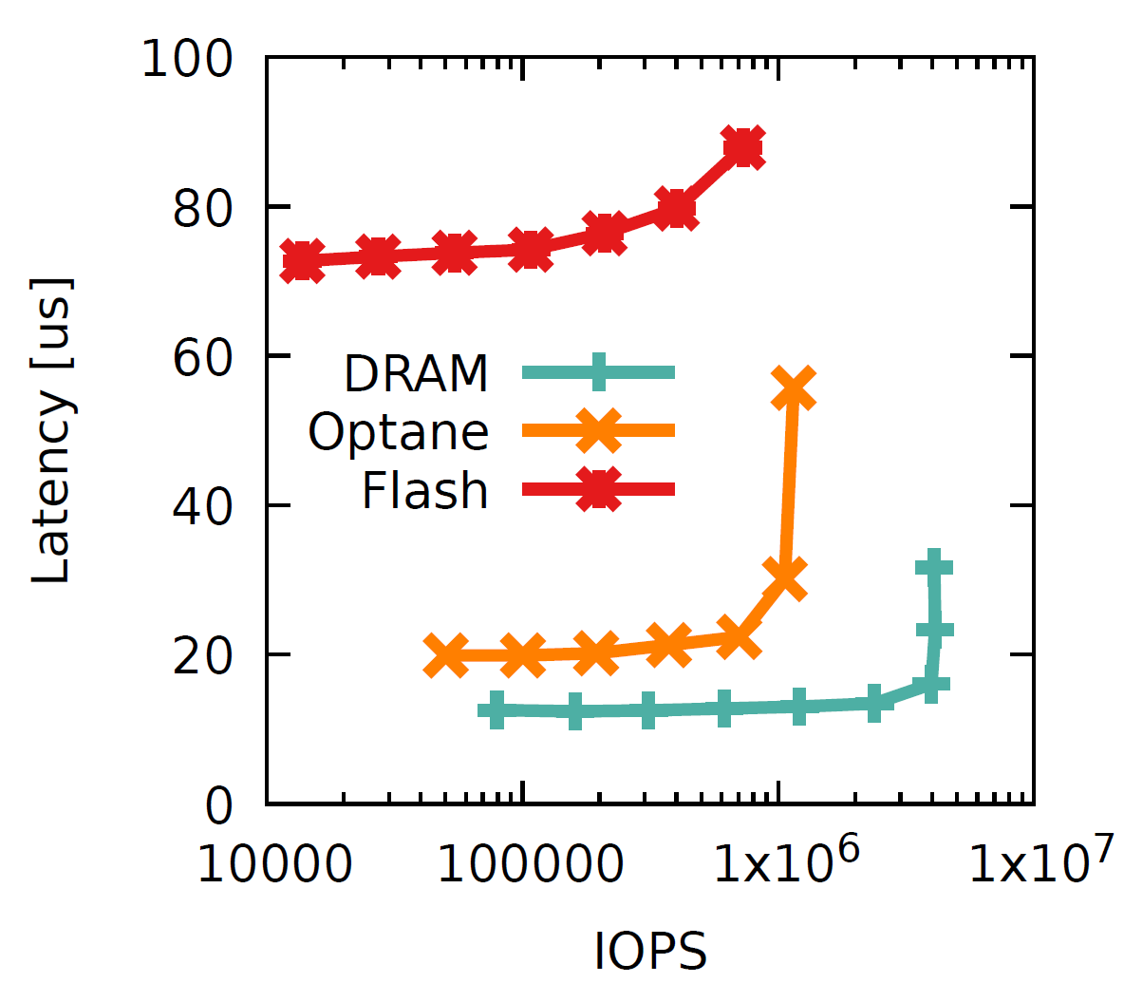


Slide 7
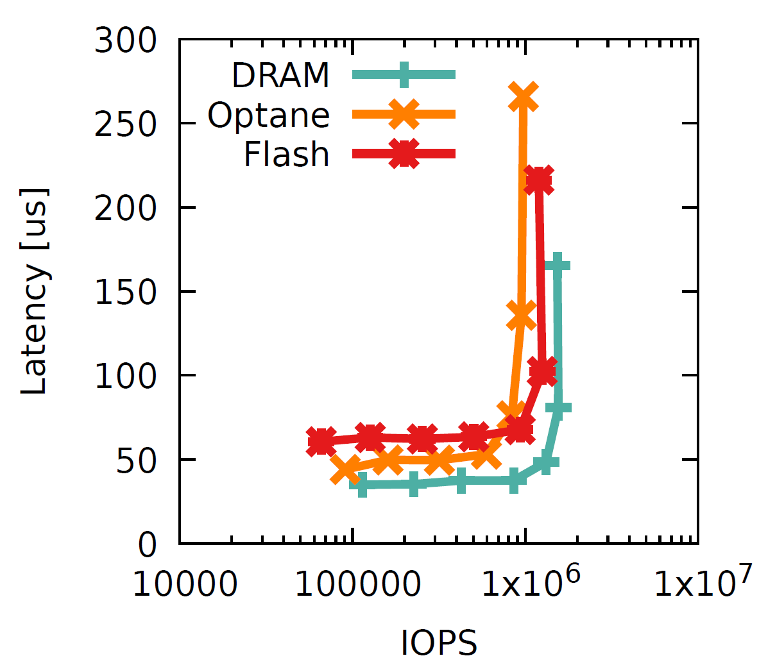
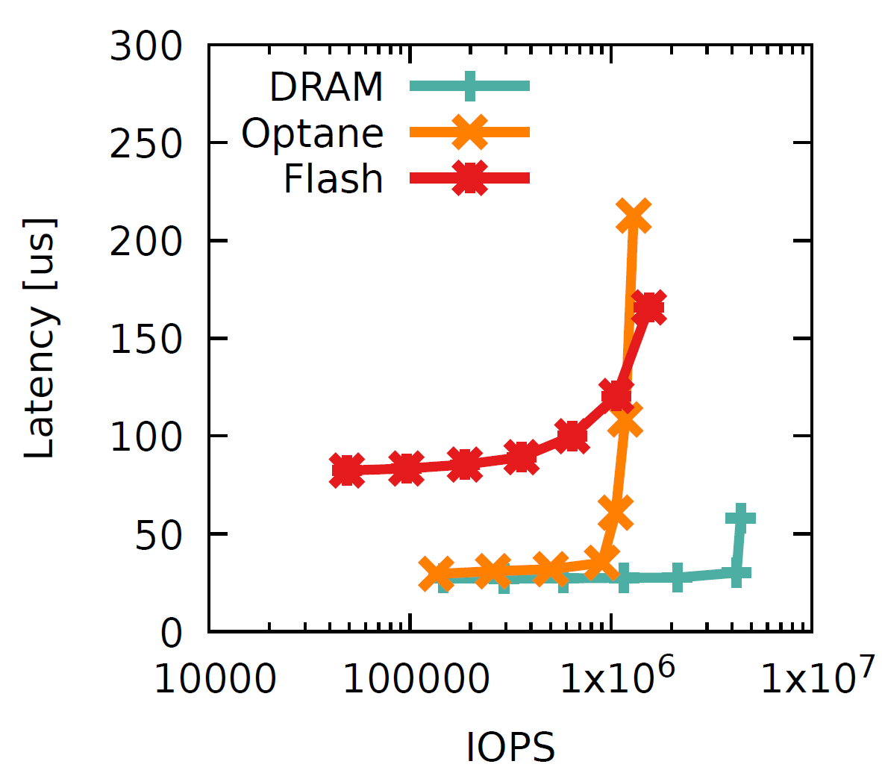

Slide 8



