Slide 1
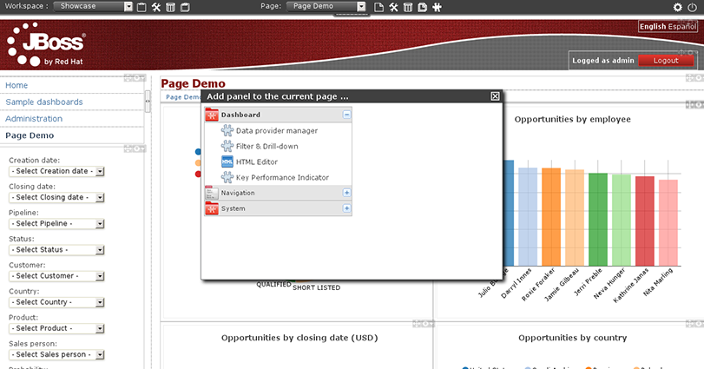
Language menu
Tree menu
Logout
Key Performance Indicator
Filter& Drill-down

