Slide 1
drools-solver
  Drools-solver solves planning problems
Drools-solver combines a search algoritm
with the power of the drools rule engine
to solve those planning problems

Slide 2
Planning problems
Solves planning problems, such as:
Employee shift rostering
Freight routing
Supply sorting
Lesson scheduling
Exam scheduling
The traveling salesmen problem
The traveling tournament problem

Slide 3
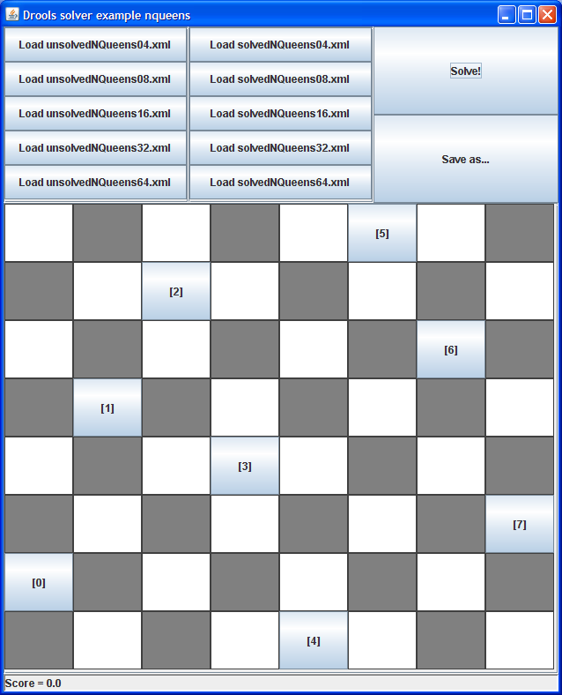
The n queens example
Place n queens that cannot attach each other on a n*n chessboard
One of the examples of drools-solver
Implementation explained in detail in the reference manual

Slide 4
Different seach algoritms
Supports several search algoritms:
Simple local search
Tabu search
Simulated annealing
You can easily switch the search algoritm, by simply changing the configuration.

Slide 5
Example configuration
<localSearchSolver>
<scoreDrl>.../smartTravelingTournamentScoreRules.drl</scoreDrl>
<scoreCalculator>
<scoreCalculatorType>HARD_AND_SOFT_CONSTRAINTS</...>
</scoreCalculator>
<finish>
<maximumMinutesSpend>2</maximumMinutesSpend>
</finish>
<selector>...</selector>
<accepter>
<completeSolutionTabuSize>1500</completeSolutionTabuSize>
</accepter>
<forager>
<foragerType>MAX_SCORE_OF_ALL</foragerType>
</forager>
</localSearchSolver>

Slide 6
Score calculation with drools
Uses the drools rule engine to calculate the score
Adding extra hard and soft constraints to the score function is easy and scalable

Slide 7
Example score rule
rule "fourConsecutiveHomeMatches"
when
$m : Match($homeTeam : homeTeam, $day1 : day);
Match(homeTeam == $homeTeam,
eval(day.getIndex() == $day1.getIndex() + 1));
Match(homeTeam == $homeTeam,
eval(day.getIndex() == $day1.getIndex() + 2));
Match(homeTeam == $homeTeam,
eval(day.getIndex() == $day1.getIndex() + 3));
then
// ...
end

Slide 8
Future plans
More examples
Refactor of the move generation (selector), to allow more efficient search algoritms
Make moves declarative

