Slide 1


Notes:
Welcome everbody.
Don't you just hate it?
You come to JavaPolis, you have like 5 talks you really want to attend,
and what happens?
2 talks are scheduled at the same time.
That just sucks. You have to miss out on one.
Wouldn't it be great if we could all send in our favorite talks and they could schedule them, and try to avoid that people miss out on any?
Wouldn't even be better, if they could also try to avoid that people have to switch rooms between talks? I just hate having to get out my seat. Those seats are so comfortable.
Oh yea, and immediatly after lunch: no difficult talks; just standard edition stuff, no JEE talks. After lunch, I want relax a bit.
Well,
If I had to schedule the talks with those constraints, I wouldn't want to do that manually, because I am lazy. I 'd use some software to do that for me...

Slide 2

Solving planning problems with Drools Solver
Geoffrey De Smet
Drools Solver lead
Notes:
So, my name is Geoffrey De Smet and today I 'll talk a bit about drools-solver, which can solve planning problems.

Slide 3
Overall Presentation Goal
Solve an n queens problem
with Drools Solver
Notes:
For starters, I 'll show some planning problem examples, such as the n queens problem, to give you some insight on the sheer size of these problems.
After that introduction, I 'll take you through an implementation of the n queens problem. By the end of this presentation you should be able to solve a planning problem with Drools Solver yourself.

Slide 4
Speaker’s Qualifications
Geoffrey De Smet is a member of the drools team (in his spare time).
Geoffrey De Smet's main job is writing government applications at Schaubroeck N.V.
Notes:
Ok, so this the mandotary slide where I have speak about myself in the 3th person.
Anyway, I wrote 99% of the drools-solver code at the moment.
In the rest of the drools code, I help out a little bit with the build process.
Drools solver uses the drools rule engine for most of the hard work.
[We actually have the drools rule engine project lead in the room here: Mark Proctor from JBoss. If you have any difficult, mind-breaking rule-engine related questions, ask him instead of me.]
In my main job at Schaubroeck I am developing business applications for regional government institutions.

Slide 5
Purpose of Drools Solver
Solve planning problems:
  Employee shift rostering
  Freight routing
  Supply sorting
  Lesson scheduling
    Example (2 simple constraints)
  Exam scheduling
    Example (many complex constraints)
  The traveling salesman problem (TSP)
  The traveling tournament problem (= TSP++)
    Example
Notes:
So what can Drools Solver do for you?
It can help you solve planning problems, such as:
- Employee shifts rostering
- Freight routing
- Supply sorting
- Lesson scheduling – a simple version of lesson scheduling is actually included in the examples. It furfulls 2 basic constraints:
-- no teacher has to teach 2 lessons at the same time.
-- And no student group has to attend 2 lessons at the same time.
- Another included example is Exam scheduling – which we'll take a look at later
- Not yet included is The traveling salesman problem
- but it's advanced form, The traveling tournament problem is included. The traveling tournament problem is about scheduling football matches and minimizing the distance travelled by the football teams.
-- It's very intresting but I won't show it today.

Slide 6
Why do I need Drools Solver?
Why do I need Drools Solver?
I can solve any planning problem
by brute force.
Notes:
You might be thinking:
“Why do I need Drools Solver?
I can solve any planning problem by brute force.”
I 'll just throw together some program loops and voila: that should solve that planning problem.
Let's take a look at some of the examples implemented in drools-solver, and see how far this attitude will get you.
Let's start with a simple one: N queens

Slide 7
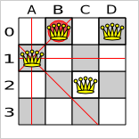
The n queens example: problem statement
Shown with n = 4
(Hard) constraints:
  Chessboard (n * n)
  Place n queens
  No queens can attack each other
Notes:
In this toy example the idea is to place a number of queens on a chessboard. That number of queens is n and it's shown here with n being 4.
Of course, there are a number of constraints, which limit you in how you can place those queens:
You must use a chessboard with n rows and n colums.
And you must place n queens on that chessboard.
Also, any 2 queens must not be able to attack each other. That's of course the difficult part.
In a solution shown on the left, you can see that the first 2 constraints are met: there are 4 rows, 4 columns and 4 queens;
but the 3th constraint is broken because queen A1 and queen B0 can attack each other.
N queens only has hard constraints: it has no soft constraints.

Slide 8
Types of constraints
Hard constraint
  Cannot not be broken
  Any broken => unfeasible solution
  None broken => feasible solution
Soft constraint
  Can be broken
  Broken as little as possible
  Least # broken (and no hard constraints broken) => optimal (feasible) solution
Notes:
So what is a hard constraint?
A hard constraint cannot be broken.
A soft constraint, on the the other hand, can be broken, but we should try to avoid breaking it as much as possible.
We are going to look for a solution without a single hard constraint broken. Such a solution is called a feasible solution.
And, on top of that, we are going to look for the optimal solution, which is the feasible solution with the least number of soft constraints broken.

Slide 9
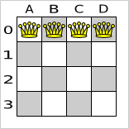
The n queens example: problem size (1/2)
Limit # possible solutions
  Always n * n chessboard
  Always n queens
  Exactly 1 queen per column
Notes:
If we do tackle the n queens problem with brute force, how many solutions can we expect to evaluate before finding a feasible solution?
To limit the number of possible solutions to evaluate, we'll always use the correct chessboard size and the correct number of queens.
Also, we'll assign each queen it's own column.
So one possible solution is shown on the left.
Another would be with all queens on the diagonal line going from the top left to the bottom right. Both solutions are unfeasible because several queens can attack each other.

Slide 10
The n queens example: problem size (2/2)
Still n ^ n possible solutions
    # queens # possible # feasible # p / # f
    4 256 2 128
    8 16777216 64 262144
    16 1e19 1e7 1e12
    32 1e48 ? ?
    64 3e115 ? ?
    n n ^ n ? ?
Notes:
Even with these limitations, there are N to the power N possible combinations.
For 4 queens, that makes 256 possible solutions, of which 2 are feasible.
On average, a brute force algoritm would need to evaluate 128 solutions to find a feasible solution.
For 8 queens that makes 16 million possible solutions.
For 16 queens it's 10 to the power 19. That's a really big number.
And for 64 queens, it's more than a 3 with 115 zero's behind it.
Notice how the chance to encounter a feasible solution with brute force turns bad quickly.
And don't forget: every single one of those solutions needs to be evaluated, ussually by nested program loops.
How long do you think brute force will take to solve 64 queens?
Drools Solver finds a feasible solution for the 64 queens problem in less then a minute, on my 2 year old desktop pc. Of course, it doesn't use brute force.
Now, let's take a look at a real example, which will make these numbers look like a joke.

Slide 11
The ITC2007 examination example: problem statement (1/2)
Schedule exams into:
  Periods (= timeslots)
  Rooms
A student has multiple exams
  An exam has multiple students
International timetabling competition 2007
  Real world data (universities)
  Real world constraints
  Example implementation unfinished
  Competition deadline: 25 January 2008
Notes:
The examination example schedules exams.
Each exam needs to be scheduled
into a period
and into a room.
Each exam has a duration and multiple students.
Each student has multiple exams.
I am actually competing in the international timetabling competition 2007 with this example.
They definied the problem statement.
They use data and constraints from real universities.
For more information, there's a link in the solver manual.
I have just started working on it, but expect some results soon, because the competion deadline is in a month or 2.
By the way, there are 2 other competition tracks, which I won't compete in due to lack of time, which also fit Drools Solver like a glove and also have a main prize of 500 pounds each. Anyone intrested?

Slide 12
The ITC2007 examination example: problem statement (2/2)
Hard constraints (7):
  Exam conflicts:
    A student can't have 2 exams in the same period
  Period duration limit
  Room seating limit
  ...
Soft constraints (7):
  2 exams in a day
  Period spread
  Mixed durations
  ...
Notes:
So what are some of the constraints?
Exam conflicts:
Student John Smith can't have 2 exams at the same time.
Period duration limit:
The Math exam takes 2 hours, so it can't fit in a period of only 1 hour long.
Room seating limit:
55 students taking 3 different exams at the same time can't fit into a single room with only 40 seats.
2 exams in a row:
John Smith doesn't like to have 2 exams on the same day.
Period spread:
John Smith preferres 4 free days betweens 2 consecutive exams.
In total there are about 7 hard constraints and 7 soft constraints.
The constraints are weighted, for example the “period spread” constraint has a lower weight than the “2 exams in a day” constraint.

Slide 13
The ITC2007 examination example: problem size
4 datasets available at this time
How many possible solutions?
    # exams # periods # rooms # possible
    607 (7883) 54 7 1e1052
    870 (12484) 40 49 2e5761
    934 (16365) 36 48 5e5132
    273 (4421) 21 1 1e51
    e p r (e ^ p) ^ r
Probably only a few optimal solutions each
Notes:
There are 4 datasets available at this time. Let's take a look at one.
The first dataset has about 600 exams, 7000 students, 50 periods and 7 rooms.
It's number of possible solutions is about a 1 with a 1052 zero's behind it.
N queens, eat your heart out!
Let's say we use a smarter form of brute force, and we're able to ignore 99% of those possible solutions, that would still leave a 1 with a 1050 zero's behind it.
Let's say we can evaluate a billion solutions every millisecond, which we can't.
It would still take over 10 to the power a 1030 years to evaluate all possible solutions. The earth isn't even 10 to the power 10 years old.
And if you look at the second dataset, with 800 exams and 12'000 students, you 'll see that it can get a lot worse easily.
Unlike n queens, there's ussually only 1 or a few optimal solutions.
Most universities however, would be happy if we'd find a relatively good feasible solution, better and faster than their current manual planning.
So, how do we solve these kind of problems efficiëntly?

Slide 14
Types of solvers
Brute force
Branch and bound
Simplex
Local search
  Simple local search
  Tabu search
  Simulated annealing
...
Notes:
Well, each type of solver has it's own algorithm to find the best solution out of all possible solutions.
Brute force evaluates every possible solution, ussually by creating a search tree.
It's useless for real-world use cases, as I hope I 've demonstrated, but it's usefull to verify the output of other implementations.
It's not implemented in drools-solver yet, but it will be at some point.
Branch and bound is an improvement over brute force, as it prunes away part of the search tree. However, it still doesn't scale enough to be usefull.
It's also not implemented in drools-solver yet.
Simplex turns all constraints and data into one big equation. It then uses a search path to find the optimum of that equation.
As far as I know, it's very limitating on how you implement your constraints.
It's also not implemented in drools-solver yet.
So what is implemented in drools-solver? Local search is.
Local search works pretty much like most humans: it starts from an initial solution and it evolves that single solution into a better and better solution. It uses a single search path and it's very scalable.
There are different forms of local search, such as tabu search and simulated annealing. These are implemented in drools-solver too.
Let's take a look at the n queens example implementation, configured with tabu search.

Slide 15
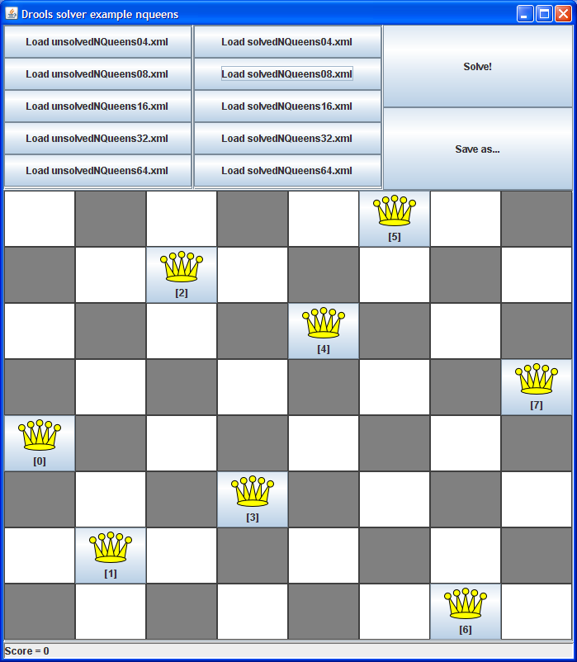
The N queens example screenshot
Notes:
Each of the included examples in drools-solver has a raw GUI.
This is a screenshot of the n queens GUI.
With the top left buttons you can load a problem instance.
In this case 8 queens is loaded.
With the top right button you can solve an instance.
As you can see, in this case it's already solved.
Notice that the score on the bottom left is 0, because no constraints are broken.
We'll use the drools rule engine to calculate that score.

Slide 16
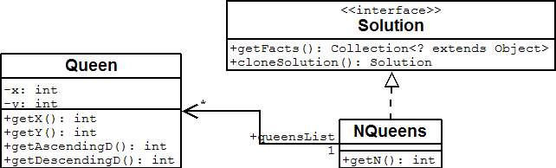
NQueens domain model
class Queen
  x (column), y (row)
  Diagonal lines: ascendingD, descendingD
class Nqueens
  Implements Solution interface
Notes:
The Queen class represents a single Queen.
A queen instance has an x and a y.
Because we 'll appoint each queen it's own column, the x property of a queen will actually never change.
Each queen can calculate it's horizontal line (y), it's vertical line (x), it's ascending diagonal line (x + y) and it's descending diagonal line (x – y).
So if 2 queens share any of those lines, they can attack each other.
The NQueens class represents a single solution instance.
It has a list of n - queen instances.
A NQueens instance can represent the problem solved or unsolved or anything in between.
We will start with an unsolved NQueens instance, which has all queens on the first row in a different column,
and then solve it, which will change the y of the queen instances.
Notice that a Solution needs to implement the getFacts method, so the solver can supply facts to the drools rule engine for score calculation. NQueens implements that method by returning the queensList.
Also, a Solution needs to be cloneable, because a solver needs to be able to remember the best encountered solution. This cloneSolution method only needs to deep clone the changing parts, for NQueens however, this means cloning all Queen instances because their y's change during solving.

Slide 17
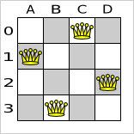
Solving a problem
Build a Solver
Set the starting solution
Solve it
Get the best solution found
XmlSolverConfigurer conf = new XmlSolverConfigurer(
"/.../nqueensSolverConfig.xml");
Solver solver = conf.buildSolver();
Nqueens startingNQueens = ...
solver.setStartingSolution(startingNQueens);
solver.solve();
Nqueens best = (NQueens) solver.getBestSolution();
Notes:
So how do we solve a problem?
First we buid a solver, ussually based on an XML configuration file.
In that configuration file we configure the solver type, time limitations, etc.
Then we load or generate the starting solution, which you can see on the left. For 4 queens, we use an NQueens instance with 4 Queen instances, of which each y is 0 and the x is from 0 to 3.
Next, we solve it. For non trivila problems, this would take some time.
And then we get the best solution, which you can see on the right.
As you can see, no 2 queens can attach each other.
Let's take a look at that configuration file.

Slide 18
Solver configuration
<localSearchSolver>
<scoreDrl>/.../nQueensScoreRules.drl</scoreDrl>
<scoreCalculator>
<scoreCalculatorType>SIMPLE</scoreCalculatorType>
</scoreCalculator>
<finish>
<feasableScore>0.0</feasableScore>
</finish>
<selector>
<moveFactoryClass>...NQueensMoveFactory</m...>
</selector>
<accepter>
<completeSolutionTabuSize>1000</c...>
</accepter>
<forager>
<foragerType>MAX_SCORE_OF_ALL</foragerType>
</forager>
</localSearchSolver>
Notes:
Here we configure a local search solver. The red lines are domain specific.
Any solver that we configure, will need a way to calculate the score of a solution. If it can't to that, it has no way of comparing solutions and recognizing the best one.
Drools solver uses the drools rules engine to calculate the score, based on a DRL file with score rules. We 'll take a look at those N Queens score rules in the next slide.
Ussually we use a hard_and_soft_constraints score calculator, but because N queens only has hard constraints, a simple score calculator is enough.
Local search doesn't recognize the optimal solution when it finds it, it just continues to try to find a better, unexisting solution. This might seem like a big distadvantage of local search. But for real use cases, you won't have time to wait a billion years to find that optimal solution anyway.
So you need to tell the solver to stop at some point. Drools solver supports several ways to finish solving, such as: time spend, score reached, etc.
In this case we know the perfect score is zero, so we 'll finish solving once we reach a score of 0.
To evolve the starting solution into the best solution, local search uses a move selector, a move accepter and a move forager.
Here, we're using a tabu accepter and a max score forager, which makes it tabu search. By simply changing the accepter and forager, we can make it simulated annealing, etc without changing anything to the code.

Slide 19
Score rules
global SimpleScoreCalculator scoreCalculator;
rule "multipleQueensHorizontal"
when
$q1 : Queen($id : id, $y : y);
$q2 : Queen(id > $id, y == $y);
then
insertLogical(new ConstraintOccurrence(...));
end
// multipleQueensAscendingDiagonal/DescendingDiagonal ...
rule "constraintsBroken"
when
$count : Number() from accumulate(
$occurrence : ConstraintOccurrence(),
count($occurrence)
);
then
scoreCalculator.setScore(- $count.intValue());
end
Notes:
This the DRL file which defines the score rules.
If you haven't worked with the drools rules engine before, this might seem very strange and complicated. But in fact, for non trivial use cases, this makes score calculation easier and a lot more scalable.
A single global scoreCalculator is available for use in the rules.
The score rules need to keep the score of the scoreCalculator up to date.
All the Queen instances are asserted into the drools working memory, which means they can be used for declarative pattern matching.
Everytime the solver moves a queen to a different row, it fires the rules and expects to find the correct score in the scoreCalculator afterwards.
The multipleQueensHorizontal rule fires when 2 different queens are positioned on the same y, so on the same horizontal line. It inserts a logical ConstraintOccurence.
The 2 score rules to detect ascending and descending diagonal violations are implemented in the same way.
The constraintsBroken rule counts all ConstraintOccurence's and updates the scoreCalculator. Notice that actually the negative count is set as the score, because the solver tries to find the solution with the highest score.
Most planning problems tend to use negative constraints and negative scores.
Note that the ConstraintOccurrence's can be weighted so certain score rules can have a bigger impact on the score than others. Of course in that case, we would need to use a sum accumulate instead of a count accumulate.

Slide 20
Why work with score rules?
Ease of development and maintenance
  Focused on the constraint logic
    => DRL instead of Java
  Seperation of constraints
    Adding/removing a constraint does not affect other constraints
Performance and scalability
  Drools rule engine pattern matching
    Faster than for/while loops and hashmaps
  Delta based score calculation
    Moving queen B won't re-evaluate if queen A and queen C are on the same row
Notes:
What are the advantages of using a rule engine to calculate the score?
If you need to find a String pattern in a String, you don't use basic java: you use a regular expression (in java). Why? Because it's faster, easier to define and you don't have to mess around with program loops.
If you need to find a constraint pattern in a Solution, don't use basic java, use a DRL (in java).
It's easier to define a constraint in DRL, because it focuses on the constraint logic and you don't have to worry about program loops.
Of course, there's a catch: you have to learn the DRL language, just like you had to learn regular expressions.
Each constraint has it's own score rule, which makes maintenance a breeze.
The drools rule engine is build for high performant and scalable pattern matching. Chances are slim to none that you will do better with custom program loops and hash maps.
Besides fast pattern matching, it's also very important to have delta based score calculation. This means that when a part of the solution changes, it won't re-calculate the score of the unchanged parts. So if we move queen B, it won't need to check if queen A and C can still attack each other.
The drools rule engine defaults to forward chaining, so you get this huge performance boost for free. Implementing delta's manually is difficult and time-consuming.
In short, adding extra constraints is easy and scalable in drools-solver. And it's definitly worth learning DRL for this.

Slide 21
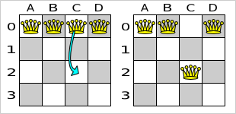
A move
Changes one solution into another solution
  YChangeMove: move a queen to a different row
  Other move types possible
Has an undo move
  Does the exact oposite
Notes:
But how do we get to that solution with the highest score?
Well, we make a move on the current solution.
Shown is a move that moves queen C to row 2.
That's a custom YChangeMove, but other moves types, for example switching the rows of 2 queens, can also be implemented.
Each move also has an undo move, which changes the new solution back to the original solution. In the shown case, that's the moving queen C back to row 0.
Notice that it's not possible to get to every possible solution with a single YChangeMove. We can't get to the solution with all all queens on the last row in a single YChangeMove.
However if we combine multiple YChangeMoves, we can get to any possible solution.
When defining your move types, you should check if they allow you to reach any possible solution.
Let's take a look athe YChangeMove implementation.

Slide 22
Move implementation
public class YChangeMove implements Move {
private Queen queen;
private int toY;
public void doMove(WorkingMemory wm) {
FactHandle queenHandle = wm.getFactHandle(queen);
queen.setY(toY);
wm.update(queenHandle, queen);
}
public boolean isMoveDoable(WorkingMemory wm) {
return queen.getY() != toY;
}
public Move createUndoMove(WorkingMemory wm) {
return new YChangeMove(queen, queen.getY());
}
// constructor, equals, hashCode
}
Notes:
A YChangeMove has a queen and a row to move the queen to.
The Move interfaces requires you to implement 3 methods: doMove, isMoveDoable and createUndoMove.
The doMove method basically just sets the y of the queen to it's new row.
However, it also needs to tell the workingMemory – which is a drools rule engine thing - that it made a change to that queen, so the drools rule engine knows what rules might be dirty the next time it is asked to calculate the score.
The isMoveDoable method always you to make a move ignored by the solver because it would create an corrupted solution or it won't change the solution. In this case, if the queen is moved to the row it's already located on, this move is not doable.
The createUndoMove method creates a move which can change the new solution back to the original solution. In this case, it's simply moving the queen back to it's original row.
Note that a createUndoMove method is called before the move is done.
So where are these moves created?

Slide 23
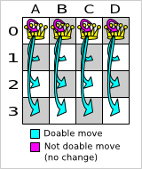
Move generation
MoveFactory
  Configured as selector
  in the configuration file
  CachedMoveListMoveFactory
    createMoveList() method
for (Queen queen
: nQueens.getQueenList()) {
for (int n : nQueens.createNList()) {
moveList.add(
new YChangeMove(queen, n));
}
}
Notes:
A MoveFactory creates the move instances.
It is currently configured as part of the selector in the configuration file.
The selector selects moves, but currently it's pretty basic. Expect some improvements on the selector in the near future, to make it more scalable.
The MoveFactory is domain-specific, but if you extend the CachedMoveListMoveFactory, you only need to implement the createMoveList method.
Here's it creates a move for every queen for every row.
That will make 12 doable moves and 4 undoable moves. The undoable moves are automatically ignored by the solver.

Slide 24
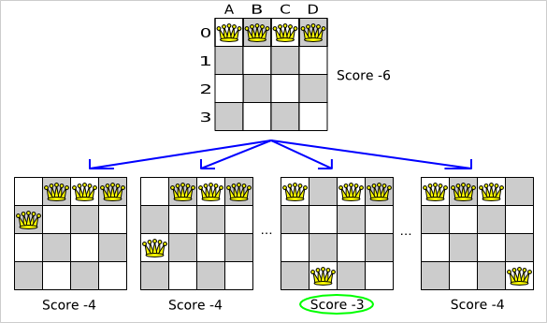
Local search: deciding the next step
Notes:
Which move is picked to change the solution?
Well, the local search solver tries every move on a solution and then picks the move which leads to the solution with the highest score. That move is called a step.
Here we start from the starting solution with all queens on row 0. It has a score of -6, because
A can attack B, C and D,
B can attack C and D
and C can attack D.
If we move queen A to row 1, it can no longer attack C or D, so it's score is only -4.
However, if we look at all moves, we see that moving queen B to row 3 is actually the best move to make, so the local search solver picks that move as the step.
This new solution only violates the constraints 3 times instead of 6 times, but how do we get to 0 violations?
Well, we simply do this again, starting from that new solution.

Slide 25
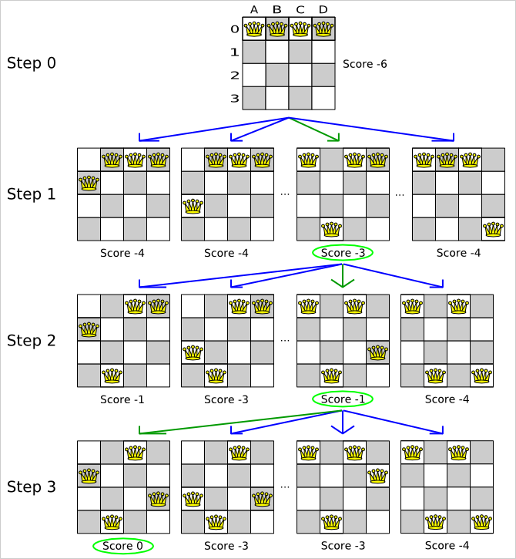
Local search: taking steps
Search path
  No search tree
4 queens
  Solved in
  3 steps
  Evaluated
  37 out of 256
  solutions
16 queens
  31 steps
  7441 out of 1e19
Notes:
If we do that a couple of times, we get this.
The green lines indicate the steps.
I've just explained the first step.
The second step moves queen D to row 2, which gives us a score of -1.
The final step moves queen A to row 1 and we get a solution with no constraints broken.
The 4 queens problem is solved after 3 steps.
In those 3 steps, we've evaluated 36 solutions, only a fraction of all 256 possible solutions.
For 16 queens this ratio is even better: only 7000 out of 10 to the power 19 possible solutions needed to be evaluated. That's pretty good, isn't it?
But what would happen if all the evaluated moves deteriorate the score and it haven't reached the optimal solution yet?
Would the local search solver get stuck?

Slide 26
Local optima
Simple local search = hill climbing
  Gets stuck in local optima
    Fixed by using an accepter
Tabu search accepter
  Solution tabu
    Don't visit the same solution twice
  Move tabu
  Property tabu
Simulated annealing accepter
  Randomly move around
  Higher acceptance chance for improving moves
Notes:
Simple local search works a lot like if you were hill climbing to the top of the world: you always try to go up.
At some point you can end up on the top of the Mont Blanc. If you're not willing to go down, you 'll never climb the Mount Everest and you will never reach the highest point on earth.
So simple local search can get stuck in local optima.
Tabu search resolves that issue. Solution tabu remembers recently encountered solutions and doesn't accept a move if it leads to such an already visited solution.
As you 've seen before the n queens configuration file uses a tabu accepter.
Notice that you don't need to implement anything yourself to use tabu search, just switch it on.
Drools solver also support move tabu and property tabu.
Simulated annealing has a very interesting way to avoid getting stuck. It doesn't try all moves, but just randomly picks the first move it likes as the next step. Improving moves have higher chance to be picked as the next step, especially if many steps have already been taken. Because simulated annealing doesn't check all moves at every step, it steps a lot faster.
The wierd algoritm does perform very well and it is worth to test it on your planning problem.
Luckily drools-solver has a benchmarking utility, which allows you to play out different algoritm configurations against each other, so you can use the best one.

Slide 27
Finish solving
Finish
  Time spend finish
  Step count finish
  Score reached finish
  Unimproved step count finish
  Composition finish
  Score reached and unimproved step count finish
Best solution
  Best encountered solution
  Can be the optimal solution
Notes:
Local search doesn't know when it finds the optimal solution. For real world use cases you won't have time to wait years to find it anyway.
So at some point the solver will need to stop solving, by using a finish.
There a couple of build-in finishes, which allow you to finish for example
after 5 minutes,
when a 1000 steps have been taken
when a score of 0 is reached,
or when the score hasn't improved in the last 10 steps.
You can even combine finishes, for example
when a certain score is reached and the score hasn't improved recently.
This avoids giving the user a solution on which he can make an obvious improvement.
Once the solve method returns, you can get the best solution from the solver. It's the solution with the highest score encountered. This isn't necesary the optimal solution, because it might not have encountered it yet.
However, the best solution should be a lot better than what human planners can do in the same amount of time. Although you'll still need a human planner to define and tweak score rules and move granularity.

Slide 28
Summary
No official releases yet
Download drools solver
  Part of drools trunk in subversion
  http://labs.jboss.com/drools/subversion.html
  Build and run with maven 2
Read the solver manual
  Linked from blog
  http://users.telenet.be/geoffrey/tmp/solver
  /manual/html_single/
Read the drools team blog
  http://blog.athico.com (label solver)
Notes:
Do you want to get started with drools solver?
Well, there are no releases yet, but you can easily check it out and build it yourself.
The source code is part of the drools trunk in subversion.
It builds with maven 2.
And even the GUI examples can be run directly from the command line with maven 2.
So that's a total of 3 command line instructions, which are documented in the solver manual.
The solver manual isn't included in the main drools manual yet, but it already covers all the basics and some advanced stuff.
If you're intrested in this technology, I can also recommend you our drools team blog. I 'll post a link to this presentation on the blog.
Feed-back is welcome on the blog or on the drools mailing lists.

Slide 29
Concluding statement
Solve your planning problems with Drools Solver.
Notes:
So, as a conclusion:
Solve your planning problems with Drools Solver.

Slide 30
Q&A
View JavaPolis talks @ www.parleys.com
Notes:
Any questions?

Slide 31
Thank you for your attention
Notes:
Thank for very much for your attention. Have a nice evening.

Slide 32
Creating a New or Converting an Existing Presentation
Creating a new presentation
  Save a copy of this file: File > Save As
  and name new presentation
  Replace content of existing slides, create
  new slides as needed and delete unwanted slides/elements
Converting an existing presentation
  Use this template file as a base to assure correct file dimensions and default settings
  In Slide Sorter view, Copy slides from existing presentation and Paste into this one
  Save with new file name

Slide 33
Presentation Fundamentals
Use this template and event artwork to create your presentation
Ensure graphics and text do not exceed the ¼-inch border of the slide
Use the provided color palette, box and arrow graphics, and chart styles
Name your file with “Session number-speaker last name.ppt”
  (i.e., 0803-goetz.ppt for PowerPoint™ software format)

Slide 34
Focus the Audience’s Attention
Consider using color to highlight or emphasize words, but use it sparingly
Use a “build sequence” to reveal elements
of a visual in stages Direct the audience to an important area of the visual with a headline, arrow, color, etc.
Limit the information you cover
  Don’t read the slides verbatim
All URLs should be this color:
  www.colourJPhyperlinks.com

Slide 35
Develop Readable Slides
Your slide should contain no more than
one graph, chart or table or five short bullet lines of copy
Use no more than 6 or 7 words per line;
no more than 40 characters per line
Use no less than 20-point font size for optimum readability
The fewer words the better
Graphically represent as much data as you can

Slide 36
Subtitle Placement Instructions
Subtitle Text
Select the subtitle text box above, copy, and paste it on to a slide that requires a subtitle
  This way the subtitles will be in the exact position throughout the presentation
Then with “Snap to Grid” on, select the bullet text box, and using the down arrow key, nudge the box down 3 times

Slide 37
Code Sample - Short Block
Here’s a sample for a block of code
Code
Recommended font size for short blocks of code.
Font used here is Courier New at 18 points
{
use the red color to highlight certain
parts of your code
}
If you have room, feel free to enlarge
the type for additional readability
}

Slide 38
Data Matrix
Q2 03 % to Q2 02
Units 1K +1%
Revenue $1,000 +1%
Gross margin 1% +1.0 pts
OPEX $1 +1%
Net income $1 +1%
EPS $.01 +1%

Slide 39
TODO
The body of your presentation starts here
  It is an outline of your presentation
  Slides in this section will be a variation
  of bullet lists, examples, and graphics

