Slide 1
Examination timetabling with Drools Planner
by Geoffrey De Smet
Drools Planner lead
Notes:
Welcome everybody to “Examination Timetabling with Drools Planner”.
Remember when you were in school and exams were just around the corner? Then they gave you the exam schedule.
Some of the exams were a week apart, while others were the next day or even later on the same day. It was like they did it on purpose.
But in fact, they didn't do it on purpose. Because, their primary concern was not to spread out the exams evenly, though they wanted to, but instead, to make sure no one had 2 exams at the same time.
So why is it so hard to timetable exams? And can we do it better?

Slide 2
Examination timetabling with Drools Planner
Assign each exam
to a period (timeslot) and a room
while respecting several constraints.
Notes:
Yes, we can, with Drools Planner.
So are we going to do?
We are going to assign
each exam, for example “Chemistry”,
to a period, for example “the 1th of june at 9 AM”,
and also to a room, for example “room 203”.
Sounds easy, doesn't it?
The only problem is, there are a bunch of constraints and we need to respect those as much as possible.

Slide 3

Agenda
What is a planning problem?
The examination timetabling problem
The score function
The search for the best solution
Notes:
First, we 'll take a look at some planning problems.
Next, we 'll take a more in-depth look into the examination timetabling problem itself.
And to solve that planning problem, we basically have to do 2 things:
- Define a score function
- and find the solution with the highest score

Slide 4
Speaker’s qualifications
Geoffrey De Smet is the Drools Planner lead
Geoffrey finished 4th in the
International Timetabling Competition 2007
Geoffrey is a committer on
  Drools
  Spring RCP
Geoffrey works at Schaubroeck N.V.,
developing Spring-JPA-RCP applications
Notes:
So I 've been working on Drools Planner in my spare time for over 3 years now.
I joined the International Timetabling Competition 2007, quite late actually, and my examination timetabling implementation, which I 'll show you today, finished 4th. Of course, Drools Planner has evolved a lot since then.
I am a community member of the Drools team.
And I also work on the spring-richclient project occasionally.
In my day job I work at Schaubroeck N.V. near Gent, where we build high quality software for local governments in Belgium.

Slide 5
Agenda
What is a planning problem?
The examination timetabling problem
The score function
The search for the best solution
Notes:
Ok, what is a planning problem?
Let's start with some examples.

Slide 6
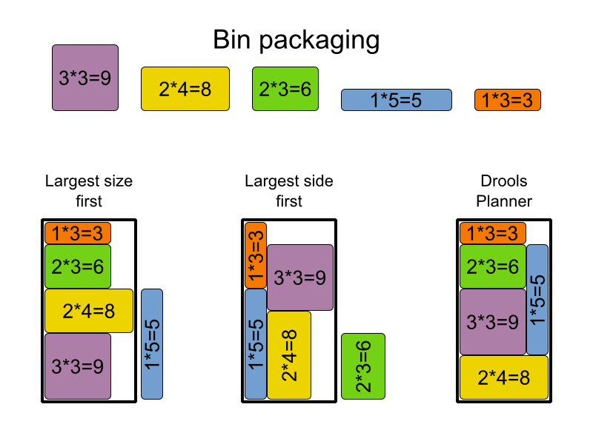
Notes:
For those of you, who have traveled here, you probably solved a bin packaging problem while filling your suitcase. Or if you ever moved houses, this problem will look familiar too.
As you can see on the top of this slide, we have 5 items of different sizes. The purple bed is 3 by 3, while the blue closet is 1 by 5.
All of them need to fit into a 4 by 8 moving truck.
The first algorithm adds the largest items first. So it puts in the purple bed, then the yellow table, then the green couch. But at that point, it's impossible to add the blue closet. There's still a place for the orange bike though.
OK, that leaves 3 options:
- turn the blue closet into firewood
- or pay for an extra moving truck
- or use a better algorithm.
The second algorithm adds the items with the longest side first, but this time, that leaves no room for the green couch.
Last, but not least, the Drools Planner algorithm adds everything and leaves nothing behind.
Still looks easy, doesn't it? What if you had a container ship? Imagine this problem in 3D, with a 1000 items and 50 containers instead of just 1, with weight balancing requirements and breakable items that must be on top. Easy, right?

Slide 7
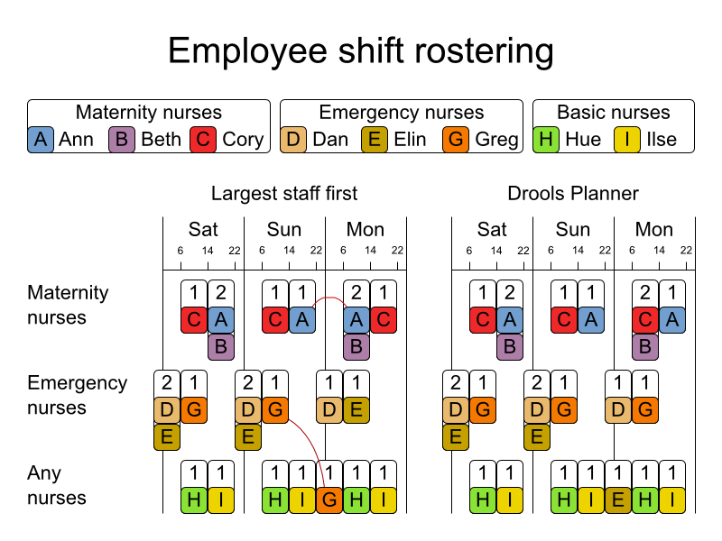
Notes:
Another planning problem is employee shift rostering, for example nurses in a hospital.
This hospital has 8 nurses. Some nurses are specialized: there are 3 maternity nurses and 3 emergency nurses. The last 2 nurses don't have a specialization.
The columns are the days and the hours of each day.
The rows are the needed nurses of each type.
On Saterday, between 6 and 14 o'clock, the hospital needs 1 maternity nurse, 1 emergency nurse and 1 any kind of nurse. Both algorithms plan Cory, Greg and Hue at that time.
The first algorithm plans specialized nurses in the largest staff requirements first. However, Ann (which is nurse A) has a shift on Sunday till 22 o'clock and 8 hours later she has a shift on Monday starting at 6 o'clock. She won't have time to drive home, eat and get a good night's sleep.
Greg has the same problem.
Of course, the Drools Planner algorithm does better. Actually it can also try to support nurse preferences. For example, young nurses dislike Saterday night shifts, while nurses with childern dislike Wednesday afternoon shifts.

Slide 8
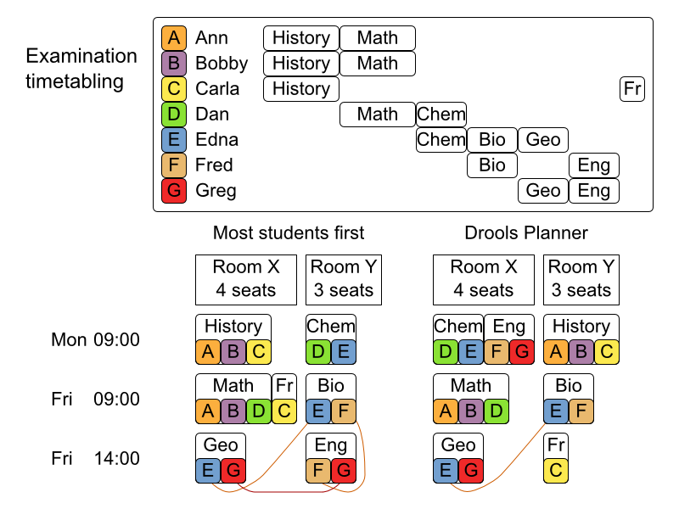
Notes:
Today we 'll be focusing on the examination timetabling problem.
Here we have 7 students and 6 exams. On the top you can see that Ann takes history and math. So does Bobby. Carla combines history and French. And so on.
At the bottom left corner you can see there are 3 periods (AKA timeslots) during which exams can be taken: monday AM, friday AM and friday PM.
There are 2 rooms: room X with 4 seats and room Y with 3 seats.
So the first algorithm puts history into room X the monday morning. During the same period it puts chemistry into room Y.
That's ok, because nobody combines history with chemistry.
On the second row, it puts Math and French in the same room during the same period. That is allowed, as long as there are enough seats in the room, which there are.
However, it also put Geography and English in the same period, Friday PM. That means that Greg (the red G) has to attend 2 different exams at the same time. That's physically impossible.
Another thing, students don't like 2 exams in the same day. Yet, Edna and Fred both have 2 exams on Friday.
The Drools Planner algorithm does a lot better, but it still gives Edna 2 exams on Friday. That's actually unavoidable because Edna has 3 exams and there are only 3 periods.

Slide 9
What is a planning problem?
Plan resources => many possibilities
Constraints => score = 0hard/-625soft
  Hard constraints: must be fulfilled
  Soft constraints: should be fulfilled as much as possible
Probably NP complete
  Impossible to plan the first item optimally
  Brute force takes forever
Notes:
So a planning problem is about assigning resources.
There are a lot of different solutions to a planning problem.
To determine the quality of such a solution, we need a objective way to rank those solutions. That's where the constraints come into play.
Hard constraints must be fulfilled. For example: a student cannot take 2 exams at the same time. Or: A room cannot have more students than it has seats.
Soft constraints, on the other hand, should be respected as much as possible. For example: a student does not like to have 2 exams on the same day.
The solution with no hard constraints broken and the least soft constraints broken is the optimal solution.
Constraints are usually weighted. The sum of the weighted constraints results in a score, for example a score of 0 hard and 635 soft.
Real-world planning problems are almost always NP complete. That means, that is impossible to start by choosing an exam and somehow calculate it's optimal period and room, without first assigning the other exams. So we will have to try many combinations. On the other hand, there are so many combinations that brute force might as well take forever.
So basically, we 're … not gonna get a free lunch. There is no shortcut. Actually, because mathematicians are looking for a shortcut for NP complete problems for so long already, it became a millennium problem back in 2000 and it is worth a million dollars if you solve it.

Slide 10
Why use Drools Planner?
Open source: ASL (business-friendly)
Maven-ready (JBoss repository)
Documentation
  Reference manual
  Examples
JBoss Drools community support
  User mailing list, issue tracking, ...
Notes:
So why choose for Drools Planner?
Well, it's open source.
It's business-friendly under the apache software license, so your boss will like it because he can still sell his software.
It's maven ready: just add a dependency to drools-planner-core and off you go.
Of course, if you prefer plain old jars, then there's a zip download for that too.
The reference manual is detailed and up-to-date. It's really extensive and covers a lot more then I 'll be able to show you today. So read the fff...fabulous manual!
There are 7 examples now, including hospital bed planning, course scheduling, tournament scheduling and of course this examination problem. I strongly recommend to copy-paste an example to prototype your first planning problem. It's fast and straightforward.
Thanks to the Drools parent project we have an active mailing list, jira issue tracking, fisheye, etcetera

Slide 11
Drools Planner usage
XML configuration
  Builds a Planner instance
Calculate score with rule engine
  Each constraint is a score rule
Planner algorithm
  Searches through many solutions
  Returns the best solution found
Notes:
So how does it work?
First you configure a simple but powerful XML file which builds a Planner. You can also use the API to build a Planner directly.
To calculate the score of a solution, Drools Planner uses the Drools rule engine. Each constraint is defined as a score rule. This approach gives you more performance, more scalability and more isolation with less code. The only downside is you 'll have to learn the DRL language. But if you know a declarative language, such as SQL or regular expressions, then that shouldn't be to hard.
The planner algorithm searches though many solutions and returns the best solution found in the amount of time it was given.

Slide 12
Agenda
What is a planning problem?
The examination timetabling problem
The score function
The search for the best solution
Notes:
Let's take a deeper look into the examination timetabling problem.

Slide 13
Examination Timetabling
Defined by International Timetabling Competition 2007
12 real-world datasets
  Set 7 has 13.795 students, 1096 exams, 80 periods and 28 rooms
14 different constraints
  7 hard constraints
  7 soft constraints
Notes:
The second International timetabling competition, organized by a partnership of several universities, defined the examination timetabling problem.
They released 12 datasets which came from real examinations. Today I 'll focus on dataset 7 in my examples. It has 13 thousand students, which take over a 1000 exams in 80 periods and 28 rooms.
The examination timetabling problem has 14 constraints: 7 hard constraints and 7 soft constraints. We 'll take a look at them later.
Let take a look at the domain diagram first.

Slide 14
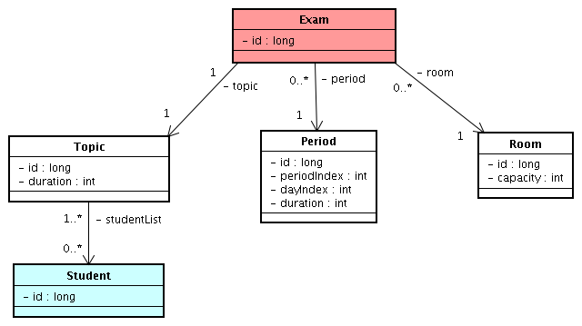
Domain model (1/2)
Notes:
The domain objects are simple classes with getters and setters.
Notice that they all have an id and are ready to be inserted into your database with JPA, JDBC or whatever you prefer.
In my implementation, I 've encapsulated the Exam properties, that do not change during planning, into a separate Topic class. There is a 1 to 1 relationship between a Topic and an Exam.
Each Topic has a duration, which is how long the exam takes, and has a list of students, which take that exam. But of course a student will take several exams, so between Topic and Student there is a many to many relationship.
Each Period has a periodIndex, which we will use to decide if 2 periods are sequential, and it also has a dayIndex. Notice I could have used a JDK date here too, or even better a Joda Date. A Period also has a duration, so it can't accommodate for a Topic with a longer duration.
Each Room has a capacity, which is the number of seats.
Now, the Exam class is in red because it's the only thing that changes during planning. Actually, it's only its period and its room property that change. An Exam never changes Topic and no Exams are created or removed during planning. The planner is just going to play with the period and room of each exam.

Slide 15
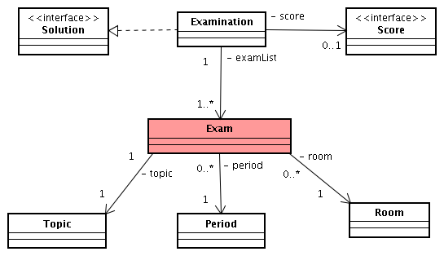
Domain model (2/2)
Notes:
There are multiple exams, so we are going to need a class instance to contain all exams. That is the Examination class.
The Examination class has a list of the exams. So it is actually a solution to our problem: one instance of the problem with each exam assigned to a period and a room.
Here I use the term Solution lightly: an Examination instance, with each Exam assigned to the first period and the first room, is also considered a solution. It's a really bad solution, because each student will have to take all his exams at the same time, so a lot of hard constraints will be broken, but it is a solution.
The Examination class implements the Solution interface, which is a Drools Planner interface. It also has a Score which is null if the score hasn't been calculated yet.
The Examination class is the only domain class which imports Drools Planner interfaces. So the rest of the domain model is free. You don't even need to put the Examination class in your database, you can just as well create it just before handing it off to Drools Planner.
The Examination class also holds a list of all topics, a list of all periods and a list of all rooms, not shown here. That's because each Solution implementation is also considered the problem representation.
Actually, coming from the database, the Examination instance will be uninitialized: this means it will have a topic list but no exam list. During initialization the exam list will be created.

Slide 16
The Solution interface
methods:
  Score getter and setter:
    getScore()/setScore(Score)
  Collection getFacts()
    Return periodList + roomList + … + examList
  Solution cloneSolution()
    Return new Solution
      Same periodList, roomList, …
      Cloned examList with cloned Exam instances
Notes:
The Examination class implements the Solution interface, which has several methods:
There's a getter and setter for the score. The Score interface extends Comparable and you can define your own Score implementation. However, most of the time you 'll just use the out-of-the-box HardAndSoftScore implementation, which has 2 ints: one for the hard score and one for the soft score. If you only have hard constraints, you can also use the SimpleScore implementation which has just a single int.
We use the Drools rule engine to calculate the score. The getFacts() method returns all facts that we can use in the rules. In it, we return all periods, all rooms, all topics and also all exams. Remember that during planning only the exams instances will change, but we 'll need those other facts to detect which constraints are broken.
During planning, the planner will regularly encounter a better solution and it will need to remember it. So before it changes the solution, it clones it with the cloneSolution() method. Only the exam instances change during planning, so our implementation only copies the exam list and the exam instances. There's no need to clone the periods, rooms or even topics.

Slide 17
Agenda
What is a planning problem?
The examination timetabling problem
The score function
The search for the best solution
Notes:
Let's take a deeper look at the constraints and how they define the score function.

Slide 18
Hard constraints
Exam conflict: 2 exams that share students should not occur in the same period.
Room capacity: A room's seating capacity should suffice at all times.
Period duration: A period's duration should suffice for all of its exams.
Period related hard constraints should be fulfilled:
  Coincidence: 2 exams should use the same period (but possibly another room).
  Exclusion: 2 exams should not use the same period.
  After: 1 exam should occur in a period after another exam's period.
Room related hard constraints should be fulfilled:
  Exclusive: 1 exam should not have to share its room with any other exam.
Notes:
There are 7 distinct hard constraints.
The first 3 constraints apply on all exams:
- any 2 exams that share a student must have a different period
- each room has a limited seating capacity
And
- no exam can take longer than the duration of the period
The last 4 constraints apply to specific exams. For example, the chemistry exam should occur after the math exam. So there are actually a couple more domain classes than I 've shown to configure that too.
Let's take a deeper look into an easy constraint first.

Slide 19
Period duration: without DRL
More time required during a period than available in that period.
public int calculatePeriodDurationTooShortScore() {
int periodDurationTooShortScore = 0;
for (exam : examList) {
if (exam.getTopicDuration() > exam.getPeriodDuration()) {
periodDurationTooShortScore += exam.getTopicStudentSize();
}
}
return periodDurationTooShortScore;
}
Notes:
The period duration constraint.
No exam should be scheduled in a period that has a shorter duration then the duration of that exam.
Normally, you would use a simple for loop to count how many times it is broken. So for each exam in the examList we check if the duration of the topic is longer then the duration of the period it is assigned to.
If it is broken, we won't just add 1 to the total, but instead add the number of students of that exam. That trick is actually pretty important as we 'll see later, because it is harder to re-assign an exam with many students than it is to re-assign one with few students.
So what's wrong with this code?
Well it is slow and it doesn't scale.
Most of the time, we 'll just re-assign 1 or 2 exams and recalculate the score. It's useless to loop through all of the other exams too. We should calculate the delta instead.
How can we do this constraint with the Drools rule engine?

Slide 20
Period duration: with DRL
public int calculatePeriodDurationTooShortScore() {
int periodDurationTooShortScore = 0;
for (exam : examList) {
if (exam.getTopicDuration() > exam.getPeriodDuration()) {
periodDurationTooShortScore += exam.getTopicStudentSize();
}
}
return periodDurationTooShortScore;
}
rule "periodDurationTooShort"
when
$exam : Exam(topicDuration > periodDuration);
then
insertLogical(new IntConstraintOccurrence("periodDurationTooShort",
ConstraintType.NEGATIVE_HARD,
$exam.getTopicStudentSize(),
$exam));
end
Notes:
On top you see the original algorithm, below you see the score rule.
Every rule has a left hand side, which is the when part, and a right hand side, which is the then part.
The left hand side, the when part, shown in red, is just a single line: when there is an exam with a topicDuration that is bigger then its periodDuration, then we do something. That exam is put into the variable called dollar exam.
That single line doesn't tell the rule engine to use a for loop. It doesn't care how the rule engine iterates over those exams. It only cares that it finds all exams that follow that pattern, which is: the topic duration is larger then the period duration.
In the right hand side, the then part, we logically insert a ConstraintOccurrence. This means that once the exam gets a different period with a sufficient periodDuration, the ConstraintOccurrence will be extracted from the rule engine automatically.
The 3th parameter of the ConstraintOccurrence constructor, shown in dark green, is the weight, which is the topicStudentSize again.
The Drools rule engine does a magical thing called forward chaining and that gives score rules the power of delta score calculation.

Slide 21
Delta score calculation
Solution with score -5
  History does not fit into period A: -3
  Chem does not fit into period B: -2
  Bio fits into period C: 0
Chem is assigned period D
  Chem fits into period D: from -2 to -0
New solution with score -5 + 2 = -3
  No need to check History and Bio!
Notes:
But what is delta score calculation?
Well, we have a solution with the period duration constraint broken 2 times. History and chemistry break it, but biology doesn't. History has 3 students, that gives minus 3, and chemistry has 2 students, that gives minus 2. Biology does fit into its period, so that gives nothing.
The total score is minus 5.
Now we move chemistry to another period. Because it fits into that period, the minus 2 no longer applies. It becomes 0. So the delta is plus 2.
The new solution will have the same score of the old solution, but accumulated with the delta. The new total score is minus 3.
The bottom line is, because we only moved the chemistry exam, there is no need to check any of the other exams, at least for the period duration constraint. So if we have 10 exams, it can be 10 times faster. If we have a 100 exams, it can be a 100 times faster. If we have 1096 exams, it can be 1096 times faster.
Because the planner algorithm spends most of its time calculating the score, this is a must-have feature.

Slide 22
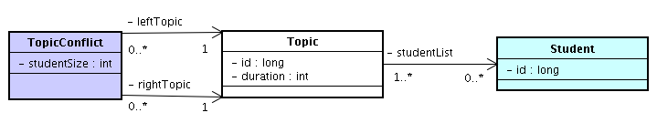
Constraints = pattern matching
Not all subpatterns belong in DRL
  Mutable during planning
    DRL rules = regex for POJO's
    Exam(topicDuration > periodDuration)
  Immutable during planning: cache in model
Notes:
The hard and soft constraints for planning problem are in reality nothing more then just patterns on our domain objects.
To find patterns in Strings, you use regular expressions. To find patterns in domain objects, you use DRL rules.
A larger constraint pattern can be broken down in to smaller subpatterns, and that's exactly what the drools rule engine will do.
However, not all of those subpatterns change during planning. It's usually a good idea to cache patterns that can't change during planning.
For example, we could write a DRL part to detect 2 topics which share students, but why do during planning?
Instead, we calculate the topic conflicts in advance. We give that cached information to the rules as TopicConflict instances. The TopicConflict class holds 2 Topic references and it know the number of students that are common to both topics.

Slide 23
Exam conflicts
2 exams that share students should not occur in the same period
rule "conflictingExamsInSamePeriod"
when
// for any 2 topics in conflict ...
$topicConflict : TopicConflict($leftTopic : leftTopic, $rightTopic : rightTopic);
// … of which the first exam ...
$leftExam : Exam(topic == $leftTopic, $period : period);
// … has the same period as the second exam
$rightExam : Exam(topic == $rightTopic, period == $period);
then
insertLogical(new IntConstraintOccurrence(... NEGATIVE_HARD,
$topicConflict.getStudentSize(),
$leftExam, $rightExam));
end
Notes:
Let's take a look at the exam conflicts constraint. Remember Greg having to take 2 exams at the same time?
In the left hand side, the when part, we read:
For any 2 topics in conflict, which we'll call leftTopic and rightTopic,
Of which the first exam, so the exam with the topic leftTopic and a period which we'll call period
Has the same period as the second exam, so the exam with the topic rightTopic and also the period period.
Doesn't this constraint read more naturally this way? Maybe you miss your for loops and your hashmaps, but this shows the business constraint as-is, without clouding it with too many implementation details. However, the rule engine will optimize this pattern with advanced things like hash indexing, a RETE network with beta joins, …: if you change the Chemistry exam, it only recalculates the exams that conflict with Chemistry, not any of the other conflicting exam combinations.
This resembles an SQL statement. And just like in SQL though, you can still define your pattern in a 100 different ways, which can impact performance.

Slide 24
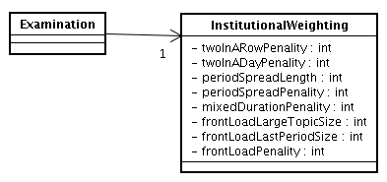
Soft constraints
2 exams in a row.
2 exams in a day.
Period spread: 2 exams that share students
should be a number of periods apart.
Mixed durations: 2 exams that share a room
should not have different durations.
Front load: Large exams should be scheduled
earlier in the schedule.
Period penalty: Some periods have a penalty when used.
Room penalty: Some rooms have a penalty when used.
Notes:
There are 7 distinct soft constraints.
Once none of the hard constraints are broken, these constraints matter.
Not all soft constraints count equally. Instead they are weighted. Part of that weight is defined in an InstitutionalWeighting instance.
For example, in data set 2 the first soft constraint, “2 exams in a row”, has a weight 3 times as heavy than the weight of the second soft constraint, “2 exams in the same day”.

Slide 25
Period spread
2 exams that share students should be a configured number of periods apart
rule "periodSpread"
when
$iw : InstitutionalWeighting(periodSpreadPenality != 0);
// For any 2 exams in conflict ...
$topicConflict : TopicConflict($leftTopic : leftTopic, $rightTopic : rightTopic);
$leftExam : Exam(topic == $leftTopic, $leftPeriod : period);
$rightExam : Exam(topic == $rightTopic, $rightPeriod : period);
// … which are in within the periodSpread
eval(Math.abs($leftPeriod.getPeriodIndex() - $rightPeriod.getPeriodIndex())
< ($iw.getPeriodSpreadLength() + 1));
then
insertLogical(new IntConstraintOccurrence(... NEGATIVE_SOFT,
$topicConflict.getStudentSize() * $iw.getPeriodSpreadPenality(),
$leftExam, $rightExam));
end
Notes:
When I was in school, some of my exams were a day apart, others were a week apart.
The period spread conflict aims to balance that out.
First, it checks if there is indeed a period spread penalty.
If the dataset doesn't penalize period spread violations, it doesn't bother checking the rest of this rule.
Know that there is only 1 InstitutionalWeighting instance.
So, for any 2 exams which are in conflict, we check the red line, which evaluates if the difference in period indexes is smaller than the length of the minimum period spread. Personally, I would have found it more logical that they wanted us to use the dayIndex instead of the periodIndex, but they didn't.
If this rule is broken, we lose a score of the penalty multiplied by the number of students affected by it.

Slide 26
Agenda
What is a planning problem?
The examination timetabling problem
The score function
The search for the best solution
Notes:
Now that we have the score of a single solution, we need to find the solution with the highest score.
So, let's keep it simple and stupid, let's brute force it!

Slide 27
Brute force
for (periodOfExam1 : periodList) {
exam1.setPeriod(periodOfExam1);
for (roomOfExam1 : roomList) {
exam1.setRoom(roomOfExam1);
for (periodOfExam2 : periodList) {
exam2.setPeriod(periodOfExam2);
for (roomOfExam2 : roomList) {
exam2.setRoom(roomOfExam2);
...
for (periodOfExamN : periodList) {
examN.setPeriod(periodOfExamN);
for (roomOfExamN : roomList) {
examN.setRoom(roomOfExamN);
Score score = calculateScore(solution);
cloneIfScoreIsBetter(solution, score);
} } } }…} }
Notes:
To brute force it, we just try every single combination. Here is some pseudo code.
We put exam1 in every period and in every room.
Then we combine that with exam2 in every period and in every room.
In the same manner, we combine that with exam3, exam4 and so on, until we reach the last exam, examN.
Then it's just a simple matter of calculating the score of that combination and, if it's better then the last best solution, we clone and store that solution as the new best solution.
Still, seems like a lot of for loops, don't you think? How many combinations are there? Are we looking for a needle in a haystack?

Slide 28

Needle in a haystack
How many possible solutions?
  1096 exams
  80 periods
  28 rooms
> devoxxians?
  3500 devoxxians last year
Source: devoxx.com
Notes:
OK, it's time for the interactive part of this presentation. Let's take exam set 2.
Exam set 7 has 1096 exams, 80 periods and 28 rooms.
How many combinations does it have? So how many possible solutions does it have?
It's a simple math question.
Last year, there were 3500 devoxxians. Is it bigger then that?
Raise your hand if you think that there are more possible solutions than that there were devoxxians last year.
OK, about a [?] percentage of the people here thinks it's bigger and they are... correct.

Slide 29

Needle in a haystack
How many possible solutions?
  1096 exams
  80 periods
  28 rooms
> humans?
  7.000.000.000 humans
Source: NASA (wikipedia)
Notes:
There are almost 7 billion humans.
Are there more possible solutions then there are humans?
Raise your hand if you think so.
About [?] percent think it's more and they are... correct.

Slide 30

Needle in a haystack
How many possible solutions?
  1096 exams
  80 periods
  28 rooms
> minimum atoms in the observable universe?
  10^80 atoms
Source: NASA and ESA (wikipedia)
Notes:
In the observable universe, they estimate the number of atoms to be at least 10 to the power 80.
So think about every drop of water, every grain of sand, every breath of air, every cubic meter of the sun. Each of those consists out of more then billions of billions of atoms.
Are there more possible solutions then the total of atom in all those things and everything else you know?
About [?] percent still think it's more and they are... correct.

Slide 31
Needle in a haystack
How many possible solutions?
  1096 exams
  80 periods
  28 rooms
> atoms in the universe
if every atom is a universe of atoms?
  (10^80)^80 = 10^3600
Source: NASA and ESA (wikipedia)
Notes:
OK, I am almost at the end of my imagination.
But let's suppose that for every atom in the know universe, there is a universe with the same amount of atoms.
That would give us 10 to the power 3600 atoms.
Does our examination set of merely 1096 exams, 80 period and 28 rooms have more possible solutions than that?
About [?] percent are still raising their hand. Do they realize how big this number is? Yet, they are still correct.
Because there are over 10 to the power 3671 possible solutions.
Let's do the math.

Slide 32
Not a needle in a haystack
80 periods and 28 rooms
  80*28 = 2240 ways to schedule each exam
2240 [e1] * 2240 [e2] * … * 2240 [e1096]
  2240^1096 = 10^3671
If 10^9 scores calculated per ms
  31.579.200.000 ms/year < 10*11 ms/year
  10^3671 / 10^20 = 10^3651 years
Notes:
There are 80 periods and 28 rooms, so we can schedule a single exam in 80 multiplied by 28 or 2240 different ways.
2 exams can be scheduled in 2240 multiplied by 2240 different ways.
So 1096 exams can be scheduled in 2240 to the power 1096 different ways. That's a little over 10 to the power 3671.
Let's be very, very optimistic. Let's presume that we can calculate the score of a billion solutions per millisecond. Remember that calculating the score of a single solution takes some time, even with tricks like delta score calculation. A billion per millisecond is even for state-of-the-art hardware exaggerated.
Since there are less then a 100 billion milliseconds in a year, it would only take 10 to the power 3651 years to look at all solutions.
That number didn't even flinch. It's still gigantic, it's still mocking us.
If we wait patiently for our hardware to become 10 times faster, we can divide that number by 10 and it will still only be 10 to the power 3650 years.
No, we are not looking for a needle in a haystack: looking for a needle in a haystack is dead simple compared to this.

Slide 33
Branch and bound
Again: try every combination
  Calculate the score of a partial solution
    Represent a subtree of combinations
  Investigate more promising subtrees first
  Discard (=prune) fruitless subtrees
Better than brute force
  Still useless: still takes forever
Notes:
So maybe brute force is a little bit too simple and too stupid. We need something smarter. What about the branch and bound algorithm?
Well, it also thinks about trying every combination, but it already calculates the score of a partial solution, so when only a subset of the exams are assigned. It investigates on the better partial solutions first.
When it finds a good full solution, it proves which partial solutions are fruitless and it can prune all those solutions based on that partial solution away without evaluating them.
So it's smarter then brute force, but despite it's pruning, it still takes forever, it's still useless.
If brute force is like an ant looking for an atom in our galaxy, branch and bound is like the same ant looking for an atom in our solar system. It still won't find it.
Nevertheless, I am planning to add a branch and bound algorithm to Drools Planner one day, so it can be used to verify the score calculation of tiny planning problems.

Slide 34
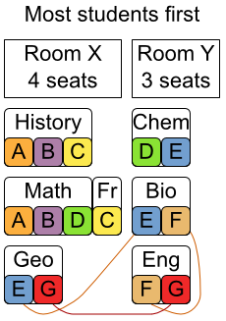
Deterministic
List<Exam> sortedExamList
= sortExamsOnDifficulty(examList);
for (exam : sortedExamList) {
// Determine best remaining spot
Score bestScoreOfExam = - INFINITY;
for (period : periodList) {
exam.setPeriod(period);
for (room : roomList) {
exam.setRoom(room);
Score score = calculateScore(solution);
if (score > bestScoreOfExam) {
... store bestPeriod, bestRoom
}
}
}
… assign exam to bestPeriod, bestRoom
}
Not optimal
  Feasible?
Good initialization
  StartingSolutionIntializer
Notes:
Another approach is the deterministic approach.
Basically, you just sort the exams, and you sort the exams that are most difficult to plan first. Then, in that order, you assign each exam to the best available spot, without thinking of the other exams that still need to be assigned.
The difficulty to plan an exam, can be measured by for example the number of students attending that exams or even better, by the number of potential conflicts that exam can have.
If you recall from one of my first slides, the Example 1 algorithm scheduled the biggest exams first and ended up with Greg having 2 exams at the same time.
So it doesn't result in an optimal solution and sometimes not even in a feasible solution. But it's fast. For dataset 2, a better version of this algorithm takes 18 seconds.
It's a good way to start. It's like swimming 25 meters and jump the first 10 meters into the pool. There are still 15 meters to swim though.
My examination implementation in Drools Planner uses a better version of this algorithm to create a starting solution for the real algorithms...

Slide 35
Metaheuristics in Drools Planner
Algorithms
  Simple local search (= hill climbing)
  Tabu search (move/solution/property)
  Simulated annealing
  Great deluge
Move based
  PeriodChangeMove(Exam exam, Period toPeriod)
  ExamSwitchMove(Exam leftExam, Exam rightExam)
Notes:
Metaheuristics. They keep going when things get hard. Actually, they are slow when things are easy, so always combine them with a deterministic StartingSolutionInitializer.
Out of the box, you can use local search, tabu search, simulated annealing and great deluge.
All of these are based on the principle that you can take a solution and change something in it, so you end up with a neighboring solution. That change is called a move. There are different kinds of moves, like for example: assign one exam to a different period, or assign one exam to a different room, or switch 2 exams of both period and room.
Now I must say, the simulated annealing and great deluge algorithms are not production quality yet, so let's focus on simple local search and its bigger brother, tabu search.

Slide 36
The Move interface
Methods:
  boolean isMoveDoable(WorkingMemory)
    return !ObjectUtils.equals(exam.getPeriod(), toPeriod);
  Move createUndoMove(WorkingMemory)
    return new PeriodChangeMove(exam, exam.getPeriod());
  void doMove(WorkingMemory)
    exam.setPeriod(toPeriod);
    wm.update(wm.getFactHandle(exam), exam);
Notes:
The Move interface represents a move and has 3 methods.
The isMoveDoable() method returns false is there's no change, for example the move wants move chemistry to the first period, but chemistry is already in the first period.
It can also return false if the move is impossible to do.
Not doable moves are automatically ignored by the planner.
The createUndoMove() method returns the move which undoes this move. For example, if the move will move the chemistry exam to the first period, the undo move is the move which moves that chemistry exam to its current period.
The metaheuristic algorithms will often try out a move, calculate the score of that neighboring solution and then undo that move. That way they don't need to clone the solution or recalculate the entire score, which would compromise delta score calculation.
The doMove() method does the move, for example change the period of the chemistry exam to the first period. But it also needs to tell the rule engine's WorkingMemory that that chemistry exam has been modified.
Move implementations also need a equals() and hashcode() implementation because 2 PeriodChangeMove instances which move the same exam to the same period should be equal.
The examination implementations has 3 different Move implementations: PeriodChangeMove, RoomChangeMove and last but not least the powerful ExamSwitchMove, which switches 2 exams.

Slide 37
Simple local search: hill climbing
Start with starting solution
Try every move from MoveFactory
  Score per move
  Using relativeSelection of 0.002 (= 0.2%)
Take best move as next step
  Step = the winning move
Continue taking steps until termination
Source: Wikipedia
Notes:
The local search algorithm starts with a single starting solution as the base solution.
Then, the MoveFactory creates a list of moves, which are the moves to change any exam to any period, to change any exam to any room and to switch any 2 exams of period and room.
For our 870 exams that gives a little under half a million moves, which is still nothing compared to the number of possible solutions.
Next, local search tries every move on the base solution. Each move leads to a neighboring solution which has a score. So every move represents a score.
The move with the best score is promoted to the next step and it is done on the base solution, which results in a new base solution.
From that new single base solution, it continues and tries every move again to pick the next step. Notice that there's no search tree, just a search path.
However, it turns out that evaluating all those moves in every step isn't efficient. So instead of trying half a million moves, we use relativeSelection to only select a percentage of that.

Slide 38
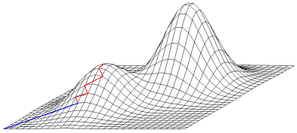
Local optima
1) Deterministic StartingSolutionInitializer
2) Simple local search
3) Stuck in local optimum!
Source: Wikipedia
Notes:
Simple local search AKA hill climbing isn't perfect. It can get stuck in a local optima.
Here we've used a fast deterministic algorithm to initialize the starting solution. Thanks to the StartingSolutionInitializer interface we were able reuse our score rules for that. And from that, we used simple local search to further improve the solution.
But as you can see, it got stuck in a local optimum on the hill. And because simple local search refuses to accept non-improving moves, so because it refuses to come down the hill, it can't go up the mountain!
Luckily, there's a simple answer for that, just replace simple local search with tabu search.

Slide 39
Tabu search = local search++
Solution tabu (high tabu size)
  Been there, no need to go there again
Move tabu (low tabu size)
  Done that recently, no need to do that again
Property tabu (low tabu size)
  Changed that recently,
  no need to change that again
Notes:
Tabu search works just like local search, but ignores some of the moves as the next step because they are tabu.
There are 3 types of tabu which can be combined.
Solution tabu remembers the base solutions and doesn't accept a move which leads to one of those solutions. So where local search takes one step down the hill and then immediately steps back up the hill, solution tabu says: “I ve been on that hill already” and it doesn't go back up the hill.
Move tabu remembers recent moves and ignores them. So if it moves the chemistry exam to the first period and later on, it chemistry is moved to another period, it won't move that chemistry exam back to the first period, for a number of steps.
Property tabu instead, remembers a property of the move, for example the exam itself. So if the chemistry exams has been moved recently, it doesn't move the chemistry exam again, for a number of steps.

Slide 40
Planner configuration
<selector>
<selector>
<moveFactoryClass>...PeriodChangeMoveFactory</moveFactoryClass>
<relativeSelection>0.002</relativeSelection>
</selector>
...
<selector>
<moveFactoryClass>...ExamSwitchMoveFactory</moveFactoryClass>
<relativeSelection>0.002</relativeSelection>
</selector>
</selector>
<accepter>
<completeSolutionTabuSize>1000</completeSolutionTabuSize>
<completeMoveTabuSize>7</completeMoveTabuSize>
</accepter>
<forager>
<foragerType>MAX_SCORE_OF_ALL</foragerType>
</forager>
Notes:
Here we see part of a planner configuration.
On both move factory's we have a relativeSelection of 0.002, so about a 1000 moves are evaluated each step.
We have combined 2 tabu's, shown in red.
The first one is a solution tabu.
The second one is a move tabu with a tabu size of 7.
By the way, it's recommended to use a prime number for the tabu size of move and property tabu.

Slide 41
Termination
Synchronous (configured)
  Max timeMillis/seconds/minutes/hours spend
  Score attained
  Max step count
  Max unimproved step count
Asynchronous (from another thread)
  planner.terminateEarly();
Notes:
Local search and tabu search don't know when to stop, so we need to tell it when to stop.
In the planner configuration, we can configure it to stop at several termination criteria, such as after a length of time or when a certain score is attained. You can combine them or define your own.
Alternatively, you can also terminate it asynchronously from another thread. This is useful when the user gets bored of waiting or even just before the planning is needed, so Just in Time.
In any case, the planner will return the best solution it has encountered during planning.

Slide 42
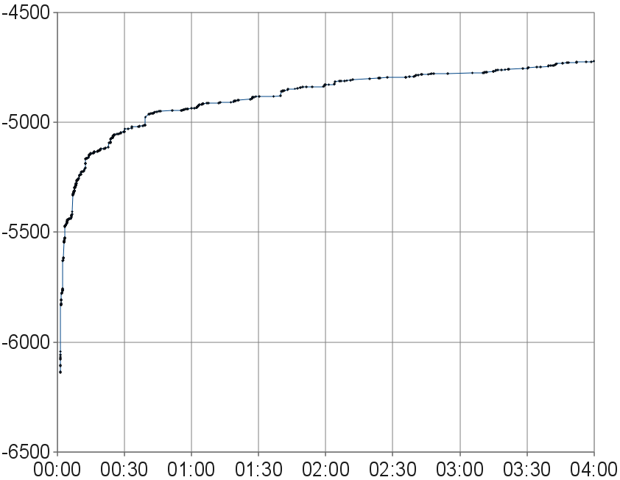
Double time !=> double score
Soft
score
Time (hours:minutes)
Notes:
Here we see the evolution of the best score over time for exam set 7.
After little over a minute, it reached feasibility, with no hard constraints broken and a soft score of about minus 6100.
Less then 10 minutes later, it's already at about minus 5200, so around a 900 points more.
At 2 hours it has a soft score of about minus 4800, but 2 hours later, so at 4 hours, it's soft score is just about minus 4700, just about a 100 points more.
The point is, if you double the performance of your hardware and use the same amount of time, you probably won't see a dramatic score improvement.
In the examination problem, you see that the first hour has the best return on investment. After that first hour, the profit for spending more hours or even days is small.

Slide 43
Benchmarker utility
Battle of different planner configurations
  Different algorithms (tabu search, ...)
  Different moves
  Different settings
On multiple datasets
Results are ranked: best one wins
Notes:
Drools Planner comes with a handy utility: the benchmarker.
It allows you play out different planner configurations against each other, on a bunch of datasets, so you can use the winning configuration in production.

Slide 44
Summary
Drools Planner solves planning problems
Adding constraints is easy and scalable
Switching/combining algorithms is easy
Notes:
So, Drools Planner solves planning problems.
Adding constraints is easy and scalable.
Switching and combining algorithms is easy.
It's been used in production, so use it if you have a planning problem.

Slide 45
Questions?
Home page
  http://www.jboss.org/drools/drools-solver.html
Reference manual
  http://www.jboss.org/drools/documentation.html
Blog
  http://blog.athico.com/search/label/solver
Notes:
Does anyone have any questions?

Slide 46
Thanks for your attention!
Home page
  http://www.jboss.org/drools/drools-solver.html
Reference manual
  http://www.jboss.org/drools/documentation.html
Blog
  http://blog.athico.com/search/label/solver
Notes:
Thanks for your attention!
You can find more information about Drools Planner on the homepage.

