Slide 1


Designing and Sharing Taverna Workflows: Exploring Taverna 2.1 Beta
Katy Wolstencroft
myGrid
University of Manchester

Slide 2
Exercise 1: Installing the Workbench
Normally, you would download Taverna from http://www.mygrid.org.uk but we will be using the new (beta) version of Taverna 2.1 today, so we will download it from myExperiment
Go to http://www.myexperiment.org/packs/60
At the bottom of the page, you can either download the zip, or the whole pack (including release notes etc)

Slide 3
1. Installing Taverna for Windows
Unzip the download file and click ‘run.bat’
Taverna will install itself
YOU WILL ALSO NEED a modern Java Runtime Environment (JRE) or Java Software Development Kit (SDK) from http://java.sun.com Java 5 or above (this is normally already installed on modern machines)
A screenshot of the workbench is included over the page

Slide 4
1. Installing Taverna for a Mac
We have not yet developed the auto-installer for the Mac 2.1 beta version, so we will have to run from the command-line today
Download the .zip file and unzip
Open a terminal window (usually found in /Applications/Utilities/Terminal) and navigate to the download directory.
type sh run.sh
YOU WILL ALSO NEED a modern Java Runtime Environment (JRE) or Java Software Development Kit (SDK) from http://java.sun.com Java 5 or above (this is normally already installed on modern machines)
If you do not already have GraphViz, you will need this too. Please go to (http://www.graphviz.org/ for the appropriate rpm for your platform)

Slide 5
1. Installing Taverna for a Linux
We have not yet developed the auto-installer for the linux 2.1 beta version, so we will have to run from the command-line today
Download the .zip file and unzip
Open a terminal window and navigate to the download directory.
Change the permissions of the run.sh file to be executable (by typing chmod +X run.sh)
Start Taverna by clicking on run.sh in the folder or typing ./run.sh on the command line
YOU WILL ALSO NEED a modern Java Runtime Environment (JRE) or Java Software Development Kit (SDK) from http://java.sun.com Java 5 or above (this is normally already installed on modern machines)
If you do not already have GraphViz, you will need this too. Please go to (http://www.graphviz.org/ for the appropriate rpm for your platform)

Slide 6
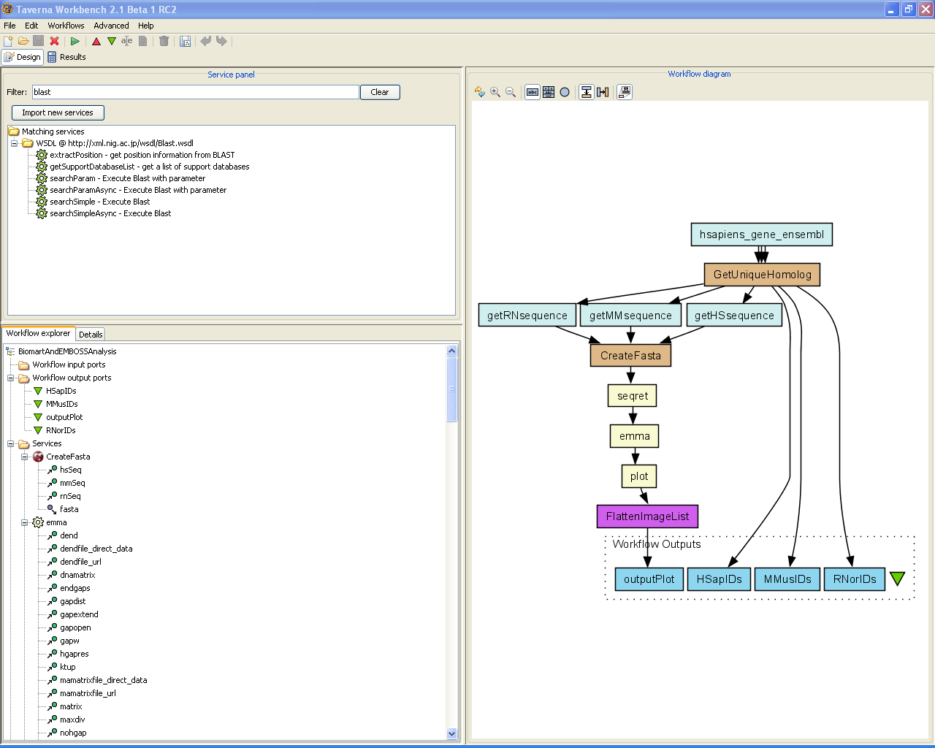

Slide 7
1. Workflow Explorer
The Workflow Explorer is the primary editing component within Taverna. Through it you can load, save and edit any property of a workflow.
The workflow explorer is also where you find configuration details of services and advanced options like iteration and looping. We will come back to these things later

Slide 8
1. Workflow Diagram
The visual representation of workflow
Shows inputs / outputs, services and control flows
Allows editing of the workflow by dragging and dropping and connecting services together
Enables saving of workflow diagrams for publishing and sharing

Slide 9
1. Available Services Panel
Lists services available by default in Taverna
~ 3500 services
Local java services
Simple web services
Soaplab services – legacy command-line application
R Processor
BioMart database services
BioMoby services
Beanshell processor
Allows the user to add new services or workflows from the web or from file systems

Slide 10
Exercise 2: Adding New Service
New services can be gathered from anywhere on the web – the default list is just a few we already know about – importing others is very straightforward
In a web browser, go to the DDBJ list of available web services at: http://xml.nig.ac.jp/index.html
These services were not designed for use in Taverna, but Taverna can use them if you supply the address of the WSDL file
Click on the DDBJ blast service (http://xml.nig.ac.jp/wsdl/Blast.wsdl ) and copy the web page address

Slide 11
2. Adding New Services
Go to the services panel in Taverna and click “import new services”. For each type of service, you are given the option to add a new service, or set of services.
Select ‘WSDL service…’ A window will pop-up asking for a web address
Enter the Blast Web service address you just copied
Scroll down to the bottom of the Services list and look at the new DDBJ service that is now included.

Slide 12
Exercise 3: Building a Simple Workflow
Go to the Services Panel
Type ‘Fasta’ into the ‘search’ box at the top of the panel (we will start with simple sequence retrieval)
You will see several services in the search results
Select ‘Get Protein FASTA’
This service returns a protein sequence in Fasta format from a database if you supply it with a sequence id
Drag this service across to the workflow explorer panel

Slide 13
Exercise 3: Building a Simple Workflow
In a blank space in the workflow diagram, right-click and select “Add Workflow Input Port”
Type in a name for this input (e.g. ID) and click “ok”
Do the same to create a new workflow output. Call this output “sequence”
You now have 3 boxes in the diagram and we need to connect them up
Click on the input box and drag towards “Get Protein Fasta”

Slide 14
Exercise 3: Building a Simple Workflow
Click on the input box, drag towards “Get Protein Fasta”, and let go. An arrow will connect the two boxes
Click on the output box, drag towards “Get protein fasta”, and let go. An arrow will connect the two boxes
You have now built your first workflow!
Run the workflow by selecting “file -> run workflow”

Slide 15
Exercise 3: Building a Simple Workflow
An input window will appear. As you can see, we have not yet added a description of the workflow or of the input.
Click on “New Value” in the input window and add a Genbank Gene identifier (e.g. 1220173) where it says “some input data goes here”
Click “run workflow”
In the bottom left of the results window, click on the results (t2ref://taverna….). You will now see a protein sequence from genbank

Slide 16
Exercise 3: Building a Simple Workflow
Go back to the design window (by clicking on “Design” in the top left corner)
In the services panel, search for “blast”
Find the result “SearchSimple – Execute Blast” and drag that across to the workflow panel
Now we have 2 services to connect into a workflow. We will connect “Get_protein_fasta” to “SearchSimple” by right-clicking “Get_protein_fasta” and selecting “link from output output_text”

Slide 17
3: Building a Simple Workflow
You will then get an arrow. Drag the arrow to “searchSimple”. A box will appear asking which port you want to connect to – select “query”. Now the services are connected
If you show the service ports, you can connect directly between an output port on one service to an input port on another
Show the service ports by clicking on the blue square icon at the top of the workflow diagram (next to abc)

Slide 18
3: Building a Simple Workflow
Delete the data link by right-clicking on the arrow and selecting delete
Put the connection back again by clicking on “Get_protein_fasta -> Output_text” and dragging to “SearchSimple -> query”. It is often easier to connect things when you are showing the ports in this way

Slide 19
Exercise 3: Building a Simple Workflow
We need to finish building the workflow by adding inputs and outputs
Right click on “SearchSimple -> Result” and select “connect as input to..New Workflow Output Port”
Taverna will suggest a name for the output, if this is ok, select “ok”
Add two new workflow inputs (called ‘database’ and ‘program’) and connect these to ‘database’ and ‘program’ in SearchSimple

Slide 20
3: Adding a Workflow Description
Right-click on a blank part of the workflow diagram and select “show details”
In the workflow explorer panel, the details page will open up. Add some metadata about the workflow. Who is the author and what does it do
You can also add examples and descriptions for the workflow inputs by selecting them and selecting “details”
An example for database is ‘SWISS’, for program, ‘blastp’, and for ID ‘1220173’
Save the workflow by going to “File -> save workflow”

Slide 21
4. Running the Workflow
Go to “File -> run workflow”. A workflow input window will appear
Each input has its own tab with descriptions and examples as well as a panel to enter data
In the fasta_id input, select “New value” and add a genbank GI number (e.g. 1220173)
In the database, add “SWISS”
In the program, add “blastp”
Select “run workflow” at the bottom of the panel to set the workflow going

Slide 22
4. Running the Workflow with Multiple Inputs
Taverna 2 has type-checking built into the workflow. Before you execute, it will check that all of your input and output values are syntactically correct (i.e. single values and lists). In the following few months semantic type checking will also be added.
Because of this, you have to declare the type of input you want for the workflow (we have declared single values by default)

Slide 23
4. Running the Workflow with multiple inputs
Go back to the blast workflow and right-click on the “Get_protein_fatsta_ID” input port. Select “edit workflow input port”
Change the depth to 1. This will allow you to add a list of inputs to the workflow
Run the workflow again (notice it has remembered the values you added last time). Additionally, add another GI number, for example, 37722019
This time the workflow will iterate over both
Notes:
23

Slide 24
5. Looking at intermediate results - provenance
As Taverna 2 workflows run, data is collected and stored as well as the provenance of that workflow run
When a workflow is complete, you can look back at intermediate results by selecting a service in the workflow results diagram panel. An intermediate results window will pop-up showing iterations and the relationships between inputs and outputs for that service.
In the full release, browsing previous workflow runs will be possible even after closing and restarting Taverna. All data and provenance is saved by default already, but a new browsing interface is yet to be introduced

Slide 25
Exercise 6: Sharing Workflows
Go to http://www.myexperiment.org
myExperiment is a social networking site for sharing workflows and workflow expertise and experiences
Browse around the site and see what it contains
Create yourself an account and join the group called MIB_Tutorial (a useful place to share items from today)

Slide 26
6. Sharing workflows
Find all the workflows containing BLAST searches. How did you find them? How many are there? Can they all be downloaded?
Which is the most downloaded workflow?
Which is the most viewed workflow? Is it the same?
What research interests does the VL-e group have?
If you wish to share your workflows with the rest of the class, upload them and set the permissions so that only those in the ‘MIB_Tutorial’ group can see them

Slide 27
Exercise 7: Workflow Reuse and Nested Workflows
Reload your BLAST workflow from exercise 4
We will extend this workflow to provide information about the pathways the proteins are involved in
In myExperiment, find all the workflow that involve pathways
Select and download the ‘NCBI Gi to Kegg Pathways’ workflow

Slide 28
7. Workflow Reuse – Nested Workflows
Go back to Taverna and look at the Blast workflow
Add a nested workflow by clicking on the blank part of the diagram and selecting ‘Add Nested Workflow’ and selecting the workflow you have just downloaded
You need to connect up the workflow as if it was any other kind of service

Slide 29
7. Workflow Reuse – Nested Workflows
The nested workflow has 1 inputs and 4 outputs. We need to connect the input, but we can choose which outputs to connect
Connect your initial outer workflow input (probably called ‘ID’ to the nested workflow input.
Connect the ‘Pathway by Gene’ and Pathway Description’ outputs in the nested workflow to new outputs in the main workflow

Slide 30
7. Workflow Reuse – Nested Workflows
Save the workflow and run the workflow using the example - 122181185
Look at the results
This time, you will have blast results and pathway results
If you save the workflow back on myExperiment, make sure you attribute the nested workflow author.

Slide 31
Exercise 8: Using BioMart
Notes:
31

Slide 32
Exercise 8: BioMart
Biomart enables the retrieval of large amounts of genomic data e.g. from Ensembl and Sanger, as well as Uniprot and MSD datasets
Open the workflow ‘BiomartAndEMBOSSAnalysis.xml’ from myExperiment
http://www.myexperiment.org/workflows/158/download?version=3
Run the Workflow
Notes:
32

Slide 33
8.BioMart
This Workflow Starts by finding all gene IDs from Ensembl corresponding to human genes on chromosome 22 implicated in known diseases and with homologous genes in rat and mouse.
For each gene ID it collects 200bp after the five-prime end of the genomic sequence in each organism and performs a multiple alignment of the sequences using the EMBOSS tool 'emma' (a wrapper around ClustalW). It then returns PNG images of the multiple alignment along with three columns containing the human, rat and mouse gene IDs used in each case.
Notes:
33

Slide 34
8. BioMart
Click on the ‘hsapiens_gene_ensembl’ service in the diagram. It is automatically selected in the workflow explorer
Click on ‘Details’ at the top of the workflow explorer and select ‘configure’. The BioMart configuration window will appear
Notes:
34

Slide 35
8. BioMart
By selecting ‘Filters’ and then ‘Region’ – change the chromosome from 22 to 21 – now the workflow will retrieve all disease genes from chromosome 21 with rat and mouse homologues
Run the workflow and look at the results
See how some of the other options were configured by finding them in the other pull-down lists (Gene, Multi-species comparison etc)

Slide 36
8. BioMart
Find out which Gene Ontology terms are associated with the genes in your region by adding a new Biomart query processor
Select another copy of ‘hsapiens_gene_ensembl’ from the services panel (Hint: you could search for hsapiens) and drag it into your workflow
The configuration window will automatically pop-up
Notes:
36

Slide 37
8. BioMart
Configure the new service. In ‘filters’, select ‘gene’ and the ‘id list limit’ tick-box next to ‘ensembl gene IDs’. This will enable you to connect it to the existing workflow
Configure the output (by selecting attributes) and select ‘External’. Select ‘GOID’ and ‘GO description’ for the GO Molecular Function categories

Slide 38
8. BioMart
Connect the input of the new service to the ‘hsapiens_gene_ensembl’ service via the ‘ensembl_gene_id’
Create 2 new workflow outputs, ‘MFGOID’ and ‘MF_Description’. Connect the outputs of the Biomart processor to them
Save the workflow
Re-run the workflow and view which GO terms are associated with your chromosomal region
NOTE: Having 2 outputs for related terms like this is inefficient and hard to read – we will come back to a solution to fix this problem later
Notes:
38

Slide 39
Exercise 9: Iteration
As you have seen already, Taverna can iterate over sets of data. This happens automatically
When 2 sets of iterated data are combined, Taverna needs extra information about how to combine them. You can have:
A cross product – combining every item from list 1 with every item from list 2
A dot product – only combining item 1 from list 1 with item 1 from list 2
You can also combine more than 2 lists in combinations
Notes:
39

Slide 40
9. Iteration
Find and load the workflow ‘Demonstration of configurable iteration’ from myExperiment
Read the workflow metadata to find out what the workflow does (by looking at the ‘Details’)
Select the ‘ColourAnimals’ service and select the ‘Details’ in the workflow explorer and ‘configure list handling’
Click on ‘dot product’ in the pop-up window. This allows you to switch to cross product
Notes:
40

Slide 41
9. Iteration
Run the workflow twice – once with ‘dot product’ and once with ‘cross product’.
Save the first results so you can compare them – what is the difference? What does it mean to specify dot or cross product?
Notes:
41

Slide 42
10. Shim Services
This exercise highlights the services that do not perform biological functions, but are vital for running life science workflows
Notes:
42

Slide 43
Exercise 10: Exploring Shims
A shim is a service that doesn’t perform an experimental function, but acts as a connector, or glue when 2 experimental services have incompatible outputs and inputs
A shim can be any type of service – WSDL, soaplab etc. Many are simple beanshell scripts
Notes:
43

Slide 44
10. Exploring Shims
Look at the ‘BiomartandEmbossAnalysis’ workflow from the last exercise
Work out which services are shims
What do the shims do?
Notes:
44

Slide 45
10. Exploring Shims
The emboss suite of programs have a subdivision – edit
All the edit services are shims
Experiment with the edit services
Find a service that will remove gaps from sequences
Notes:
45

Slide 46
Exercise 10: Shims for Data Input
Reload the ‘Blast’ workflow we built earlier
So far, we have only added a few input values to our workflows. Normally, you would have a much larger data set. The “GetProteinFasta” activity can only handle one ID at a time.
You can add more manually by adding multiple values into the input window (as we have already seen), but if you have a whole file, this is not ideal. Instead, we need an extra service to split a list of data items into individual values

Slide 47
10. Shims for Data Input
In the services panel, search for “split”
Select “split string into string list by regular expression” (a purple local java service) and drag it into the workflow
Delete the data link between the “ID” input and “GetProteinFasta” by selecting and right-clicking on the diagram
Connect “ID” to the “string” port of the new “split” activity
Add “\n” as a constant value to the “regex” input on “split…” by right-clicking and selecting “Set constant value”
Notes:
47

Slide 48
10. Shims for Data Input
Run the workflow
This time, instead of adding individual IDs add a file of IDs. If you don’t have one to hand, there is one to download here: http://www.cs.man.ac.uk/~katy/taverna/IDList.txt
You can download and add the file, or you can add the URL from the input window
As the workflow runs, you will see it iterate over the IDs in the file
The local workers are ‘pre-configured’ shims. Have a look at the different categories on offer. These may come in handy in later exercises

Slide 49
11. Beanshell Introduction
Load your modified ‘BiomartAndEMBOSSAnalysis.xml’ workflow from earlier
Look at the diagram. Each brown service is a beanshell script
Select ‘CreateFasta’ in the diagram. Right-click and select ‘edit beanshell’

Slide 50
11. Beanshell Introduction
Look at the script and see if you can work out its function
Look at the ports and their types as well as the script
Note the names of the ports and where they appear in the script, you will need to know how to specify an input/output in the next exercise

Slide 51
Exercise 12 Writing your Own Beanshell
Create a new workflow by selecting ‘file’ and ‘New Workflow’
Add a new beanshell from the “service template” section of the service panel. A configure window will pop-up
Create 2 input ports named: myName and mySurname after selecting the ‘Ports’ tab
Cretate 1 output port named: myFullname

Slide 52
Exercise 12 Writing your Own Beanshell
Select the script tab and Paste the following script myFullname = myName +"\t" + mySurname
Create 2 workflow inputs and 1 workflow output and connect them to the configured beanshell service.
Run the workflow
You should get your full name printed in the output.

