Slide 1
How-To Infra
With
Chris Wells
And
Chris Thistlethwaite
From your ASF Infra Team
Notes:
Introductions:
Cwells:
ChrisT:
WTF are we doing here?

Slide 2
Overview
ASF Infra structure
How to reach us?
Overview of our services
How can we help you?
Notes:
Say things about those bullet points

Slide 3
Infra’s Structure
6 Full-time and 2 part-time
Located in the EU and US, covering +2 UTC to -7 UTC
1 team member on-call 24/7, shift is year round
Notes:
Introduce the rest of Infra
Talk about where we all are geographically
Something else

Slide 4
Infra’s Structure
Board of
Directors
President
(David Nalley)
You
VP, Infrastructure
(Myrle Krantz)
Infrastructure Staff
(7 nerds)
Infrastructure
Administrator
(Greg Stein)
Notes:
Here’s us, 6 full time, 2 part time.
Maybe make this flat? Idk just need to move things around.

Slide 5
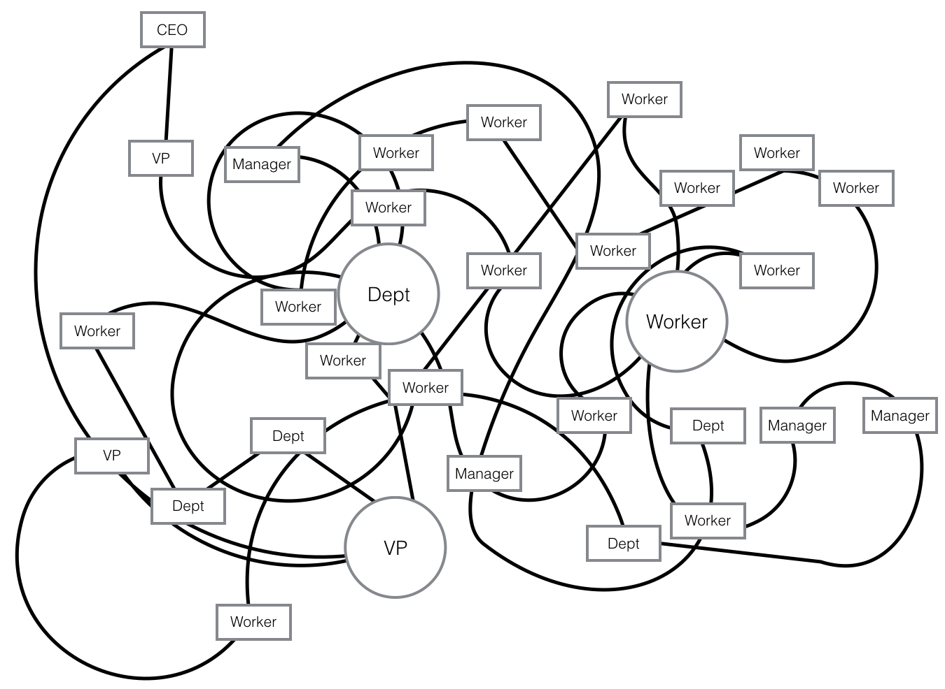
Probably a Company
Notes:
Basically just that we’re a different org vs a “normal” company org.

Slide 6
A day in the life of Infra
Jira tickets
Project work
Monitoring Slack chat (#asfinfra) and email

Slide 7
Infra On-Call
Whoop whoop something’s busted
24/7 for a week, rotation, etc
What we monitor and why.

Slide 8
Infra and ASF Policies
Infra handles operational policy
  Traffic on our services (things like bans)
The Foundation handles legal policy
  Members help shape policy that Infra enforces. Things like how releases are handled, how voting happens, etc.

Slide 9
Infra’s bad rap
Not really, we’re kind and loving systems administrators.
We enforce the policy created by members, committers, the board, us, gnomes, dogs, cats, etc.
How can we improve?

Slide 10
Effective use of Infra
How to change policy
How to introduce a new $thing
How to face rejection when we tell you no

Slide 11
Questions?
Contact us
  Slack
  users@infra.apache.org
  builds@apache.org
    For builds stuff
  Roundtables

