Slide 1
General view
apache access log
jmeter access log
TestPlan
Generator
date range
Test plan
Server + port + protocol

Slide 2
Generated jmeter access log
Apache
access log
Jmeter
access log
IP1 time1 ....
IP1 time1 ....
IP2 time1 ....
IP3 time2 ....
IP3 time3 ....
IP3 time4 ....
IP1 time3 ....
IP2 time4 ....
IP2 time5 ....
IP4 time6 ....
IP4 time9 ....
0
1
2
3
4
5
IP3 time2 ....
IP3 time3 …
IP3 time4 …
IP1 time3 ...
IP2 time4 ....
IP2 time5 ...
Thread group IP3
(offset 0)
Generate
acesses from
time2 to time5
Thread group IP1
(offset 3)
Thread group IP2
(offset 4)

Slide 3
Acces Log Timer
Accesses from time(2) to time(5)
Access Log Timer
for IP3
Thread group start up delay = 2 – 2 = 0
Sample IP3 time(2).... → delay = 0
Sample IP3 time(3) … → delay = 1
Sample IP3 time(4) … → delay = 1
Access Log Timer
for IP1
Thread group start up delay = 3 – 2 = 1
Sample IP1 time(3) … → delay = 0
Access Log Timer
for IP2
Thread group start up delay = 4 – 2 = 2
Sample IP2 time(4) .... → delay = 0
Sample IP2 time(5) … → delay = 1

Slide 4
Timing
Accesses from time2 to time5
time
Http
server
Test plan start
0
1
2
3
(thread group IP3) GET...
(thread group IP1) GET...,
(thread group IP3) GET...
(thread group IP3) GET...,
(thread group IP2) GET...
(thread group IP2) GET...
Test plan end

Slide 5
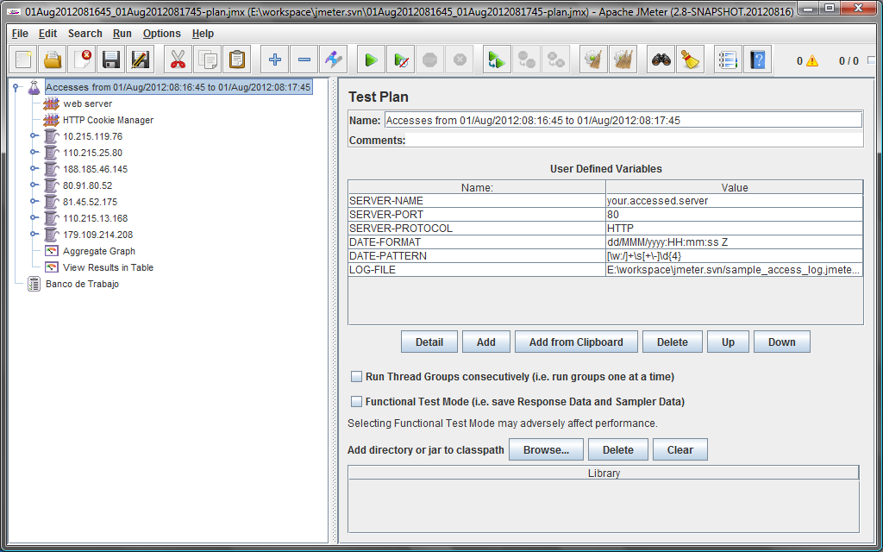
Test plan
Date range
Default values

Slide 6
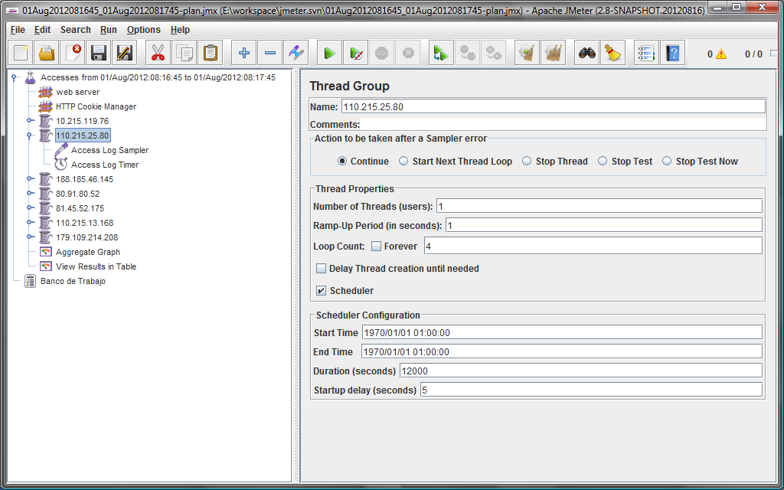
Thread group
Number of requests
(calculated by generator)
+5 seconds
Fileds calculated by generator
110.215.25.80 - - [01/Aug/2012:08:16:50 +0200]
110.215.25.80 - - [01/Aug/2012:08:16:55 +0200]
110.215.25.80 - - [01/Aug/2012:08:17:02 +0200]
110.215.25.80 - - [01/Aug/2012:08:17:02 +0200]

Slide 7
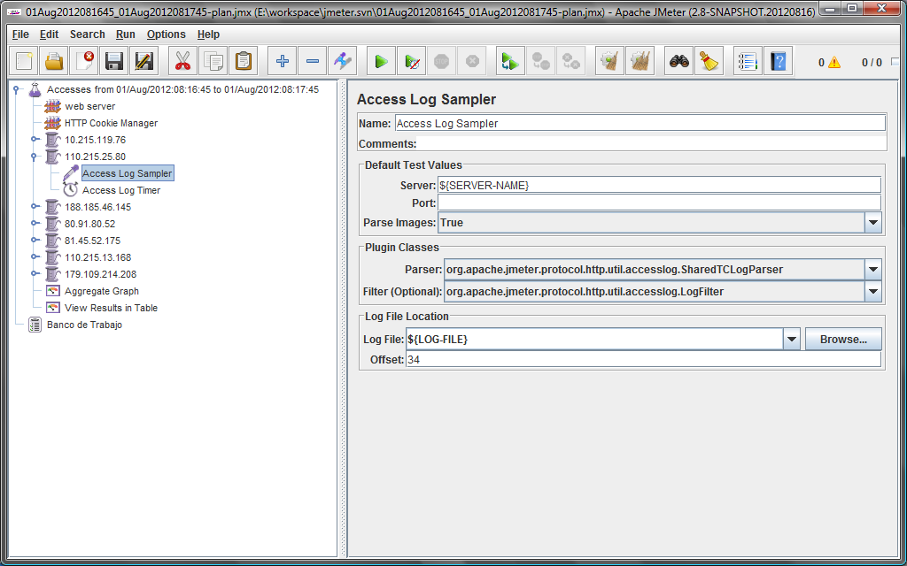
Access log sampler
New field, calculated by generator
(0) 10.215.119.76 - - [01/Aug/2012:08:16:45 +0200]
.
.
.
(34) 110.215.25.80 - - [01/Aug/2012:08:16:50 +0200]

Slide 8
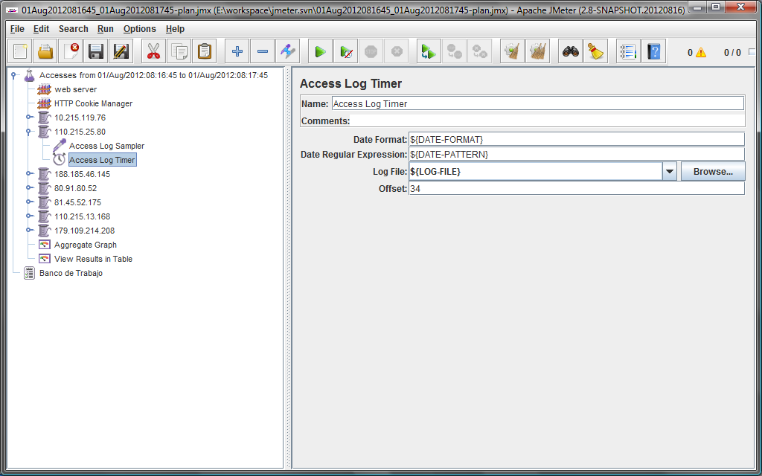
Access log timer

Slide 9
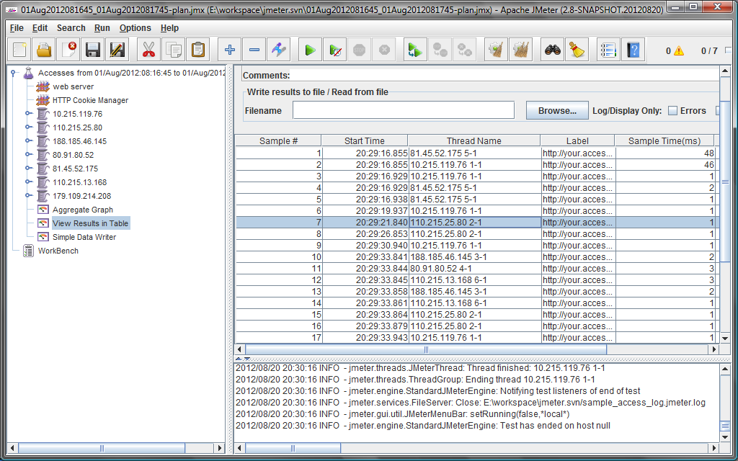
Execution
1sr access was delayed 5 seconds after test started
2nd access was delayed 5 seconds after 1st access
3rd access was delayed 7 seconds after 2st access
110.215.25.80 - - [01/Aug/2012:08:16:50 +0200]
110.215.25.80 - - [01/Aug/2012:08:16:55 +0200]
110.215.25.80 - - [01/Aug/2012:08:17:02 +0200]
110.215.25.80 - - [01/Aug/2012:08:17:02 +0200]
4th access was delayed 0 seconds after 3st access

Slide 10
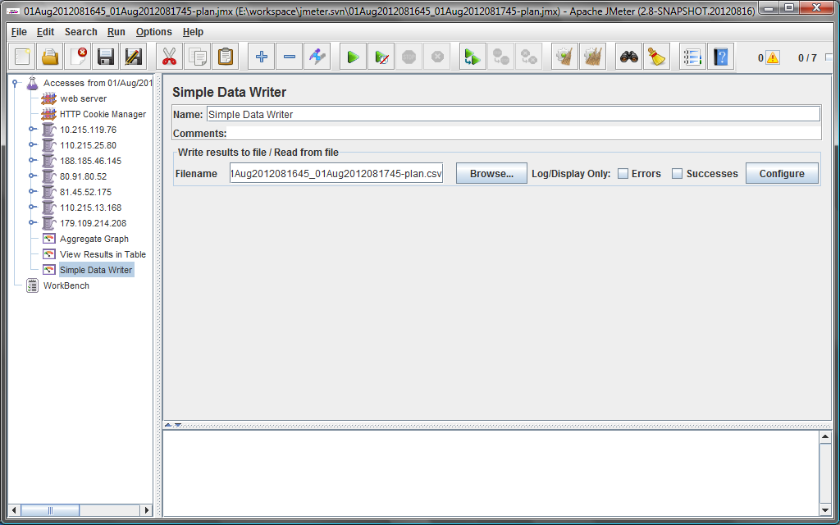
Results
Result file

Slide 11
Tests and demos
Tested with an apache access log of 100.000 samples
and 2.200 thread groups generated
To try it, you can generate some sample plans with Junit (*) available in test
org.apache.jmeter.protocol.http.util.accesslog.TestPlanGeneratorTest.java:
testGivenDateRangeInsideAccessLogRangeGeneratesTestPlan()
testGivenDateRangeOutsideAccessLogRangeGeneratesTestPlan()
testGivenNoRangeGeneratesTestPlan()
To see what the generator produces, I suggest to set in these tests:
request.printProgress=true;
request.progressInterval=1000; //prints how many entries of the access log have been processed so far
(*) in a later phase the generator could be a command line

