Slide 1
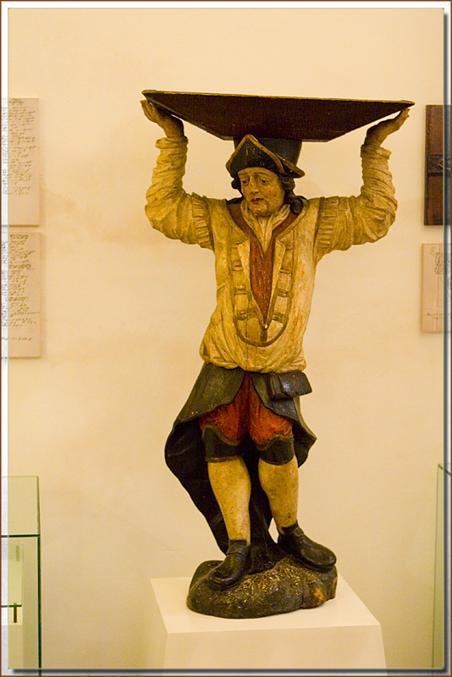






Mahout Scala and Spark Bindings: Bringing algebraic semantics
Dmitriy Lyubimov 2014
Notes:
On the right side is the picture called “Statue of a miner”. I snapped it in Kunta Hora, Czech Repulbic about 10 years ago. More specifically, it is a statute of a miner mining for sivler for a state mint. It was a heavy

Slide 2
Requirements for an ideal ML Environment
Wanted:
Clear R (Matlab)-like semantics and type system that covers
Linear Algebra, Stats and Data Frames
Modern programming language qualities
Functional programming
Object Oriented programming
Sensible byte code Performance
A Big Plus: Scripting and Interactive shell
Distributed scalability with a sensible performance
Collection of off-the-shelf building blocks and algorithms
Visualization
Mahout Scala & Spark Bindings aim to address (1-a), (2), (3), (4).

Slide 3
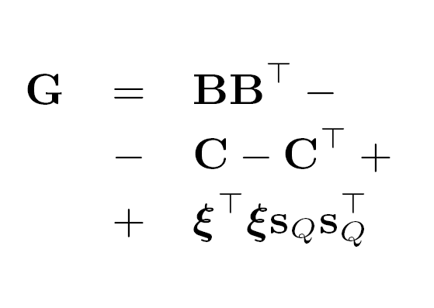
What is Scala and Spark Bindings? (2)
Scala & Spark Bindings are:
Scala as programming/scripting environment
R-like DSL : val g = bt.t %*% bt - c - c.t + (s_q cross s_q) * (xi dot xi)
Algebraic expression optimizer for distributed Linear Algebra
Provides a translation layer to distributed engines: Spark, (…)

Slide 4
What are the data types?
Scalar real values (Double)
In-core vectors (2 types of sparse, 1 type of dense)
In-core matrices: sparse and dense
A number of specialized matrices
Distributed Row Matrices (DRM)
Compatible across Mahout MR and Spark solvers via persistence format

Slide 5
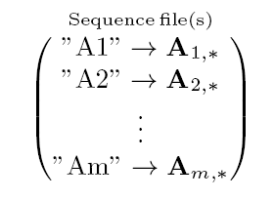
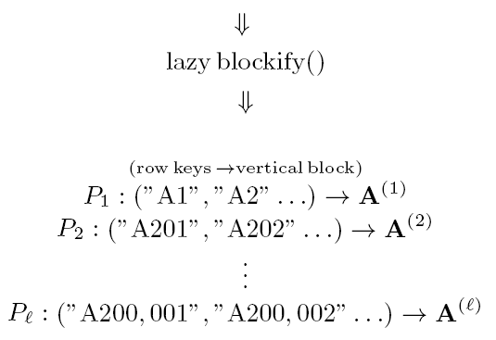
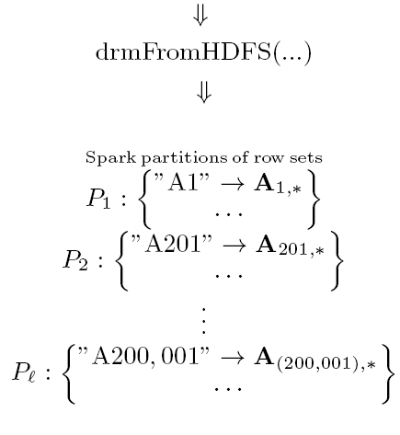
Dual representation of in-memory DRM
Automatic row key tracking:
// Run LSA
val (drmU, drmV, s) = dssvd(A)
U inherits row keys of A automatically
Special meaning of integer row keys for physical transpose

Slide 6
Features (1)
Matrix, vector, scalar operators: in-core, out-of- core
Slicing operators
Assignments (in-core only)
Vector-specific
Summaries
drmA %*% drmB
A %*% x
A.t %*% A
A * B
A(5 until 20, 3 until 40)
A(5, ::); A(5, 5)
x(a to b)
A(5, ::) := x
A *= B
A -=: B; 1 /=: x
x dot y; x cross y
A.nrow; x.length;
A.colSums; B.rowMeans
x.sum; A.norm …

Slide 7
Features (2) – decompositions
In-core
Out-of-core
val (inCoreQ, inCoreR) = qr(inCoreM)
val ch = chol(inCoreM)
val (inCoreV, d) = eigen(inCoreM)
val (inCoreU, inCoreV, s) = svd(inCoreM)
val (inCoreU, inCoreV, s) = ssvd(inCoreM, k = 50, q = 1)
val (drmQ, inCoreR) = thinQR(drmA)
val (drmU, drmV, s) = dssvd(drmA, k = 50, q = 1)

Slide 8
Features (3) – construction and collect
Parallelizing from an in-core matrix
Collecting to an in-core
val inCoreA = dense(
(1, 2, 3, 4),
(2, 3, 4, 5),
(3, -4, 5, 6),
(4, 5, 6, 7),
(8, 6, 7, 8)
)
val A = drmParallelize(inCoreA, numPartitions = 2)
val inCoreB = drmB.collect

Slide 9
Features (4) – HDFS persistence
Load DRM from HDFS
Save DRM to HDFS
val drmB = drmFromHDFS(path = inputPath)
drmA.writeDRM(path = uploadPath)

Slide 10
Delayed execution and actions
Optimizer action
Defines optimization granularity
Guarantees the result will be formed in its entirety
Computational action
Actually triggers Spark action
Optimizer actions are implicitly triggered by computation
// Example: A = B’U
// Logical DAG:
val drmA = drmB.t %*% drmU
// Physical DAG:
drmA.checkpoint()
drmA.writeDrm(path)
(drmB.t %*% drmU).writeDRM(path)

Slide 11
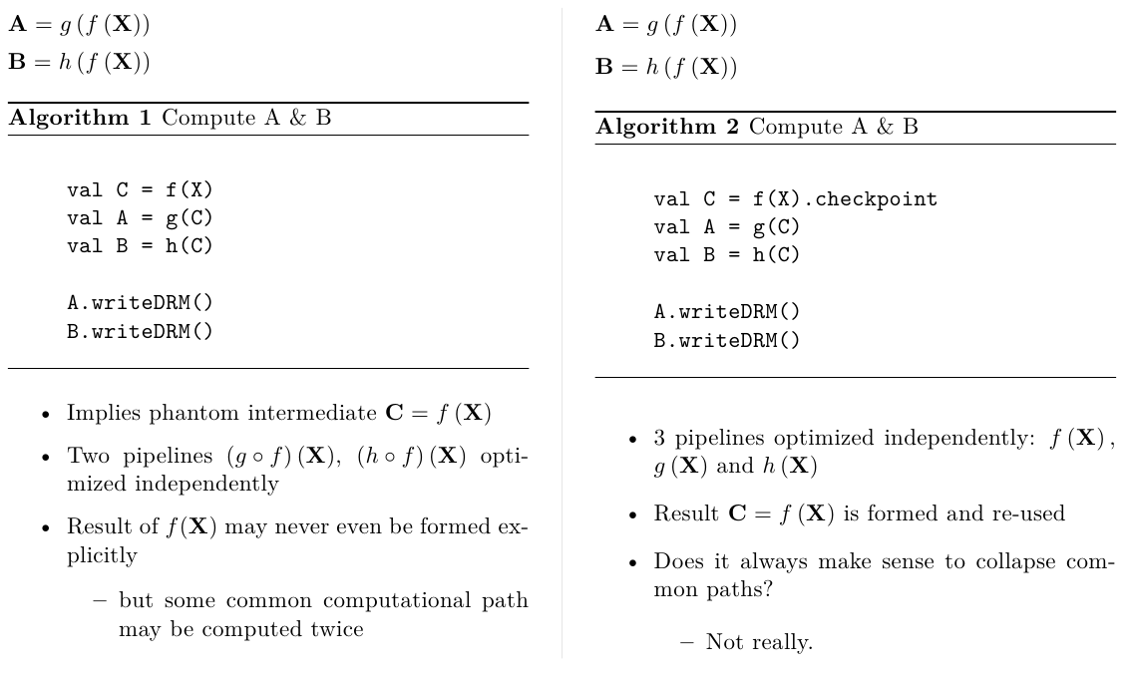
Common computational paths

Slide 12
Checkpoint caching (maps 1:1 to Spark)
Checkpoint caching is a combination of None | in-memory | disk | serialized | replicated options
Method “checkpoint()” signature:
def checkpoint(sLevel: StorageLevel = StorageLevel.MEMORY_ONLY): CheckpointedDrm[K]
Unpin data when no longer needed
drmA.uncache()

Slide 13
Optimization factors
Geometry (size) of operands
Orientation of operands
Whether identically partitioned
Whether computational paths are shared
E. g.: Matrix multiplication:
5 physical operators for drmA %*% drmB
2 operators for drmA %*% inCoreA
1 operator for drm A %*% x
1 operator for x %*% drmA

Slide 14
Component Stack
Algebraic DSL (“syntactic sugar”)
Logical translation layer (Optimizer)
In-core math
Physical translation layer
translation
Engine 1
Engine N …
???
Algebraic DSL
HDFS
In-core math

Slide 15
Customization: vertical block operator
Custom vertical block processing
must produce blocks of the same height
// A * 5.0
drmA.mapBlock() {
case (keys, block) =>
block *= 5.0
keys -> block
}

Slide 16
Customization: Externalizing RDDs
Externalizing raw RDD
Triggers optimizer checkpoint implicitly
val rawRdd:DrmRDD[K] = drmA.rdd
Wrapping raw RDD into a DRM
Stitching with data prep pipelines
Building complex distributed algorithm
val drmA = drmWrap(rdd = rddA [, … ])

Slide 17
Broadcasting an in-core matrix or vector
We cannot wrap in-core vector or matrix in a closure: they do not support Java serialization
Use broadcast api
Also may improve performance (e.g. set up Spark to broadcast via Torrent broadcast)
// Example: Subtract vector xi from each row:
val bcastXi = drmBroadcast(xi)
drmA.mapBlock() {
case(keys, block) =>
for (row <- block) row -= bcastXi
keys -> block
}

Slide 18
Guinea Pigs – actionable lines of code
Thin QR
Stochastic Singular Value Decomposition
Stochastic PCA (MAHOUT-817 re-flow)
Co-occurrence analysis recommender (aka RSJ)
Actionable lines of code (-blanks -comments -CLI)
 | Thin QR | (d)ssvd | (d)spca
R prototype | n/a | 28 | 38
In-core Scala bindings | n/a | 29 | 50
DRM Spark bindings | 17 | 32 | 68
Mahout/Java/MR | n/a | ~2581 | ~2581

Slide 19
dspca (tail)
… …
val c = s_q cross s_b
val inCoreBBt = (drmBt.t %*% drmBt)
.checkpoint(StorageLevel.NONE).collect -
c - c.t + (s_q cross s_q) * (xi dot xi)
val (inCoreUHat, d) = eigen(inCoreBBt)
val s = d.sqrt
val drmU = drmQ %*% inCoreUHat
val drmV = drmBt %*% (inCoreUHat %*%: diagv(1 /: s))
(drmU(::, 0 until k), drmV(::, 0 until k), s(0 until k))
}

Slide 20
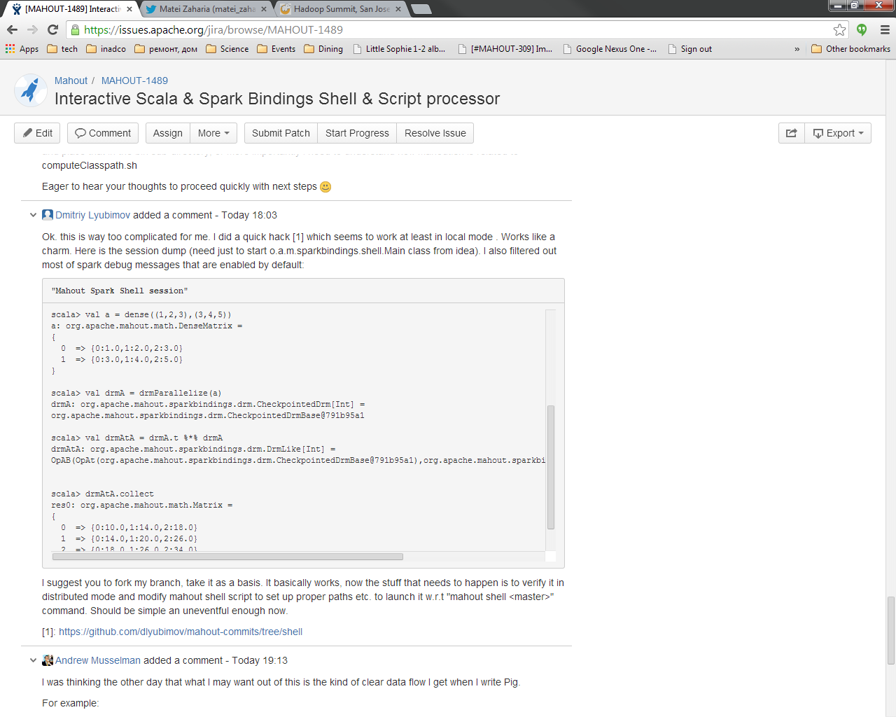
Interactive Shell & Scripting!

Slide 21
Pitfalls
Side-effects are not like in R
In-core: no copy-on-write semantics
Distributed: Cache policies without serialization may cause cached blocks experience side effects from subsequent actions
Use something like MEMORY_DISK_SER for cached parents of pipelines with side effects
Beware of naïve and verbatim translations of in-core methods

Slide 22
Recap: Key Concepts
High level Math, Algebraic and Data Frames logical semantic constructs
R-like (Matlab-like), easy to prototype, read, maintain, customize
Operator-centric: same operator semantics regardless of operand types
Strategical notion: Portability of logical semantic constructs
Write once, run anywhere
Cost-based & Rewriting Optimizer
Tactical notion: low cost POC, sensible in-memory computation performance
Spark
Strong programming language environment (Scala)
Scriptable & interactive shell (extra bonus)
Compatibility with the rest of Mahout solvers via DRM persistence

Slide 23
Similar work
Breeze:
Excellent math and linear algebra DSL
In-core only
MLLib
A collection of ML on Spark
tightly coupled to Spark
not an environment
MLI
Tightly coupled to Spark
SystemML
Advanced cost-based optimization
Tightly bound to a specific resource manager(?)
+ yet another language
Julia (closest conceptually)
+ yet another language
+ yet another backend

Slide 24
Wanted and WIP
Data Frames DSL API & physical layer(M-1490)
E.g. For standardizing feature vectorization in Mahout
E.g. For custom business rules scripting
“Bring Your Own Distributed Method” (BYODM) – build out ScalaBindings’ “write once – run everywhere” collection of things
Bindings for http://Stratosphere.eu
Automatic parallelism adjustments
Ability scale and balance problem to all available resources automatically
For more, see Spark Bindings home page

Slide 25
Links
Scala and Spark Bindings http://mahout.apache.org/users/sparkbindings/home.html
Stochastic Singular Value Decomposition http://mahout.apache.org/users/dim-reduction/ssvd.html
Blog http://weatheringthrutechdays.blogspot.com
Thank you.

