Slide 1

Introduction to MINA
Trustin Lee
trustin@apache.org
http://people.apache.org/~trustin/

Slide 2

Agenda
Overview
In-depth View
Implementation Demo
Future
Conclusion

Slide 3
Overview
A Multi-purpose Infrastructure for Network Applications

Slide 4
What is MINA?
Overview
Java network application framework
High productivity
  Easy-to-learn
  Elegant application design
High performance
  Asynchronous · Event-driven

Slide 5
Elegant Application Design
Overview
Unit test friendly
  You can test your application without a real client or server via mock objects.
Extensible
  Runtime modification of application behavior using ‘filters’
Maintainable and Reusable
  Separation of networking code (MINA), protocol codec, and business logic

Slide 6
Who Uses MINA?
Overview
The Apache Directory Project
QuickFIX – QuickFIXEngine.org
  Financial Information eXchange Protocol
RED5 Server – OSFlash.org
  Macromedia Flash Media RTMP
JStyx – JStyx.sf.net
  Styx, a file sharing NFS-like protocol
Proprietary SMS · MMS servers
LDAP Kerberos | DNS NTP

Slide 7
In-depth View
A Multi-purpose Infrastructure for Network Applications

Slide 8
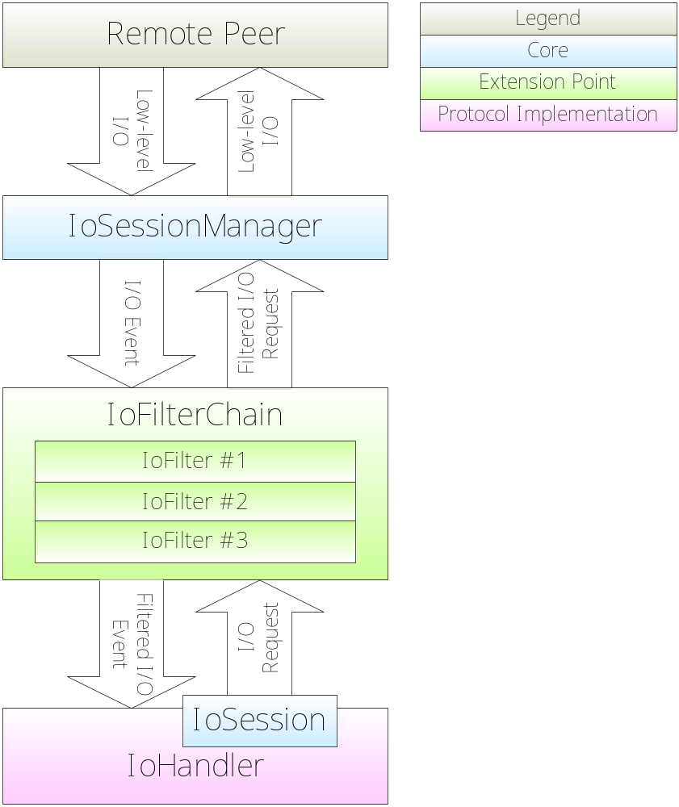
At a Glance
In-depth
IoSessionManager
  Where real I/O occurs
IoFilters
  Filters I/O events · requests
IoHandler
  <Your protocol logic>
IoSession
  Represents a connection
Notes:
IoSession:
A connection between an IoHandler and a remote peer
Provides ways to send an I/O request
Write a message
Close the current connection
State information
Idleness
Last I/O time
Transport layer parameters
Attributes: Protocol-specific data storage

Slide 9
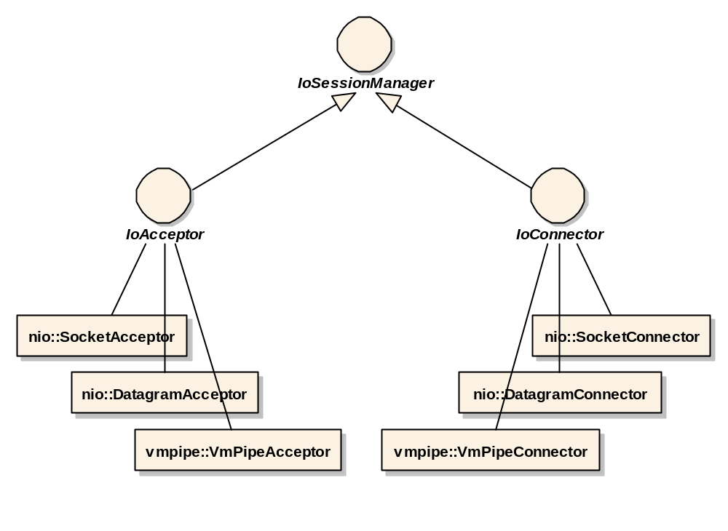
IoSessionManagers
In-depth
Server-side:
Accepts clients
Client-side:
Connects to a server
And their implementations

Slide 10
IoFilters
In-depth
An event & request interceptor
  Reusable
  Hot-deployable
SSL · TLS Thread pool SASL Performance profiler Lightweight firewall | Peer blacklist Logger Authorization Traffic shaper Overload detector

Slide 11
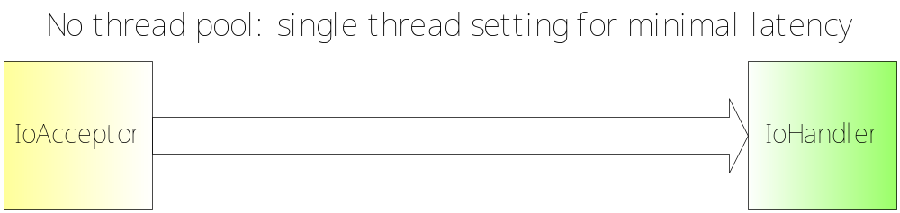
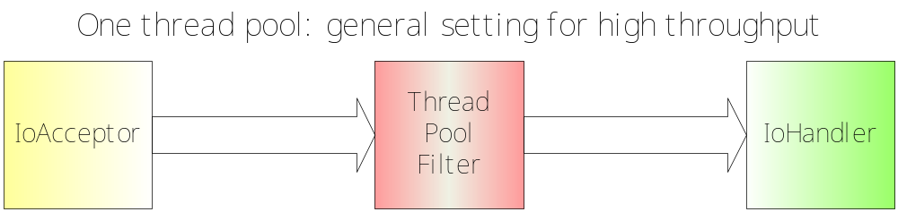
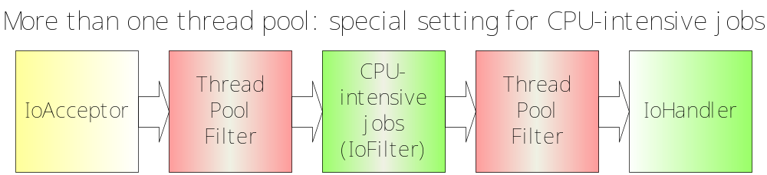
IoFilters: ThreadPoolFilter
In-depth

Slide 12
IoFilters: ProtocolCodecFilter
In-depth
Clear separation and reusability
Business logic – IoHandler
Protocol codec – ProtocolCodecFilter
Out-of-the-box
  Object serialization
  Text line

Slide 13
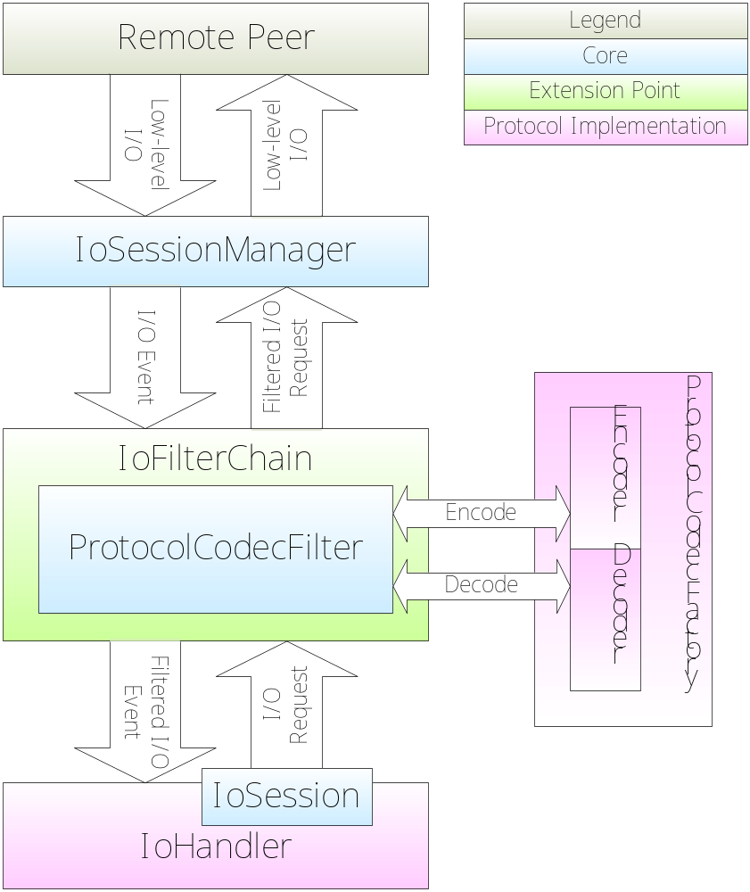
IoFilters: ProtocolCodecFilters (Cont’d)
In-depth
POJO → ByteBuffer
ByteBuffer → POJO
Business Logic Only!

Slide 14
In-VM Pipe
In-depth
I/O events are converted into
‘Direct Method Invocations’
No protocol codec
No network latency
Using the same API

Slide 15
Implementation Demo
A Multi-purpose Infrastructure for Network Applications

Slide 16
Reverse Echo Server
Demo
Echo server which reverses a line
Using a built-in text line protocol codec in MINA
Click here to start the demo.

Slide 17
Future
A Multi-purpose Infrastructure for Network Applications

Slide 18
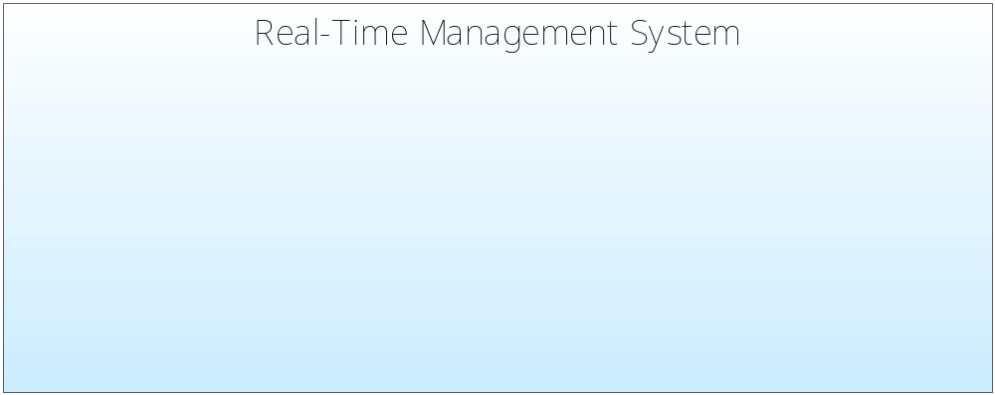
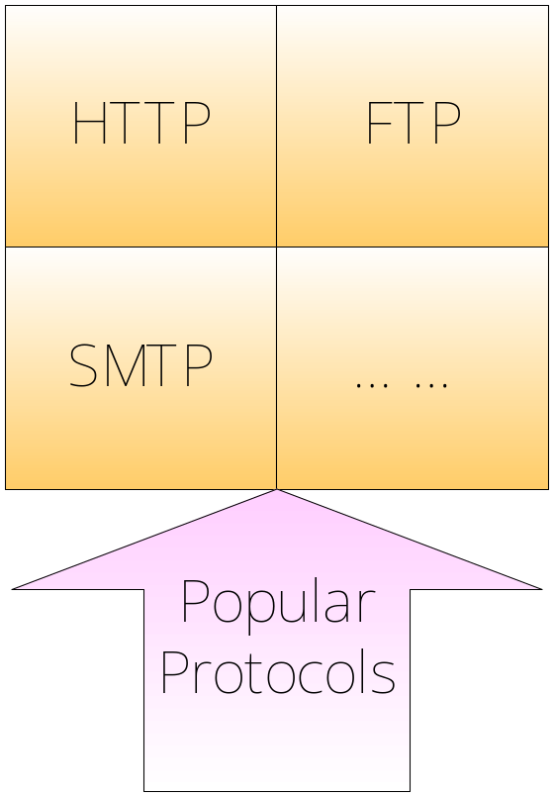
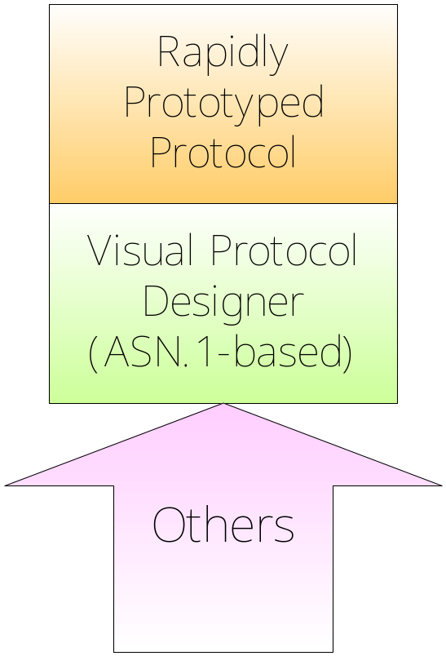
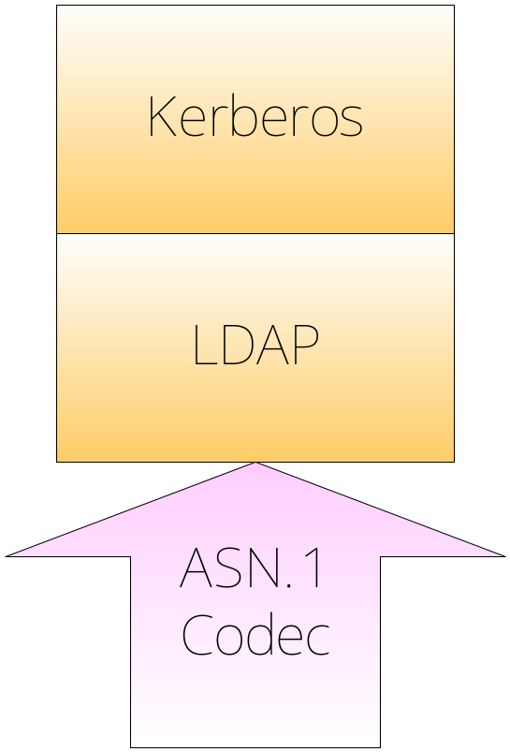
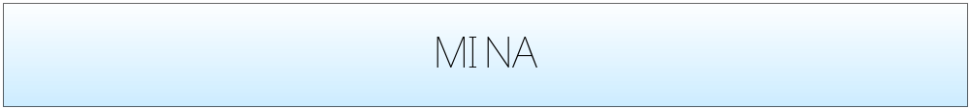
MINA as a Platform
Future
Integration with Apache ASN.1 for complex protocols
Users can build customized servers with ready-made protocol codecs.
Design custom protocols just like drawing a UML!

Slide 19
Real-Time Management System
Future
A universal management view
JMX console and Web browser
Real time access
  Server traffic
  IoFilter Hot-deploy
  Which client is sending what message now?
  Which message takes too long to process?
  And <what you want to monitor>

Slide 20
We Need Your Participation!
Future
Sounds exciting?
Please help MINA team!
  Try MINA
  Ask questions
  Criticize
  Report bugs
  Benchmark
  Contribute code
  Contribute a tutorial

Slide 21
Conclusion
A Multi-purpose Infrastructure for Network Applications

Slide 22
Conclusion
Conclusion
MINA is an extensible network application framework that helps you implement your network application elegantly without compromising productivity.
MINA will be a full-featured network application dev. & mgmt. platform if we get our efforts together.

Slide 23
Resources
Homepage
  http://directory.apache.org/subprojects/network/
  Tutorial
  More useful examples
Mailing List
  dev@directory.apache.org
  (Please use ‘[mina]’ prefix)

Slide 24
Thank You!
Q & A

