Slide 1

C. Mattmann¹, C. Goodale¹, J. Kim², D.E. Waliser^{1,2}, D. Crichton¹, A. Hart¹, P. Zimdars¹
and Peter Lean*
The International Workshop on CORDEX-East Asia, September 23, 2011, Jeju, Korea
¹: Jet Propulsion Laboratory/California Institute of Technology
²: Joint Institute for Regional Earth System Science and Engineering
*: Present affiliation: University of Reading, UK
Notes:
Not sure how to ORDER the Credits. This is just a re-tooled version of Jinwon’s lead in slide

Slide 2
Climate Science at JPL
NASA – Jet Propulsion Laboratory
  Federally Funded Research and Development Center
  Rockets and Rovers
Data Management Systems
  Planetary Data System
  Distributed Archives
  Scalable System Design
In 2008 JPL committed to Climate Change Research
  Designing Tools and Infrastructure
  Climate Data Exchange

Slide 3
What Problem are we Solving?
Improve Regional Climate Modeling
Develop a Rich Pool of Reference Data
  Catalog and Archive Datasets from different sources and bring them together in an accessible format
Provide Analysis Tools that can Expand
  Regridding, Bias Estimation, Daily and Monthly processing, RMSE, etc…
Notes:
We want to enable climate modeling scientists to focus more on the models and less on the tideous work of collecting and munging the data they collect.

Slide 4
JPL Regional Climate Model Evaluation System (RCMES)
March 2010 - JPL and UCLA started working on the RCMES
  Commitment to using Open Source Software
  Originally designed for California State Policy Makers
  Presented in September 2010 to California Leaders
December 2010 – JPL Climate Office Funds RCMES Directly
  Expanded the scope to a Global Scale
  Build a User Facing Toolkit
March 2011 – Presented the System to CORDEX Africa
  Collaborating with University of Cape Town
Notes:
Giving the background of the project and a simple timeline of events leading up to now.

Slide 5
Main Focus of RCMES Architecture
Efficient
  Fast access to the reference data
User friendly
  Intuitive GUI
Flexible
  Extractors for multiple data formats (netCDF, HDF, Grib, Ascii)
  Data storage solution can change to meet data scale (MySQL > MongoDB > Apache Hadoop)
  Easy to add new data and/or analysis tool
  Cloud-based architecture for storage and user interface is being explored.

Slide 6



user
choice
RCM data
URL
TRMM
Metadata
Extract OBS data
Extract RCM data
MODIS
Data Table
User’s own codes for analysis and VIS.
Data Table
Regridder
Put the OBS & RCM data on the same grid for comparison
AIRS
Extractor
MySQL
Data Table
Data extractor
(Fortran binary)
SWE
Data Table
Metrics Calculator
Calculate comparison metrics
Soil moisture
Data Table
Data extractor
(Fortran binary)
Data Table
Common Format,
Native grid,
Efficient architecture
Visualizer
Plot the metrics
ETC
Raw Data:
Various formats,
Resolutions,
Coverage
RCMED
(Regional Climate Model Evaluation Database)
A large scalable database to store data from variety of sources in a common format
RCMET
(Regional Climate Model Evaluation Tool)
A library of codes for extracting data from RCMED and model and for calculating evaluation metrics
Credit – Jinwon Kim
Notes:
I am throwing this one in for a sort of SHOCK and AWE factor. The really daring folks can come back to this slide and investigate it.
The standard RCMES diagram with some enhancements from Jinwon.

Slide 7






user
choice
RCM data
TRMM
Metadata
Extract OBS data
Extract RCM data
MODIS
Data Table
User’s own codes for analysis and VIS.
Data Table
Regridder
Put the OBS & RCM data on the same grid for comparison
AIRS
MySQL
Data Table
Data extractor
(Fortran binary)
SWE
Data Table
Metrics Calculator
Calculate comparison metrics
Soil moisture
Data Table
Data extractor
(Fortran binary)
Data Table
Common Format,
Native grid,
Efficient architecture
Visualizer
Plot the metrics
ETC
Raw Data:
Various formats,
Resolutions,
Coverage
RCMED
(Regional Climate Model Evaluation Database)
A large scalable database to store data from variety of sources in a common format
RCMET
(Regional Climate Model Evaluation Tool)
A library of codes for extracting data from RCMED and model and for calculating evaluation metrics
Notes:
Here is a high-level break down of the RCMES Architecture. I have masked the internal technologies for the moment to instead focus on the main building blocks that are actually technology independent.
Speak about the DIFFERENT formats that RCMED is able to ingest into it’s datastore
The break between RCMED and RCMET is linked by a REST interface (technology agnostic, but PHP at the moment)
RCMET is where computations are performed using data that have been pulled down from the RCMED. Here you can extend the RCMET to inlcude any number of features and you do not RISK any negative impact on the RCMED.

Slide 8














user
choice
RCM data
TRMM
Metadata
Extract OBS data
Extract RCM data
Data Table
User’s own codes for analysis and VIS.
MODIS
Regridder
Put the OBS & RCM data on the same grid for comparison
Data Table
AIRS
MySQL
Data Table
Data extractor
(Fortran binary)
SWE
Data Table
Metrics Calculator
Calculate comparison metrics
Soil moisture
Data Table
Data extractor
(Fortran binary)
Data Table
Common Format,
Native grid,
Efficient architecture
Visualizer
Plot the metrics
ETC
Raw Data:
Various formats,
Resolutions,
Coverage
RCMED
(Regional Climate Model Evaluation Database)
A large scalable database to store data from variety of sources in a common format
RCMET
(Regional Climate Model Evaluation Tool)
A library of codes for extracting data from RCMED and model and for calculating evaluation metrics
Notes:
This slide will accent the portions of code that have been built as lightweight connectors, glue code really, in order to support the known and unknown changes in the previous 3 components.

Slide 9
Apache OODT
Open Source
  Fosters and promotes collaboration
  Complete understanding of the software
Extensible
  Framework for Data Catalog and Archive
  Improvements and changes are possible
  Includes support for distributed reference and model data
Proven
  Has been developed at JPL for over 10 years
  Currently deployed to support Lunar Mapping, CO2 Research, Snow and Ice Research, Cancer Research, Planetary Data System
Notes:
13:23 – Practice on the Plane ride.
Mention in Extensible the support for distributed datasets, and how our plans to connect with the earth system grid is a prime example of this.

Slide 10
RESTful Interface
Uses Open Standards for the Internet
  Based on HTTP
  Any modern programming language can use it
Language Agnostic
  Currently ours is written in PHP
  Java, Python, Scala, Ruby, C++ …
Flexible
  Support Multiple response formats (XML, JSON, CSV)
  Enables the RCMET and RCMED to evolve separately
  Able to connect with other systems, not just RCMET

Slide 11
Next Steps
Improve the Metadata for each Dataset
Provide Summary Information via RESTful Interface
Collect quality control information of observations
The user interface and metrics library of RCMES will be updated with user inputs and collaborations.
Connect RCMES into the Earth System Grid
Load North American Climate Assessment Program (NARCCAP) into RCMED

Slide 12
Summary
Improve Climate Model Evaluations
Flexible Future Looking Architecture / Design
Analysis Tools and the Database can Evolve
JPL is committed to Climate Research
Notes:
Re-iterate the 3 main points of the talk.
JPL is committed to developing software and systems to improve climate research. We want to collaborate and share our knowledge with the world.
"JPL has made substantial progress in developing a rich computing infrastructure to enable model-to-data comparison as a service to the broader community to enable climate assessment"

Slide 13
Acknowledgements
APCC
  Dr. Jin-Ho Yoo
JPL
  Duane Waliser (Program Manager)
  Dan Critchon (Data Systems Program Manager)
  Jinwon Kim (Climatologist)
  Chris Mattmann (Development Lead and System Architect)
  Peter Lean (Climatologist and Python Developer)
  Andrew Hart (Developer and UI Designer)
  Paul Zimdars (System Administrator)
Notes:
Double check if anyone else from APCC needs to be included.

Slide 14
Contact Information
Cameron Goodale
  Email: Cameron.E.Goodale@jpl.nasa.gov
  Mailing List: RCMES@jpl.nasa.gov
  Twitter: @sigep311

Slide 15
Back Up Slides
RESTful
  Start with http://
  http://www.google.com
  http://www.google.co.kr
Search for ‘CORDEX’
  http://www.google.com/#sclient=psy-ab&hl=en&site=&source=hp&q=CORDEX&pbx=1&oq=CORDEX&aq=f&aqi=g…..

Slide 16
Back Up Slides
RESTful (RCMES - Example)
  List all Datasets
  http://rcmes.jpl.nasa.gov/rest/datasets
    Name: CRU_TS_3.0, Id: 3
    Name: TRMM_v6 , Id: 6
  Metadata about Dataset ‘6’
  http://rcmes.jpl.nasa.gov/rest/metadata/dataset_id=6

Slide 17
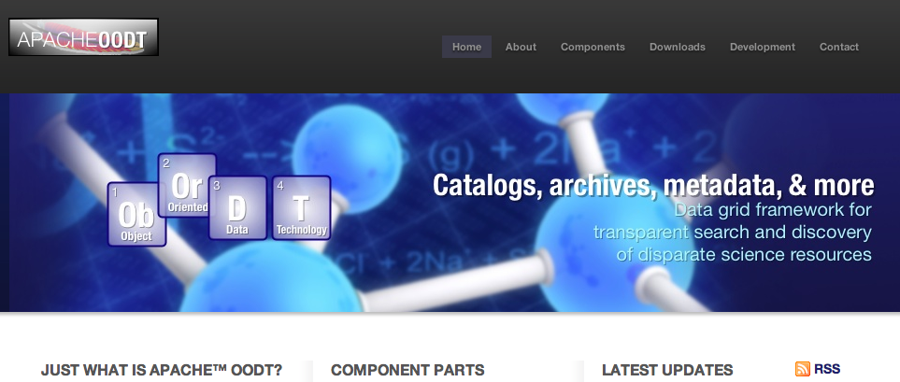
Back Up Slides
Apache OODT
  http://oodt.apache.org

