Slide 1
ARRA Project Modeling Component
Regional Climate Model Evaluation System (RCMES)
Designed for Research and Decision Support Related to
Climate Change
Water Resources
Air Quality
Mission Development
Peter Lean¹, Jinwon Kim^{1,3}, Duane Waliser^{1,3}, Alex Hall^{2,3},
Daniel Crichton¹, Chris Mattmann¹, Cameron Goodale¹, Andrew Hart¹, Paul Zimdars¹
JPL (1), UCLA (2), Joint Institute For Regional Earth ^{System Science &} ^{Engineering (3)}

Slide 2
ARRA Modeling: Development of RCMES
Overarching Goals
IPCC AR5 has a new emphasis on decadal predictions:
  downscaling provides regional details needed for near-term decision support
Model evaluation is crucial to understand strengths and weaknesses of individual models
JPL/UCLA are collaborating to develop an observation-based regional model evaluation framework for quantifying biases in regional climate model simulations.
Aim: To facilitate the use of remote sensing data by modeling, climate, and climate change impact assessment community.

Slide 3
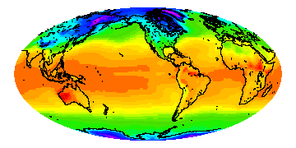
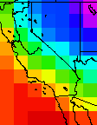
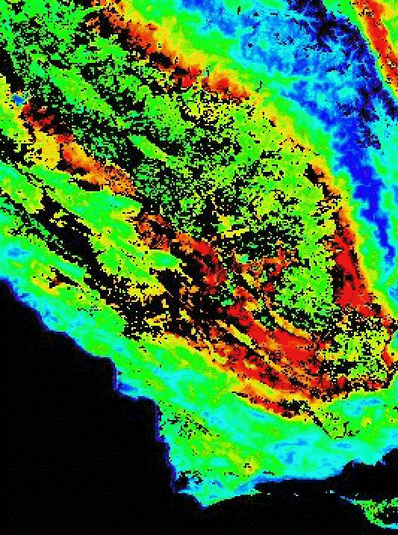
ARRA Modeling
Regional Climate Modeling
Regional-scale climate data are crucial for understanding regional climate characteristics and assessing the impacts of anthropogenic and natural climate variations, especially in the presence of anthropogenic climate change induced by the increase in greenhouse gas concentration.
Seasonal-to-interannual hydroclimate forecasting provides valuable information for water resource needs in the western US and for the preparation for weather-related natural disasters (flooding, wildfire, drought).
Spatial downscaling is a key process for generating regional-scale climate data because GCM data are not, in general, directly applicable to assessment models due to the lack of spatial resolution
GCM: Global, O[100km]
RCM: Regional, O[10km]
RCM: Local, O[1km]
Spatial downscaling of GCM data is usually performed using a regional climate model or statistical models.

Slide 4
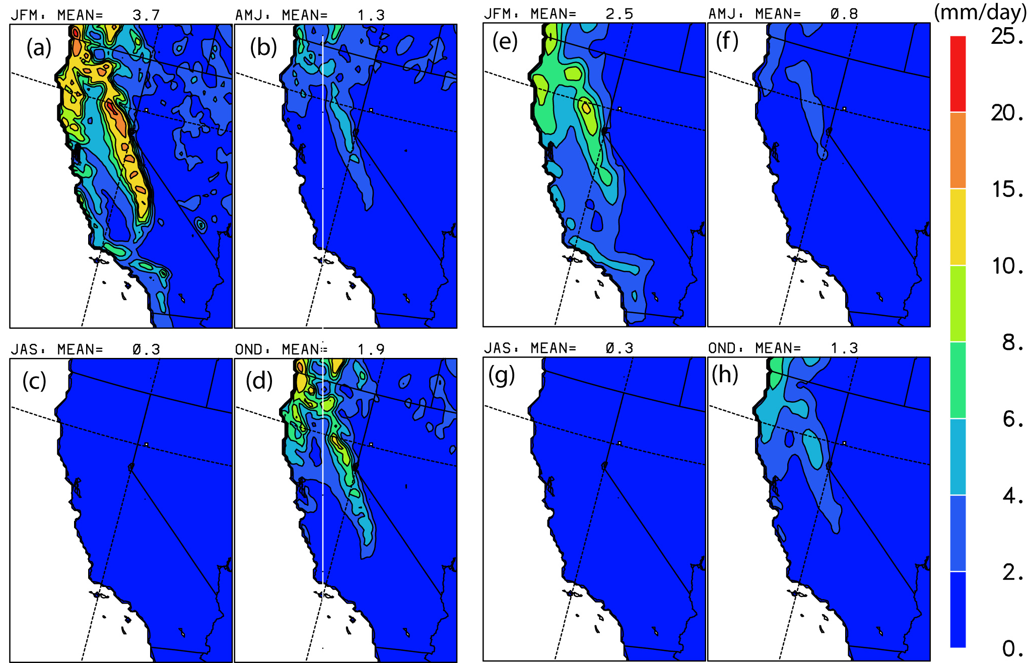
Model Biases
ALL model results contain biases (e.g., Seasonal precipitation from a 10-year hindcast and URD)
winter
spring
winter
spring
summer
fall
summer
fall
WRF
URD
Model biases are closely related with uncertainties in assessing impacts
  Assessment of model biases is the fundamental step for assessing uncertainties in the impact assessment model results (the law of “garbage in – garbage out”).
  Reliable estimates of the model biases are the key for deriving the bias correction factors in preparing forcing data to drive impact assessment models.
Access to a wide range of observational data is needed for model evaluation
  It is often difficult and time consuming to find/collect/process observational data.

Slide 5
Regional Climate Model Evaluation System overview
User friendly:
  No need for users to download large datasets
  No need for users to “re-invent the wheel” coding standard metrics
Flexible:
  Designed to be relatively easy to add new datasets to the database (extractors written for common formats: netCDF, GRIB, comma-separated ASCII)
  Front-end written in Python to take advantage of wide range of existing modules and Fortran bindings.
Expandable:
  Database expands over time as researchers add new datasets for their own evaluation studies
  Statistical processing library expands over time as researchers add new metrics
Notes:
04/20/10

Slide 6

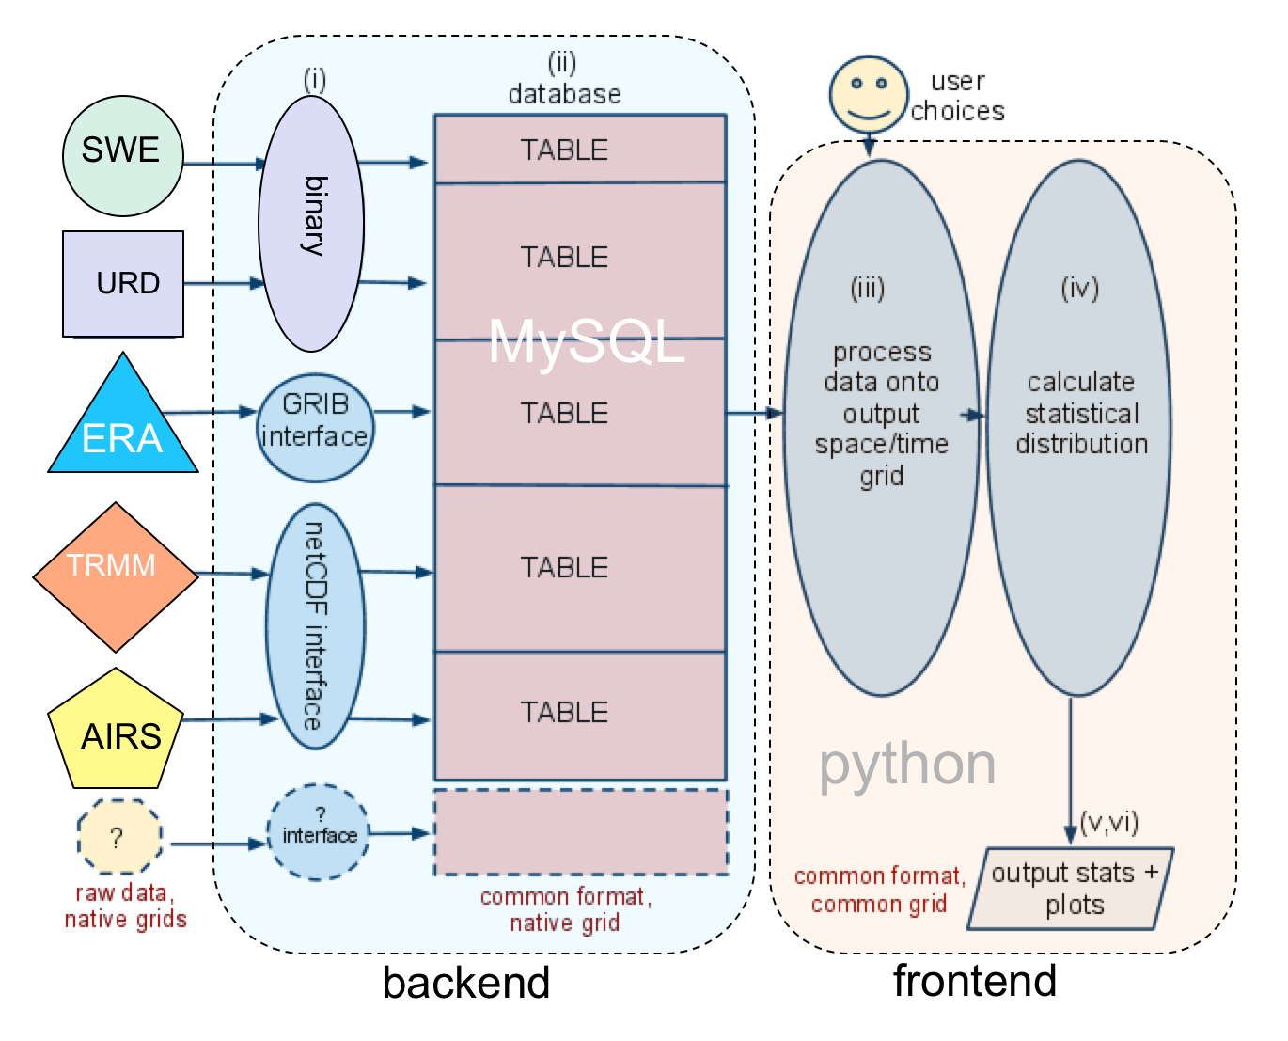

RCMES (Regional Climate Model Evaluation System)
High level technical architecture
RCMED
(Regional Climate Model Evaluation Database)
RCMET
(Regional Climate Model Evaluation Tool)
RCMED:
A large database to store satellite, reanalysis and gridded surface data in a common format
RCMET:
A library of data processing, statistical metric and plotting routines to perform evaluation studies utilizing the database.
URL

Slide 7
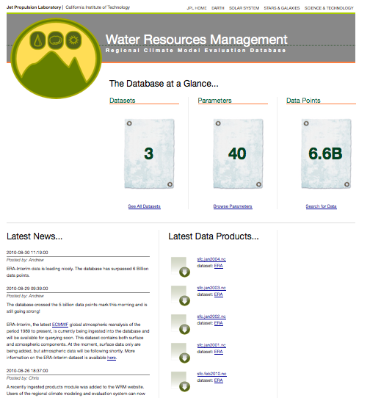
Web-Based Access
The WRM RCMED Data Portal:
- Database Statistics
- Project information
- Advanced search options
- Data product download
- Query API for 3rd Party Scripts

Slide 8
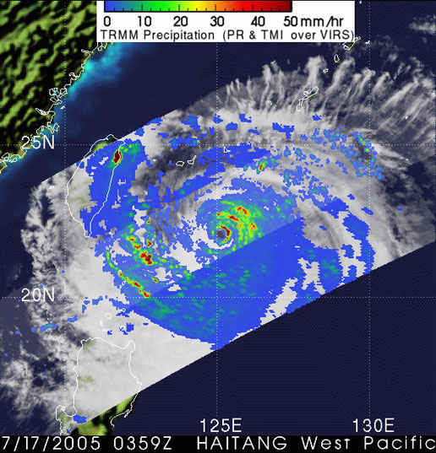

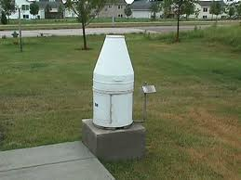
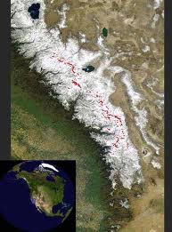
Prototype system:
Datasets that have been included so far:
TRMM (satellite precipitation): [1998_x0013_– 2010]‏
AIRS (satellite atmospheric surface + profile retrievals) [2002 – 2010]
ERA-Interim (reanalysis): [1989 – 2010]
NCEP Unified Rain gauge Database (gridded precipitation):
[1948 – 2010]
Snow Water Equivalent (Noah Molotch): [2000-2009]‏
Statistical Metrics included:
Bias, RMS error, Anomaly Correlation, Pattern Correlation
Notes:
04/20/10

Slide 9
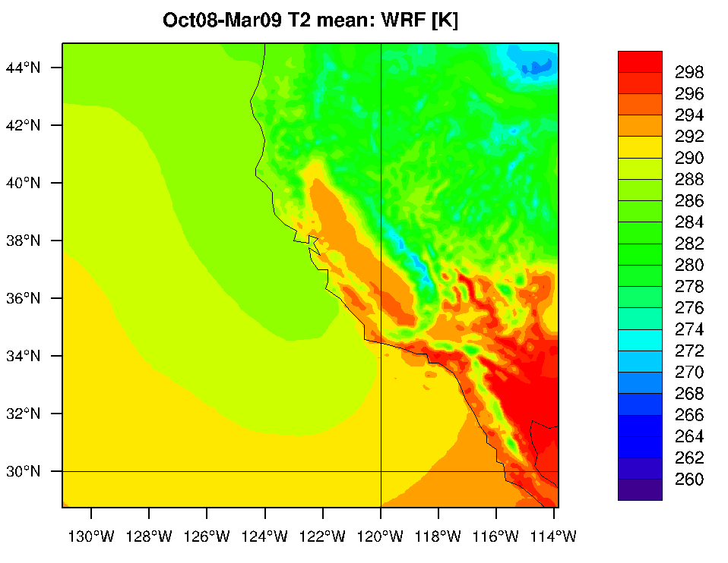
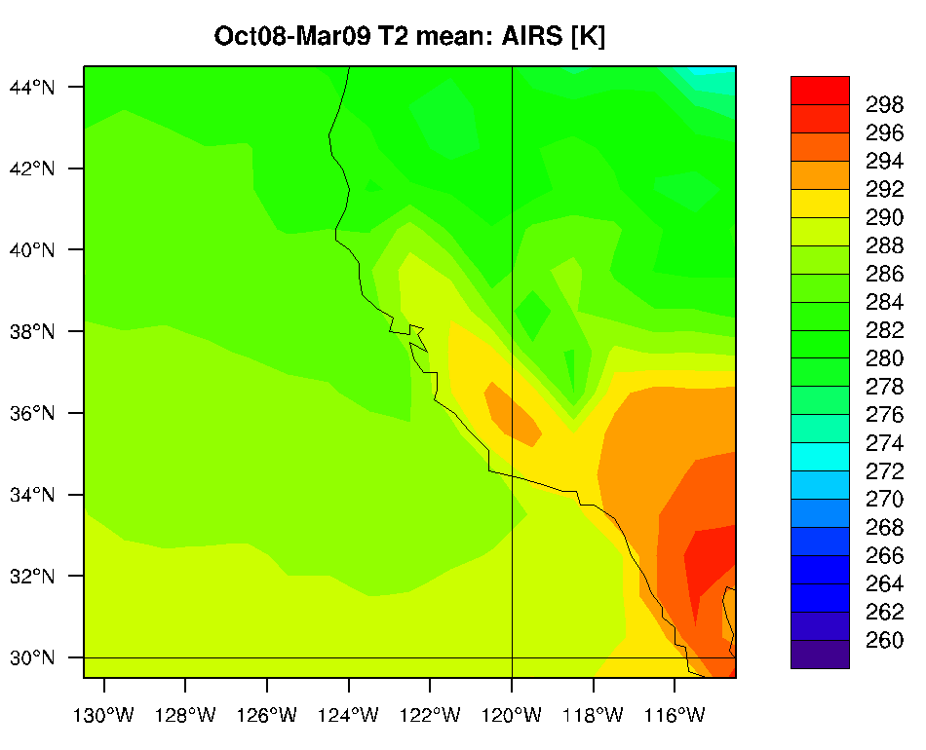
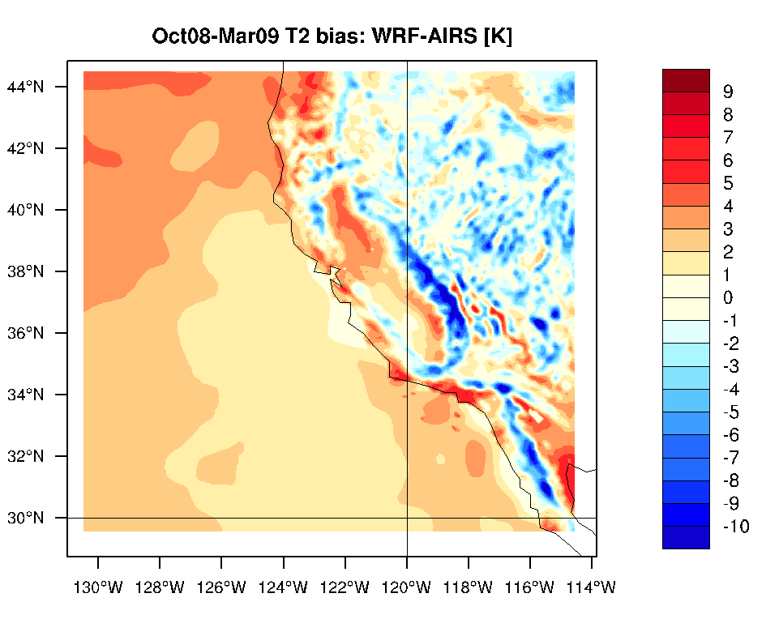
Comparing model 2m temp against AIRS
WRF model (00UTC only)
AIRS (ascending passes)
Bias
NB. AIRS Ascending passes shown = 1:30pm local time.
Nearest WRF output times used for comparison.
WRF model cold-season simulation Oct 08 – Mar 09 driven using NCEP final analysis boundary data.
Notes:
04/20/10

Slide 10
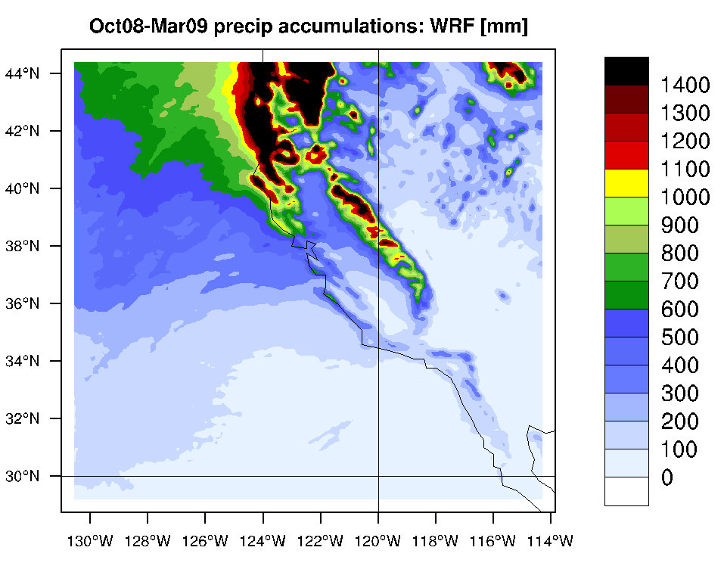
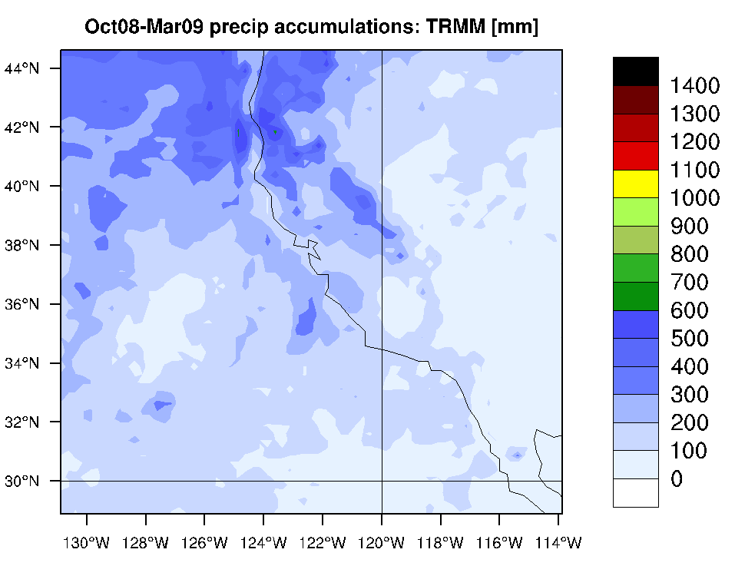
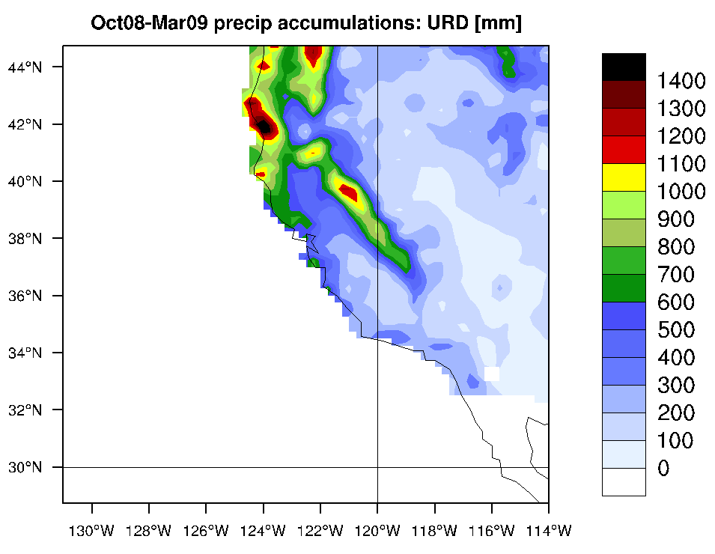
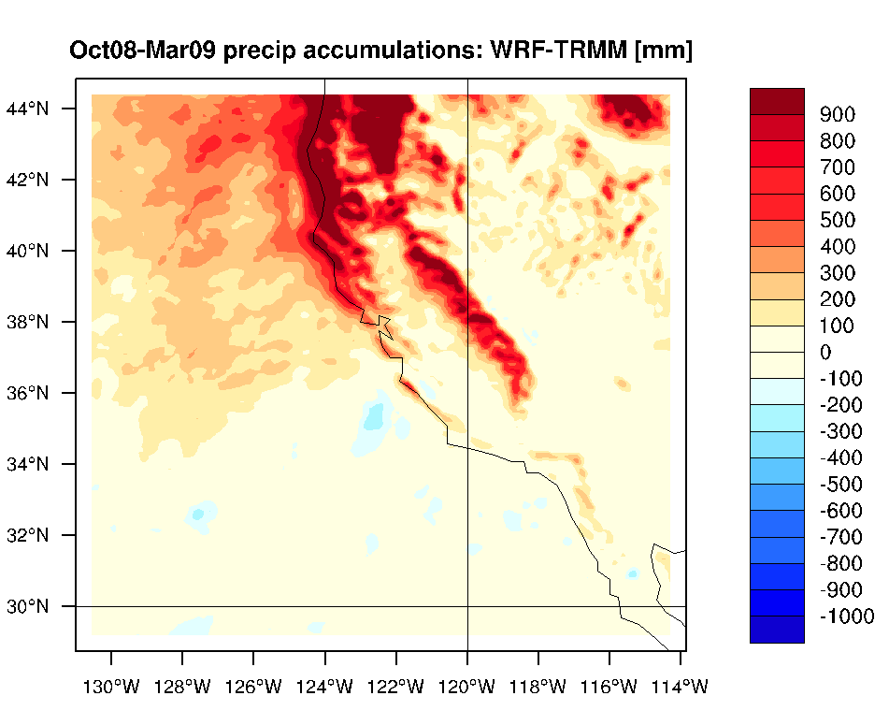
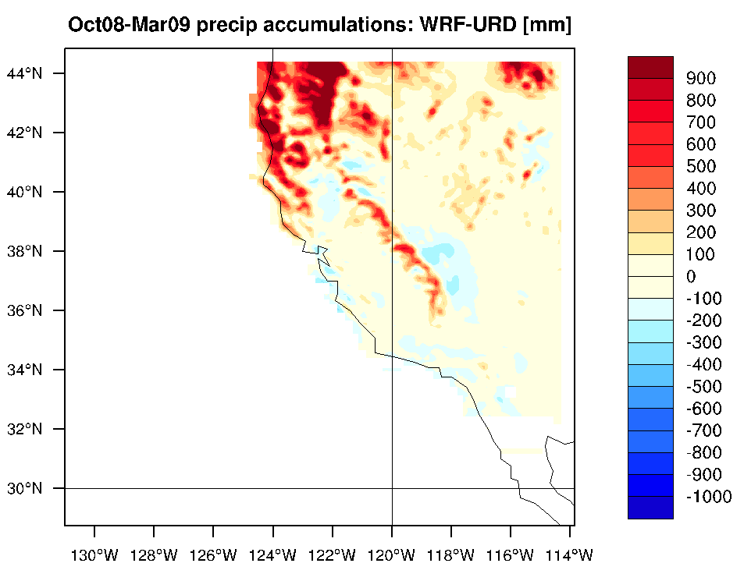
Comparison of WRF precipitation with TRMM & URD
WRF model
TRMM observations
URD gridded rain gauge obs
Biases
Against TRMM
Against URD
Notes:
04/20/10

Slide 11
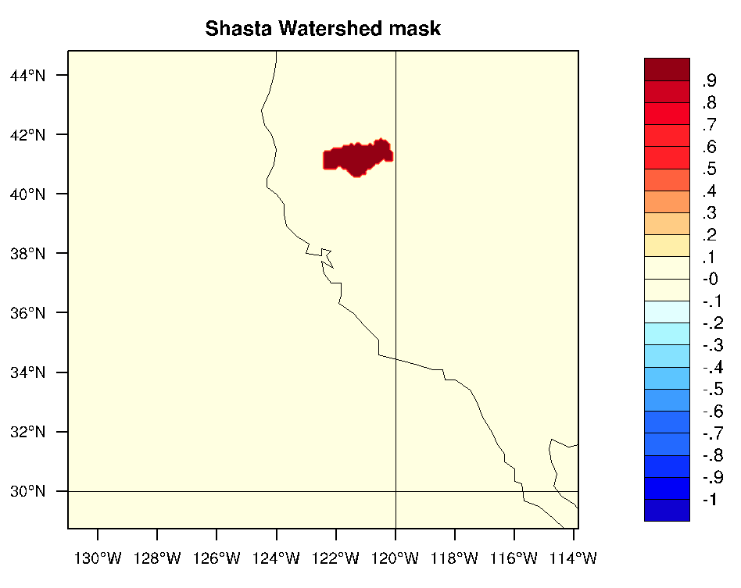
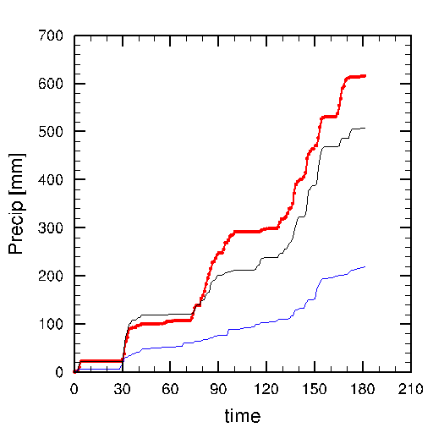
Area-average precipitation within watershed
User specified mask
WRF
URD
TRMM
NB. TRMM resolution = 0.25° x 0.25°
URD resolution = 0.25° x 0.25°
WRF resolution = 0.12° x 0.12°
(days)
Notes:
04/20/10

Slide 12
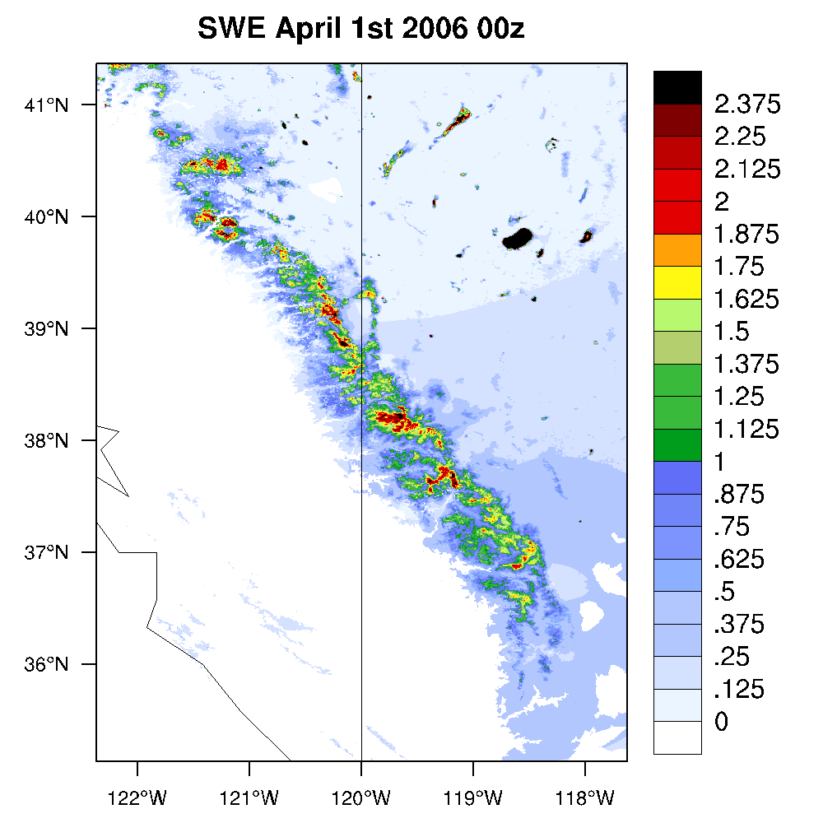
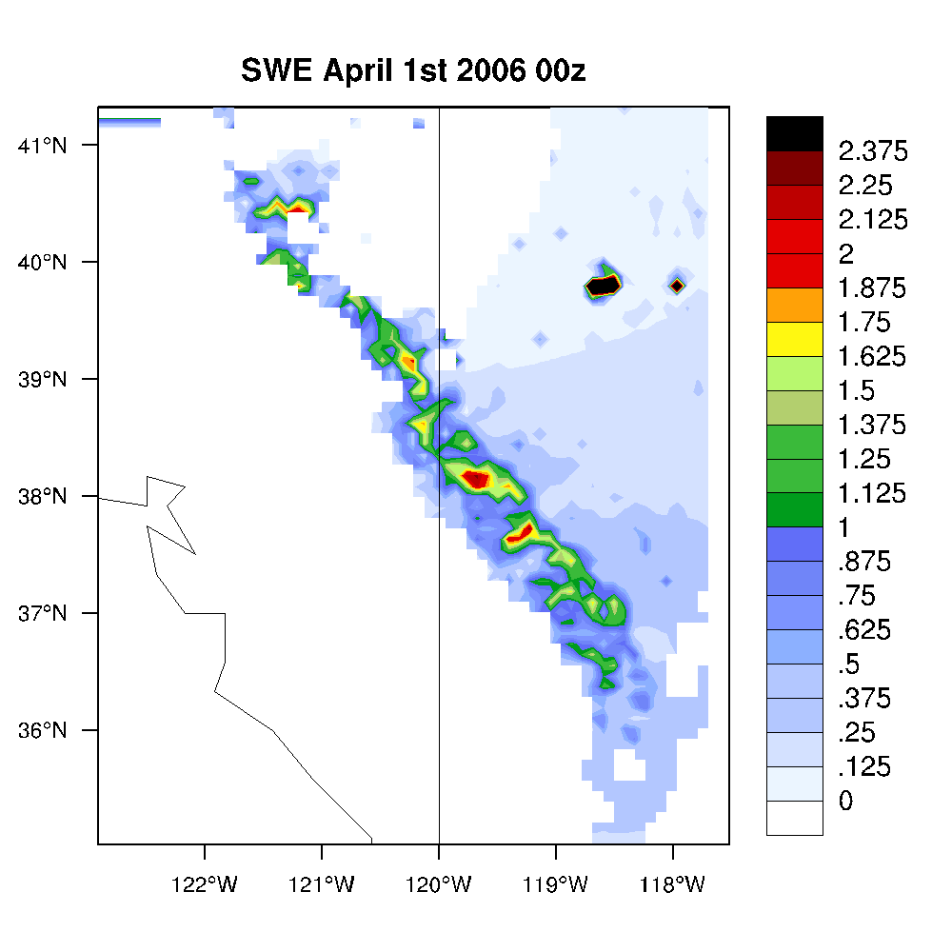
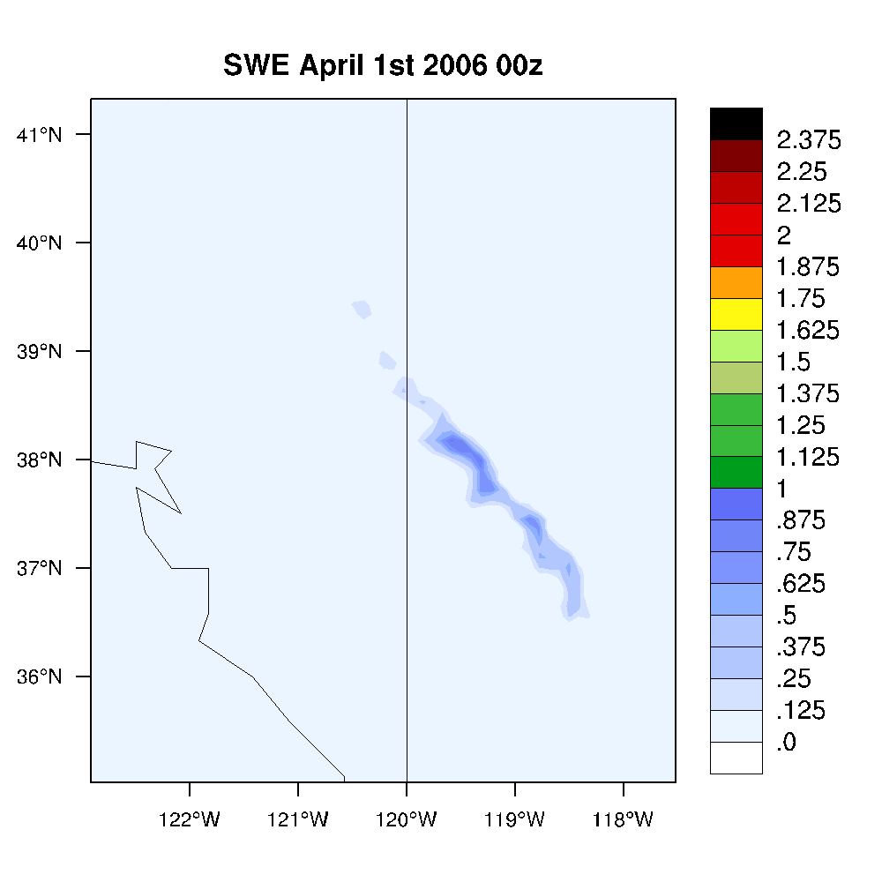
Snow Water Equivalent
(Moltoch, Gaun, Lestak)_x0013_
[m]
Assimilated SWE data
Re-gridded to model grid
Model output
Notes:
04/20/10

Slide 13
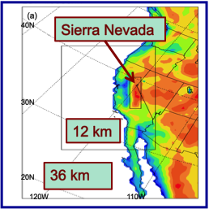
Next steps
Use RCMES to evaluate a 10-year hindcast over California (Alex Hall)
  1981-1990: WRF coupled with ROM
Notes:
04/20/10

Slide 14
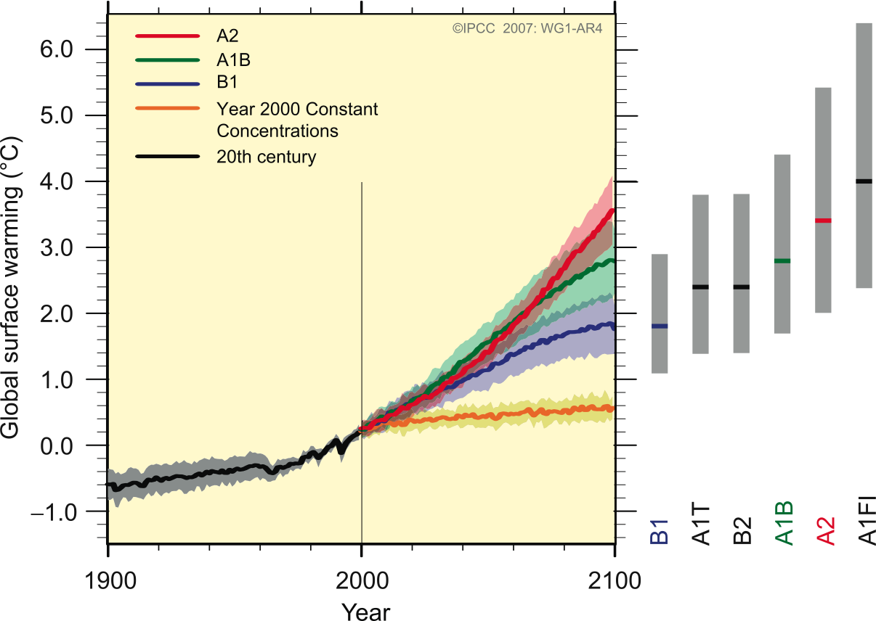
Future applications for IPCC AR5
IPCC AR5 downscaling assessment
  30-year predictions:
    ~20 models, each with ~5 ensemble members
    Regional Climate Models used to downscale these to provide California regional predictions
      e.g. to better represent severe storms, Sierra Nevada snowpack, heat wave occurrence etc
  Use evaluation system to quickly assess strengths and weaknesses of each model
    Vastly reduced time to process large number of simulations.
frequency
2000
2030
Temperature
Illustrative Probability Distribution Function from ensemble of model projections
Notes:
04/20/10

Slide 15
ARRA Modeling: Development of RCMES
Conclusions
Evaluation of regional climate model performance against satellite, reanalysis and surface observations is essential to understand the strengths and weaknesses for variables of interest to specific end-user groups.
JPL/UCLA has developed a prototype model evaluation framework (RCMES) comprising a large database of observational data (RCMED) and a front-end evaluation tool to access and use the data for model evaluation purposes (RCMET).
The system makes it easy for researchers to quickly compare model results against multiple observation datasets.
This system could play a useful role in future IPCC regional climate downscaling studies
We need feedback from you to help make this system as relevant and useful as possible.

Slide 16
Thanks for listening!

Slide 17
Discussion Points
What datasets are already used for model evaluation by the hydrological community?
Specifically, what aspects of regional climate projections are of interest to water resource managers?
How significantly do forcing data errors impact on water resources projections?
What useful features could be added to the evaluation system?
How should issues of observation representativeness / quality control be addressed?

Slide 18
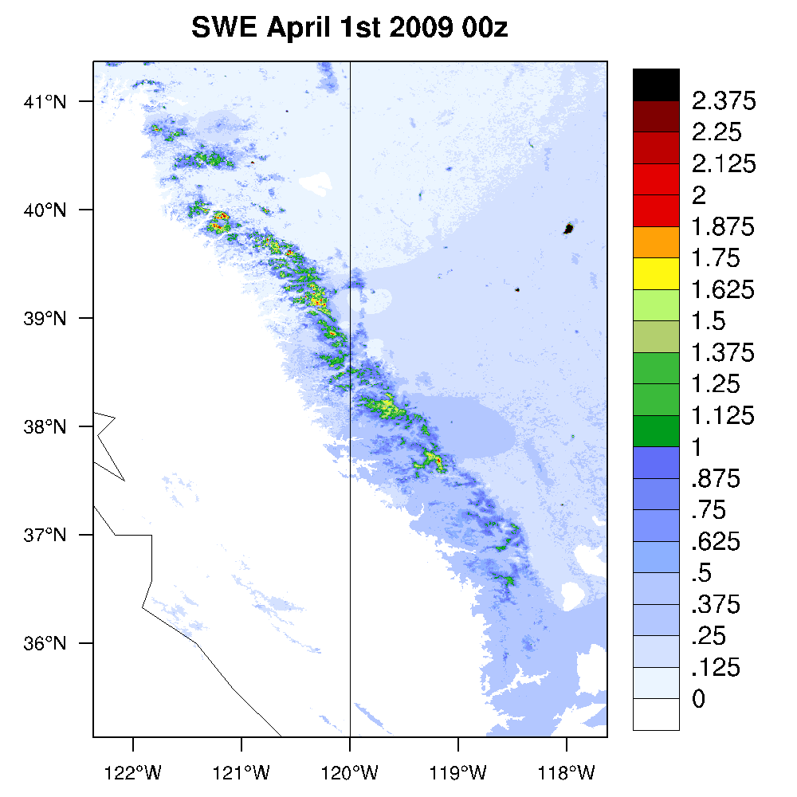
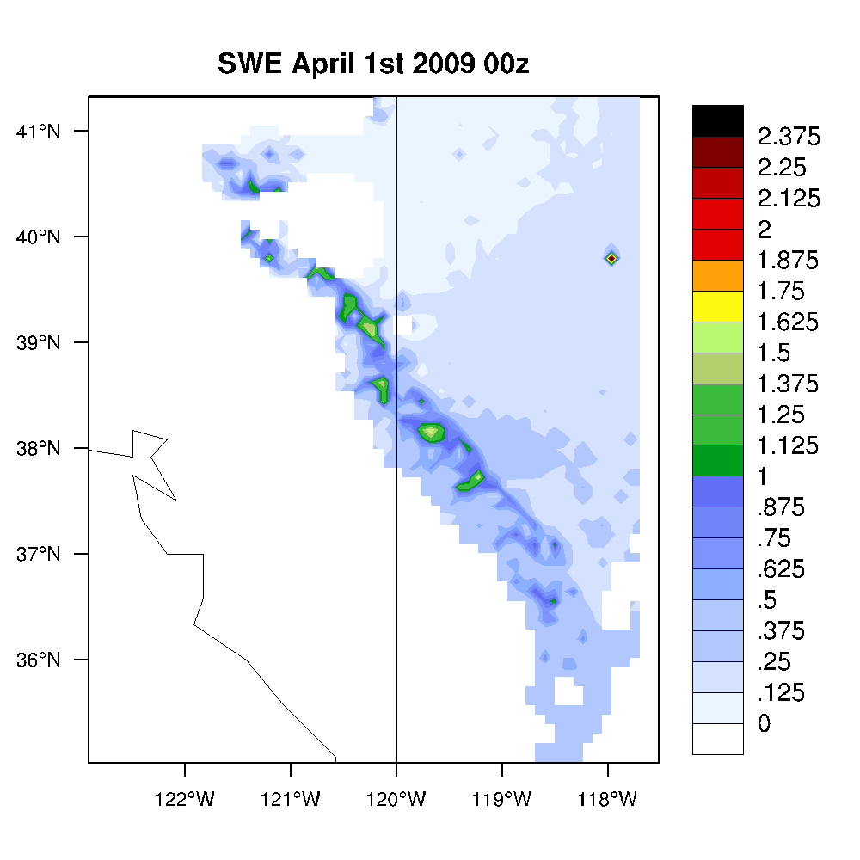

Snow Water Equivalent (Moltoch, Gaun, Lestak)_x0013_
Re-gridded to model grid
Model output
SWE product
Notes:
04/20/10

Slide 19
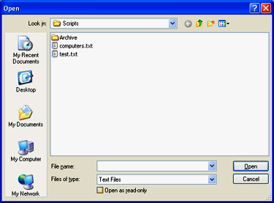
User experience mock-up*:
Select Observation Dataset:_x0016_
Select model data source:
TRMM
AIRS level III gridded
ERA-Interim
URD
SWE
Select Variable:
Surface temperature
Precipitation
Outgoing LW rad (TOA)
Cloud fraction (surface)
10m wind speed
Next >
* GUI not currently implemented

Slide 20
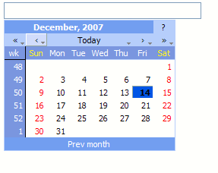
User experience mock-up*:
Select Date Range:_x0016_
Select output grid:
Use observational grid
Use model grid
Other regular grid (specify)
Select output plots:
Map
Time series
Select granule size:
Select statistical metrics:
Seasonal
Monthly
Pentad
Daily
Annual
Decadal
Mean error
RMS error
Mean absolute error
Anomaly correlation
PDF similarity score
Coefficient of efficiency
Pattern Correlation
Process
* GUI not currently implemented

