Slide 1
RedOffice/OpenOffice
In China
Hu Caiyong
CEO
RedFlag Chinese 2000 Soft. Ltd. Co.
http//www.ch2000.com.cn

Slide 2
OUTLINE
I. Company History
II. Government Support
III. Market Position
IV. RedOffice Highlights
V. RedOffice’s Vision
VI.Our expectations

Slide 3
I. Company History
Redflag Chinese 2000 Software Co., Ltd. was founded in December 2000 with registered capital of RMB10 million Yuan. The company is an affiliated high-tech software enterprise of Chinese Academy of Science (CAS), focusing on cross-platform software products development.
The core technical team members of the company come from Software Institute of CAS, mastering the core technology of Chinese language processing. The technical team has also undertaken and participated into many national and local goverment R&D projects and assignments. With over 200 staffs, the company has a R&D team of more than 160 technicians.

Slide 4
I. Company History
RedOffice is the first cross-platform office suite which based on OpenOffice in China. With persistent efforts, RedOffice in the past six years has become an must-have of many Chinese local governments and many enterprises. The company has successfully developed a complete system of products development, training, technical support and after-sale services.
The key reason we research office suite based on OpenOffice is :We consider that ONLY OpenOffice can compete with MS Office in the world.

Slide 5
I. Company History
In Dec. 2001, RedOffice v1.0 defeated against MS Office and won the ever first government bid for genuine software – Beijing government’s procurement for software.
From 2004, Chinese governments at all levels have launched the campaign to purchase genuine software. RedOffice has made achievements in the campaign by repeatedly breaking Microsoft monopoly. Now, RedOffice has the biggest market share among Chinese software companies.
By March 2006, RedOffice has been widely used by near 100 local governments, e.g. Beijing, Guangdong and etc.

Slide 6
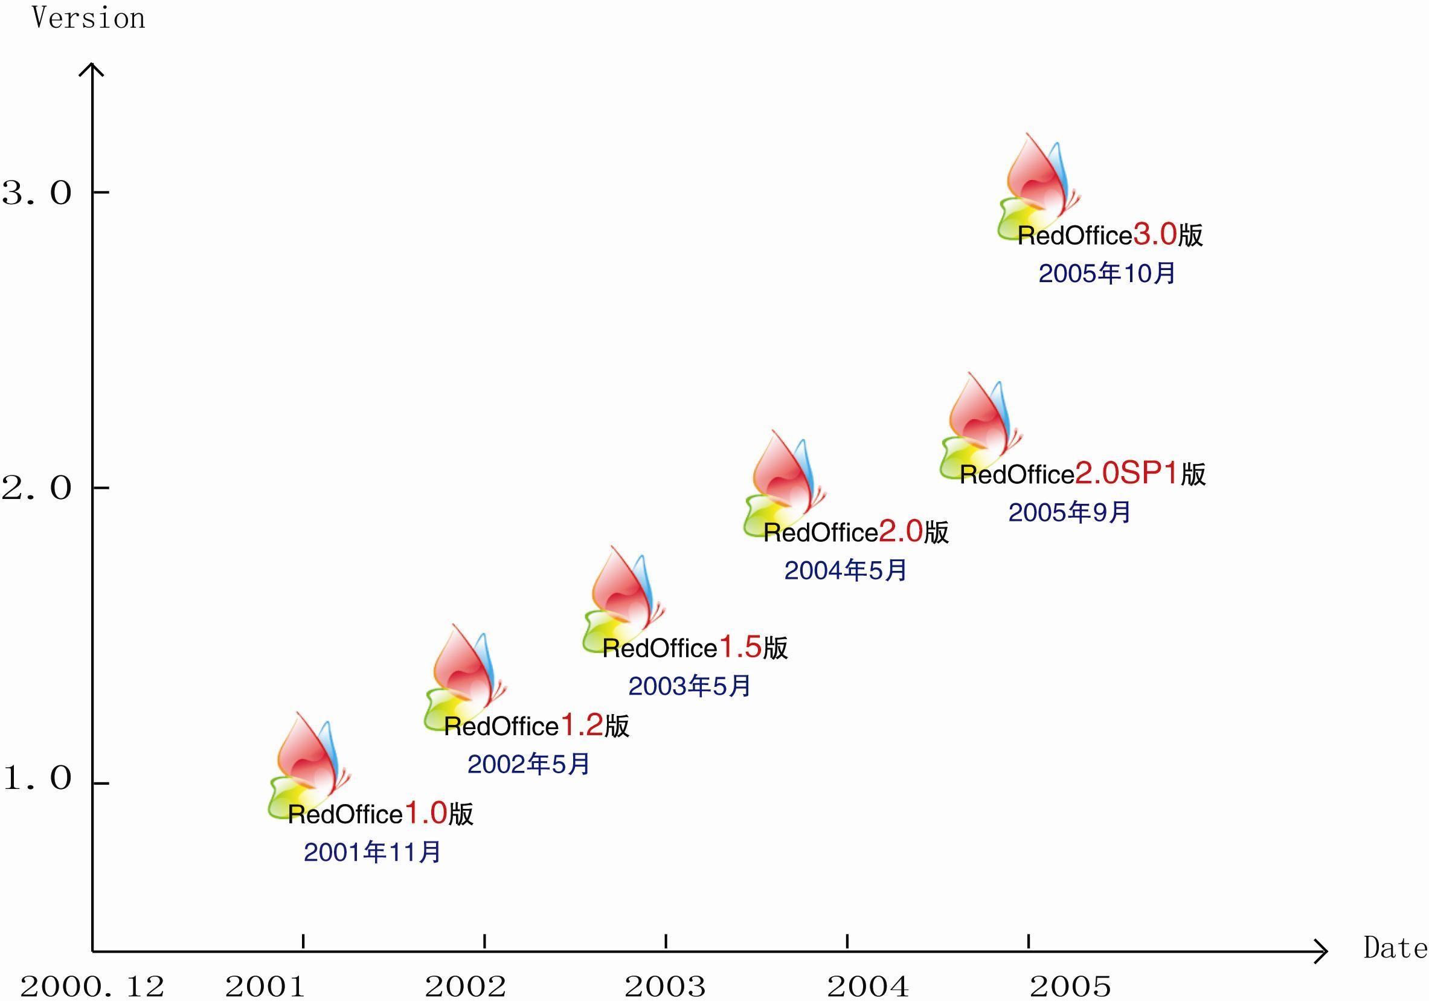
October 2005
September 2005
May 2004
May 2003
May 2002
November 2001

Slide 7
II. Government Support
National Policies
Notice on Issues of Pre-installed Genuine Computer Operating System and Software
Letter of Proposal to Enterprises to Use Genuine Software
The People’s Republic of China Government Procurement Law
Notice on Government’s Leadership in Using Genuine Software

Slide 8
II. Government Support
National and Local Projects
National 863 Project – Research and development of cross-platform Uigur and Mongolian language office suite
Ministry of Information Industry, China - Research and development of cross-platform Tibetan language office suite
National 863 Project – Standards of Chinese Linux and Office Software (in cooperation). The company is one of the core members of the standard development team.
Participated as core team member into Guideline on Application of Electronic Official Documents Exchange of Beijing.
Participated as a member of the Technical Committee into the establishment of Linux Application Software Standard of Guangdong Province.

Slide 9
II. Government Support
National and Local Projects
“Sail Setting, Sail Making” Project, Beijing Science and Technology Commission
Integration of Office Suite and Internet Browser, Beijing Science and Technology Commission
Research and Development of NC-Based Browser, Beijing Science and Technology Commission
RedOffice collaboration Office Terminal, Beijing Science and Technology Commission
Performance Optimization and Compatibility Strengthening of Office Suite, in Sail Setting of 2004, Beijing Science and Technology Commission
Software Key Project of National 863 Project – Development and Application of RedOffice Office Suite

Slide 10
II. Government Support
Qualification and Honor
In 2004, gained the highest-class award of "Beijing Technical and Scientific Improvement Prize"
Passed top certification by national authoritative GB18030.
Passed evaluation organized by Ministry of Science and Technology, and gained support by being entitled only special key project of Open-source office software sub-branch of National 863 Project.
In August 2002, honoured by Beijing Economic Development Zone Grand Contribution Award.

Slide 11
II. Government Support
For successive three years, honoured Excellent Software of the Year. In December 2004, honoured Excellent Software Product of China (only office suite honoured).
On May 18, 2005, RedOffice Office Suite was listed into projects of 2005 National Torch Plan, and Project Number was 2005EB010020.
In 2005, recognised jointly by four ministries and commissions of China as national key new product.
In 2006, honoured one of Top 10 Independent Innovation Software.

Slide 12

State Key High-Tech Product

Slide 13

State Torch Project

Slide 15
III. Market Position
More than 1,000 government organizations and enterprises have adopted RedOffice.
By now in 2006, won 100 bids in provincial, city and country government procurement.
Forecasted 35% growth rate again.

Slide 16
III. Market Position
Market Potential
In 2006, New computers sales volume – 18 million.
Demand for genuine office suite by new computers and old computers will be over 5 million sets.
As office suite is a higher-price product, the market will reach at least multi billions Yuan.

Slide 17
Some Clients of RedOffice
Successful bids in government procurement in 2006 and after
Successful multi-year bids in government procurement
Some corporate clients
Successful cases of embedded e-government solution
黄石市政府
延边州政府
牡丹江市政府
江西省赣州市
陕西省西安市
黑龙江省大庆市
山西省晋中市
广东省江门市
福建省莆田市
河南省商丘市
湖南省衡阳市
山西省临汾市
山东省济宁市
河南省鹤壁市
山西省大同市
河北省保定市
河南省安阳市
陕西省西安市
等其他省市……
国家部委
北京市政府
北京市科委
济南市政府
郑州市政府
长沙市政府
黑龙江省政府
贵州省政府
湖北省政府
福建省政府
深圳市政府
甘肃省政府
广州市政府
山西省政府
成都市政府
东莞市政府
佳木斯市政府
哈尔滨市政府
等其他……
国务院机关事务管理局
北京钢铁设计研究院
中国数字图书馆
富士高集团
雅戈尔集团
升冈国际集团
上海东吉集团
惠聪资讯集团
江西省电力公司
中国路桥集团
桂林三金药业
金山电子（深圳）
南方基金管理公司
中名（东莞）电子
深圳华软泰科德
马鞍山钢铁设计院
鞍山焦耐总院
等其他……
RedOffice与北京市纪委监察局电子政务系统的集成案例
RedOffice与北京市科委MIS/OA系统集成案例
RedOffice与北京市知识产权局电子政务系统的集成案例
RedOffice与北京市安全生产局电子政务系统的集成案例
RedOffice与北京市卫生局办公自动化系统的集成案例
RedOffice与北京市信息办办公自动化系统的集成案例
RedOffice与北京市市政管理委员会办公自动化系统的集成案例
RedOffice与浙江省上虞市办公自动化系统的集成案例
RedOffice与佛山市南海区西樵镇电子政务系统集成案例
等其他……

Slide 18
IV. RedOffice Highlights
1. Native Language and Localization
Including Chinese word processing, supporting Chinese Codeset Standard such as GB18030, Chinese printing, Chinese characteristic module, Chinese input method support, diagonal heading, strengthening support to Chinese layout calculation .
2. Adding lots of featured functions
RedOffice, based on OpenOffice, adds many useful features which could satisfy office management requirements in Chinese, such as automatic online upgrade function, suited printing of envelops, document cooperation, handwriting editing ,electronic official chop function, and etc.

Slide 19
IV. RedOffice Highlights
3. Fix many OpenOffice bugs
Accumulatively, made up 664 bugs of different versions of OpenOffice;
Among which, 116 bugs from OpenOffice Version 1.1;
Among which, 548 bugs from OpenOffice Version 1.9.120;
This significantly improved easy-use, easy-maintenance and stability of the software.
4. Improved compatibility to MS Office
By adding document filter and format conversion function and improving some functions of RedOffice, a much better compatibility of RedOffice to MS Office has been achieved to meet user's need.

Slide 20
IV. RedOffice Highlights
5. Customized integration application solution
Integration with application systems is the most important breakthrough of RedOffice, which provides some featured and necessary functions to satisfy the requirements of e-government, e.g. official document field, handwriting editing, online editing, and electronic official chop connector.
By improving RedOffice’s application development capability, achieve the data exchange of office software and application system, document cooperation editing function,etc.

Slide 21
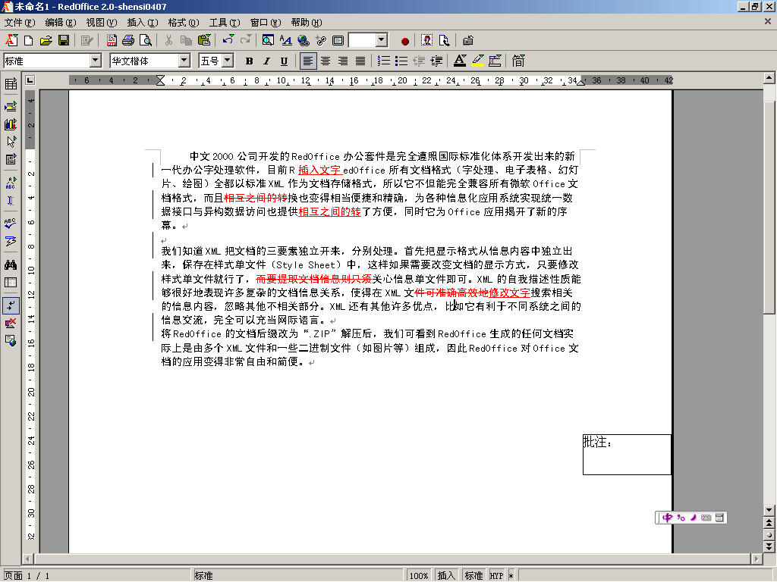
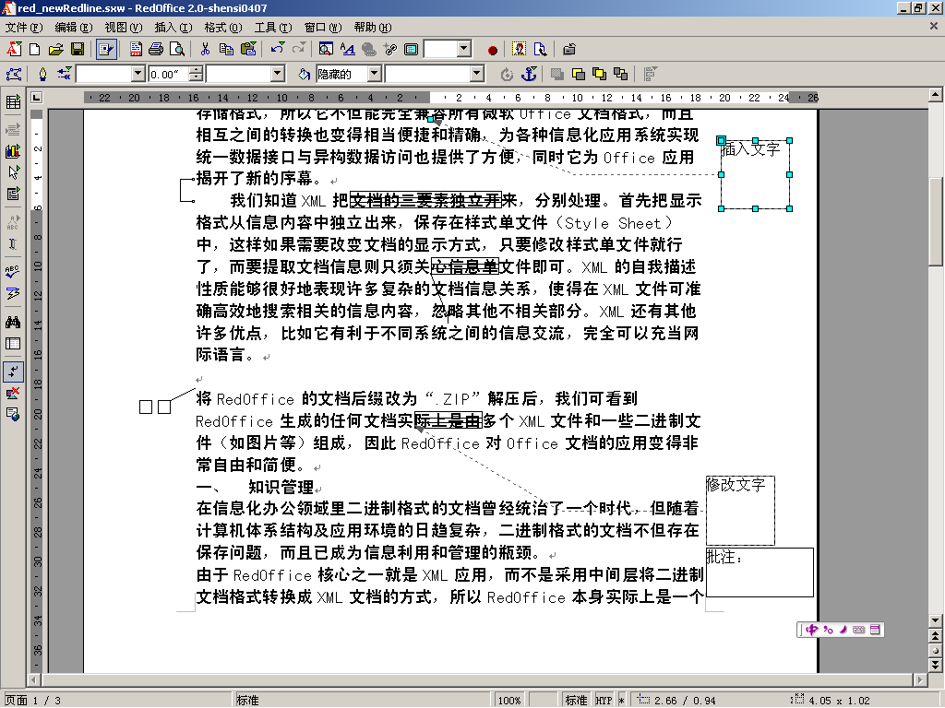
RedOffice Integration Application Feature I
Online editing, handwriting editing, trail preservation and other functions satisfy special requirements of e-government (I)

Slide 22
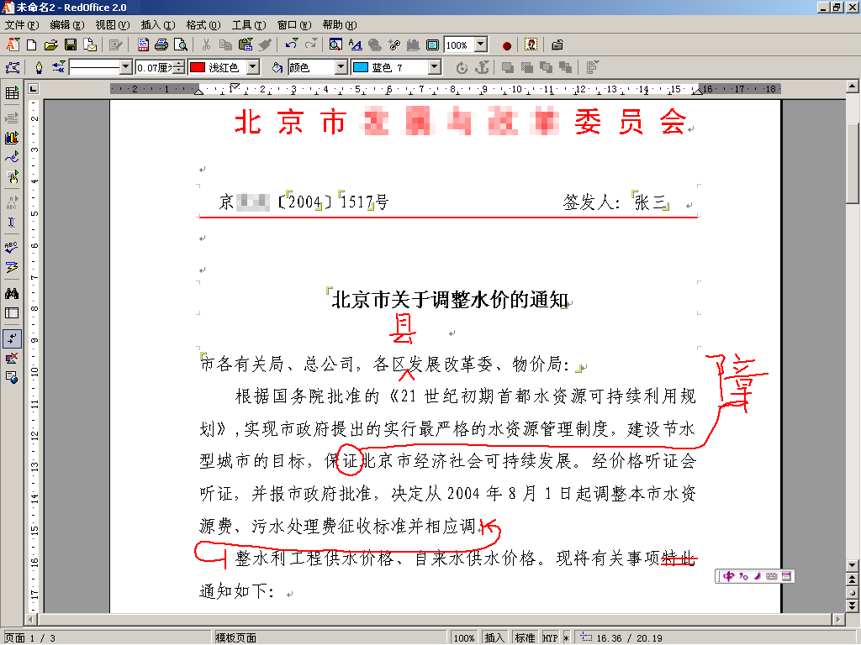
RedOffice Integration Application Feature I
Online editing, handwriting editing, trail preservation and other functions satisfy special requirements of e-government (II)

Slide 23
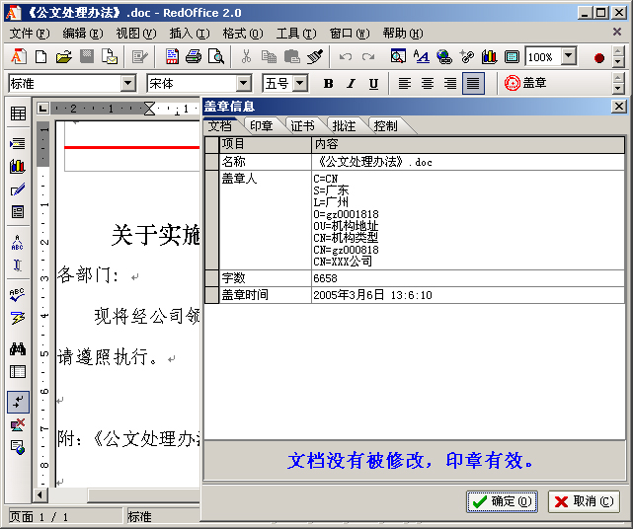
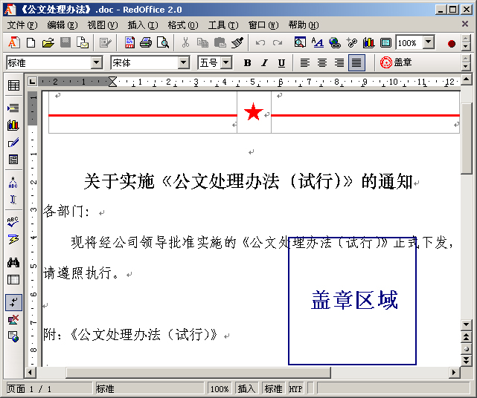
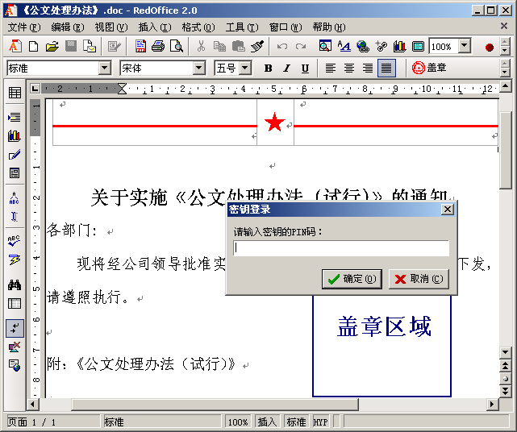
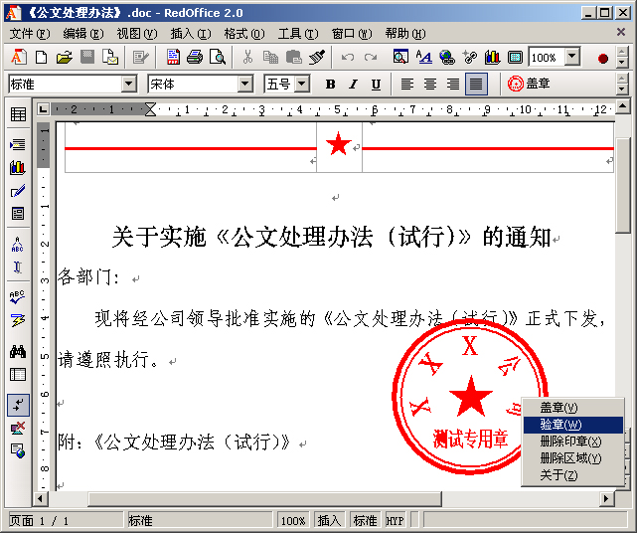
RedOffice Integration Application Feature II
Integrated electronic chop and digital certification successfully meet some special demand of e-government

Slide 24




RedOffice Integration Application Feature III
Group User Network Deployment
Organization Intranet
Installing RedOffice featured “Network Deployment” function, the online installation and upgrading may be finished automatically.
Organization intranet server
Internet

Slide 25
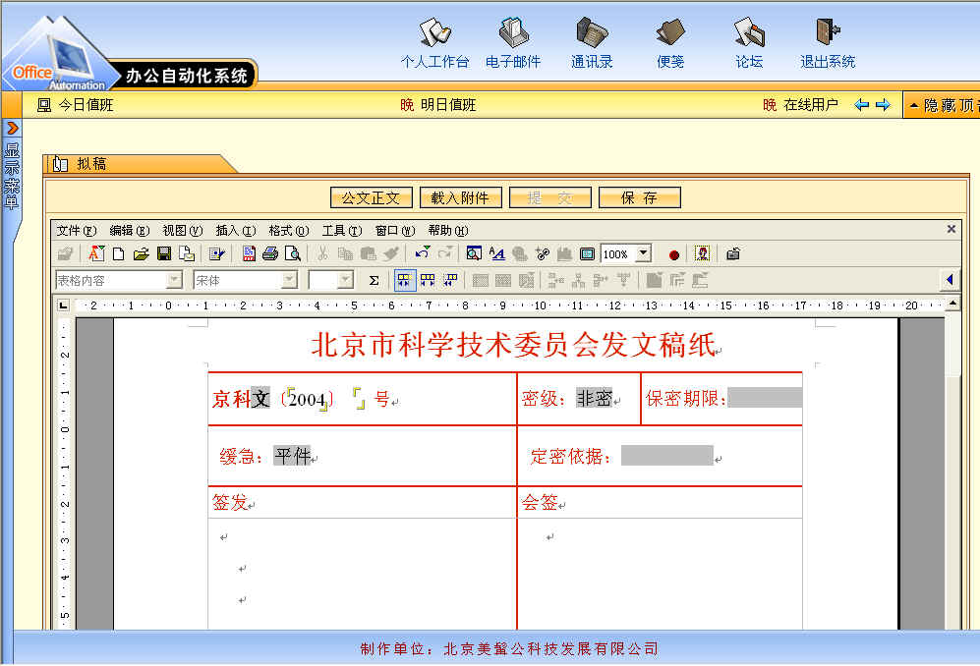
Case Study - Beijing Science and Technology Commission

Slide 26

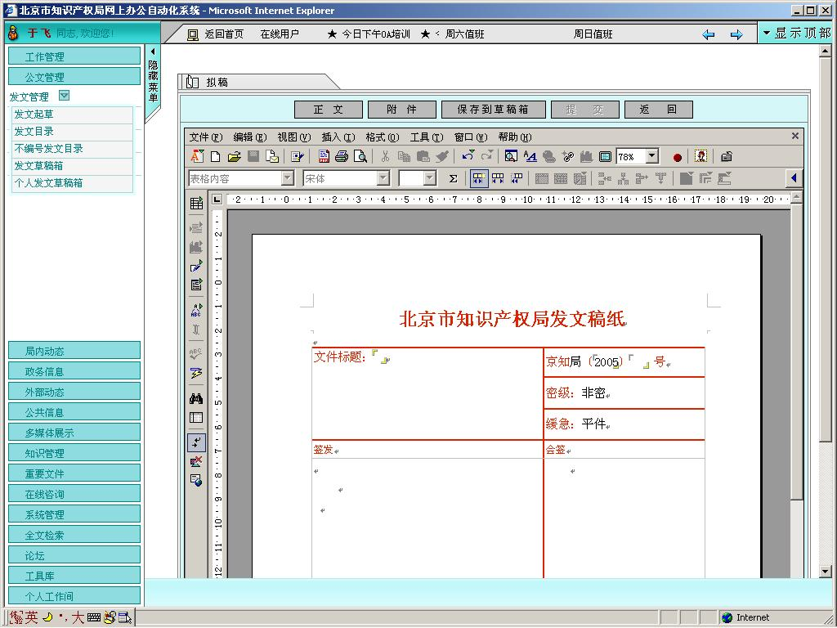
Case Study – Beijing Bureau for Production Safety, and Beijing Intellectual Property Bureau

Slide 27
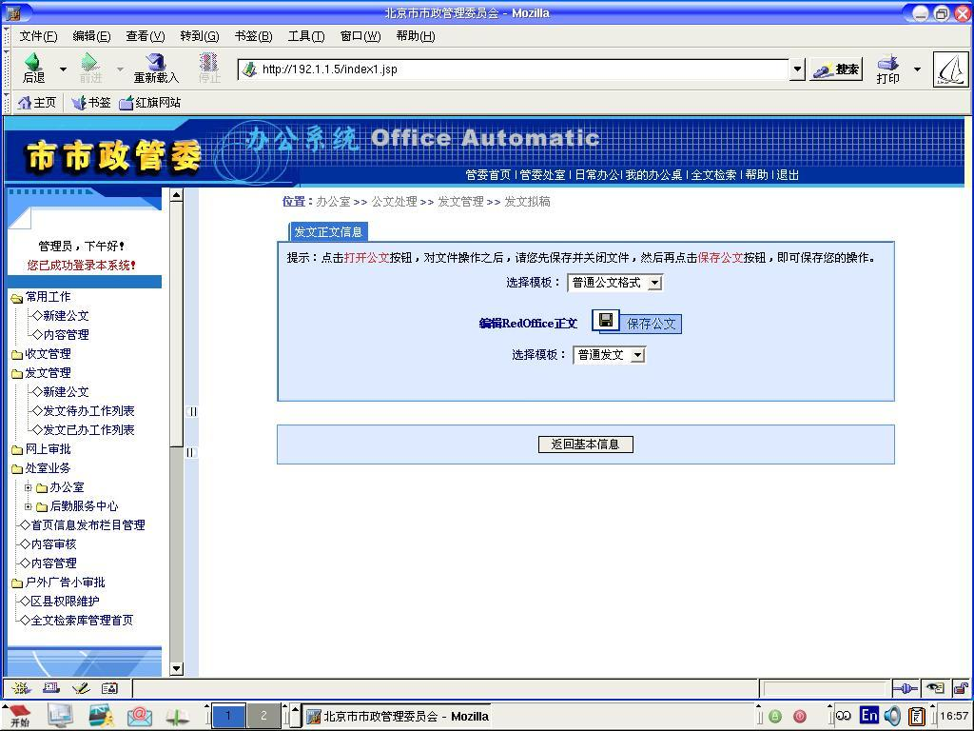
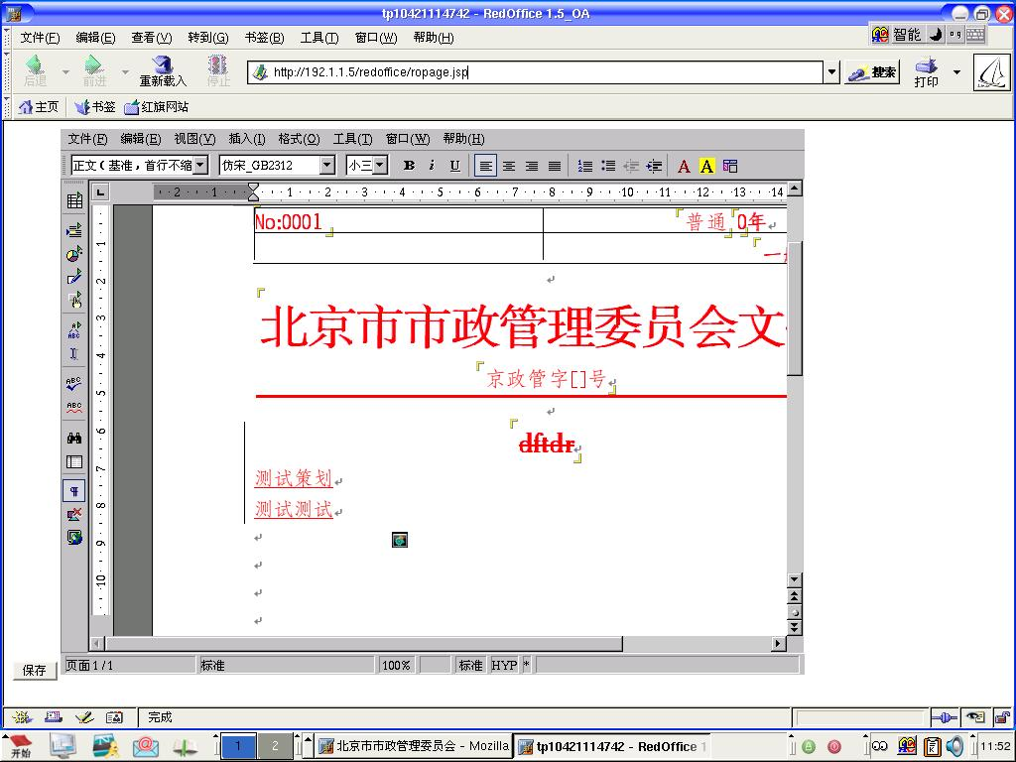
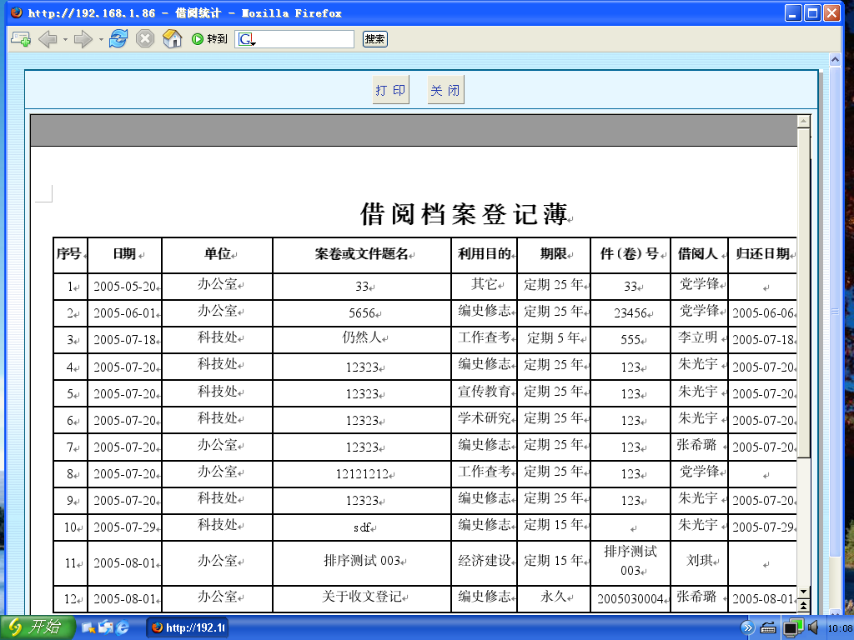
Case Study – Beijing Municipal Affairs Administration

Slide 28
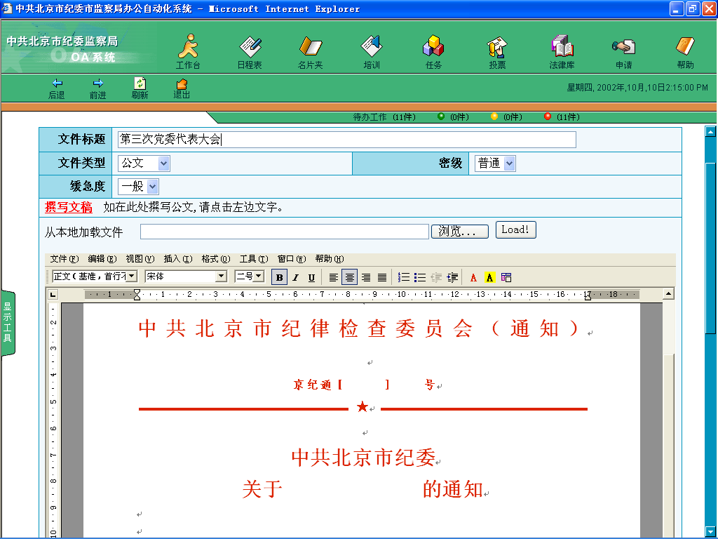
Case Study – Beijing Discipline Committee (18 Remote Districts)
实现整个REDOFFICE应用框架作为WEB元素嵌入网页中
May use JavaBean,
ActiveX and other method to embed RedOffice into browser to work as part of e-government, which may allow online document editing and processing, and avoid repeated documents upload and download in previous application solutions, and make official document editing and official document flow become an integrated whole body.
北京市纪委监察局系统案例

Slide 29
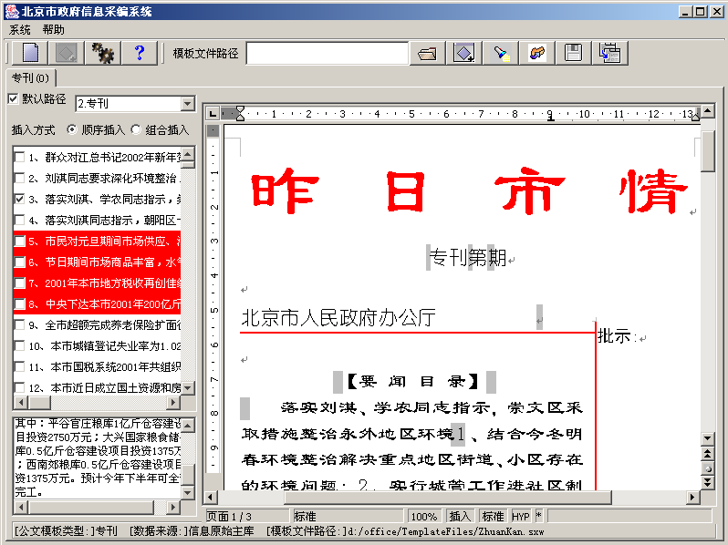
Case Study – Information Office, Beijing
May use JavaBean, ActiveX, OLE and other methods to integrate RedOffice into normal C/S application programs ……

Slide 30
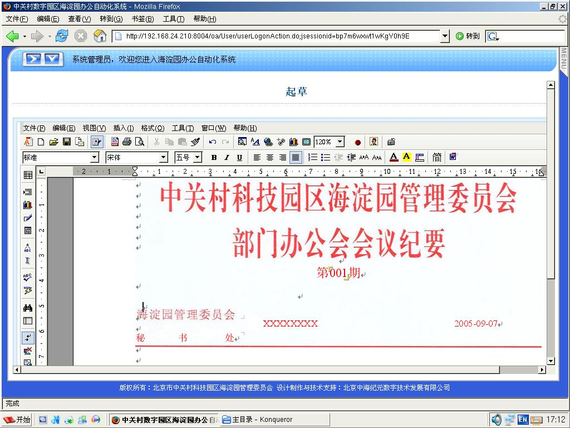
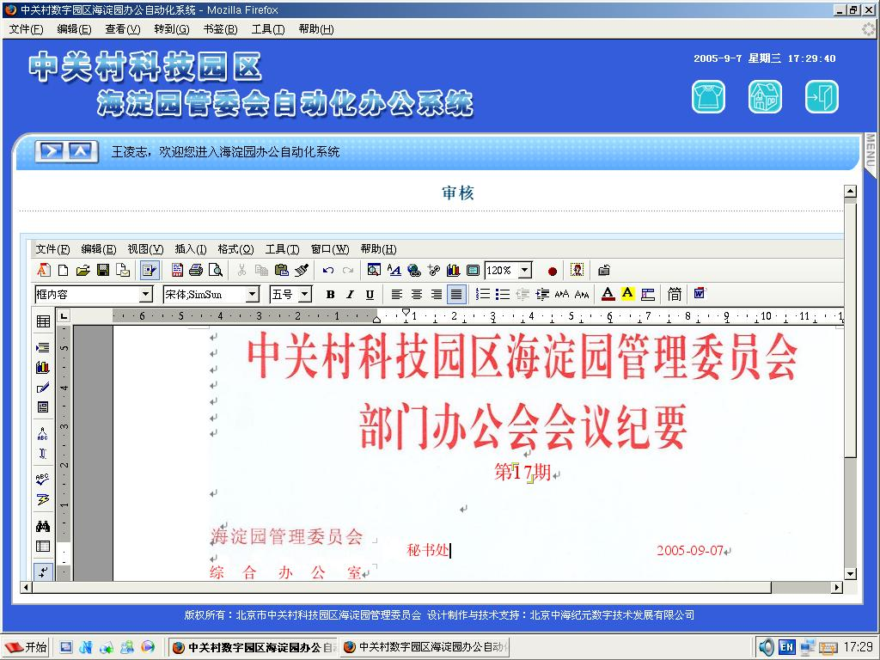
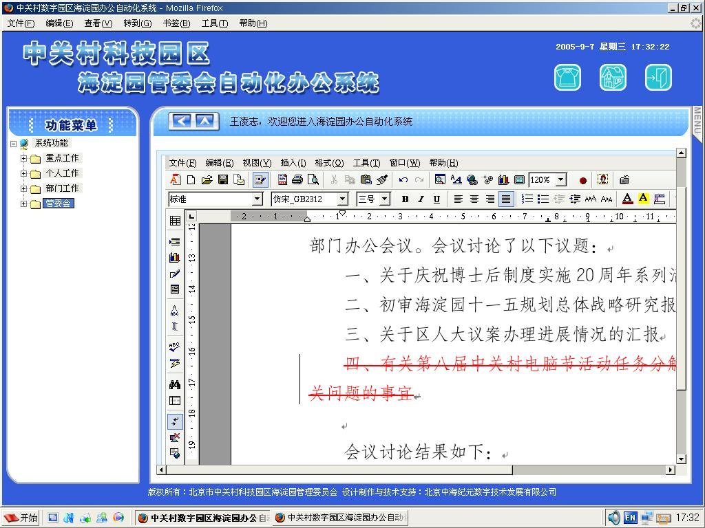
Case Study – Zhongguancun Science and Technology Park

Slide 31
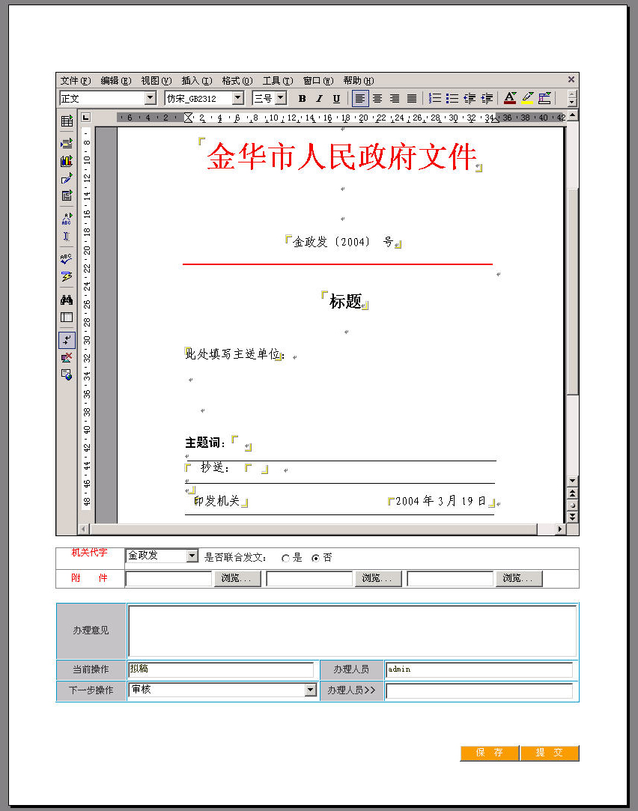
Case Study – People’s Government of Jinhua City

Slide 32
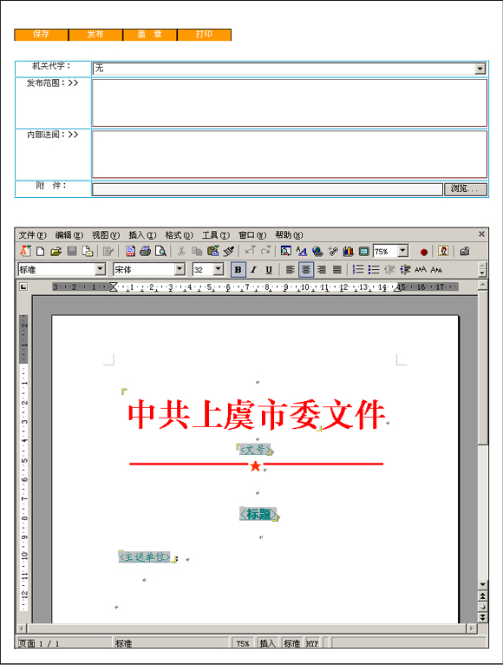
Case Study – Shangyu Municipal Government

Slide 33
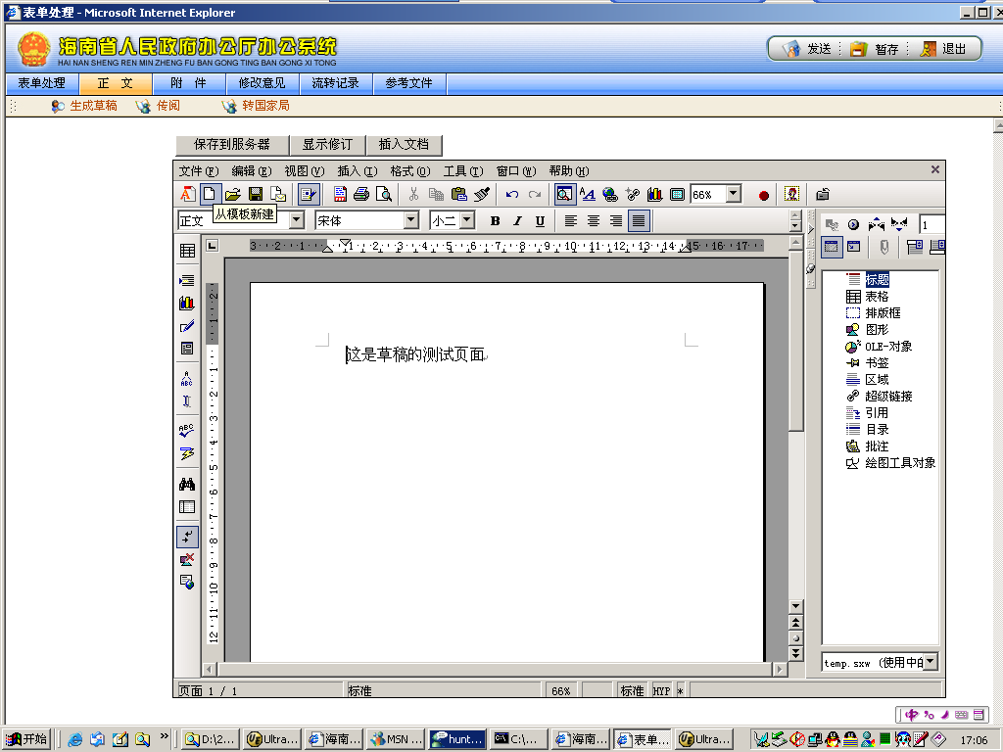
Case Study – General Office, Hainan Province

Slide 34
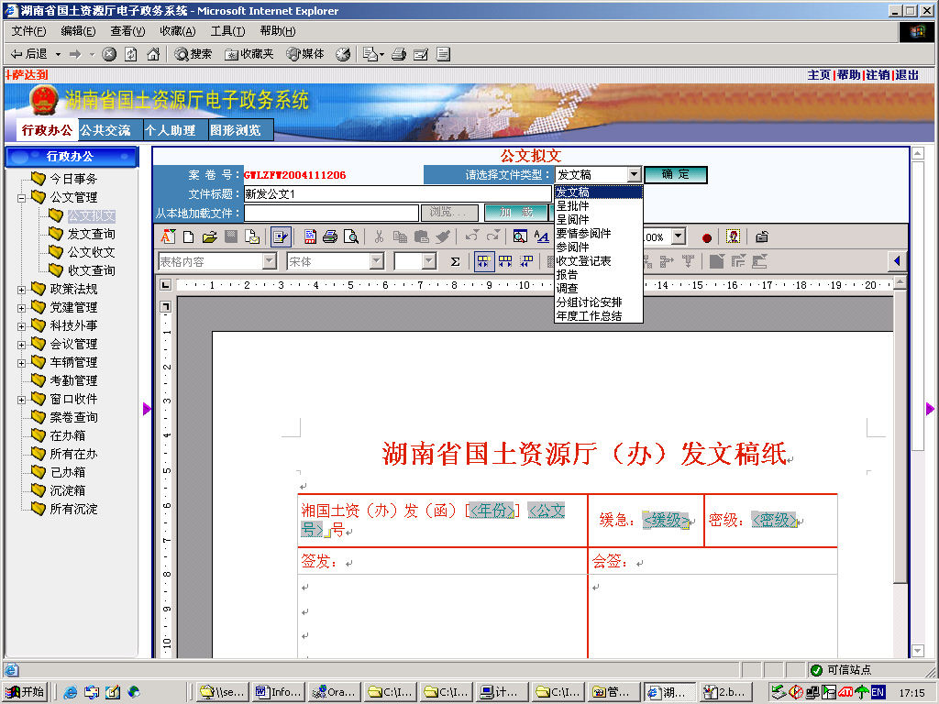
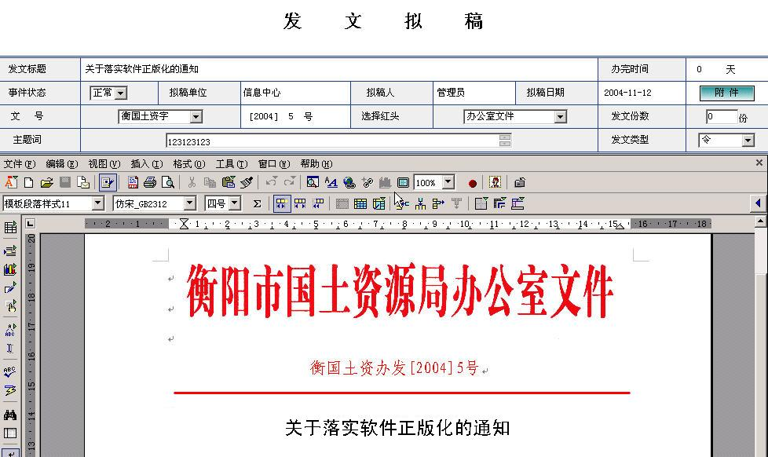
Case Study - Hunan

Slide 35
IV. RedOffice Highlights
6. Support to UOF and ODF
Uniform Office Format (UOF) Standard is a national standard initiated by China Electronic Technology Standardization Institute, and developed by Beijing Redflag CH2000 Software Co., Ltd. and other OA software companies and the specialists of the industry. RedOffice supports ODF standard and Chinese standard (UOF), local standards.

Slide 36
IV. RedOffice Highlights
7. Support Linux and Chinese Linux
By improving integration of RedOffice into Linux operating system, especially Chinese language version RedFlag Linux and other operating systems, RedOffice makes all sorts of Chinese Linux operating system smoothly supported by nice office suite.

Slide 37
V. RedOffice’s Vision
Following Ooo development orientation on the technology, submit our customer's demands to the community.
Contribute RedOffice source code to the community and promote OpenOffice.
Establish a subcommunity about OpenRedOffice in the community to promote a development of Chinese localization project.

Slide 38
V. RedOffice’s Vision
Fully support development strategy of open document format standards, and promote development of ODF in China, and proactively support integration strategy of UOF into international ODF standards.
Further research and develop integration capability of RedOffice with other application systems, and develop into network application service module.

Slide 39
Our expectations
Making a close relationship with OpenOffice.org community.
To know and understand the general community structure, such as management model, development model, etc.
Participate technical development positively, making our contribution in many projects, such as Chinese localization, documentation format, application interface development, bug fix, performance optimization, etc.

Slide 40
Our expectations
Establish a full cooperation with the community, in addition, establish a cooperation with some Software makers.
Through cooperating with the community, improving ODF development and promotion.
Other possible ways.

Slide 41
Our expectations
There are just two key things:
Create and Keep touching with OpenOffice.org
Become a valuable contributor to OpenOffice.org

Slide 42
谢谢
Thank You
Merci

