Slide 1
GStreamer in OpenOffice.org?
  Cédric Bosdonnat, Radek Doulík

Slide 2
Introduction
Cédric Bosdonnat
  INSA Lyon
Radek Doulík
  Novell, Inc.

Slide 3
Overview
GStreamer library introduction
Macros using GStreamer
Media handling in OpenOffice.org
avmedia with GStreamer backend
Future work
Questions / Discussion

Slide 4
GStreamer library introduction
Multimedia framework library
  Using pipelines and linked bins to handle the stream
  Many plugins available, even for video editing
  Free software
  Like brick games for children

Slide 5
Macros with GSreamer

Slide 6
Macros with GStreamer
Component Context
  Goal, objectives
  History
Component Design
  An independent component
  A wrapper for the GStreamer API
Component Use
  Build up the pipeline
  Control the pipeline

Slide 7
Component Context
Goal, Objectives
  Running GStreamer pipelines from macros
  Providing a generic pipeline-based multimedia API
  Better control of the multimedia handling
History
  Developing an URE based application at INSA
  Handling multimedia
  Use of GStreamer

Slide 8
Component design
A wrapper for the GStreamer API
  Providing an API to handle multimedia through pipelines
  GStreamer implementation is work in progress
  Could be adapted to other pipeline-based libraries
An independent component
  To be usable in any UNO based application
  Copied some comphelper useful classes and templates

Slide 9
Using the component
Build up the pipeline
  Add the needed bins to the pipeline
  Set their properties
  Create the links between the bins
Control the pipeline
  Simply change the pipeline state to:
    PLAYING
    PAUSE
  Send an event on the pipeline bus to control
    Current position in the stream
    Stream reading speed

Slide 10
Media handling in OpenOffice.org
Redundancy
  VCL Sound
  avmedia
VCL Sound
  around 5 unix backends
  another 2 shared library loaded on start
avmedia
  UNO based
  audio/video playback

Slide 11
avmedia GStreamer backed

Slide 12
avmedia with GStreamer backend
Plan
  create new backend for avmedia which will use Gstreamer
  UNO magic and Player first, MediaWindow and FrameGrabber later
Benefits
  one unix backend
  many supported formats
  GStreamer is easily extensible by plug-ins
  threaded
  well documented
  easy to use

Slide 13
avmedia with GStreamer backend
Inside
  magic black box called PlayBin – GStreamer pipeline
  you feed it with URI and it does everything for you (mostly :-)
  stream auto detection – links all the necessary elements together
  half the code just forwards requests to our black box Playbin
  uri, seeking, volume management, state management
URI

Slide 14
avmedia with GStreamer backend
Inside (continued)
  we watch the pipeline bus and use some of passing messages
  set the X window ID
  state changes

Slide 15
avmedia with GStreamer backend
OOo sync. vs. GStreamer async.
  OOo UNO API works synchronously
  while GStreamer is threaded and works asynchronously
Issues
  we need to provide X window ID to the video sink
  when playback window is created we need to know the video size
Solution
  in the beginning we tell the Playbin to use fake videosink
  wait until we reach PAUSED state

Slide 16
avmedia with GStreamer backend
OOo thread
GStreamer threads
Player::create
state to PAUSED
link the elements
prepare the pipeline
query window size
wait for condition
pipeline is ready
in PAUSED state
set condition
wakes up
resets video sink
ready to create window

Slide 17
Examples

Slide 18
Example 1
Photos slideshow with background music
  current limitation: sound objects cannot live across slide boundaries
  temporary solution: let animate photos on one slide
  audio was edited in audacity (trim, fade in) http://audacity.sourceforge.net/
  sound was recorded in the morning in the forest. photos taken at the same time

Slide 19
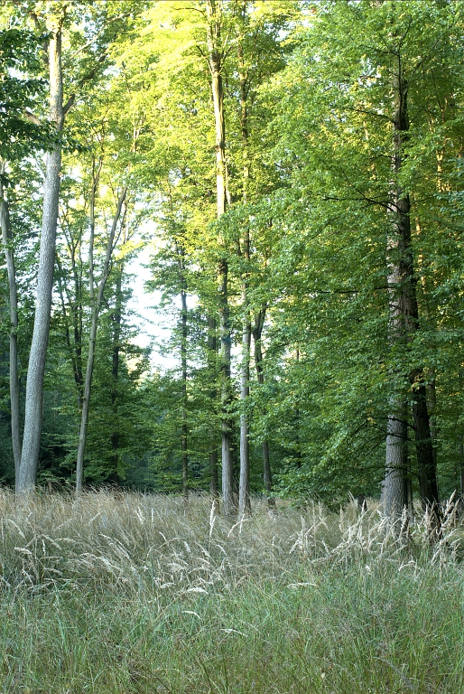
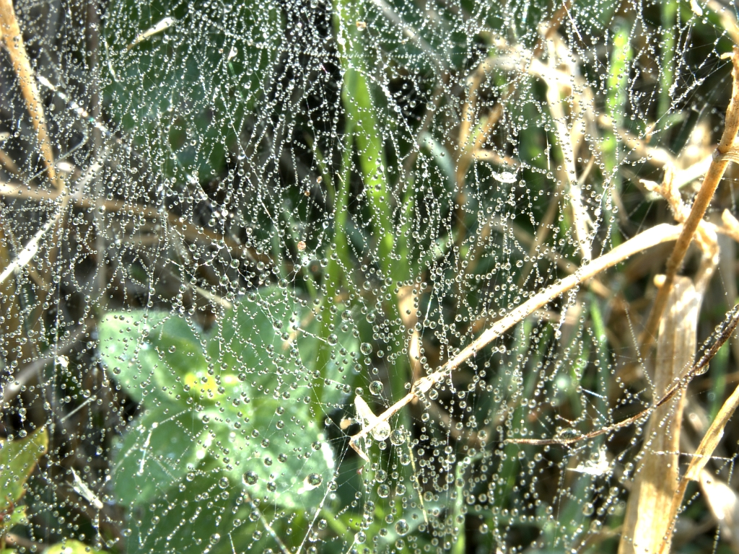
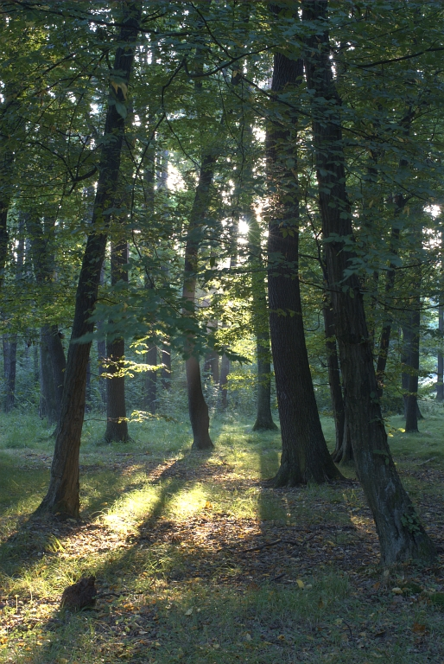

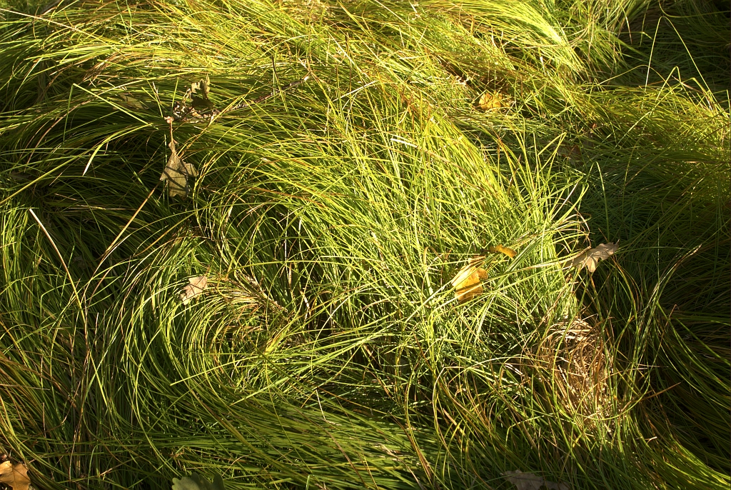
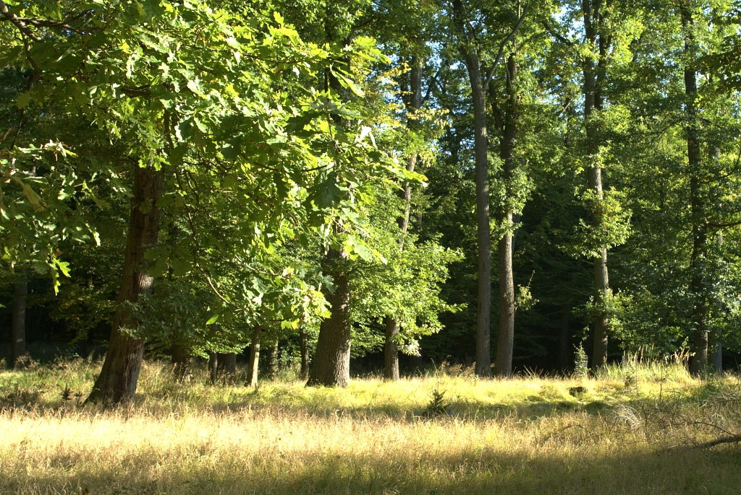
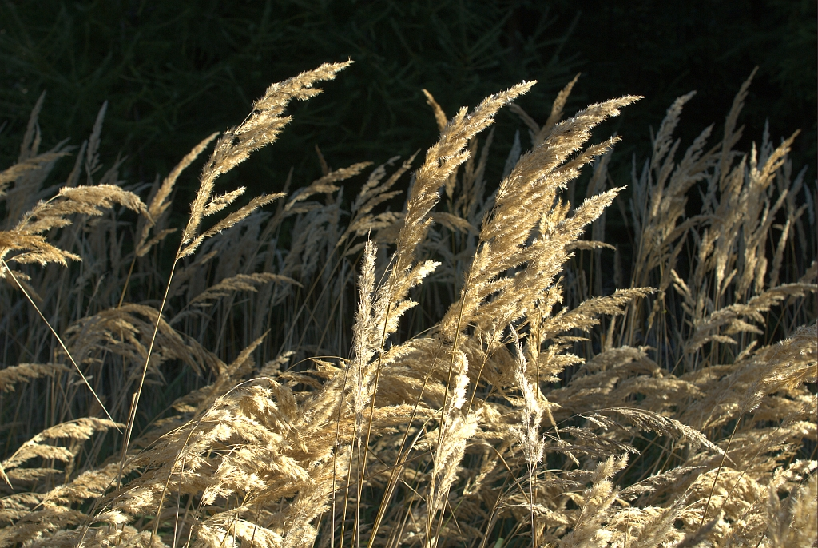
Morning in the forest ...
The end

Slide 20
Example 2
Include captured video in your presentation
  recorded with xvidcap http://xvidcap.sourceforge.net/
  shows how the previous example was created

Slide 22
Future work
Kill vcl Sound?
  few possibilities
  replace it with avmedia.Player whenever used
  add GStreamer backend to it
  replace it with another simple UNO component
New features
  sound effects across multiple slides (see issuezilla)
  include the media files inside the document
  fade in/fade out effects
  trimming
  suggest one

Slide 23
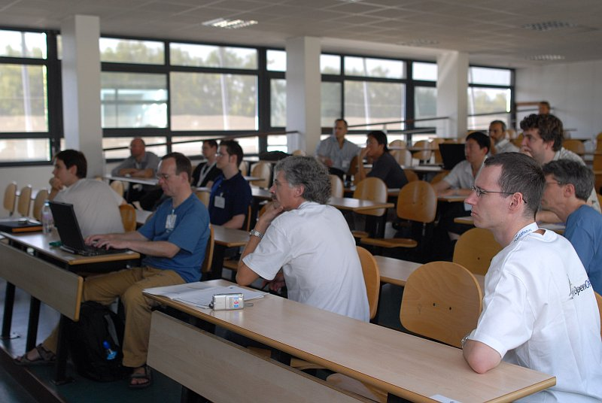
Questions and discussion

Slide 25
Unpublished Work of Novell, Inc. All Rights Reserved.
This work is an unpublished work and contains confidential, proprietary, and trade secret information of Novell, Inc. Access to this work is restricted to Novell employees who have a need to know to perform tasks within the scope of their assignments. No part of this work may be practiced, performed, copied, distributed, revised, modified, translated, abridged, condensed, expanded, collected, or adapted without the prior written consent of Novell, Inc. Any use or exploitation of this work without authorization could subject the perpetrator to criminal and civil liability.
General Disclaimer
This document is not to be construed as a promise by any participating company to develop, deliver, or market a product. Novell, Inc., makes no representations or warranties with respect to the contents of this document, and specifically disclaims any express or implied warranties of merchantability or fitness for any particular purpose. Further, Novell, Inc., reserves the right to revise this document and to make changes to its content, at any time, without obligation to notify any person or entity of such revisions or changes. All Novell marks referenced in this presentation are trademarks or registered trademarks of Novell, Inc. in the United States and other countries. All third-party trademarks are the property of their respective owners.

