Slide 1


Slide 2

OpenOffice.org as the lynch-pin of the Malaysian Public Sector OSS Master Plan
Eric Yeoh
R&D Engineer, OSSC MAMPU

Slide 3
Agenda
Self Introduction
The case for OSS and The Malaysian Public Sector OSS Master Plan.
OSS Implementation
OpenOffice.org Migration Life-Cycle
Current Status of OpenOffice.org Migrations
OpenOffice.org Migration Challenges
Summary

Slide 4
Self Introduction

Slide 5

MAMPU
- Malaysian Administrative Modernisation and Management Planning Unit -
Central agency in the Prime Minister's Department in charge of the administrative modernisation and management planning for the Public Sector
To be the change leader of excellence and distinction for the Malaysian Public Service
VISION
To continuously Modernise The Malaysian Public Service In Achieving A High Level of Quality
MISSION

Slide 6
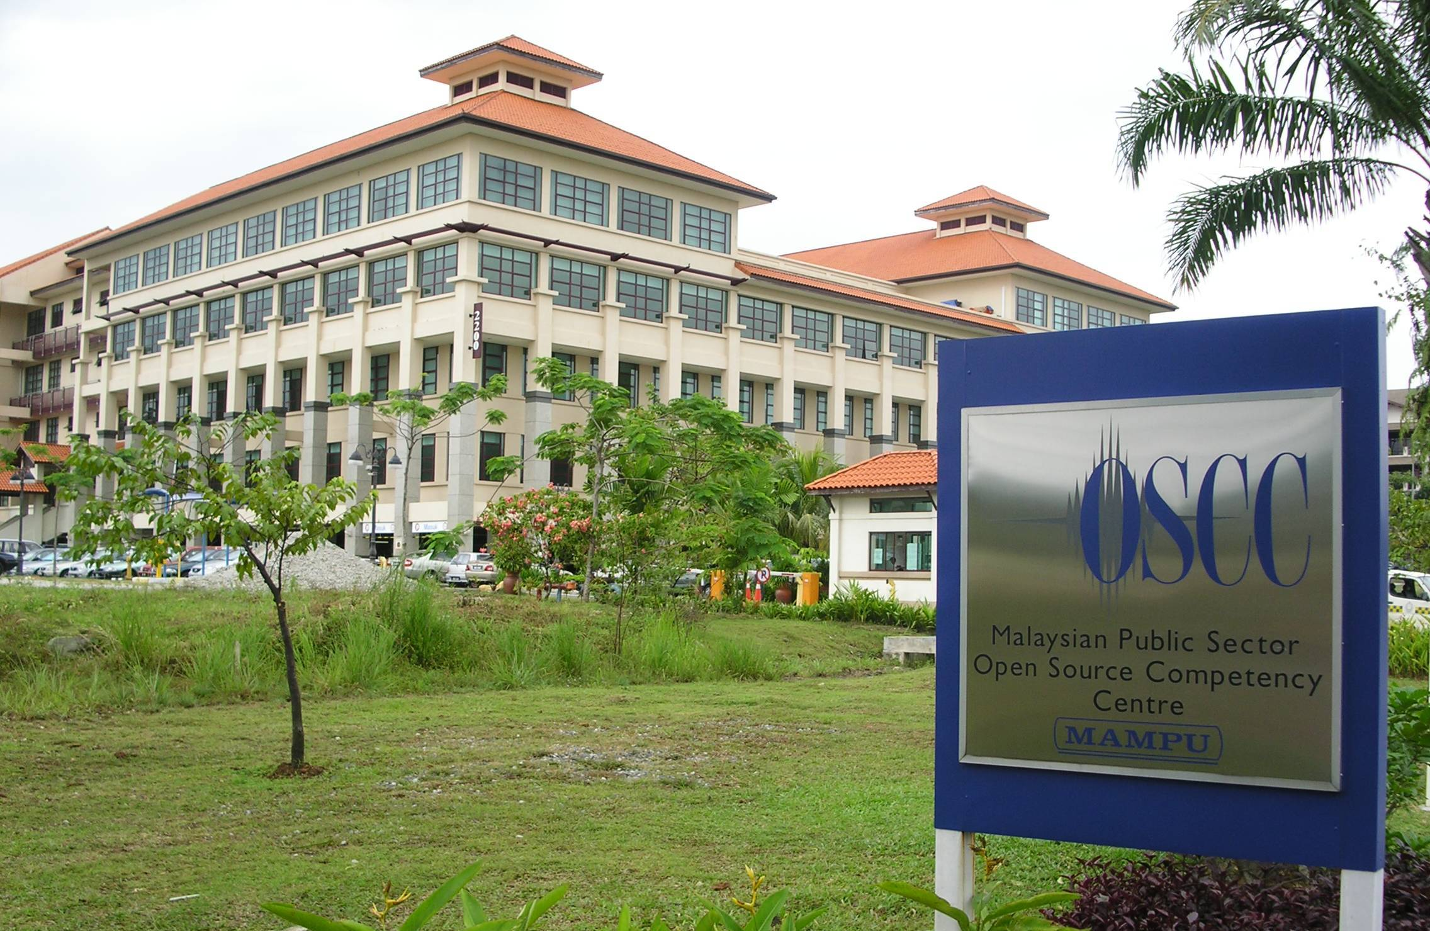

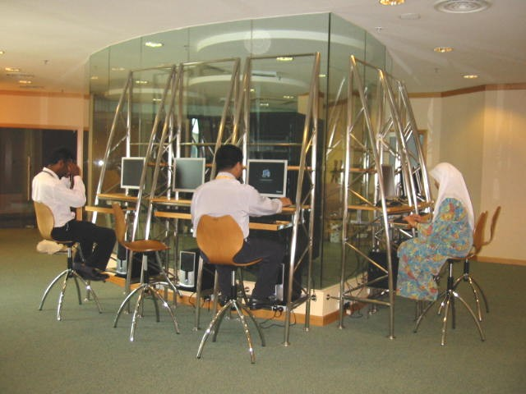
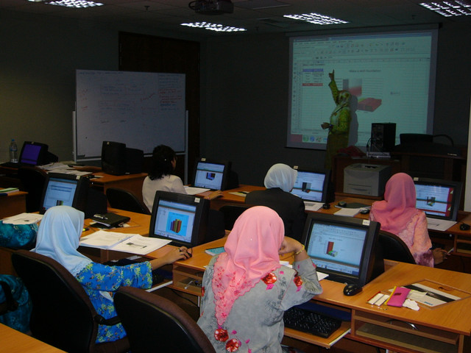
OSCC
- Open Source Competency Centre -
MAMPU is the lead agency for OSS Master Plan implementation and manages the Open Source Competency Centre.

Slide 7
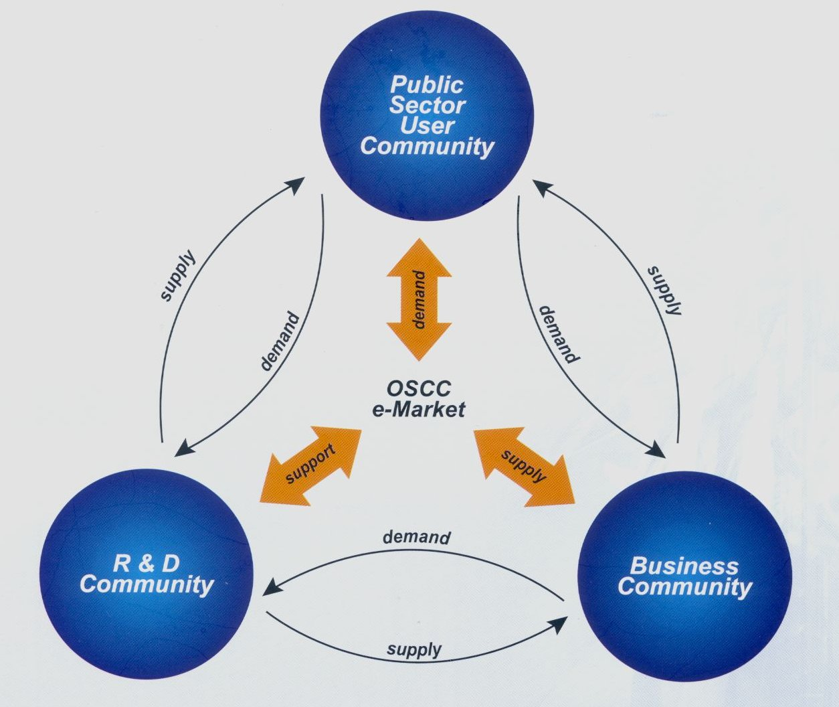
OSCC
- Open Source Competency Centre -
Open Source Competency Centre, part of MAMPU.
Established as part of the OSS Master Plan.
One stop OSS solution hub for the public sector.
Bringing together the public sector, OSS communities, R&D as well as business communities.

Slide 8
The case for OSS
and
The Malaysian Public Sector OSS Master Plan

Slide 9
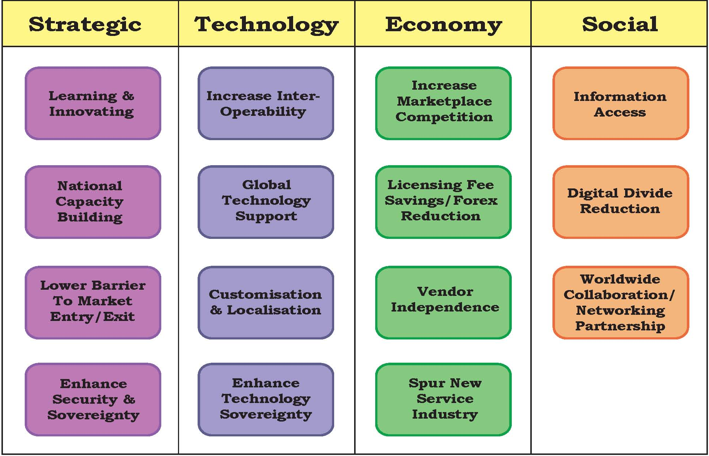
The case for OSS

Slide 10

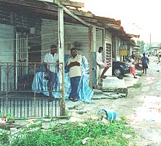
The case for OSS - Economic
There are >700,000 people living in poverty in Malaysia.
Monthly income <RM500 (US$143) in a family of four are considered below the poverty line (RM1 = US$0.28).
A copy of MS Windows Vista Premium retail pack costs RM899.00 (US$257.00) and Office 2007 Standard retail pack costs RM1,299 (US$371.50).
Photo obtained from http://mothersfightingforothers.wordpress.com/2007/04/03/outreach-asia/ &
http://aliran.com/oldsite/images/squatters.jpg

Slide 11
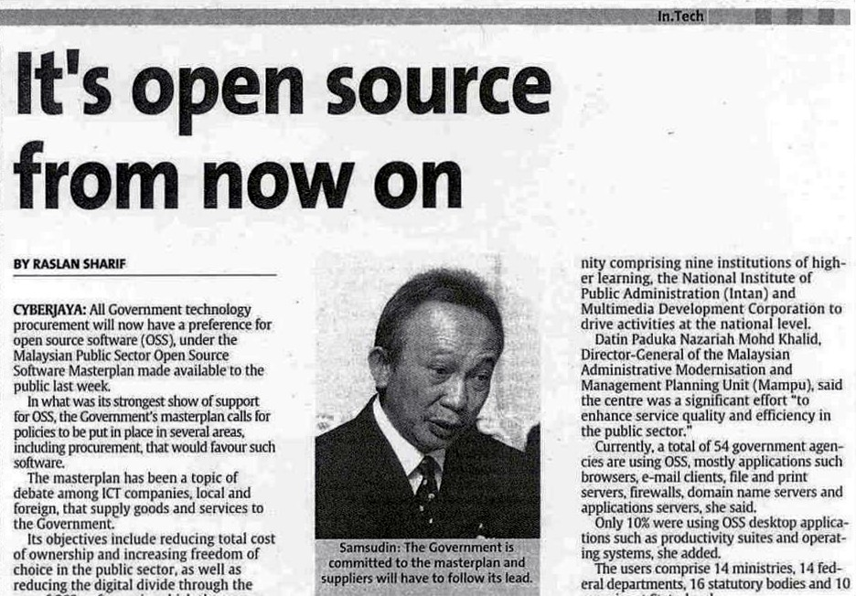
Malaysian Public Sector OSS Master Plan
Established by the Cabinet in July 2004.
Encourage uptake of OSS in the Government.
Formulated through consultation with government agencies, institutions of higher learning, non-profit organisations.
The Star - Friday July 16, 2004

Slide 12
OSS Master Plan
- Principles and Objectives -
OSS Master Plan
Objectives
Reduce total cost of ownership
Increase freedom of choice of software usage
Increase interoperability among systems
Increase growth of ICT industry
Increase growth of OSS user and developer community
Reduce digital divide
Guiding Principles
Fit for purpose
Least disruptive to operations
Co-existence with other legacy proprietary systems
Leverage on existing facilities, hardware, software and expertise
Not driven or controlled by hardware or software vendors

Slide 13
OSS Master Plan
- What it is not -
It DOES NOT discriminate against proprietary stuff.
  In cases where OSS solution == Proprietary ones, go OSS.
It is not a “religious” doctrine.
Go proprietary only when there's no OSS equivalent.
  e.g. CAD/CAM
Solution to be used must be fit for purpose.
It does not FORCE the adoption of OSS.

Slide 14
OSS Master Plan
- Framework & Strategic Thrust Areas -
1
MOSTI
MOSTI
7
Develop OSS
Technical
Implementation Plan
Encourage smart
Partnerships with
relevant organisations
2
MAMPU
MAMPU
6
Entrust a Govt. body to
drive and monitor
OSS Adoption
Provide incentives to
Grow OSS
Adoption
3
MOE
ATTORNEY GENERAL
4
MOSTI
5
Develop and Train
personnel to use and
support OSS
Encourage OSS R&D
to be competitive
Develop legal
framework To drive
OSS adoption

Slide 15
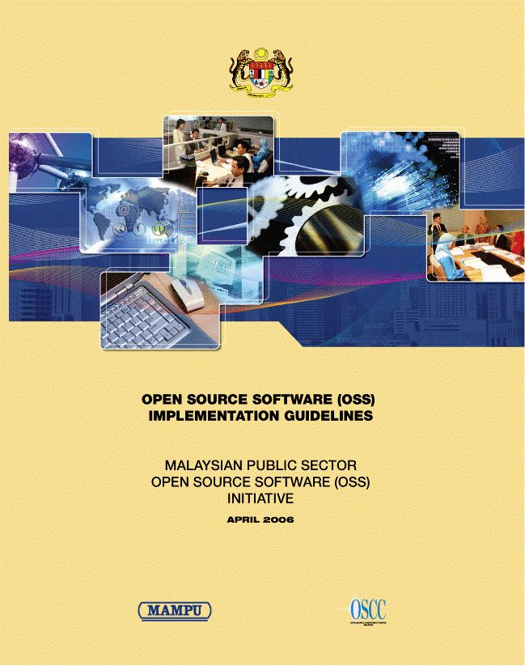
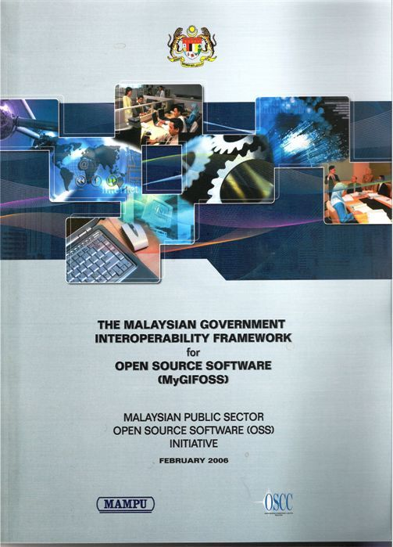
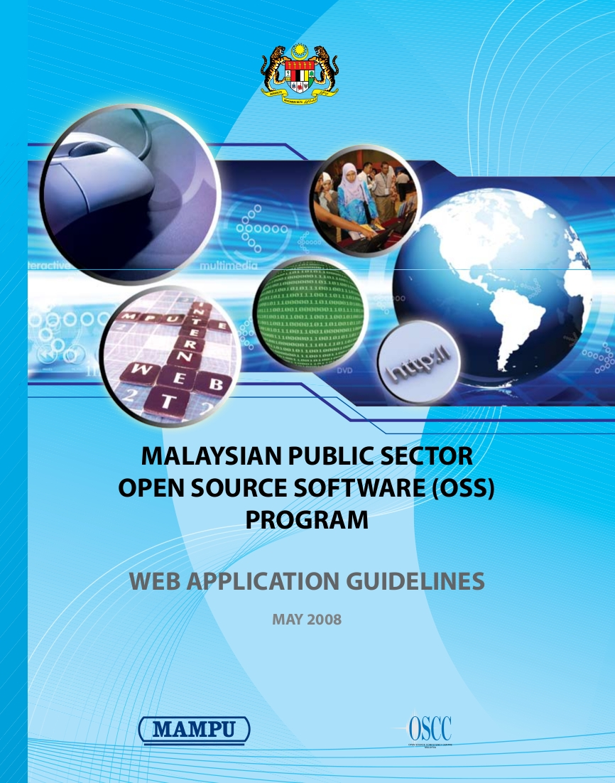
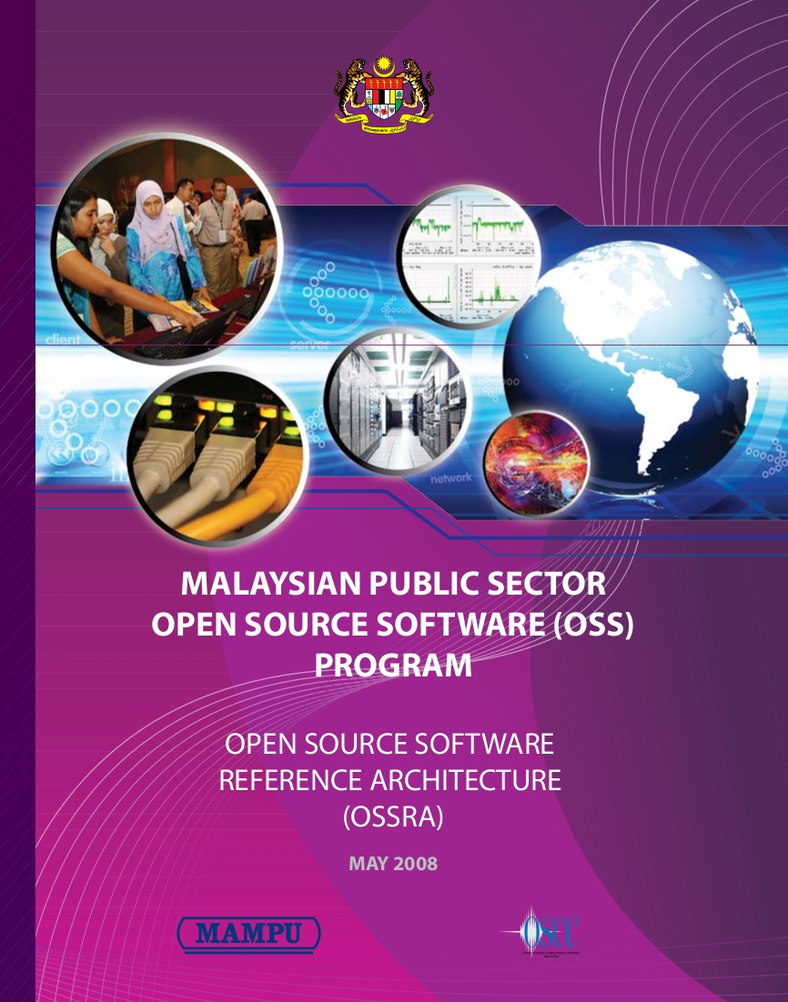
OSS Master Plan
OSS Policies, Standards & Guidelines
OSS Implementation
Guidelines
Malaysian Government
Interoperability
Framework for
OSS (MyGIFOSS)
Web Application
Guidelines
OSS Reference
Architecture
All documents are downloadable
from http://opensource.mampu.gov.my or
http://www.oscc.org.my

Slide 16
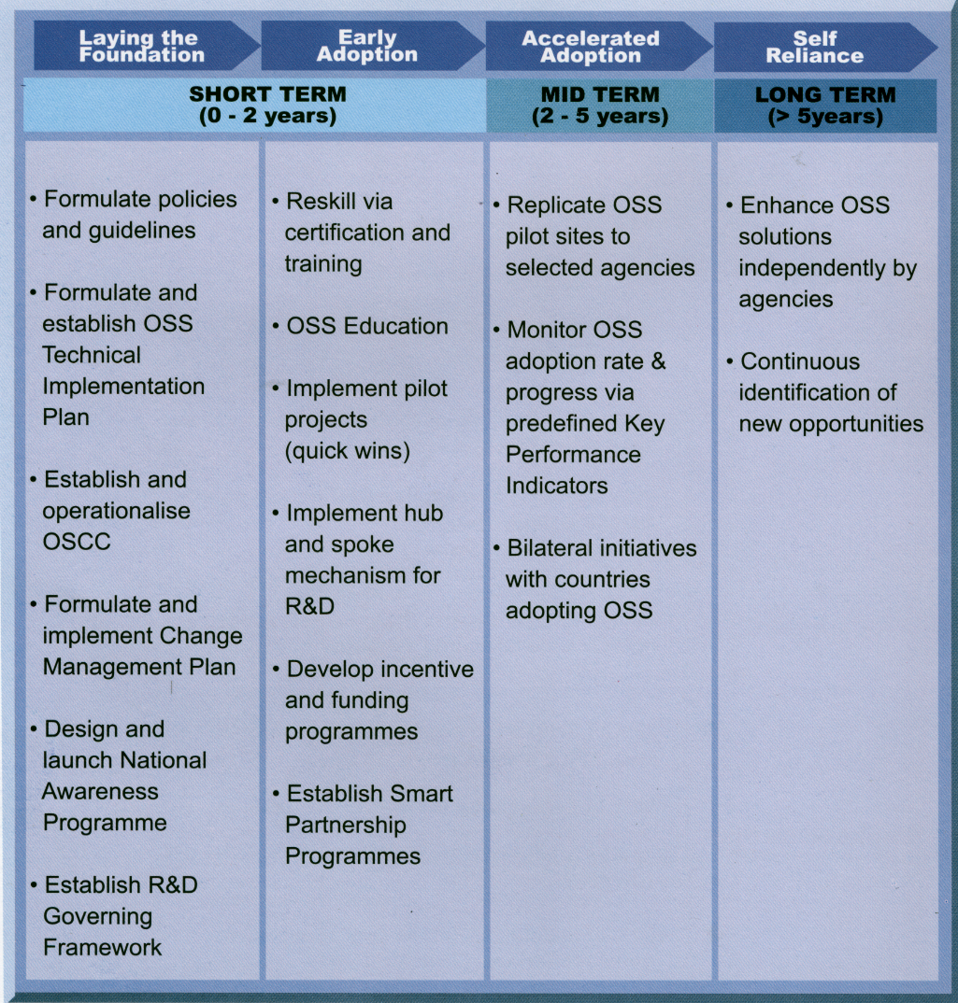
OSS Master Plan
- Roadmap -

Slide 17
OSS Master Plan
- Where are we now -
Laying the
Foundation
Early
Adoption
Accelerated
Adoption
Self
Reliance
SHORT TERM (0 - 2 years)
MID TERM (2 – 5 years)
LONG TERM ( > 5 years)
We Are Here
Moving forward
A long-term project
Short-term successfully laid the foundation
Accelerated Adoption in progress within The Ninth Malaysian Plan (2006-2010)

Slide 18



OSCC's Products & Services
MySpamGuard is an anti-spam solution that scans and blocks spam and viruses in incoming and outgoing emails
MyNetWatch is a network monitoring and management solution that identifies service unavailability and sends alerts to the network administrator
MyMeeting is an online paperless meeting management application for Public Sector agencies. Open sourced under BSD License
MySurfGuard is an integrated web content filtering suite that curbs unproductive web browsing activity
MyWorkSpace is an email collaboration suite with integrated email, calendar, address book, task management and notes features

Slide 19
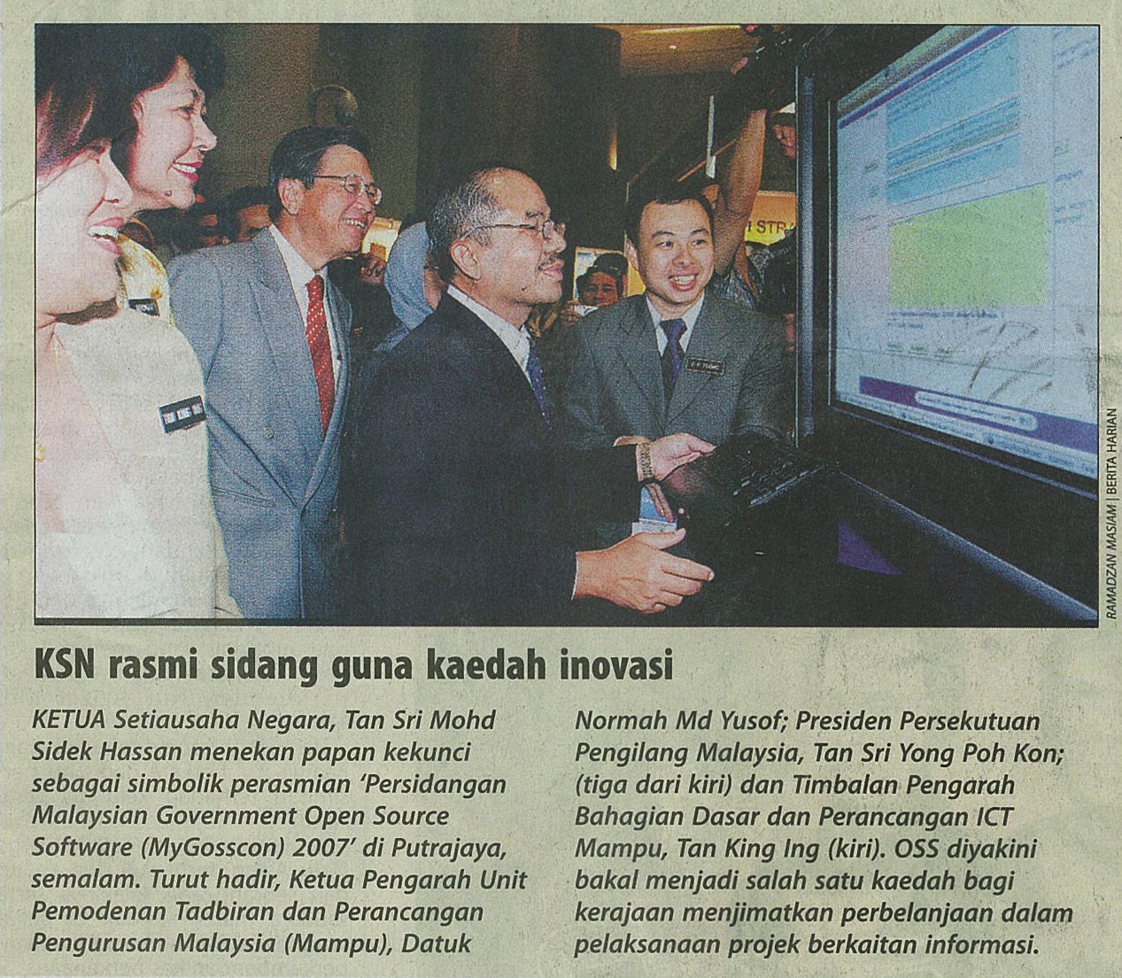

OSCC's Products & Services
All products are available to all for free.
Product and OSS training are free for public servants (since Jan 07 to Sept 08 – 1,964 have been trained).
LPI-1 based certification developed with industry participation is available.
Help Desk with email support.
Knowledge Bank and E-Marketplace.
Organising talks in institutes of higher learning/agencies, OSS Seminars (e.g. MyGOSSCON).
OSS Development Toolkit (for Windows platform only)
Advanced Virtualisation Facility.

Slide 20
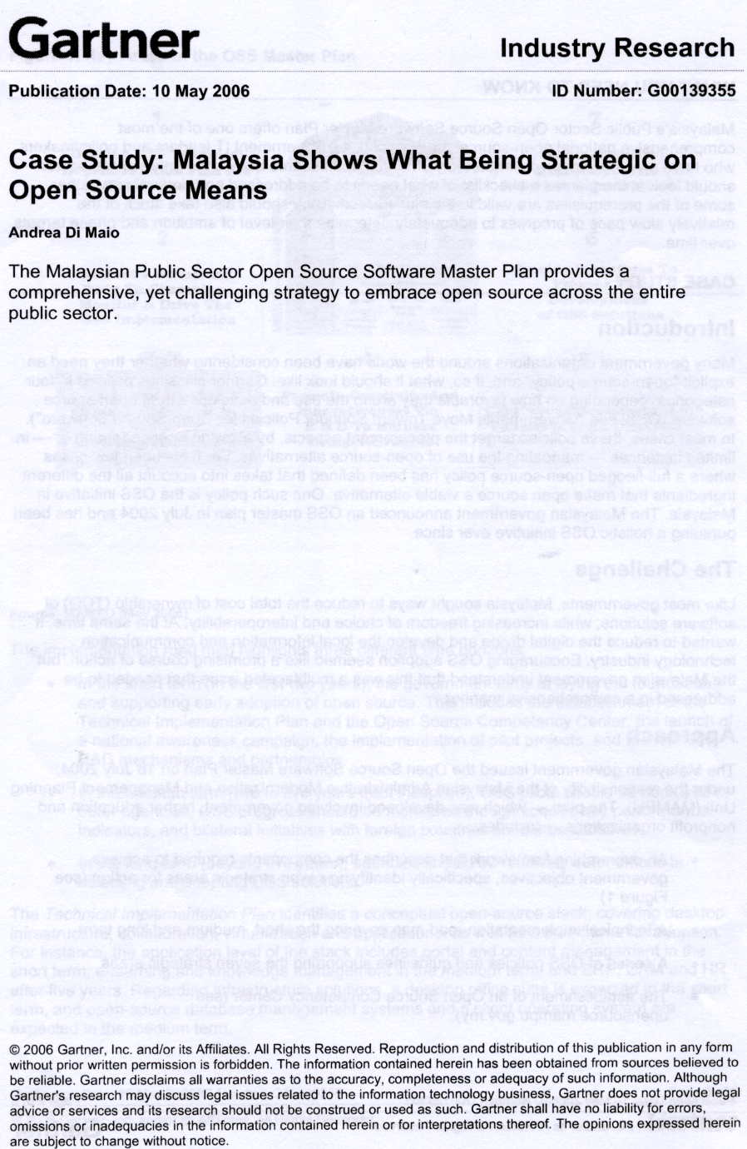
OSS Master Plan
- Recognition -
Gartner Case Study (May 2006)
OSS Master Plan is Strategic and comprehensive, recommended as a model

Slide 21
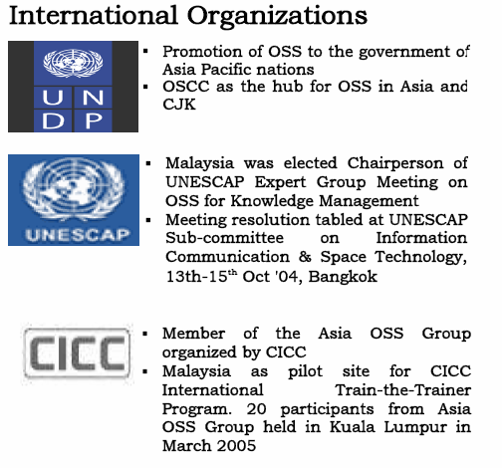
OSS Master Plan
- Recognition -
“The Government of Malaysia has taken a very proactive attitude in promoting the development of OSS in the country and its use in the Public Sector.”
- United Nations Joint Inspection Unit Report (2005)

Slide 22
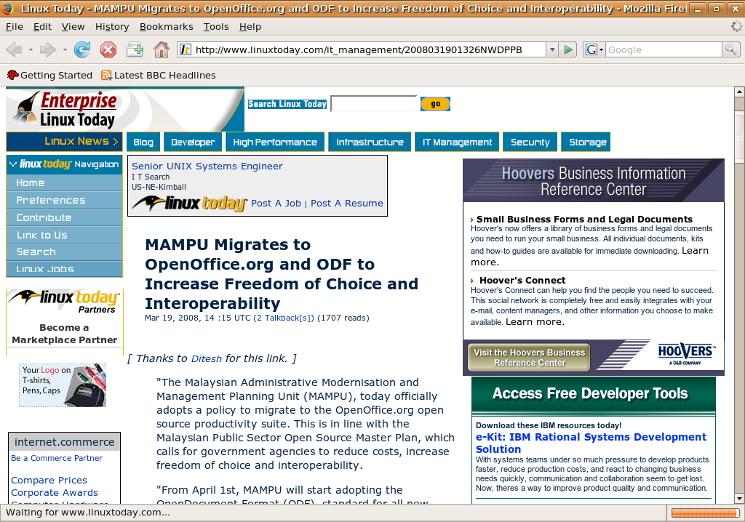
OSS Master Plan
- Recognition (Web) -
Linux Today –
19 March 2008
MAMPU Migrates to OpenOffice.org and ODF to Increase Freedom of Choice and Interoperability
http://www.linuxtoday.com/news_story.php3?ltsn=2008-03-19-013-26-NW-DP-PB

Slide 23
The case for OSS - Savings
Total Estimated Known Savings (2004 – 2008)
RM32,692,000 (US$9,140,352)
From deploying OpenOffice.org and OSSC Products
11,020 installed seats of OpenOffice.org in 19 agencies
MySpamGuard installed in 74 agencies
MySurfGuard installed in 40 agencies
MyWorkspace installed in 20 agencies
MyMeeting installed in 26 agencies
MyNetWatch installed in 24 agencies
Other government projects
OSS Infrastructure in 250 offices for Perak State Govt. (RM900,000, US$251,596)
OSS on every Desktop in Melaka City Council (RM120,000, US$33,545)
OSS for applications Terengganu Development Board (RM700,000, US$195,684)

Slide 24
OSS Implementation

Slide 25
OSS Implementation
- Years 2003 to October 2008 -
An increase of 1308% !!

Slide 26
OSS Implementation
- By Solutions Areas -
Sept 07 – Sept 08

Slide 27
OSS Implementation
- OSSC Products & OpenOffice.org -
Sept 07 – Sept 08

Slide 28
OSS Implementation
- The case for Openoffice.org -
Cost of deployment for MS Office in Malaysia is estimated at RM4.4 Billion (US$1.23 Billion) in licensing fees alone
  4.9 Million PCs in Malaysia (Source: 2006 ITU Report)
  Cost of MS Office Standard 2007 (boxed-set) is retailed at RM900/unit (approximately)
OpenOffice.org is a viable alternative
  Similar features, easy to learn and complies to widely supported ISO standard
Migration effort to the new MS Office 2007 will be similar or worse (e.g. different UI and default file formats)

Slide 29
OSS Implementation
- OpenOffice.org planned adoption
OpenOffice.org
Over 222 agencies planning to implement
OpenOffice.org over next 6 months

Slide 30
OSS Implementation
- Lessons learnt -
People just want to get things done – Freedom? Standards? What's that? Go away & stop bugging me!
Expectations, comparisons between OSS and MS stuff.
Humans are habitual animals; face, pride.
Changing the OS outright on desktops is near impossible.
Ease them in with Firefox, OO.o, Thunderbird, VLC etc.
Back end is always less complex – especially perimeter.
Adhere to standards – protocols, data; do web whenever possible.

Slide 31
OpenOffice.org Migration
Life-Cycle

Slide 32
OpenOffice.org Migration
Life Cycle
Change
Management
Plan
Implementation
Plan
Training
Plan
Technical
Support
Plan

Slide 33
OSS Implementation
- OpenOffice.org Migration Pack -
Consists of
  Change Management Plan
  Training Plan
  Technical Support Plan
  Deployment Plan
  Portal with Quick Guides, FAQs and Tutorials
Promoted to agencies to use with OSCC's support

Slide 34
OpenOffice.org Migration
- Change Management -
A plan to address transitional challenges
  Ensures migration takes place smoothly with least disruption
Approach
  High level buy-in from management
  Create OOo migration policy in consultation with OSCC
    Document distribution (internal and external)
    OO.o version standardisation
    Set key migration milestone dates
  Identify OOo Champions

Slide 35
OpenOffice.org Migration
- Technical Plan -
Level 1: OOo Champions
  Includes non technical, peer-to-peer and morale support
Level 2: Agency Helpdesk
  Technical issues
Level 3: OSCC Helpdesk
  Complex issues
Migration Team
  Technical members from agency
  Ease user transition to OOo (create templates, training)
  Assist Level 2 helpdesk on technical issues

Slide 36
OpenOffice.org Migration
- Training Plan -
Train-the-Trainer session
Draw up a schedule to ensure staff at all levels receive the basic OOo training
  ICT/helpdesk staff to have knowledge in OOo
  OOo Champions
  OOo end users
Identify further OOo trainings for the future
  Advanced users
  Migration training to address common issues
  Usage of templates and OOo extensions

Slide 37
OpenOffice.org Migration
- Implementation Plan (Phase 1) -
There are 3 phases in the Implementation Plan
Phase I: Pre-Implementation
  Brief senior and middle management
  Establish a clear OOo migration policy
  Appoint OpenOffice.org Champions
  Finalise and communicate plans
    Technical Support Plan
    Training Plan
    Deployment Plan

Slide 38
OpenOffice.org Migration
- Implementation Plan (Phase 2) -
Phase II: Implementation
  Communicate early to users on policy
    Provide users ample time for changes to take place
  Deploy OOo to agency
    Enforce & monitor policy
  OpenOffice.org training for users
  Champions, helpdesk and migration teams to address implementation issues with strong support from senior management

Slide 39
OpenOffice.org Migration
- Implementation Plan (Phase 3) -
Phase III: Post-Implementation
  Technical support
    OOo Champions will continue to be identified
    Helpdesk and Migration team will need to keep updated with latest OOo development
  Maintenance
    Upgrading OOo and adding functionalities
  Further OOo trainings
    Based on the needs of users

Slide 40
Current Status of OpenOffice.org Migrations

Slide 41
Migration Pioneers
There were already many Government bodies migrating to OpenOffice.org
Involved mostly states and agencies with limited budgets
Motivation factors
  Limited budget
  Presence of local champions (internal tech. people)
  Support from top management
  Local ICT support available.

Slide 42
Migration Pioneers
- State Agencies -
Kedah - Installed on all state agency PCs (current total 2202) since 2003
Pahang – July 2008 Circular for all state agencies to install and use OpenOffice.org PCs
Sabah - all state agencies to install OpenOffice.org and training to be provided
Perak – Has trained almost 2000 staff, circular to be issued January 2009 for all state agencies to use OpenOffice.org
Terengganu – From Jan 2009 all its 497 state schools will be installed with OpenOffice.org.
Melaka - 300 PCs since 2004

Slide 43
Migration Pioneers
- Ministries -
Ministry Of Human Resources (MOHR)
  3000 new PCs with OpenOffice.org deployed over 3 years (2007 - 2009)
    66% completed with 2000 PCs been deployed
    Change management successful, MOHR self-reliant now
Ministry Of Education (MOE)
  Advanced stage of deploying OpenOffice.org to 300,000 PCs in schools nationwide
    Project charter and implementation plan done

Slide 44
OpenOffice.org Migration
- Further List of Agencies -
Ministry of Housing and Local Government (1,300 seats)
Ministry of Finance (100 seats)
Ministry of Defence, Civil (Pilot 200 seats, total 6000)
National Security Council (500 seats)
Anti Corruption Agencies (400)
Civil Aviation Department Sarawak (173)
MARA Matriculation College (324 seats)
Kemaman City Council (300 seats)
National Hydraulic Research Institute of Malaysia NAHRIM – (158 seats)

Slide 45
OpenOffice.org Migrations Challenges

Slide 46
OpenOffice.org Migration Challenges
Support Issues
  Lack of in-house OpenOffice.org expertise in agencies.
  Dependency issues – reliant on proprietary standards or applications e.g. VBA, MS Access, MS Visio.
User issues
  Document formatting – nested tables, heavy formatting, etc – issues with sharing documents with MS Office users.
  Localisation – the UI and thesaurus are not in Malay.
  Mindset – some feel that OSS is inferior, unstable.
  MS Office power users – hardest to convince.
  Some complain OO.o is ugly and slow.

Slide 47
OpenOffice.org Migration Challenges
- Remedial actions -
Training – most “inconvertible” docs due to improper formatting
  OO.o classes also teaches proper way to format docs.
Promotion – colourful flyers, talks to agencies, colleges
  Talks and demos will introduce OSS – dispel any myths.
  Accelerated Adoption Seminars – 4x a year
  One in each zone, North, East, West and Central
Supported OO.o version is fixed at 2.4x – ease support
Use intermediary formats (PDF, PNG) to ease doc migration
Identify and train champions.
Presence - OSCC is here to answer any OSS questions.

Slide 48
Summary
OSS Adoption in the Malaysian Public sector has grown exponentially – with OpenOffice.org setting up the beach-head.
OSS-phobia due to FUD – seminars, demos can set things right – knowing is half the battle won.
Technical issues can be solved – human factor is key.
Current economic situation – ripe for OSS adoption.
To convince users, beauty is a feature – OO.o must go beyond pure features.

Slide 49
Resources
OSCC-MAMPU Portal
http://ww.oscc.org.my
MAMPU OpenOffice.org Policies, Presentations and Migration Plan
http://knowledge.oscc.org.my/solution-areas/desktop/OpenOffice.org
Adoption Status Wiki
http://knowledge.oscc.org.my/solution-areas/desktop/OpenOffice.org/openoffice-adoption
Case Studies
http://knowledge.oscc.org.my/case-studies/malaysian-case-studies

Slide 50


