Slide 1


Community Mapping
Zaheda Bhorat
Open Standards Programs Manager
November 5, 2008

Slide 2

Mapping Site

Slide 3
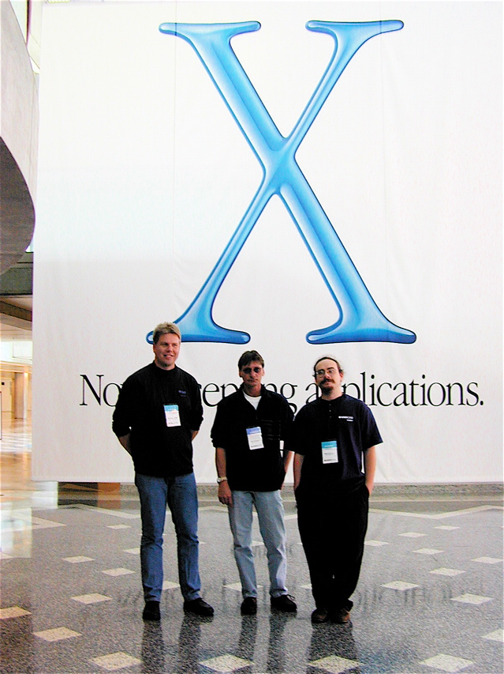

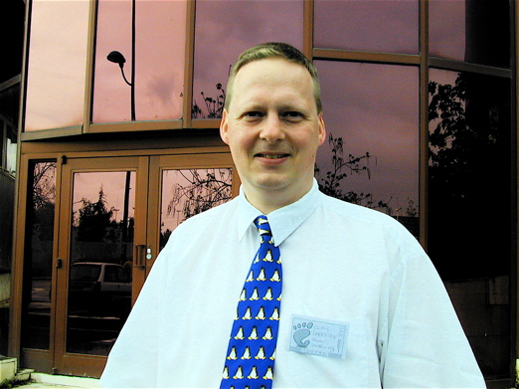
Mapping Site
    Sander Vesik: Release manager Estonia
    Mac OS X Beta Launch,
    May 2002
    Claus Sorrenson
    Attending GUADEC
    In 2002.

Slide 4
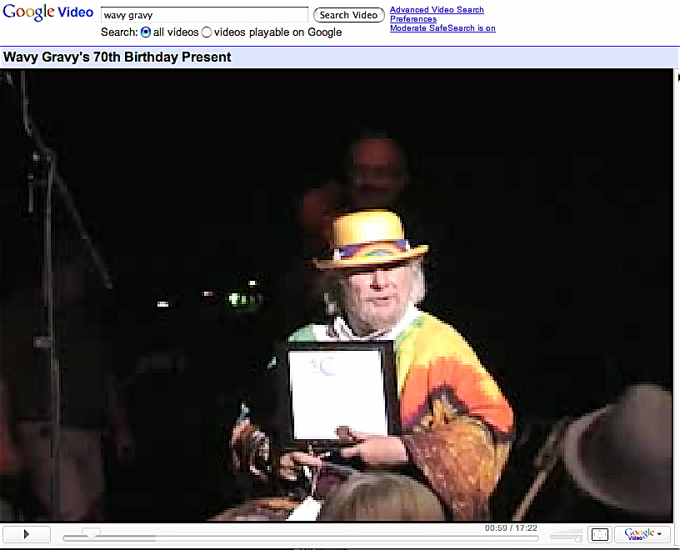
Mapping Site

Slide 5
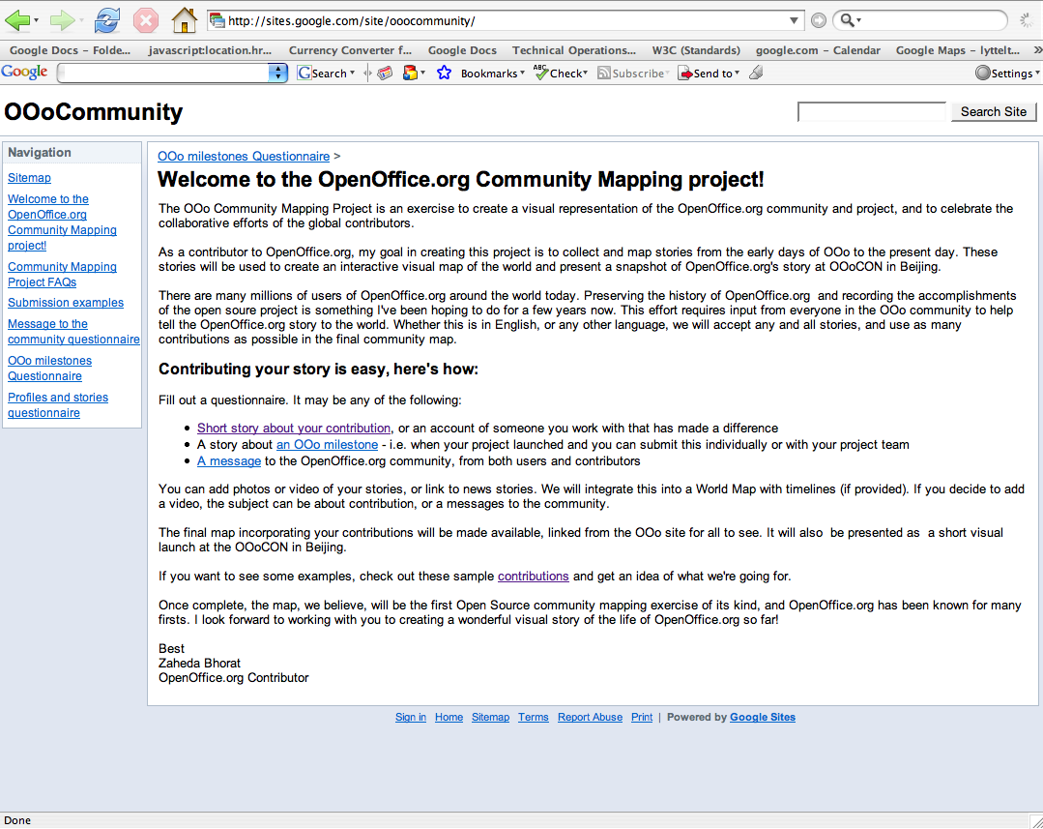
Mapping Site
  http://sites.google.com/site/ooocommunity/

Slide 6
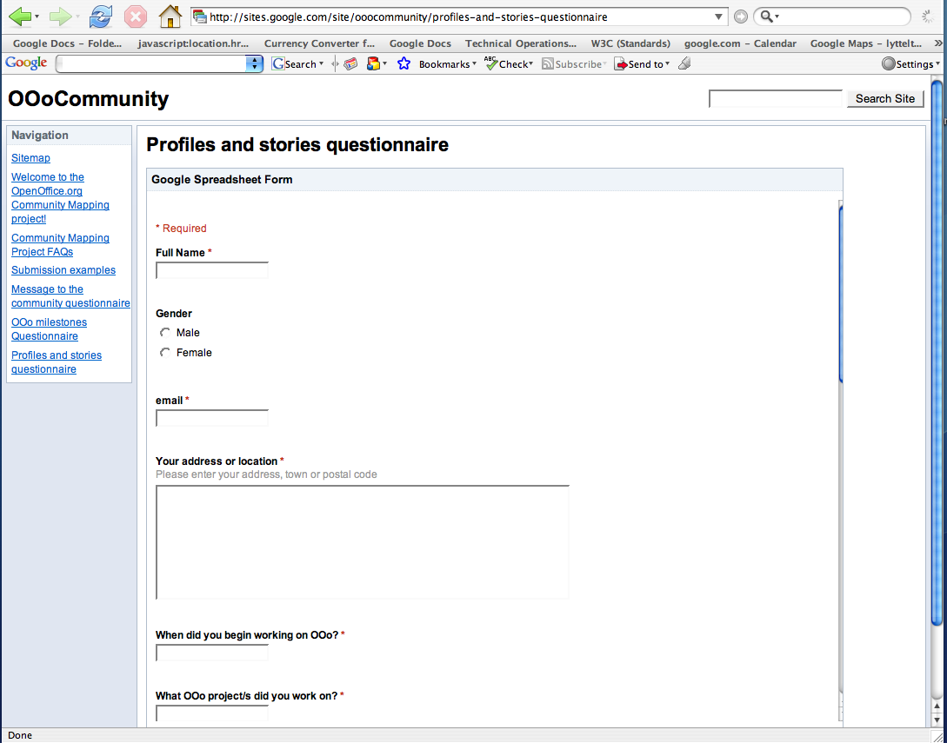
Questionaire

Slide 7
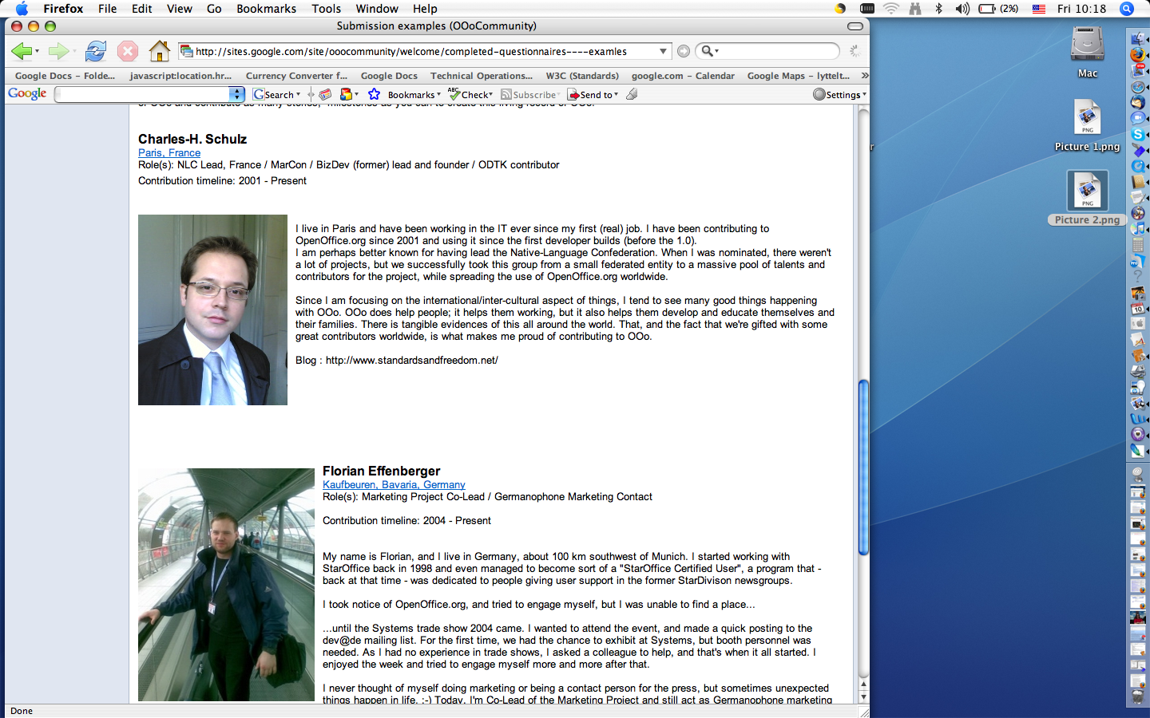
Content Sample

Slide 8
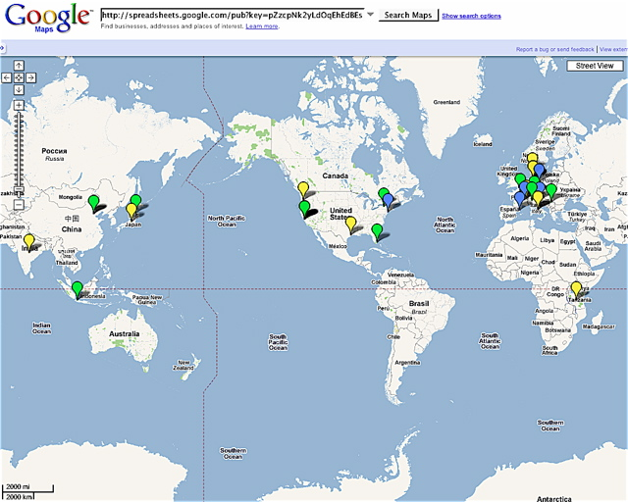
Mapping Site

Slide 9
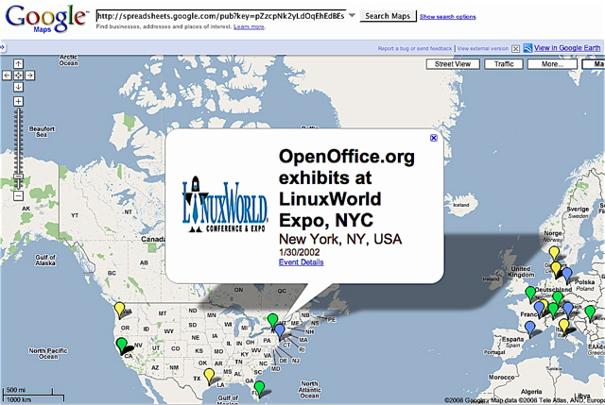
Mapping Site

Slide 10
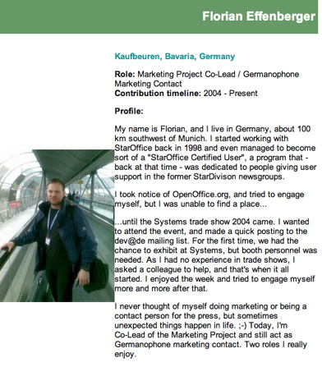
OooCON Sample

Slide 11
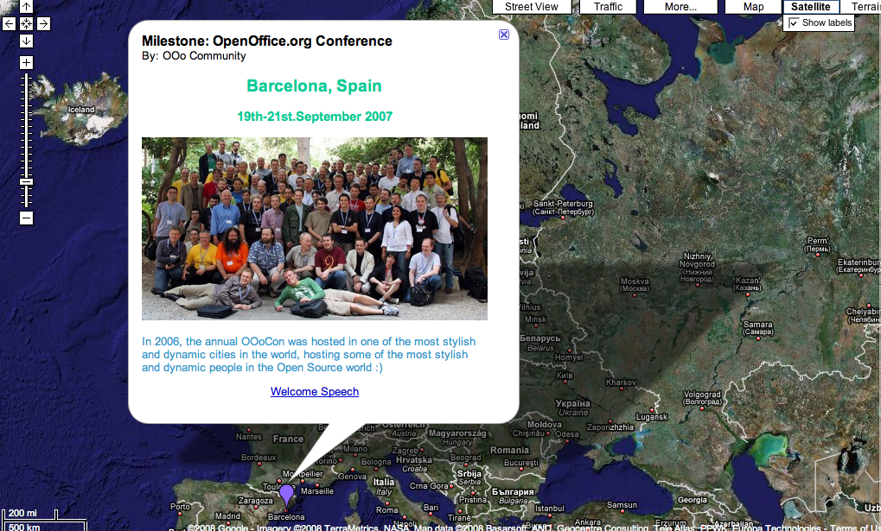
OooCON Sample

Slide 12
COMPLETE A QUESTIONAIRE !! PLEASE !!!
  http://sites.google.com/site/ooocommunity
  Put yourself on the Map !!
Any questions, email :
zaheda@openoffice.org
THANK YOU !

Slide 13
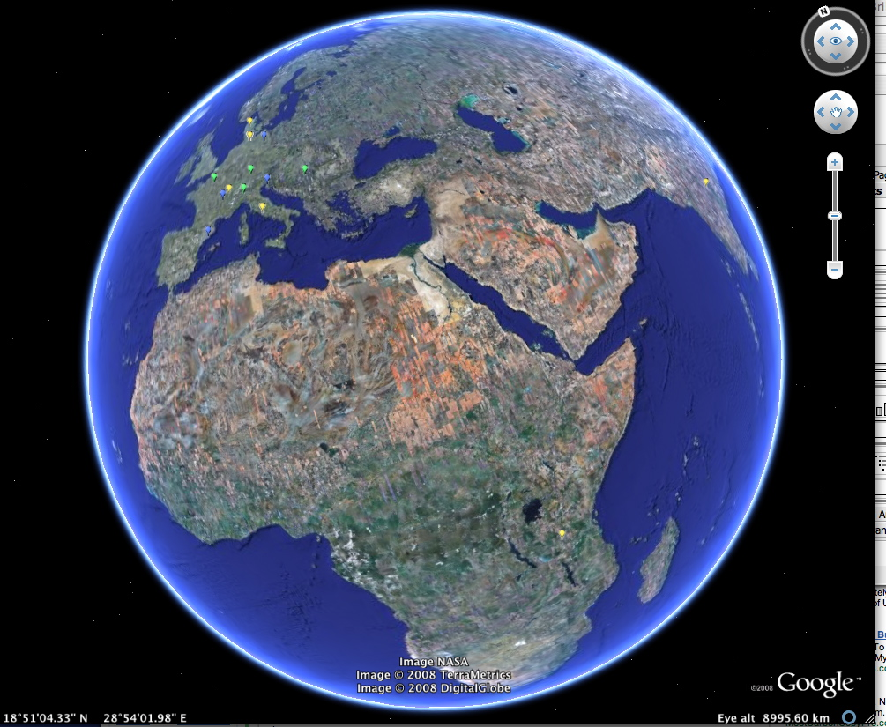
ROLL VT : The OpenOffice.org Story

