Slide 1
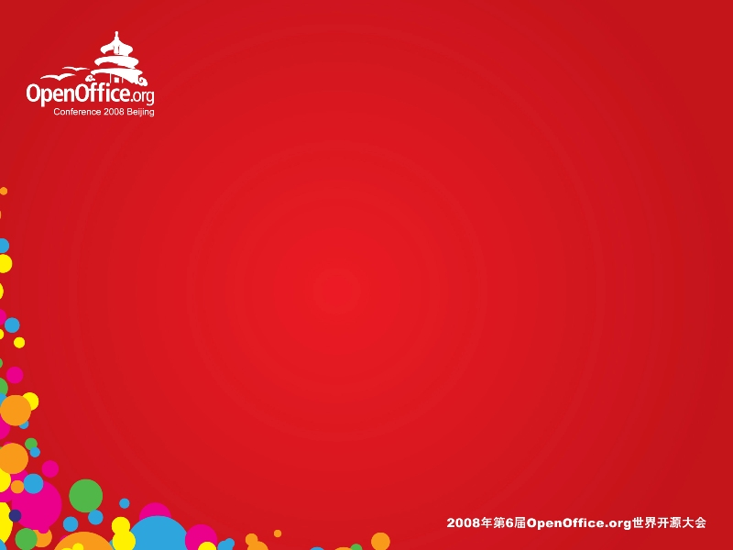
Symphony and Beyond
Dr. Michael Karasick
Director of Lotus Developent, IBM China

Slide 2
Yes, we are moving to Open Office 3.0
(and we will be contributing)
Now that I have your attention.......

Slide 3

Agenda
Symphony in 4 charts
What is IBM doing?
IBM Report Card
What IBM does to “Improve its Grades”
Moving Beyond Office

Slide 4

What is Symphony
We started in 2003
  On Linux delivering “Open Storm” to KingSoft
  “IBM Productivity Editors” are part of Notes 8
User interface is based on Eclipse Rich Client Platform
  Symphony is “one application”, not “three”
Symphony has an integrated web browser and http server
It is (mostly) free
  Downloads are free (~3M downloads in Year #1)
  Moderated support forums are free
Symphony can be rebranded, and used by anyone
  Also for free.

Slide 5


Symphony is also a Toolkit
Eclipse is well-accepted by the industry
  Business partners are already educated
Toolkit has source code samples
  UNO for modifying documents
  Eclipse for extending the editor
Symphony web site has plugins
  Rebrand, integrate with back-end DB, translate document text to other languages....
Symphony extension model: Talk on Thursday

Slide 6

What Our Customers Say
“Lotus, are you serious about this space?”
The UI is Cool and Modern
  The sidebar is useful
  Integrating all three applications is a “good thing”
Why does Symphony take so long to start up?
Why is Lotus using Eclipse?
Why are you idiots (Lotus) still on Open Office 1.1?
When are Symphony Spreadsheets “Going to Work?”
  Pivot Tables® Integration
  Visual Basic® Integration
  Spreadsheets take forever to load

Slide 7
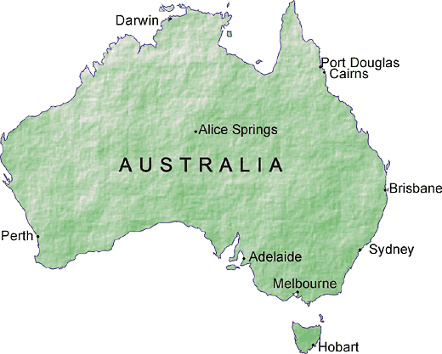


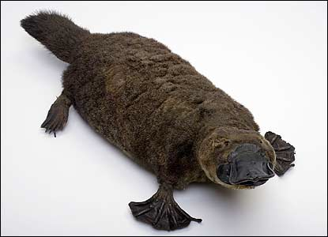

Evolution

Slide 8
Evolution
Open Office
3.x
ODF 1.2
Charts
Translations
Extensions
Office
IAccessibility2
Eclipse
Charts
Translations
Symphony
Open
Open Office
1.1.4

Slide 9
Agenda
Symphony in 4 charts
What is IBM doing?
IBM Report Card
What IBM does to “Improve its Grades”
Moving Beyond Office

Slide 10
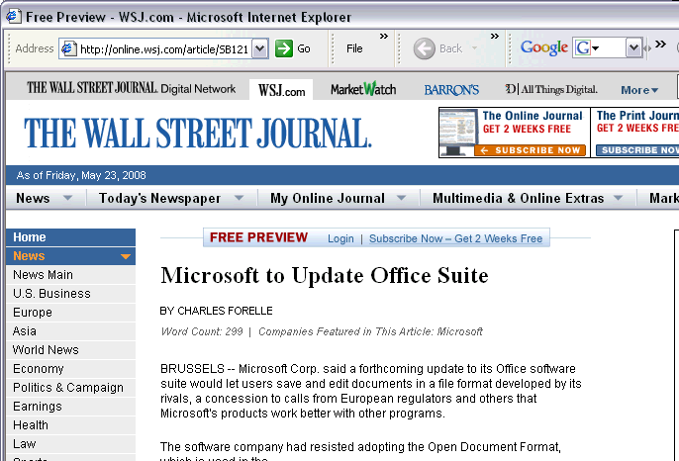

What is IBM Doing?
Make an Open Document Format (ODF) Ubiquitous
Liberate IT budgets of our customers
  They want to decide how to spend their IT budgets
  Not much innovation in “Office” products for years
    ... and Microsoft Office® costs a lot
Contribute to an innovation platform
  Remember Eclipse, Java, Linux...
Maybe stir things up a little (“free” helps)
Watch a marketplace change

Slide 11
Agenda
Symphony in 4 charts
What is IBM doing?
IBM Report Card
What IBM does to “Improve its Grades”
Moving Beyond Office

Slide 12
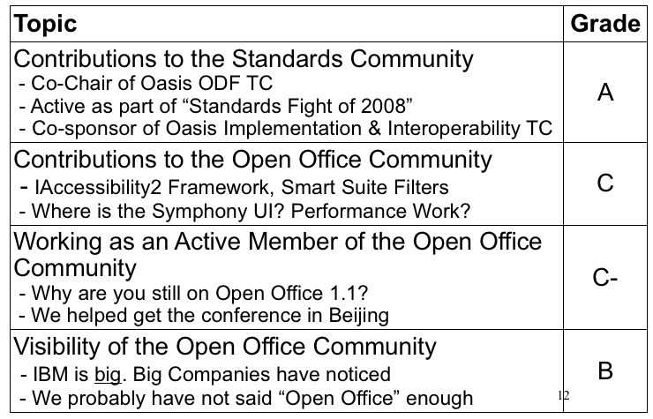
IBM Report Card

Slide 13
Agenda
Symphony in 4 charts
What is IBM doing?
IBM Report Card
What IBM does to “Improve its Grades”
Moving Beyond Office

Slide 14

Transition to Open Office 3.0
5 Years of work to be tested/migrated
  Contributions
    IAccessibility2
    Smart Suite Filters
    Symphony UI, Including SideBar
    Performance work
    Bug-fixes
      Some of them are still there...
    Enhancements
      Some still are...

Slide 15
Migration to Open Office is Blocked By Spreadsheets
A suite of applications is as strong as its weakest element
  Load/Store performance
    We have done some work. Need to benchmark the work
  Scripting
    In order to port Microsoft Excel® spreadsheets, we need a functional open-source Visual Basic® runtime
    Come to talk and participate (16:45 Wednesday)
      200 API's down, 4853 (approximately) to go....

Slide 16
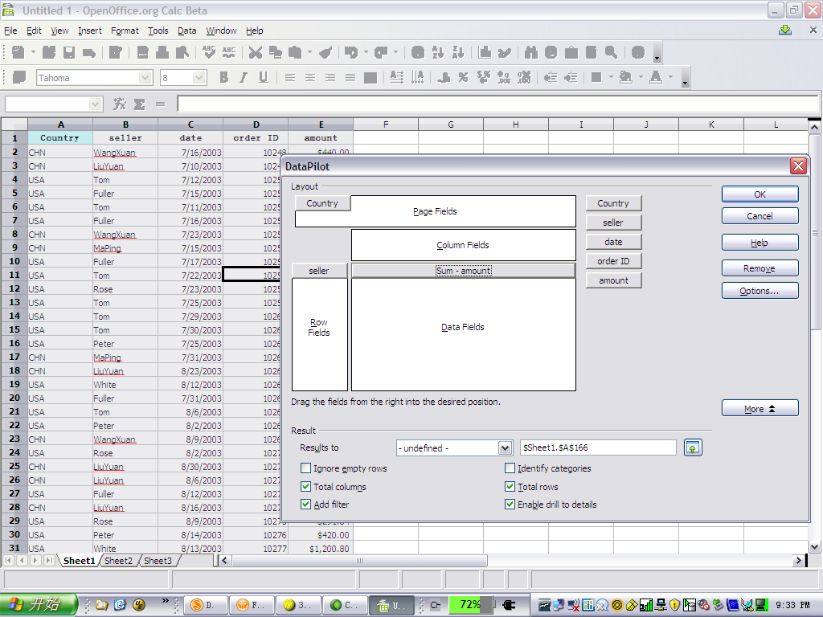
Data Pilot in OO 3.0

Slide 17
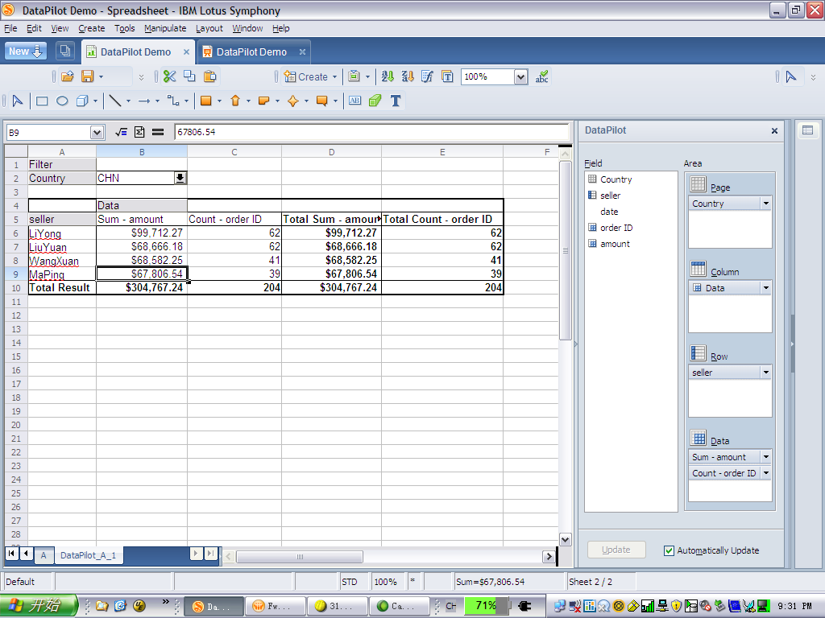

Data Pilot in Symphony 1.2
Sidebar Wizard
Spreadsheet updated in real-time
Planned Contribution

Slide 18
Agenda
Symphony in 4 charts
What is IBM doing?
IBM Report Card
What IBM does to “Improve its Grades”
Moving Beyond Office

Slide 19
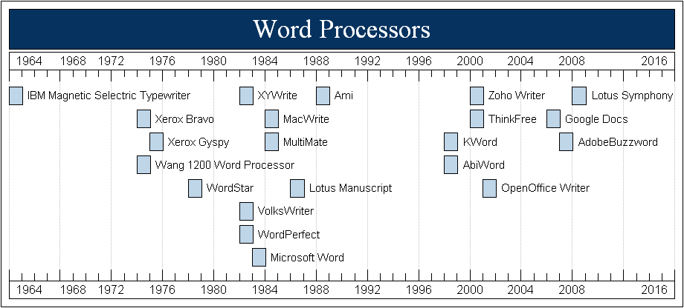
How Did We Get Here?

Slide 20

Beyond Office?
Assumptions
  ODF-based implementations become more prevalent
    Open Office, Google Docs, Symphony, Microsoft!!, Zoho, ...
  Trend towards people working together via social networking continues
  Paper continues to decrease in importance as rendering medium
Conclusions
  “People working together” is more important than “People creating documents”
  People publish ODF fragments and pieces thereof
    People find, reuse, rate fragments [IBM pioneered approach with DITA]
Focus on how people network to create documents and artifacts
  Both informally and in more structured (enterprise) environments
  Systems have to be extensible (new kinds of editors and new kinds of content)
  Content will get reused in multiple contexts
    Presentations ==> Pictures; Document ==> Text; Spreadsheets ==> Tables
      Components with successive disclosure of capanilities
  Both Web-based and Rich client experiences

Slide 21

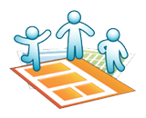


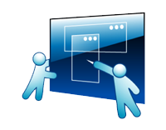




“Beyond Office” Technical Strategy
Activity oriented
Collaborative Authoring
What you you want to do?
I want to create a...
Rich content
Programmable
Content layer
Semantics layer
Reputation/Ranking/Value
Live connections
Discovery

Slide 22
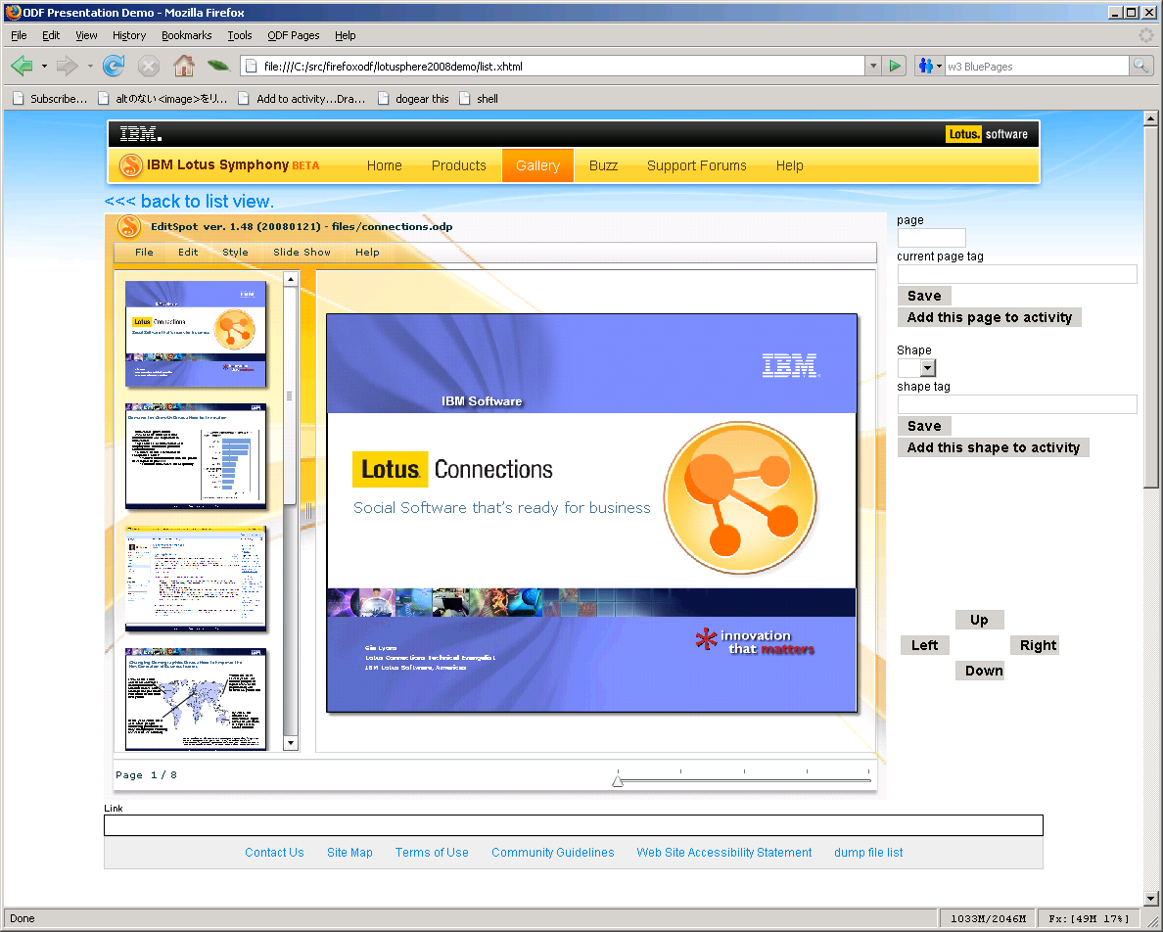
EditSpot: Flash-based Presentation Editor
Subset of ODF
  Presentations only
Also looking at (very) simple Spreadsheet processing (i.e. update field)
For ubiquitous success some standards work
  ODF “Web Profile” for Interoperability with similar tools

Slide 23

Web-Based Presentation (Slide) Repository
  Easily harvest slides from library of existing presentations
  Tag- and content-based search for slides

Slide 24
Slide River Plugin for Lotus Symphony

Slide 25
How do People Create Content
Individually
  Reuse content from the community
As a team member with a specific role
  Responsible for a specific portion of a “document”
  Documents are disaggregated and then aggregated
Responsible for steps in a business process
  Documents represent aggregated business decisions
  Assembled using specfic work flow
More people and organizational structure
Net:
Issue is not:
  What are the tools ... and ...
  Are they web-based or rich-client based
Issue is instead:
  How do I find existing content ... and ...
  How to I reuse it efficiently ... and ...
  How do my tools scale from individual to team-based tools

Slide 26
Dandelion: Collaborative Content Creation

Slide 27



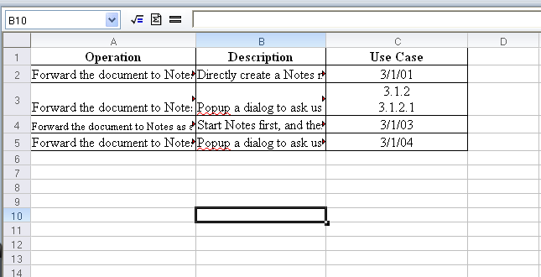
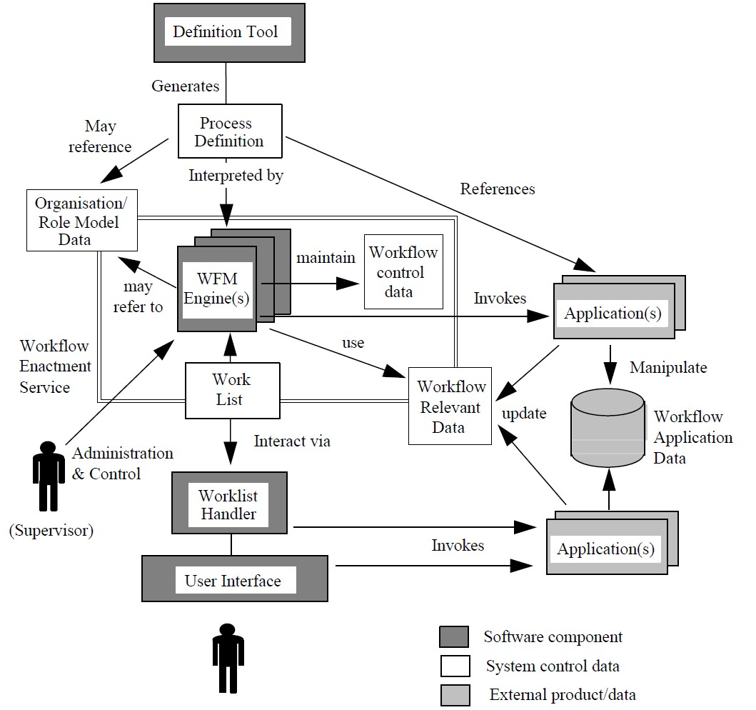


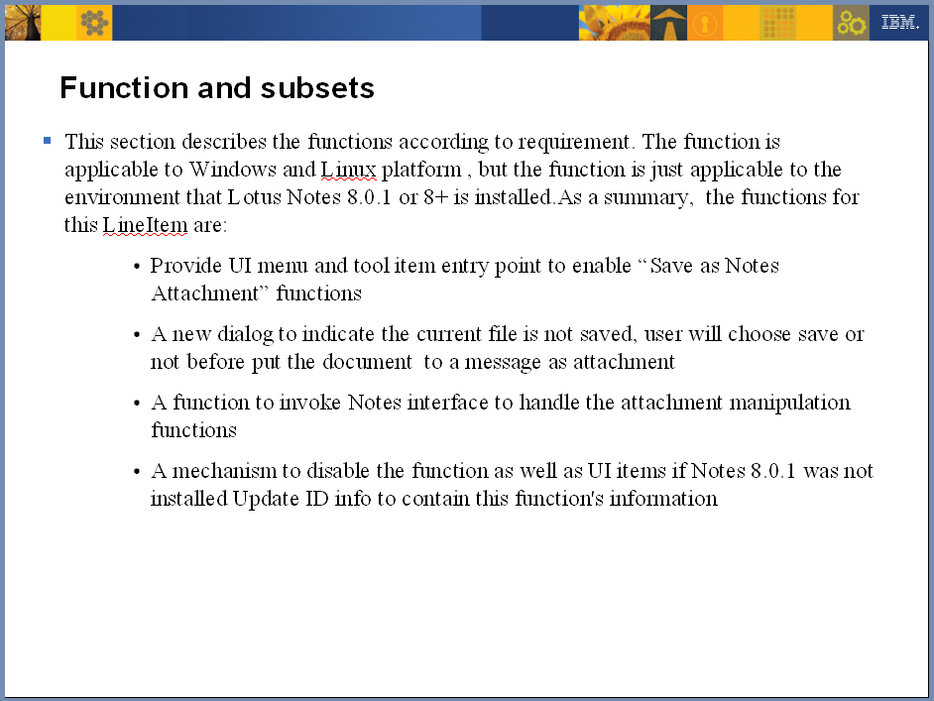
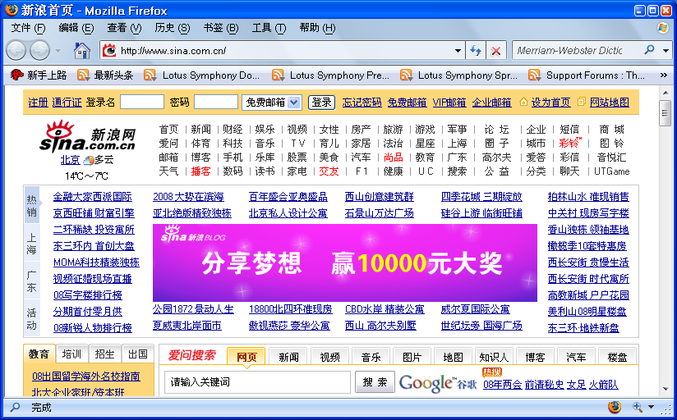
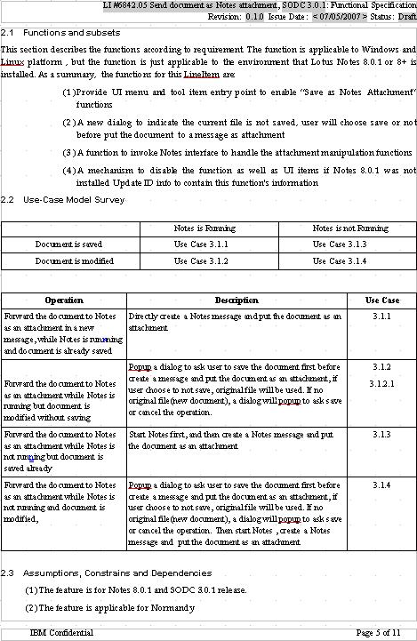
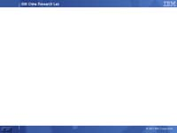
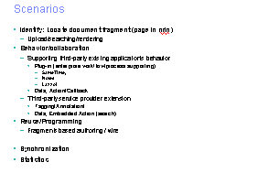
Matching Document Model with Mental Model
Comment
Annotation
Reference
Reference
=
Discussion

Slide 28
Dandelion Services
(Work in Progress)
  Searchable content
  search scopes
  URI's within documents
  tags, comments, ratings
  Document Structure
  Aggregate “chunks”
  Decomposie documents
  Domain-specific semantic model
  Templates provide structure
  Static or live content
  Version tracking
Time
Content

Slide 29
Agenda
Symphony in 4 charts
What is IBM doing?
IBM Report Card
What IBM does to “Improve its Grades”
Moving Beyond Office
  So “how do we get there from here?”

Slide 30
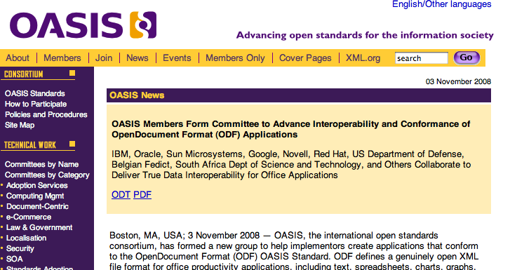
Ubiquity Requires Interoperability

Slide 31
Announcing:
The ODF Toolkit Union
Founding members include: Sun Microsystems and IBM
  Many more members are expected to join
  Will deliver immediate benefits to developers of business applications and Web and Mobile software
An open source project based at http://odftoolkit.org
ODF Toolkit deliverables will be offered under the Apache2 license. http://www.apache.org/licenses/LICENSE-2.0
Initial code contributions from Sun Microsystems
Code not dependent nor related to OpenOffice software

Slide 32

ODF Toolkit: Description, Benefits and Uses
The ODF Toolkit will include:
  ODF DOM API
  ODF Reader
  ODF Writer
Similar to the W3C's HTML DOM
  ... Sheet, Cell and Chart objects.
  Goal: develop an API which covers the entire ODF 1.2 spec
Directly support programmatic manipulation of ODF documents
Easily add support for ODF to applications
  Traditional desktop, Web browser, and mobile device users
Innovation
Innovation
Innovation
Innovation

Slide 33
Pluggable reading and writing
ODF Writer
ODF Reader
Office Writer
ODF DOM
WordPerfect Writer
Office Reader
SmartSuite Writer
WordPerfect Reader
HTML Writer
SmartSuite Reader
PDF Writer
HTML Parser
DocBook Writer

Slide 34

ODF Toolkit Use Cases
Interactive creation in an a heavy-weight client application
Interactive creation in a light-weight web-based application
Collaborative (multi-author) editing
Automatic creation in response to a database query (report generation)
Indexing/scanning of document for search
Scanning by anti-virus
Other types of scanning, perhaps for regulatory compliance, legal or forensic purposes
Validation of document, to specifications, house style guidelines, accessibility best practices, etc.
Read-only display of document on machine without the full editor (viewer)
Conversion of document from one editable format to another
Conversion of document into a presentation format, such as PDF, PS, print or fax
Rendering of document via other modes such as sound or video (speech synthesis)
Reduction/simplification of document to render on a sub-desktop device such as cell phone or PDA.
Import of data from an office document into a non-office application, i.e., import of spreadsheet data into statistical analysis software.
Export of data from a non-office application into an office format, such as an export of a spreadsheet from a personal finance application.
Application which takes an existing document and outputs a modified version of that presentation, e.g., fills out a template, translates the language, etc.
Software which adds or verifies digital signatures on a document in order to control access (DRM)
Software which uses documents in part of a workflow, but treats the document as a black box, or perhaps is aware of only basic metadata.
Software which treats documents as part of a workflow, but is able to introspect the document and make decisions based on the content.
Software which packs/unpacks a document into relational database form

Slide 35
Questions?

