Slide 1
Open Standaarden
en
OpenDocument
Notes:
The presentation is about Open Standards, and about OpenDocument, the open standardized file format that OpenOffice.org 2 uses.

Slide 2

ir. Simon Brouwer
Project lead of nl.openoffice.org

Slide 3
Overview
Standards, what are they and what are they good for
Different kinds of standards
What is an Open Standard
Why is it important?
OpenDocument
Further developments
Conclusion

Slide 4
Standards
Wikipedia:
“A standard is a procedure or a measure of which a group of people have agreed that they are going to use it”.
Notes:
A good definition of standards can be found on the (Dutch version of) Wikipedia, the free internet encyclopedia.
It is actually a wide description that could be about social interaction. On the next pages I give some examples of technical standards.

Slide 5



Examples of standards
Notes:
I can be sure that M6 bolts fit on M6 nuts.
And I can connect my new refrigerator at home without problems as the electrical and mechanical properties of plug and socket are accurately standardized
And A4- format paper always fits in my printer, and the letter that I print neatly goes into a standard envelope (e.g. a B5).

Slide 6
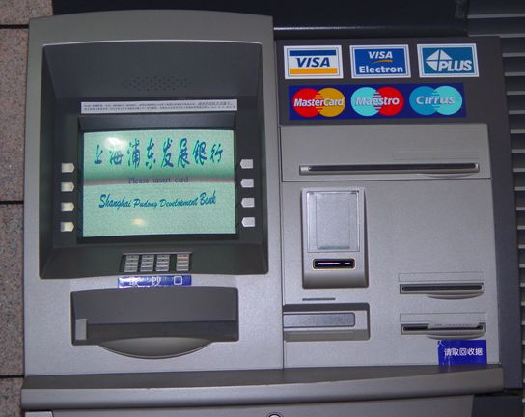

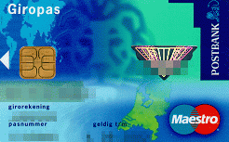
Examples of standards
Notes:
Because the physical properties of bank cards and the communication protocols between banks are standardized, I can use my Dutch bank card to withdraw money in, for example, Shanghai.
A somewhat less technical standard helps Dutch speakers to write understandable texts.

Slide 7
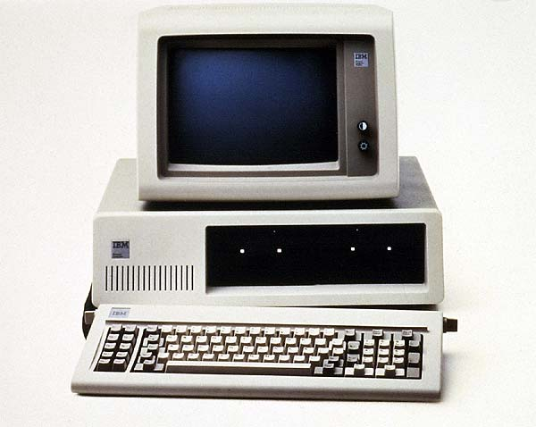
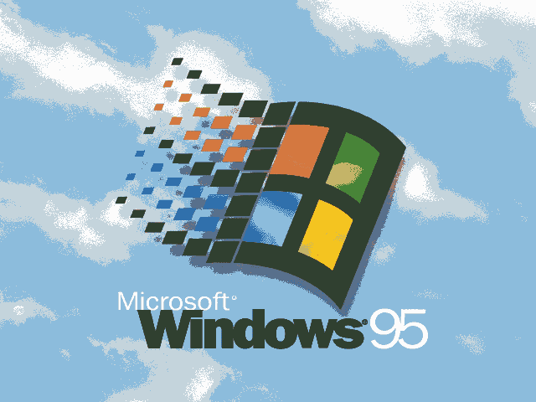
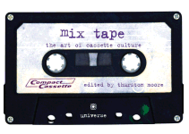
Differences in standards
Formal and 'de facto' standards
Closed and open standards
When no standard? “Connector conspiracy”
Notes:
Not all standard function the same way. Some are developed as such, for example the SI metric system of measures and weights.
Other standards come into existence because many people or organizations use a certain thing, and therefore it makes sense to join them. That is called a 'de facto' standard. You can think of the alphabet, or the compact cassette of Philips or the IBM compatible computer.
Ifaccess to the content or the application of a standard is limited, you can speak of a closed standard; an open standard is the opposite.
Note that all the standardized products mentioned so far are made by a large number of vendors, leading to sound competition. In some cases a company can choose to not user standards, forcing the customer to keep using the products or services of that company. For example, in the 70s computer had all kinds of non standard connectors so that only peripheral equipment of the same manufacturer could be used with them.

Slide 8
What is an open standard?
OSOSS: An open standard is a standard that is no-one's property and that anyone can use.
NLGG: An open standard is freely accessible to everyone and free to be used.
Published
Specification available for free (or at nominal cost) to everyone
Free of legal constrictions such as patents (or: non discriminatory, reasonably priced licences)
Has to be administered by an independent (non-profit) standards organization
No limitations on re-use (or actually, some!)
Notes:
I give two descriptions of open standards, one of the programme Open Standards and Open Source Software for the public administration, and one of the Dutch Linux Users' Group.
It is not simple to get to a single definition of Open Standards, here I have tried to summarize several definitions.

Slide 9
Why are open standards important?
Choice and flexibility
End-user independence from vendors (lock-in, forced upgrades)
Promote a fair market, more competition, and more innovation
Better exchange of information
Accessibility of public administration's documents
Notes:
* you have the freedom of choice between different softwares to open a certain file, and it is relatively easy to switch.
* So you can also switch to another software vendor.
* The different vendors have to compete on price and quality
* Exchanging documents is easier, even if others don't use the same software as you
* Government documents are accessible without requiring the citizen to use a specific (expensive) software, and also stay accessible to the government itself when the specific software that was used to make them is not available anymore

Slide 10
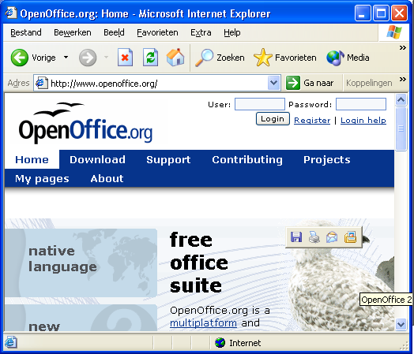
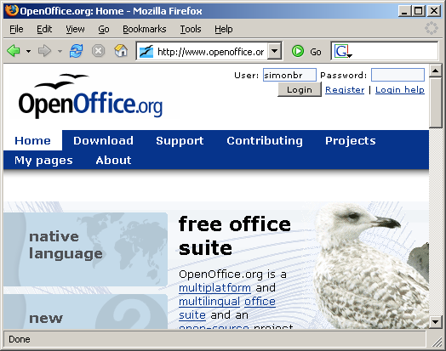
Examples of Open Standards
TCP/IP (IETF en ISOC)
HTML, XML (W3C)
OpenDocument
Notes:
Together the open standards TCP/IP and HTML ensure that you can view the same web pages using different softwares on different platforms
XML is comparable with HTML and is the basis for structured file formats such as OpenDocument.

Slide 11
OpenDocument
“Oasis Open Document Format for Office Applications”
An open, freely available XML file format
Derived from the OpenOffice.org / Star Office file formats
Several types of documents
Standard developed in OASIS
Provides an alternative for vendor dependent file formats
Notes:
The official name of the OpenDocument format or ODF is “OASIS Open Document Format for Office Applications”

Slide 12








Wat is Oasis?
Industry consortium
Members include:
Notes:
OASIS is a consortium of a great number of IT companies.
Here, just a few of those companies/organizations, that have been involved in the standardization of OpenDocument, are shown
A number make Office-related software, such as Sun (Star Office), IBM (Workplace), Novell (SuSE Linux), Corel (WordPerfect) and KDE project (Koffice).
Others are users of such software, such as Intel and Boeing (large , complex documents) and the Nationale Archives of Australia (documenten that have to be accessible in the long term)

Slide 13

Many expect ISO will accept and approve OpenDocument using its fast-track process, and that once ISO ratifies the standard, the European Union will require OpenDocument as the office suite standard for the European Union.

Slide 14
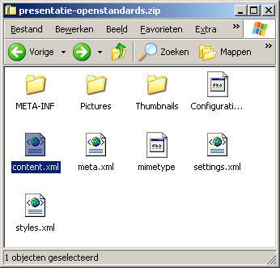
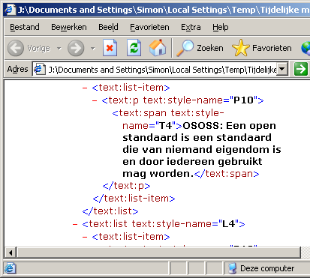
What does it look like?
Notes:
To get an impression of the insides of an OpenDocument file: in fact it is a zipped file. I have renamed ths presentation to a .zip file, and MS Windows then shows its contents (on the left). Besides a number of directories containing e.g.. images, in common formats, the most important file is content.xml. This can be opened in an ordinary text editor. Here I opened it in Internet Explorer because it highlights the different elements with colors.
You can see that the content of the text is easy to find. The pieces that are surrounded by < and > are the so called XML-tags. These contain further information about the formatting of the document and their meanings are defined in the OpenDocument standard. Using this standard, an average programmer should find it easy to deal with such a document.

Slide 15
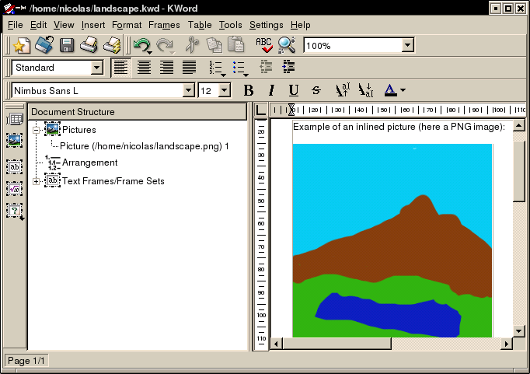
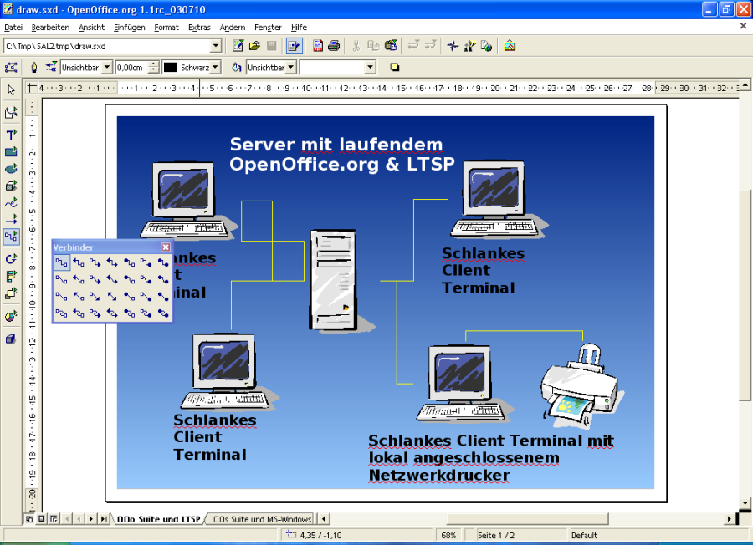
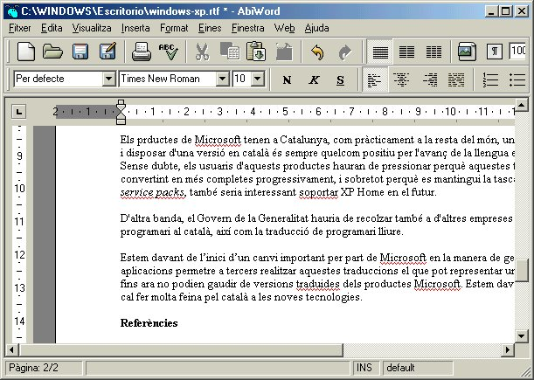
Some implementations of OpenDocument
Notes:
OpenOffice.org is certainly not the only software that supports OpenDocument ondersteunt. Shown here are just some examples: besides OpenOffice.org, the text processorAbiWord, the office suite Koffice, and IBM's Workplace.

Slide 16
Public administration and OpenDocument
Many public administrations consider the importance of Open Standards.
Massachusetts: government should only use Open Standard documents: OpenDocument and PDF
Europe: when OpenDocument becomes an ISO standard wordt, the public administration may be obliged to use it

Slide 17
An alternative from Microsoft?
“OpenXML”
New default file formats for MS Office 12
Specifications were already available
Microsoft is going to offer these for standardization by ECMA, later by ISO
Exclusion of Open Source (GPL, LGPL)?
Only a real open standard if it is allowed to be applied by anyone
Notes:
Only yesterday, Microsoft announced that it intends to present the XML schemas of MS Office, that were released before, for standardiszation by the European Computer Manufacturer;s Association (ECMA) and later by ISO. Standardization should be a fact in about 18 months.
It is questionable how open that standard is. The licenses for the XML schemas had been drawn up in such a way that they were not compatible with use in GPL/LGPL software (the major open soure projects use this license). If Microsoft does not change this then you have to ask yourself how open this standard will actually be.

Slide 18
Conclusion
Open Standarden offer freedom of choice, , flexibility, promote competition and innovation, and better access to information
OpenDocument is the open standard in the area of office documents, and is very promising

Slide 19
Image “seagulls” copyright Justin M. Kane (used with permission)

