Slide 1

What open source lovers want?
Erwin Tenhumberg
Community Development and Marketing
Open Source Group
Sun Microsystems
  September 2006

Slide 2
What I will talk about
OpenOffice.org Developer Surveys
OpenOffice.org User Surveys
User Feedback == Potential To-Do List Items

Slide 3
OOoCon Ad-hoc Developer Survey - Top 3
Build system pain
Modularization, refactoring, clean-up
Specifications and code review
n = 25 Participants

Slide 4
Other issues mentioned
Community management and process
Translation process, i18n
Development docs
Replacing VCL and UI development
Focus on actual user satisfaction

Slide 5
OpenOffice.org Contributor Survey
Promoted on various developer mailing lists
Focus on code contributors
30 people participated

Slide 6
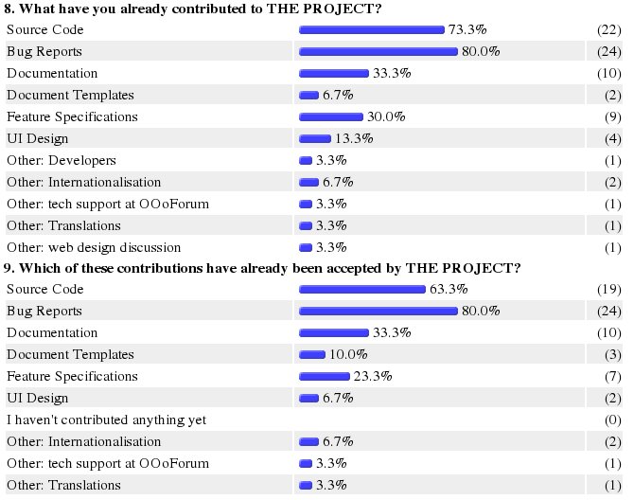
Contributions of survey participants

Slide 7
OOo Survey: What three things do you like most about OpenOffice.org?
The high visibility of the project, e.g.
  Broadly used end-user product
  Best Microsoft alternative
  Participation from large companies
The community experience, e.g.
  Distributed development
  Team work via IRC and email
  OpenOffice.org Conference (OOoCon)
Technology exposure / learning new skills, e.g.
  UNO

Slide 8
What three things do you find most annoying about OpenOffice.org?
Bug fix inclusion process, e.g.
  Inclusion of bugs takes to long
  Complex process
Code complexity
Lack of documentation
Build system, e.g.
  Builds take too long
  Build system not easy to understand
Project infrastructure, e.g.
  Performance and reliability

Slide 9
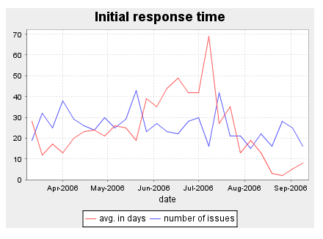
New Patch Metrics:
Initial Response Time (IRT)

Slide 10
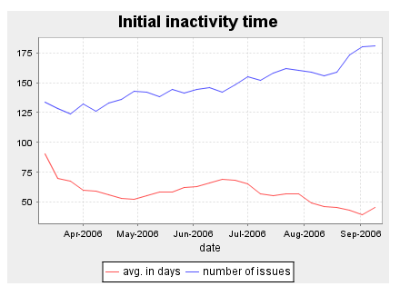
New Patch Metrics:
Issue Inactivity Time (IIT)

Slide 11
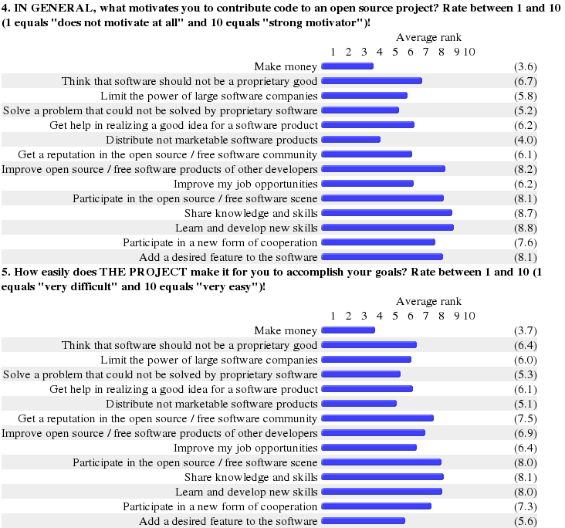
Motivations for Participation

Slide 12
Motivations - The Good and the Bad

Slide 13
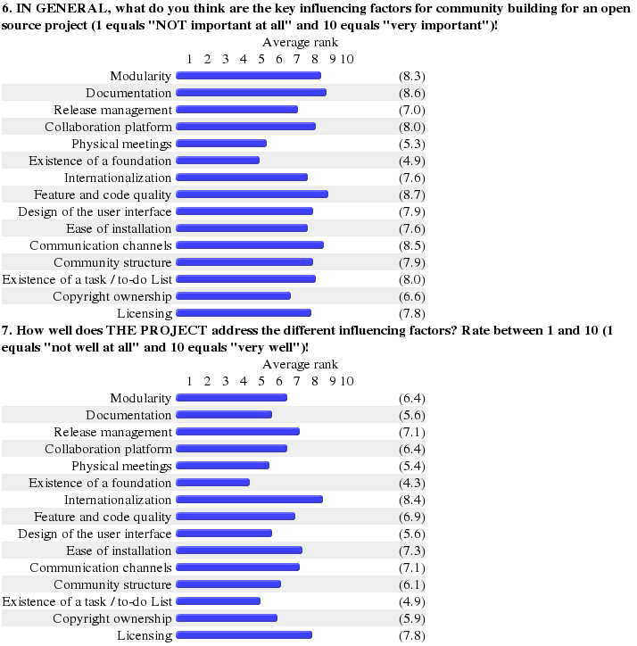
Key influencing Factors

Slide 14
Influencing Factors - Good/Bad

Slide 15
OpenOffice.org Developer Survey on development.openoffice.org (ended)

Slide 16
OpenOffice.org User Survey
Started 20 October 2005, i.e. the launch of OpenOffice.org 2.0
Only available in English!!!
People get to the survey via the registration dialog
Link to the survey has been deactivated by quite a few (Linux) distributions
More than 900,000 participants so far

Slide 17
More than 2,000 participants per day!!!
Longer outage!

Slide 18
80% new survey participants

Slide 19
More than 60% new users

Slide 20
How People find out about OpenOpenOffice.org

Slide 21
OpenOffice.org Distribution/Acquisition

Slide 22
Majority is using OpenOffice.org 2.0.x

Slide 23
Platform Importance

Slide 24
OpenOffice.org Users by Country
(Top 15)

Slide 25
Importance of Languages (Top 15)

Slide 26
Primary Use of OpenOffice.org

Slide 27
Industries / Verticals

Slide 28
Company Sizes

Slide 29
Switch/Migration Rate

Slide 30
Feature Area Importance

Slide 31
Opportunities for Complementary Products

Slide 32
About 70% of the users are not interested in contributing back to OpenOffice.org – Can we change that?

Slide 33
What users want,
and what new developers
could look at

Slide 34
Top-12 Wishes (“announce”, Dec. 2004)
Microsoft interoperability incl. macro support
Microsoft Access clone/alternative
Performance and stability
Groupware client (PIM / Microsoft Outlook clone/alternative)
Dictionaries, spell checking, grammar checking
Mac version
Modern UI
PDF export and import
Bibliographic tool
AutoUpdate
Support for distributed editing / collaboration
Document templates

Slide 35
Top Barriers for Businesses (User Survey)
Microsoft compatibility (including roundtrip)
Inertia
Existing vendor relationship
Training costs
Visibility of OpenOffice.org
Open source / non-Microsoft mistrust
Third party integration/support
Existing Microsoft Office licenses
Missing Outlook alternative
Missing VBA macro support
Support availability (internal and external)
Migration costs
Usability

Slide 36
Top Annoyances (User Survey, 1 of 2)
Microsoft Office compatibility
Startup performance
General performance
Ease-of-use
Stability
Microsoft UI compatibility
Memory usage
Macro recorder

Slide 37
Top Annoyances (User Survey, 2 of 2)
Mail merge
Developer documentation
Base functionality
Microsoft Access import/support
Chart functionality
Bullets and numbering
Poor HTML export
Online help

Slide 38
Things that should be added (1 of 2)
Improved compatibility (including rountrip)
Outlook alternative
MS Access alternative (including reports)
Better macro recorder/editor
PDF import
VBA macro migration/conversion
HTML/XHTML editor (including CSS support)

Slide 39
Things that should be added (2 of 2)
Improved/extended PDF export (e.g. security features)
More/better photo editing features
More/better templates
Grammar check
Developer documentation
More/better dictionaries
Better PivotTable support

Slide 40
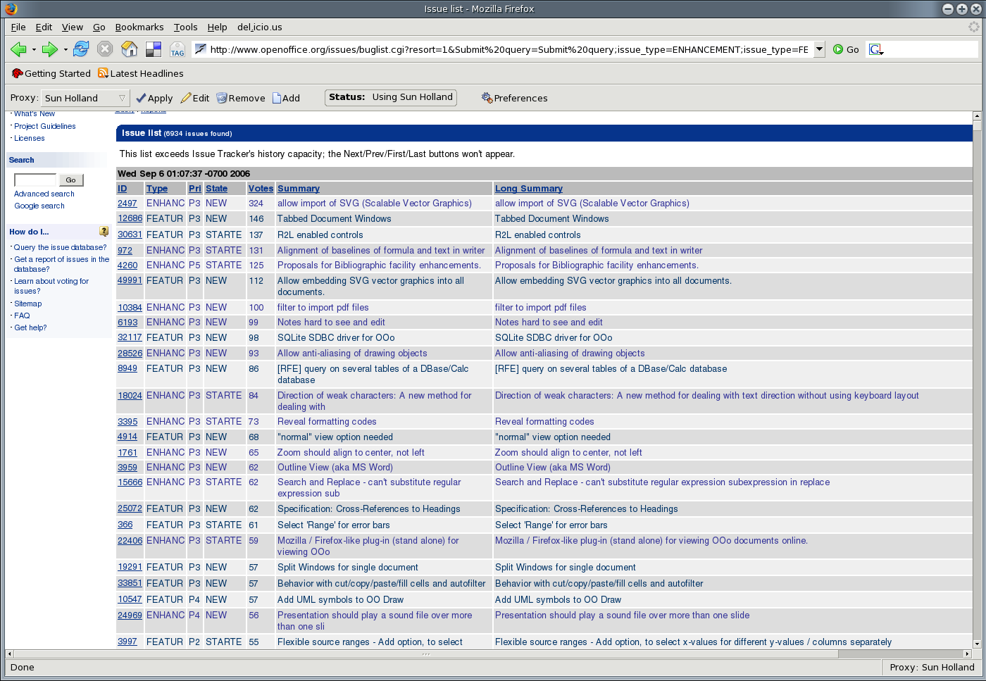
Top Issue Tracker RFE's

Slide 41
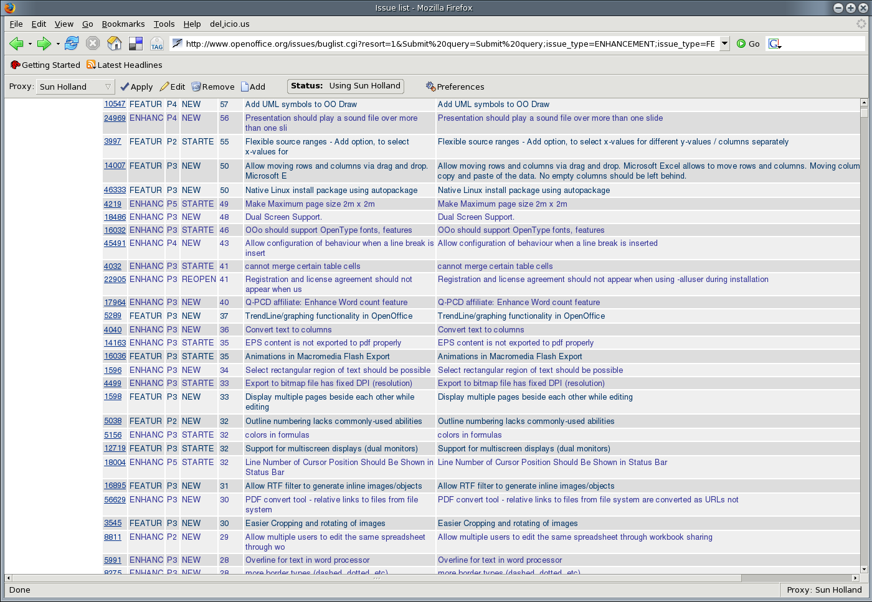
Top Issue Tracker RFE's

Slide 42
Next steps
“Deep dive” into the survey data
Redesign of the user survey e.g. elimination of some open ended questions and insufficient answer options
Setup of (a) new developer survey(s)
Creation of “job descriptions” (i.e. to-do list items) based on the user survey and Issue Tracker data
Finding ways to move people up the “open source loyalty ladder”, i.e. turning users into evangelists and evangelists into contributors

