Slide 1

RedOffice4.5 UI Implementation
Speaker:Chao Sun
Date:04/11/2008
Notes:
单击鼠标键添加备注

Slide 2
Objective
  To develop a highly optimized framework for integration in current OpenOffice.org system, giving developers the maximum flexibility and comprehensibility.
  The method is to implement one layout manager for all user interface elements based on UNO, extension and scripting code extending and manipulating the user interface.

Slide 3
Introduction to RedOffice 4.0

Slide 5
TITLE
Container Window ( WorkWin )
Backing Window (Self-Defined)
RoStandardBar
LeftPanel
Original OpenOffice.org Container Window
StatusBar

Slide 6
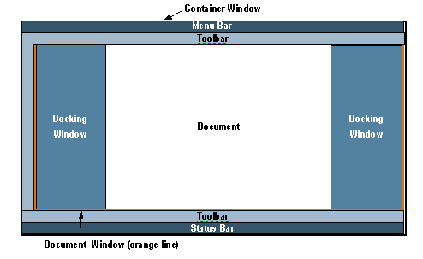
OpenOffice.org 3.0 Layout
Referenced from the engineer of SUN company

Slide 7
Drawbacks
  Three Layoutmanagers
  One for toolbar, menubar and statusbar
  One for Document Window
  One for Top level Window (New)
  No chance for extension or scripting code
  No customized elements(UI layout)allowed
  Massive glue code needed
  Plus drawbacks of current OOo layout

Slide 8
New Requirement (Way out)
  Two Layoutmanagers
  One for old and our new UI elements
  One for Document Window
  Give chance to extension or scripting code
  Customized elements(UI layout)allowed
  Maximize the user flexibility
  Minimize drawbacks of current OOo layout

Slide 9
  Welcome RedOffice 4.5 UI Layout

Slide 14
Additional Docking Areas
Top Docking Area (new)
Top Docking Area (old/classical toolbars)
Document Window
Left Docking Area (new)
Right Docking Area (new)
Left Docking Area (old)
Right Docking Area (old)
Bottom Docking Area (old)
Bottom Docking Area (new)

Slide 15
UI Layout
ImplBorderWindow
Default WinTitle
ROBorderWindow
RoWinTitle
Container Window （WorkWin）
New
New
New
Old
Od
Document Window
Od
Old
New

Slide 16
Achievement
One layoutmanager for all elements
Extensions and scripting code
Simple and easy for developers
Provides more than the requirement

Slide 17
Implementation

Slide 18
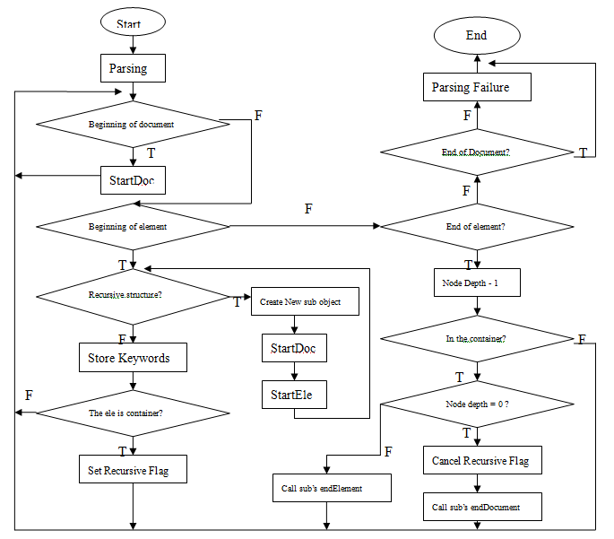
XML Parsing Flow Chart

Slide 19
XML Structure
<ropanel:ropanel ropanel:name="firstpanel">
<ropanel:ropanelitem ropanel:name="Window1"ropanel:container="true" >
<ropanel:ropanelitem ropanel:name="Button1"/>
<ropanel:ropanelitem ropanel:name="RadioButton1"/>
</ropanel:ropanelitem>
<ropanel:ropanelitem ropanel:name="Window2" ropanel:text="Container2">
<ropanel:ropanelitem ropanel:name="Button1" />
<ropanel:ropanelitem ropanel:name="RadioButton1"/>
<ropanel:ropanelitem ropanel:name="Window3" ropanel:container="true" >
<ropanel:ropanelitem ropanel:name="Button4" />
<ropanel:ropanelitem ropanel:name="Window4" ropanel:container="true" >
<ropanel:ropanelitem ropanel:name="Button5" ropanel:text="Text_Button5"/>
</ropanel:ropanelitem>
</ropanel:ropanelitem>
</ropanel:ropanelitem>
<ropanel:ropanelitem ropanel:name="Button3"/>
</ropanel:ropanel>

Slide 20
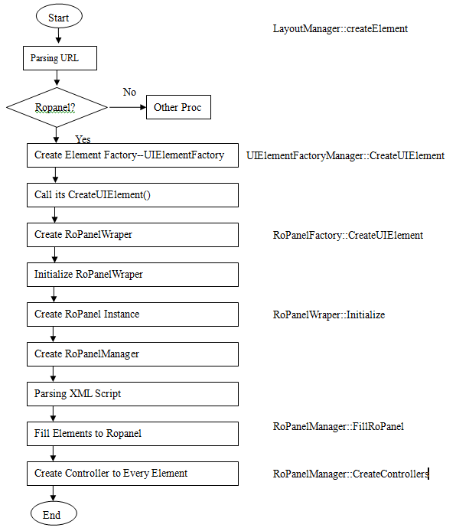
Create Process of the Panel

Slide 21
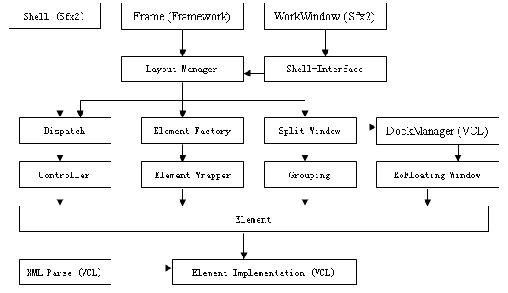
Structure Chart of the Panel

Slide 22
Further Development
Realizing the grouping concept
Layout in the containers
Let customer decide their GUI

Slide 23
  The End

Slide 24
  Any Questions?

Slide 25


