Slide 1

The new ODF 1.2 Metadata Framework
Svante Schubert
Software Engineer
Sun Microsystems Inc.

Slide 2
Why am I here?
For introducing metadata feature & possibilites
  Member of the OASIS OpenDocument Format (ODF) TC
  Co-editor of the OASIS ODF Metadata Specification
  Member of Sun Microsystems StarOffice / OpenOffice.org team since 1999
  OpenOffice.org XML project co-lead
Notes:
Co-lead of OpenOffice XML project
Responsible for the XML based filters
(added new XSLT2 support)

Slide 3
Metadata Basics
What is metadata?
  “Metadata is data about data”
Why do I need metadata?
  Classify / 'Tag' your data
  Make data machine interchangeable
  Bridge the semantic gap
  ...
1) http://en.wikipedia.org/wiki/Metadata
Notes:
The semantic gap characterizes the difference between two descriptions of an object by different linguistic representations,
Make metadata interchangeable with other applications
Reuse the existing Semantic Web Technology Stack

Slide 4
Why using Metadata?
What is metadata?
  Labels to identify/categorize your data
  Related data
Why do I need metadata?
  Metadata makes your data interpretable by other applications

Slide 5
Potential Interoperability Savings..
Information Integration in the Enterprise, Philip A. Bernstein and Laura M. Haas, CACM, September 2008, pp. 72-79 (source for IT budgets (source for interoperability costs)
Untapped Assets: The $3 Trillion Value in US Enterprise Documents http://www.brightplanet.com/images/stories/pdf/documentsvalue.pdf
NIST Strategic Planning Summary, http://www.nist.gov/director/planning
summary_strategic_
planning_study_results.html
Notes:
http://europa.eu.int/idabc/3761
RDF start by Goverment..
Common spread RDF authoring application (even Xforms enabled)
National Institute of Standards and Technology

Slide 6
EU Public Key Interoperability Areas
Income taxes: declaration / notifications
Job search services by labour offices
Personal documents (passport and driving licence)
Car registration (new, used and imported cars)
Application for building permission
Declaration to the police (e.g. in case of theft)
Public libraries (catalogues, search tools)
Certificates (birth, marriage): request and delivery
Enrolment in higher education / university
Notes:
http://europa.eu.int/idabc/3761
RDF top down approach start with Government..
Common spread RDF authoring application (even Xforms enabled)

Slide 7
EU Public Key Interoperability Areas
(Businesses)
Social contribution for employees
Corporation tax: declaration, notification
VAT: declaration, notification
Registration of a new company
Submission of data to statistical offices
Customs declarations
Environment-related permits (including reporting)
Public procurement
Notes:
http://europa.eu.int/idabc/3761

Slide 8

Do you know ODF?
The OASIS / ISO standard for office documents (2005/06)
The document format of many office applications

Slide 9
Do you know ODF?
Origin from OpenOffice.org's default format
A zipped package of XML and related files
(image, sound, user files)

Slide 10

ODF Basics - Package & Files
ISO standardized default content
(as shown, but NOT Picture folder)
Manifest as an Inventory /
“table of content”
Any user content...

Slide 11
Existing Metadata Standards
Resource Description Framework (RDF)
Resources
  Unique identification by unicode enabled URI -
  Internationalized Resource Identifier (IRI)
  Described by RDF statements
Notes:
Internationalized Resource Identifiers (IRIs)
Internationalized Resource Identifiers (IRIs) are a new protocol element, a complement to URIs [RFC2396]. An IRI is a sequence of characters from the Universal Character Set (Unicode/ISO10646). There is a mapping from IRIs to URIs, which means that IRIs can be used instead of URIs where appropriate to identify resources.
(http://www.w3.org/International/O-URL-and-ident.html)
Web Philosopy - Localisation vs. Semantic Philosopy – Identificaiton
http://sun/employees/svante ex:isPresenting http://2007.xmlconference.org/public/schedule/speaker/579

Slide 12
Existing Metadata Standards
Resource Description Framework (RDF)
RDF Statements -
Triple: subject + predicate + object
  http://dbpedia.org/resource/Beijing http://dbpedia.org/ontology/PopulatedPlace#populationTotal “17430000” .
Based on http://dbpedia.org/page/Beijing searched by http://sindice.com
Notes:
Web Philosopy - Localisation vs. Semantic Philosopy – Identificaiton
Sindice Semantic Web Engine worth to check out (see link)

Slide 13
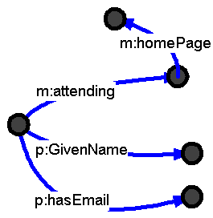
Existing Metadata Standards
RDF graphs...
Based on http://www.w3.org/2000/Talks/1206-xml2k-tbl/slide6-0.html

Slide 14
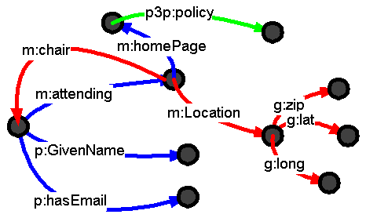
Existing Metadata Standards
...superimpose
Based on http://www.w3.org/2000/Talks/1206-xml2k-tbl/slide7-0.html

Slide 15
Existing Metadata Standards
Web Ontology Language (OWL)
Ontology (from Greek)
  Onto (being)
  Logia (written/spoken discourse)
Description of entities/concepts and their relations
  Like OO language using classes, properties, etc.
ODF 1.2 includes OWL package description
  OWL Classes of pkg:Document, pkg:File, odf:Element
Notes:
OWL instead of WOL like the name of the OWL from Winnie Poh. Symbol of Wisdom, nice marketing.. ;-)

Slide 16
Describing ODF content with RDF
pkg:Document
pkg:Element
pkg:File
pkg:hasPart
pkg:idref
pkg:MetadataFile
pkg:mimeType
pkg:path
xhtml:about
xhtml:content
xhtml:datatype
odf:ContentFile
odf:Element
odf:prefix
odf:StylesFile
odf:suffix
Notes:
Our own RDF Vocabulary to describe our ODF document(s) in the ODF Package.

Slide 17
Using RDF/XML standard in ODF
How connect graph from RDF/XML to ODF Package and ODF XML files?
  RDF/XML not compatible to XPATH
  Data has to be mapped to Lingua Franca of applications
Based on http://www.w3.org/2000/Talks/1206-xml2k-tbl/slide7-0.html

Slide 18



Describing ODF with RDF
Metadata Files in the Package
Meta data manifest
“manifest.rdf”
Content file
e.g. “/content.xml”
RDF file
e.g. “/meta/data.rdf”
Content file
e.g. “/styles.xml”
RDF file
e.g. “/meta/cita.rdf”

Slide 19
Metadata Model of ODF 1.2
Metadata Files in the Package
Content files (e.g. content.xml, styles.xml)
  About 50 ODF elements with xml:id attribute
Metadata manifest (manifest.rdf)
  Heart of metadata model
  Lookup index for application interested in metadata
User RDF/XML files
  Metadata file possibly from an office extension

Slide 20
Metadata Model of ODF 1.2
Metadata Files in the Package
Content files
e.g. “/content.xml”
<table:table xml:id=”someID”>
... Hospital Doctor Duty List ...
</table:table>
Meta data manifest
“/manifest.rdf”
<odf:Element rdf:about="content.xml#someID"/>
RDF files
e.g.“/meta/data.rdf”
<odf:Element rdf:about="../content.xml#someID">
<ex:workingHoursOf>
<med:Doctors rdf:about="John.Example@somewhere.org">
<med:fieldName xml:lang="en">Neurologist</med:fieldN.

Slide 21
Metadata Model of ODF 1.2
In Content Metadata
If metadata is equal text/visual data
Reason: No data duplication
Used by ODF 5 elements:
  Bookmark start - <text:bookmark-start>
  Heading - <text:h>
  Metadata text - <text:meta>
  Paragraph - <text:p>
  Table cell - <table:table-cell>

Slide 22
Metadata Model of ODF 1.2
In Content Metadata
Content files
e.g. “/content.xml”
<text:p>The doctor's name was
<text:meta xhtml:about=”John.Example@somewhere.org”
xhtml:property=”http://xmlns.com/foaf/0.1/name”>
Dr. J. Example</text:meta>
RDF files
e.g.“/meta/data.rdf”
<med:Doctor rdf:about="John.Example@somewhere.org">
<med:hasPatient>
<med:Patient rdf:about=”http://hospital-DB/patients/ID007”>

Slide 23
The RDF Application as Field User
Metadata Text Field
Content of field “text:meta-field” based on metadata
  Appears within paragraph
  Holds any paragraph content
  (E.g. Citation “According to [2]”)
<text:p>According to
<text:meta-field xml:id=”someID”>
<text:style text:style-name=”s1”>[2]

Slide 24
Metadata support in OOo 3.1
Support of metadata in the ODF 1.2 package
API for metadata extension developers
  Providing OOo API to access metadata
  Wrapping existing opensource tool:
  Redland RDF Library – librdf
Possibility of a generic metadata extension
  Import / Create your own RDF vocabulary
  Relate vocabulary to ODF content by GUI

Slide 25
Metadata support in OOo 3.1
Metadata on different Documents in a Package
  Multiple documents in an ODF package
  Metadata relative to document
  Metadata concept reusable by ODF package implementors

Slide 26
Authoring with Metadata in OOo 3.1
Scenarios with Embedded Objects
  Insert Embedded Object
  Extract Embedded Object
  Remove Embedded Object
All details on http://wiki.services.openoffice.org/wiki/Writer/Metadata_Support

Slide 27
Authoring with Metadata in OOo 3.1
Handling of metadata on editing a text document
  Deletion of an entity
  Copy of an entity
  Cut of an entity
  Paste of an entity
  Edit of entity content
  Split of entity
  Merge of two entities
All details on http://wiki.services.openoffice.org/wiki/Writer/Metadata_Support

Slide 28
Scenarios to add Metadata to ODF
ODF Template with Metadata (e.g. formular)
RDF application (e.g. Citation Extension) offers some GUI
Explicitly by the user
  Similar to spell-checker but text pattern base
  (User have to agree on metadata)
  Generic Metadata Extension:
  User choose some RDF Vocabulary and relates vocabulary to ODF content by GUI
Notes:
1) ONCE TEMPLATE PREPARED FOR THE USER (FORMULAR) (PLUGIN CREATOR)
NOTE: ODF 1.2 has XForms support
EU has many of those scenarios (no User Knowledge)
2) Plugin offers GUI (mostly domain specific plugin)
2a) Explicitly by the user (domain level) (PLUGIN CREATOR / OOo USER)
2b) PATTERN MATCHING (PLUGIN CREATOR / OOo USER)
2c) Explicitly by the user (Generic / RDF level) (OOo USER
Choose an RDF vocabulary (from server)
3) By a different application using the OOo 3.1 API (THE PROGRAMMER)

Slide 29
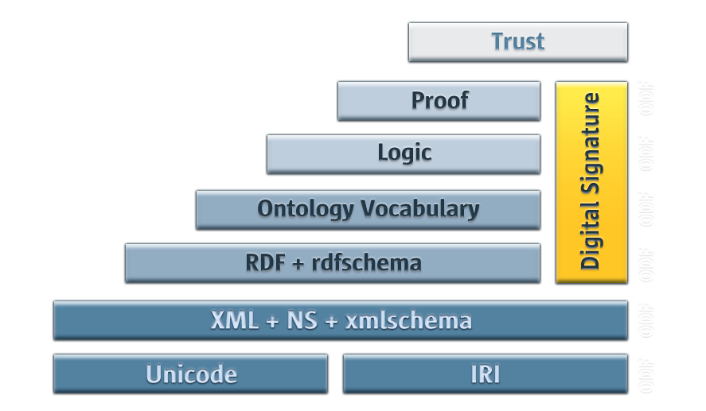
Existing Metadata Standards
Semantic Web Architecture
Based on http://www.w3.org/2000/Talks/1206-xml2k-tbl/slide10-0.html

Slide 30
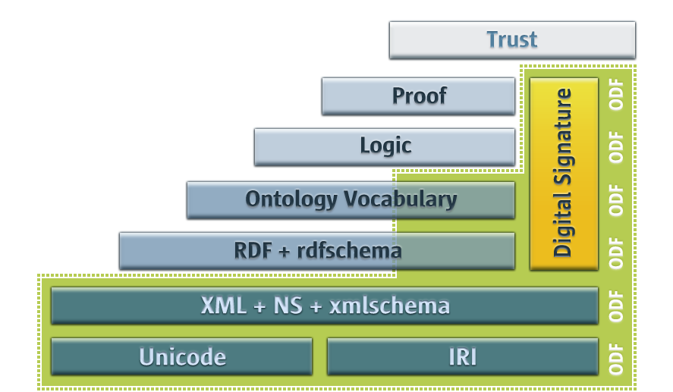
Existing Metadata Standards
ODF in the Semantic Web
Based on http://www.w3.org/2000/Talks/1206-xml2k-tbl/slide10-0.html

Slide 31
More Information
Download latest ODF specification:
  Latest Draft: http://www.oasis-open.org/committees/download.php/29446/08-09-24-ODF-Metadata-Change-Request.odt
  ODF Metadata Examples: http://www.oasis-open.org/committees/download.php/26846/08-01-16-ODF-Metadata-Examples-Committee-Draft.odt (old)
  Upcoming adaptions: http://lists.oasis-open.org/archives/office/200811/msg00006.html
OOo API (not final):
  http://api.openoffice.org/docs/common/ref/com/sun/star/rdf/module-ix.html

Slide 32

Thank you –
Questions & Answers
Svante Schubert
Svante.Schubert@sun.com

