Slide 1



Slide 2

Overview of SMIL Animation and Implementation in IBM Lotus Symphony
Clarence Guo
Software Engineer/IBM

Slide 3
Agenda
What is SMIL
What's new in SMIL 3.0
Characters of SMIL
Animations in Symphony
Looking forward to the animation in Symphony
QA

Slide 4
Agenda
What is SMIL
  SMIL ≠ smile
  Bird's eye on SMIL
  A Sample for the animation
  Main Elements
  Recommended 5-layer structure for the animation
What's new in SMIL 3.0
Characters of SMIL
Animations in Symphony
Looking forward to the animation in Symphony
QA

Slide 5

SMIL
Synchronized Multimedia Integration Language
1.0 published by W3C for web-based multimedia support in 1998, 2.0 in 2000, 3.0 in Oct. 2008
A standard language that is also recommended by OASIS (Organization for the Advancement of Structured Information Standards) and it is integrated into ODF
Defines an XML-based language to get powerful support for interactive multimedia
Sponsors: RealNetworks, IBM, Intel, Microsoft, Macromedia, AOL, Nokia, Panasonic, Philips...
Products: IE, RealOne, QuickTime...

Slide 6
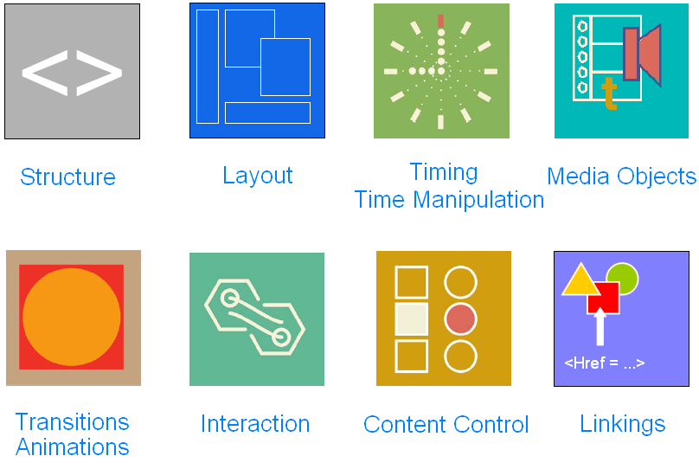
SMIL – Bird's Eye

Slide 7
SMIL – a Sample

Slide 8
SMIL – Main Elements
animateTransform: animates a transformation attribute, e.g., scale, rotate, skew, etc.
animateMotion: animates along a path
animateColor: specifies an animation of a color attribute
transitionFilter: animates the progress of changing a polygon
animate: animates numeric attributes, e.g., x, y, width, height, etc., as well as non-numeric attributes
set: animates simple attributes, e.g., font name, font size, etc.
seq: represents sequence (main or interactive)
par: timing container/Synchronization

Slide 9
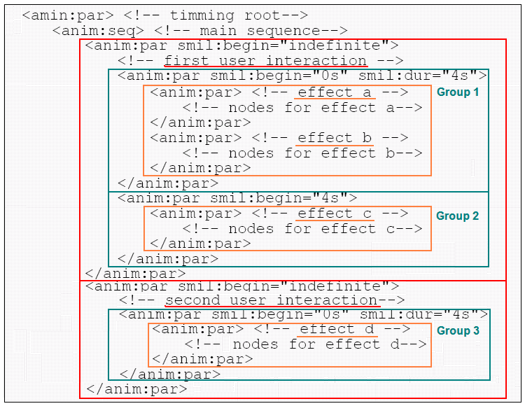





SMIL – 5-layer structure for Animation
par: timming-root
seq: sequence
par: once interaction
par: group starting at the same time
par: an effect

Slide 10
Agenda
What is SMIL
What's new in SMIL 3.0
Characters of SMIL
Animations in Symphony
Looking forward to the animation in Symphony
QA

Slide 11
What's New in SMIL 3.0 (part I)
Three new functional areas
  smilText - a new media type that provides a text container element for defining the timed text, and a set of additional elements and attributes to control timed text rendering
  State - Provides a mechanism for the author to create more complex control flow
  DOM - Better DOM support for programmable content control

Slide 12
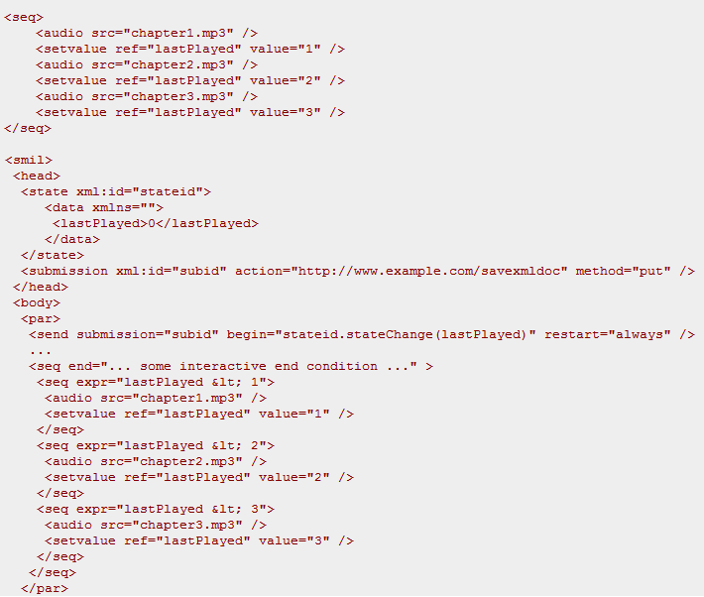
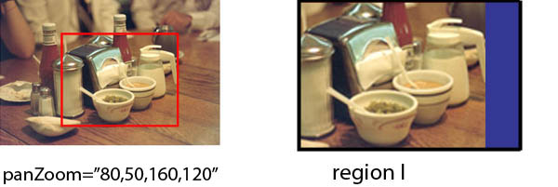

What's New in SMIL 3.0 (part II)
Introduces new modules with extended functionalities
  MediaPanZoom: Defines and manages a two-dimensional rendering space
  MediaOpacity: Allows the opacity of a media object to be defined
  TextStyling & TextMotion: Supports rich text style & motion effect
  StateTest: Determines pre-defined conditions then do the correct thing
  UserState & StateSubmission: Allows elements to be rendered depending on author-defined values / Saves author defined state or to transmit it to an external server
  DOMTimingMethods: Contains DOM methods to start and stop parts of a presentation during playback, and also DOM events that may be used to influence a presentation

Slide 13
What's New in SMIL 3.0 (part III)
Revised some functional areas
  Content Control
  Layout
  Linking
  Media Object
  Timing and Synchronization
  ... ...
No change for animation

Slide 14
Agenda
What is SMIL
What's new in SMIL 3.0
Characters of SMIL
Animations in Symphony
Looking forward to the animation in Symphony
QA

Slide 15
Characters of SMIL
An open and free architecture
Clear responsibility definitions
Easy to learn and use
Integrates/conforms to other standards, e.g., XML, SVG, DOM
Synchronously play multiple multimedia objects that are deployed at different sites
Complex control flow in terms of different situations
Easy to convert to/from other languages, e.g., HyTime
A declarative language; Is Scripting required by experts?

Slide 16
Agenda
What is SMIL
What's new in SMIL 3.0
Characters of SMIL
Animations in Symphony
  Design for model
  Design for UI
  Timing and Drawing
  Design for copy/paste
Looking forward to the animation in Symphony
QA

Slide 17
Animations in Symphony - Design for model
par: timming-root
SvxSmilPar
Mapping to
seq: main Sequence
SvxSmilSeq
par: 1st user interaction
par: 2nd user interaction
SvxSmilPar
SvxSmilPar
par: group 1
par: group 2
par: group 3
SvxSmilPar
SvxSmilPar
SvxSmilPar
par: effect A
par: effect B
par: effect C
par: effect D
SvxSmilPar
SvxSmilPar
SvxSmilPar
SvxSmilPar

Slide 18
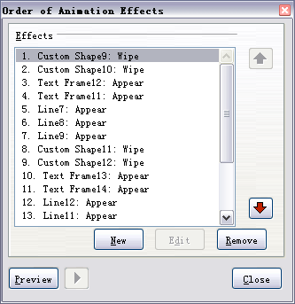
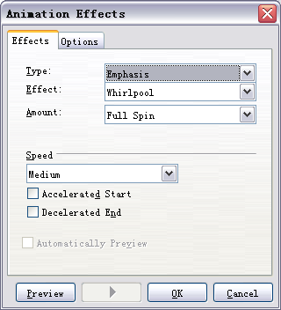
Animations in Symphony - Design for UI

Slide 19
Animations in Symphony - Timing and Drawing
Timing Control
Modal
Object
Drawing Control
Timing
Temporary
Information
SvxSmilPar
Target Object 1
Drawing
Control
Information
Target Object 2
Drawing
Control
Information
Timing
Temporary
Information
SvxSmilSeq
Target Object 3
Drawing
Control
Information
Timing
Temporary
Information
SvxSmilPar
SvxSmilPar
Cloned Object 1
Timing
Temporary
Information
SvxSmilPar
SvxSmilPar
SvxSmilPar
Cloned Object 2
... ...
SvxSmilPar
SvxSmilPar
SvxSmilPar
SvxSmilPar
Cloned Object 3

Slide 20
Design for copy/paste
Target Object 1
par: timming-root
C
l
o
n
e
seq: main Sequence
Target Object 1'
par: 1st user interaction
par: 2nd user interaction
par: 3rd user interaction
par: group 1
par: group 2
par: group 3
par: group 1
par: effect A
par: effect B
par: effect C
par: effect D
par: effect A'
par: effect D'

Slide 21
Agenda
What is SMIL
What's new in SMIL 3.0
Characters of SMIL
Animations in Symphony
Looking forward to the animation in Symphony
QA

Slide 22
Looking forward to the animation in Symphony
Interoperability
Performance
Rich and colorful effects
New UI

Slide 23
Ref Link:
http://www.w3.org/TR/2008/PR-SMIL3-20081006/
Let's SMIL/Smile

Slide 24
Agenda
What is SMIL
What's new in SMIL 3.0
Characters of SMIL
Animations in Symphony
Looking forward to the animation in Symphony
QA

Slide 25


