Slide 1


Slide 2

ESC achievments since Barcelona
OpenOffice.org's Engineering Steering Commitee

Slide 3
Agenda
The ESC Objective and Organization
The ESC Dashboard
...

Slide 4
The ESC Objective
The Engineering Steering Committee (ESC) is responsible for advising the Community Council (CC) of technical implementation.
Constituted by senior engineers appointed by the CC, the ESC is further charged with improving the code submission process.
http://.../about.html

Slide 5
The ESC Organization
The ESC was established by agreement of the Community Council (CC) on 20th Feb 2004.
CC charter drafted starting June 2002; concerns of required “long-term confidentiality” to discuss “Strategic Planning and Resource Allocation”; ESC was proposed.
Members shall be senior engineers which have demonstrated experience working with the project and the code.
More detailed Rules of Organization are at http://council.openoffice.org/esc/

Slide 6
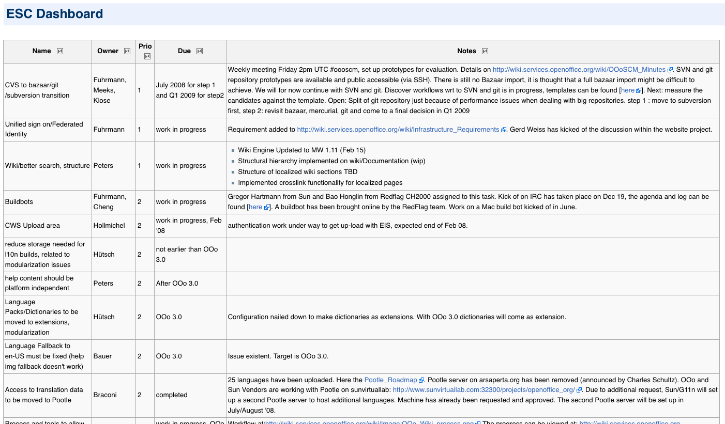
The ESC Dashboard

Slide 7
The ESC Dashboard
The ESC Dashboard is intended to address issues preventing contributions to OpenOffice.org under the current project guidelines.
It reflects a collection of issues raised within the ESC's regular f2f meetings, the priority of those issues and the current status of the resulting ToDo's.
http://wiki.services.openoffice.org/wiki/ESC_dashboard

Slide 8
Dashboard Items (1)
CVS to bazaar/git/subversion transition
  ESC agreed upon a two step approach
    Migration to SVN (clean start towards OOo 3.1)
    Migration from SVN to a DSCM in 2009
  Status: Migration to SVN done
    More then 70 CWSs migrated/created, already
    Several milestone builds done
    100 users until now

Slide 9
Dashboard Items (2)
Wiki/better search, structure
  Wiki Engine Updated to MW 1.11 (Feb 15)
  Structural hierarchy implemented on wiki/Documentation
  Structure of localized wiki sections TBD
  Implemented cross-link functionality for localized pages

Slide 10
Dashboard Items (3)
Buildbots
  Sun maintained:
    Solaris 10 SPARC
    Solaris 10 x86
    Windows XP (cygwin)
    Ubuntu 6.06 32-bit
    Ubuntu 8.04 64-bit
  Community maintained:
    Mac OS X 10.5
    Ubuntu 8.04 32-bit

Slide 11
Dashboard Items (4)
Dictionaries to be moved to extensions
  Done! OOo comes with a defined set of dictionaries, more dictionaries available on extensions.services.openoffice.org
Tools->Spelling->Options->Get more dictionaries online

Slide 12
Dashboard Items (4)
Access to translation data to be moved to Pootle
  Done!
make cvs artwork authoritative
  Done! Image tool does correct updates, so people are able to deal with images within CVS/SVN directly without getting any conflicts.
More ...

Slide 13
Dashboard: Conclusion
We achieved some significant progress but we are by far not done! There are several open issues on the dashboard
The ESC is able to address things, but we need input from the community to pick the right ones:
esc@council.openoffice.org

Slide 14


