Slide 1


Slide 2

Testing OpenOffice.org at Redflag 2000
Zhu Lihua
Beijing Redflag 2000 Software Co., Ltd.

Slide 3
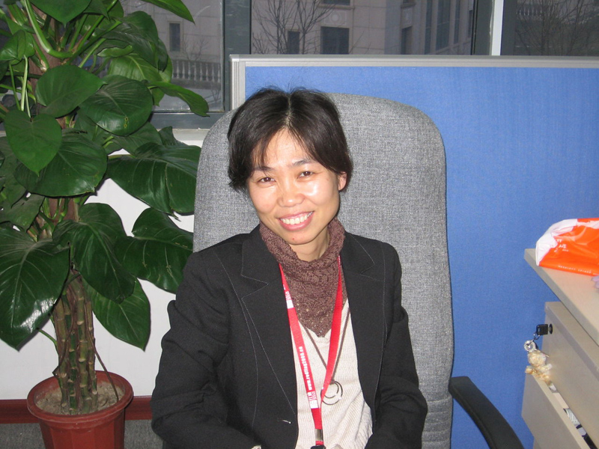
Introduction of QA in Redflag2000
Cheng Hua, the manager

Slide 4
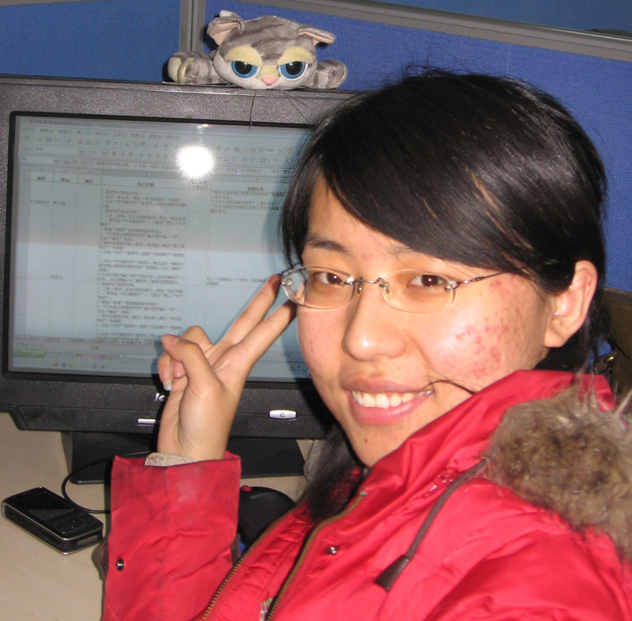
Introduction of QA in Redflag2000
Zhang Hong

Slide 5
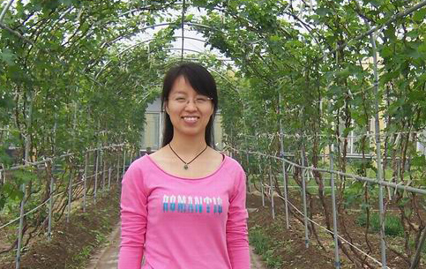
Introduction of QA in Redflag2000
Li Meiying

Slide 6
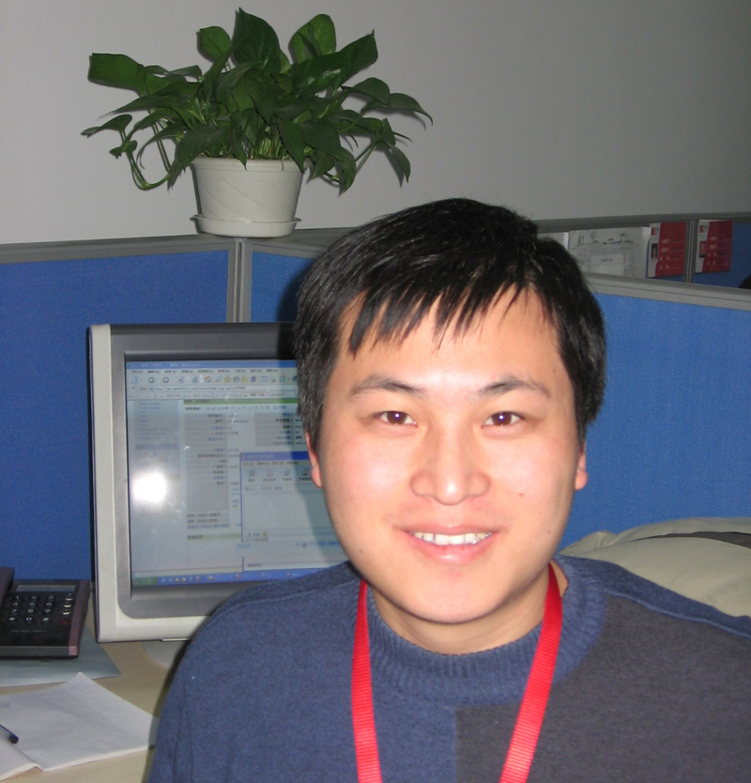
Introduction of QA in Redflag2000
Liu Shibo

Slide 7
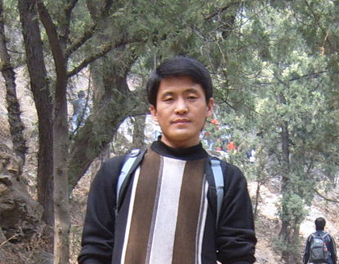
Introduction of QA in Redflag2000
Cheng Huailei

Slide 8
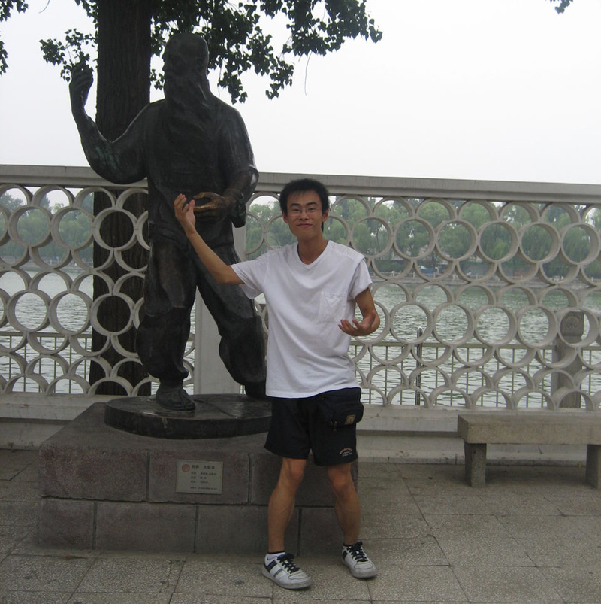
Introduction of QA in Redflag2000
Ji Ming

Slide 9
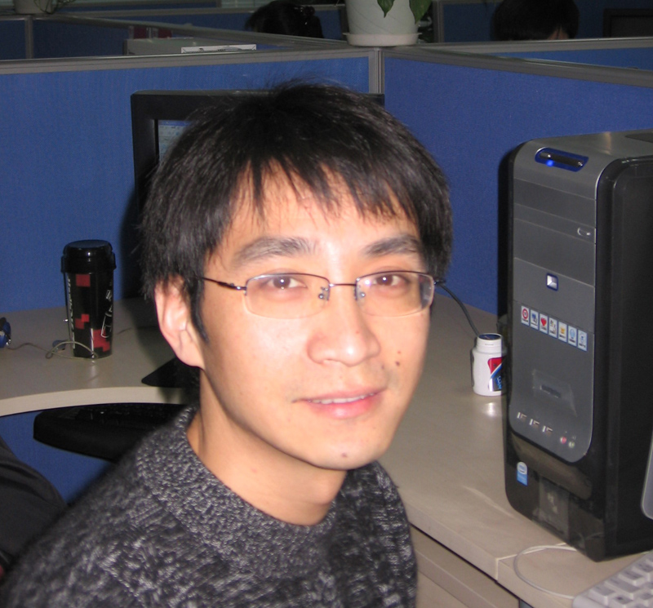
Introduction of QA in Redflag2000
Zhu Lihua

Slide 10
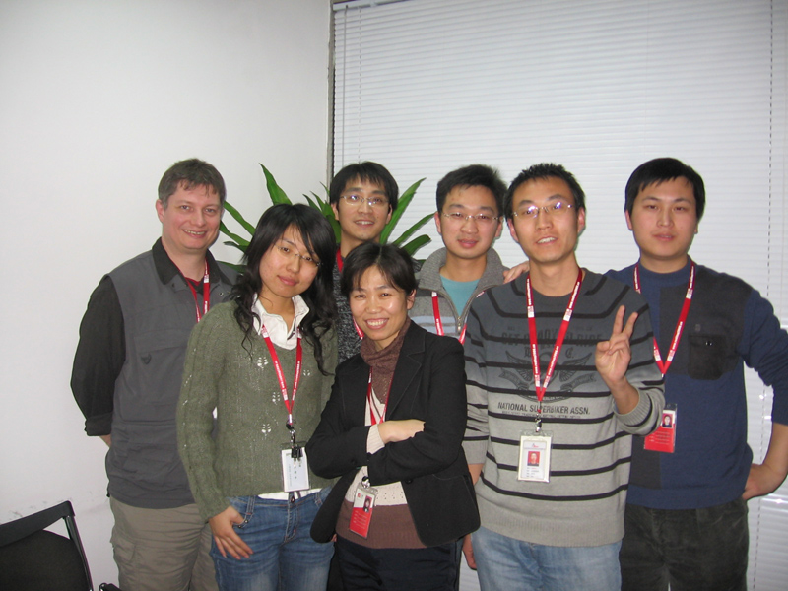
Introduction of QA in Redflag2000
All togeter
  Peter Junge
  Kuang Yong
  Wei Xuqiang

Slide 11
Achievements
TCM Testing
  Localization21
  Localization27
  Localization29
  Translate TCM testcases

Slide 12
Achievements
Issue handling in IssueTracker
  File Issues
  Unconfirmed Issues
  Verified Issues

Slide 13
Achievements
Work in EIS
  uoffilter
  swrefactor071015
  rehearsetiming080318
  formatpaintbrush0803

Slide 14
Achievements
QATrack
  OpenOffice.org 2.4.0
  OpenOffice.org 3.0.0

Slide 15
Plan
Continue the works in the Issue handling, TCM, and QAtrack
Make further efforts to contribute in TestTool automation test

Slide 16
Difficulties and Ideas
Difficulties
  Working experiences
  Background knowledges
  Specifications/Documentations
  Language Skills

Slide 17
Difficulties and Ideas
Ideas
  Learn from work
  Consult the mailing lists
  Study, study, study

Slide 18
Appreciations
Co-workers participated in TCM tests, issue handling
Volunteers in zh.openoffice.org
Mentors in qa.openoffice.org
Special thanks to Peter Junge

Slide 19
Questions?

Slide 20


