Slide 1
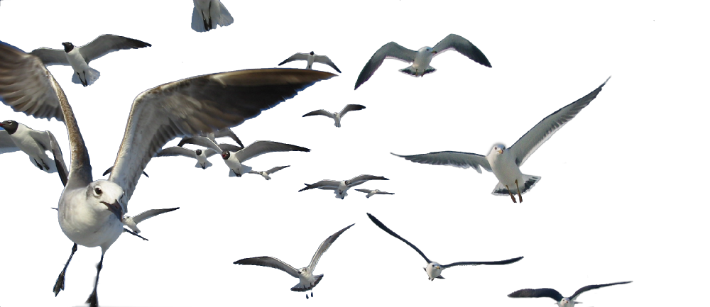

YOUR OpenOffice.org
Magazine
Claudio F Filho
Líder NLP pt-BR

Slide 2
We had a dream!
Based on old fanzines, several comunities have created their magazines on IT, such as Linux, Distros, Hacks among others. So why not a magazine on BrOffice.org, OpenOffice.org and ODF?
We did it:
Notes:
I work with IT since 86 and in there time to here, we has our fanzine in txt, after in doc, and now, in html or pdf.

Slide 3
How to start?
What to do??
What do we need in a magazine?
  Definition of:
    Basic elements – what constitutes a magazine?
    Communication formats – visual, graphical, textual;
    Public – to whom is it addressed?
    Distribuition.
  OBJECTIVES !!!!
Notes:
Basic elements: front, index, editorial and content.
Communication formats – how and why will be in this form and not in other? How send a msg for our readers?
Public – we have a defined public? If yes, who? How? When?
And Distribution – how we will distribute this magazine?
But, after all this stude, we thinked: Why?
What are ours goals?
After this point, we started to think about.

Slide 4
Objectives
Main Objective:
  Have a media product to address the community and NGO BrOffice.org in the country!
Specific Objectives:
  Promotion of BrOffice.org / OpenOffice.org
  Product documentation, with tips and tutorials
  Consolidate BrOffice.org, OpenOffice.org and ODF brands.
  Proof of concept on the tool;
Notes:
The main objective
Specific objectives
* we need discovery other ways to be more closed of final user (or “normal user”) and a magazine was one of ideas of Broo community;
* Present content in other form, more beaultful that the “generic way” (only a big text);
* Broo is well known in Brasil, but not out, so, broo zine also is a good way to promote our community and start relationship with other communities;
* Is possible to use Draw as publish tool?

Slide 5




Begining: magazine structure
Initial talks in dev@br-pt.ooo
Redirected to broo-clipping@listas.broo
  What DTP tool to use?
  What graphics tools to use?
  Visual presentation?
Notes:
* The discussion of idea started in Ooo lists and won a exclusive list;
* What DTP tool is better? Criterias:
* multi-plataform;
* translated;
* free !!!
* That we can give support for new users, , exist knowledge in our community.
* And the graphics tools? Same thing. But above all, aways using open standarts!!!
ODG (ODF), SVG, PNG and some cases jpg or others poor/estrange formats.
* How will be the design of our magazine?!?!

Slide 6

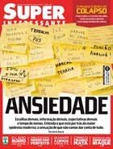
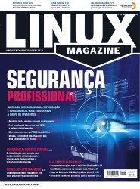
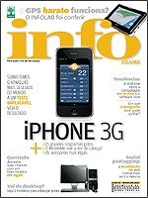

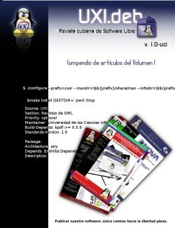
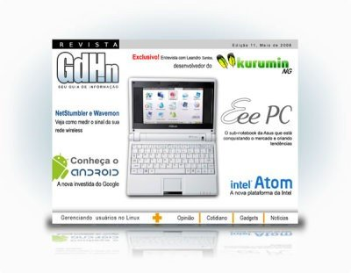
Comerciais - Variedades
Comerciais - Informática
Comunidades de projetos, generalidades e linux
Notes:
We started a stude of others magazines in market and community.

Slide 7

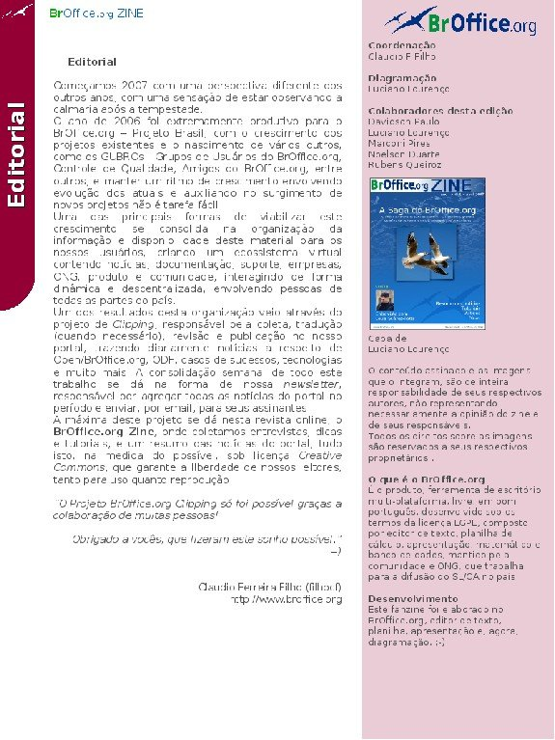
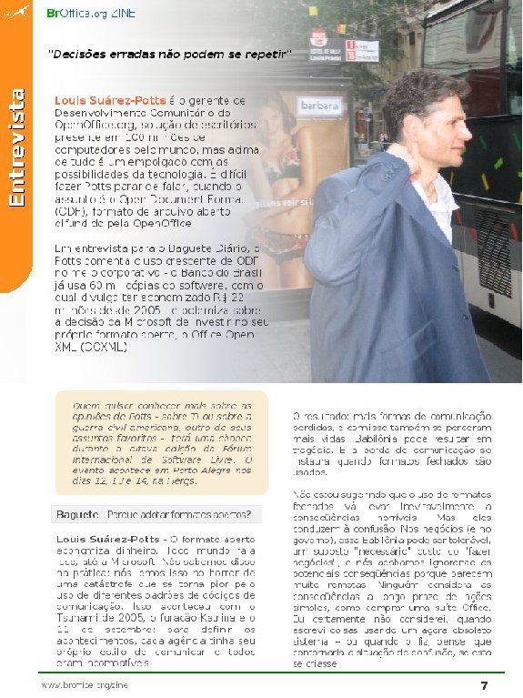
Visual achievements
This Fanzine has been prepared in BrOffice.org, word processor, spreadsheet, presentation, and now publishing. ;-)
Notes:
So, we got our inicial look.
* Cover – brand, language, content
* Editorial – “msg of editor”, colaborators, and details about the Open/BrOffice.org, and details about the development:
“this fanzine
* internal example: a interview of Louis Suaréz-Potts.
Visual elements:
* section – you know where you are;
* visibility – spaces in page, colors and fonts good to read;
* pages and language

Slide 8
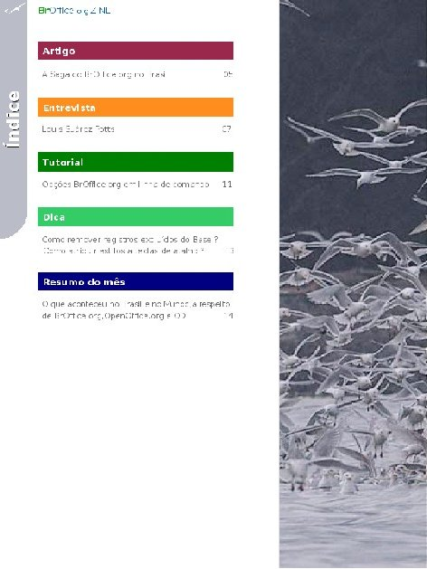
Textual achievements
Papers
Contents from experts in Broo/OOo/ODF, in clear and didactic format
Interviews
People that move things, local and Intn'l personalities on OO/ODF, Relevant local CIOs, developers, etc...
Tutorials
Papers with hints and how-tos on basic and advanced usage of BrO / OO;
Tips
Quick suggestions on methods, applications, extensions, sites and technologies
Monthly summary
The main news listed in clear and accessible format for quick search
Notes:
Other sections
* How we do...
* Letters of readers
* Open Office

Slide 9
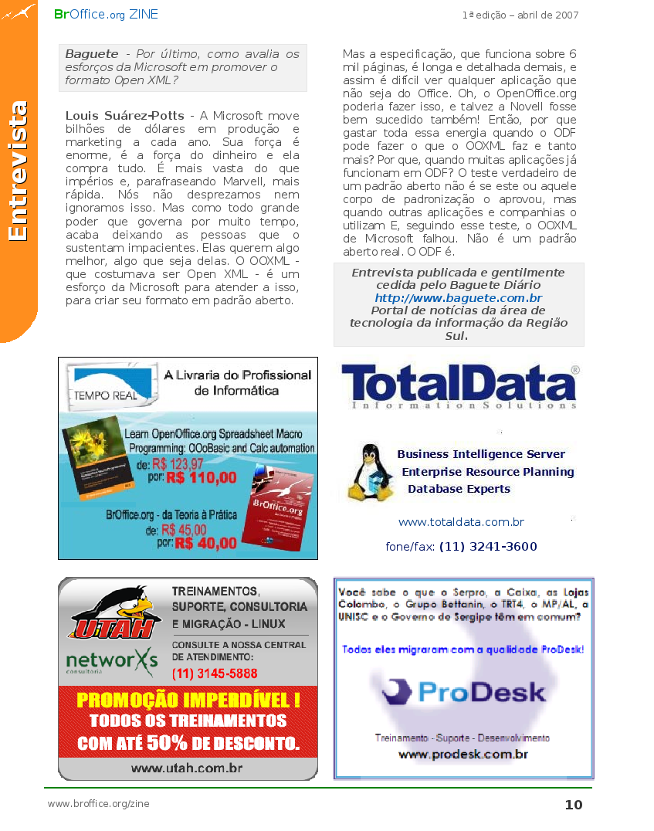
Proof of concept
Scope?
Consumers?
Distribution?
Sustainable?

Slide 10
Results
100.000 !!!

Slide 11

Collateral effects
Profitability is possible
  1st edition ~ 1,100 U$.
Getting closer with other communities
Gov. recognition
New volunteers in many
other knowledge areas
Other languages:
pt-BR, gl, es, fr & en.

Slide 12
Issues
Allow import of SVG (Scalable Vector Graphics) (bug #2497);
Allow text box frames in Draw/Impress to be linked for text overflow (bug #33501)

Slide 13
Today and tomorrow
Today – Open issues
  Time regularity
  Lack of business-wise personnel
  Content management - clipping
Today – Issues resolved
  Peoples committment
  Business partnerships
Tomorrow
  Personnel hiring and business sutainable

Slide 14
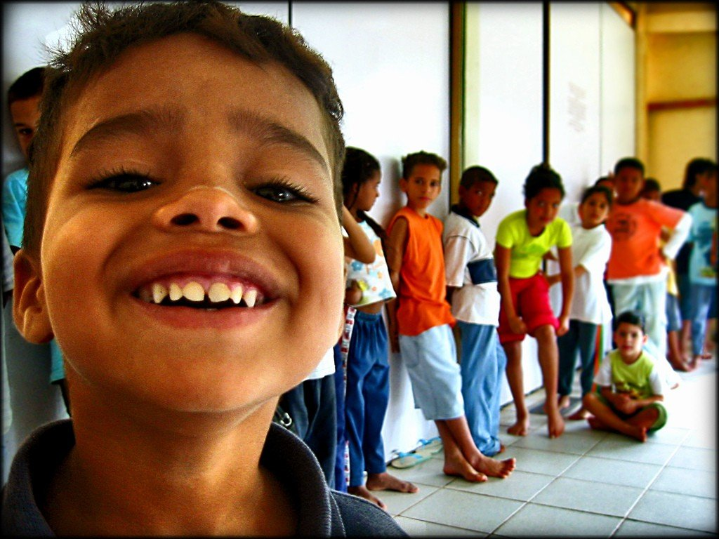


You
Also
CAN
CONTRIBUTE!!
Thanks !!!
OpenOffice.org e.V.
Olivier Hallot by
translation. ;-)
Contacts:
Claudio F Filho
filhocf@openoffice.org

