Slide 1


Slide 2

Visualize Writer Document Structure for Productive Development
Jian Hong Cheng
E-mail:chengjh@cn.ibm.com
Lotus Symphony Docments Developer/IBM

Slide 3

Agenda
Writer's Challenges to Developers
A Tool Based on Visualizing Data Infrastructure of Writer
Benefits of the Tool
Future Enhancements of the Tool
Q/A?

Slide 4

Writer's Challenges to Developers
Challenges
  Powerful and complex OpenOffice Writer
  Unexpectedly damaged frame structure or data relations
  Easily plunged into disordered situations for developers when tracing Writer code
  Poor productivity to solve problems,especially related to formatting
Requirements
  Possibility to solve problems quickly,avoiding to study complex code details
  Possibility to share knowledge in practical code study

Slide 5
Agenda
Writer's Challenges to Developers
A Tool Based on Visualizing Data Infrastructure of Writer
Benefits of the Tool
Future Enhancements of the Tool
Q/A?

Slide 6
A Tool Based on Visualizing Data Infrastructure of Writer
Main Idea
  Record information of node and frame for visualization
  Compare the information snapshots to identify the information changes
  Diagnose root cause through analysing the data changes
  Organise the visualization information with hierarchy structure
Implementation
  Provide functions to go through all the nodes and print out the nodes' index, type, string content,memory address and their relations
  Provide functions to go through all frames and print out their type, memory address,register's address and their relations
  Print portion information along with printing the information of a frame

Slide 7
Agenda
Writer's Challenges to Developers
A Tool Based on Visualizing Data Infrastructure of Writer
Benefits of the Tool
Future Enhancements of the Tool
Q/A?

Slide 8
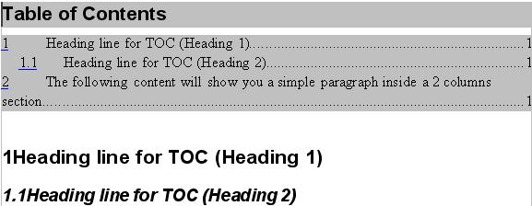
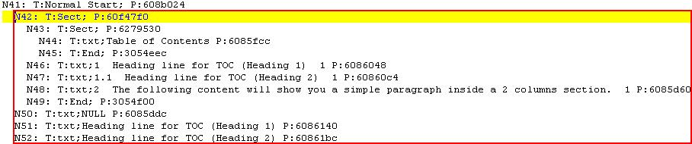
Benefits of the Tool
Visualize Nodes Information
Segment of a document
Snapshot of visualizing these nodes

Slide 9
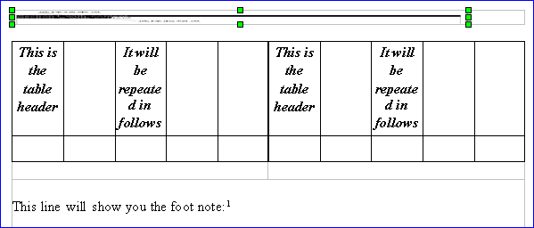
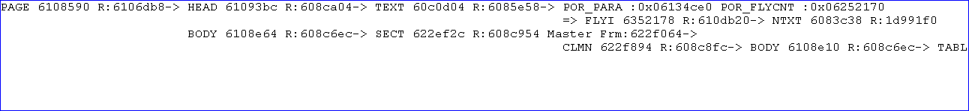
Benefits of the Tool
Visualize Frames Information (1)
Segment of a document
Snapshot of the Segment

Slide 10
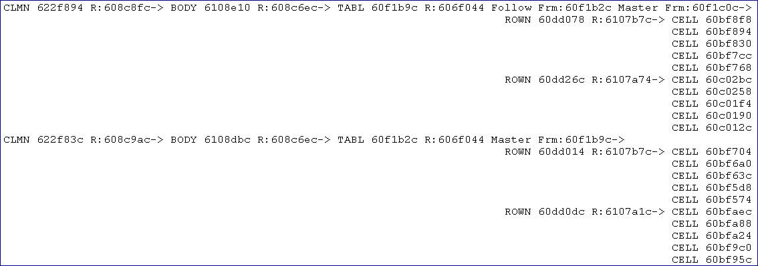
Benefits of the Tool
Visualize Frames Information (2)

Slide 11
Benefits of the Tool
How to use?
  Integrate the tool into development environment
  Call the appropriate functions in the execution path of an operation
  Not able to be used independently

Slide 12
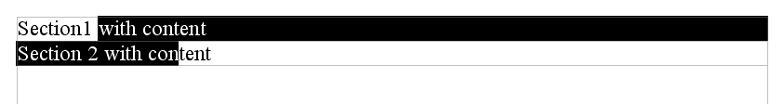
Benefits of the Tool
An Operation Description:
  Launch Writer and New a Document
  Insert 2 parallel sections into the beginning of the document and Input some words in both sections
  Select some words from any position of the second section to certain middle position of the first section, delete the selected content
  Undo once, writer crashed
The tool is used to know about how the data changes

Slide 13
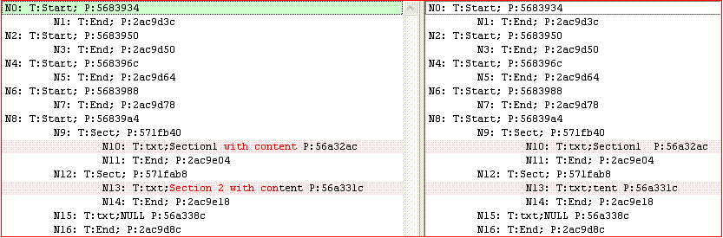
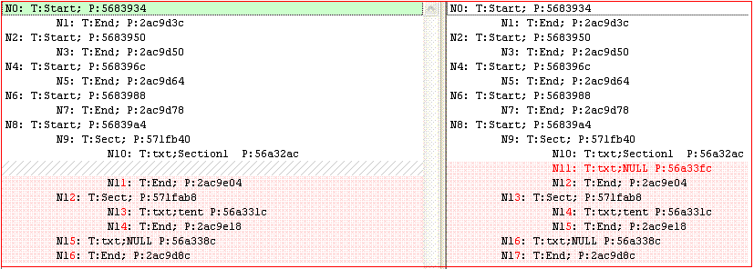
Benefits of the Tool
Actually, Including Five Actions
  The first action is to delete the selected content
  The second action is to create a copy node for the first section

Slide 14
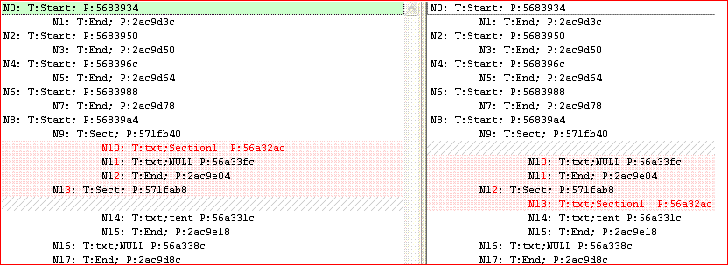
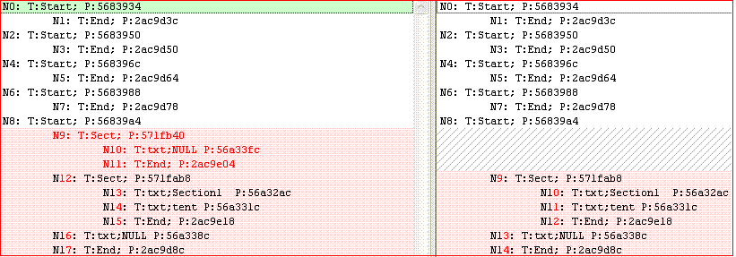
Benefits of the Tool
An Operation - Actions
  The third is to move the first node to the beginning of the second section
  The fourth is to move nodes within selected scope to the undo node list

Slide 15
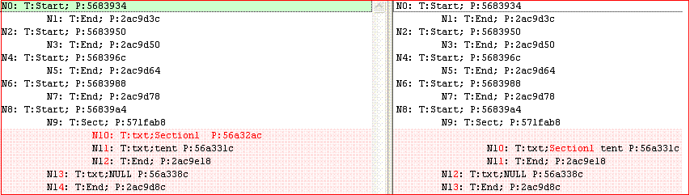
Benefits of the Tool
An Operation - Actions
  The fifth action is to merge the left content from the front to the back

Slide 16
Benefits of the Tool
A Formatting Problem Description:
  Open the sample file and Select Tools->Footnotes menu item
  Input text in "End of Footnote" and "Start of next page" text box in Footnotes tab page, then click OK
  Close the document,Writer Crash...
  The tool is used to find out the frame whose relation has problem

Slide 17
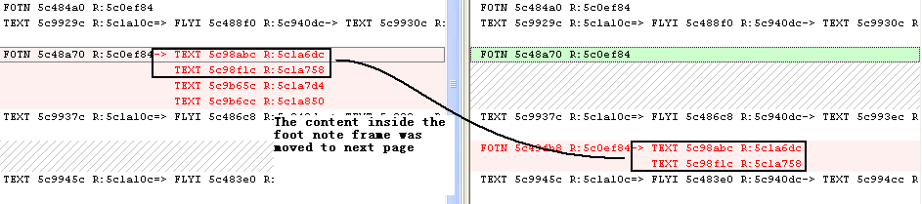
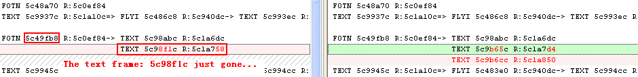
Benefits of the Tool
A Formatting Problem's Snapshot Comparison:
  Comparison 1:Move and Append to the Next Page
  Comparison 2:Relation Destroyed by New Move and Append Action

Slide 18
Agenda
Writer's Challenges to Developers
A Tool Based on Visualizing Data Infrastructure of Writer
Benefits of the Tool
Future Enhancements of the Tool
Q/A?

Slide 19
Future Enhancements of the Tool
Currently Supported
  Visualized node information
  Visualized frame information
  Visualized portion information
Future Enhancements
  Record controller and activity Information
  Make rules to support diagnostic capability automatically
  Generate analysis report

Slide 20


