Slide 1


  Life of one NL project
  History of Bulgarian NL project

Slide 2


Topics
Introduction of the team
  Who am I?
  Others people from the team
The BEGINNIN
  Starting localization
  Native-Language Project was born
Difficulties and resolves
  Translation specification
  Place to store translations
  Place to gather people
Future activities
  Involving firms to produce and sell CDs
  Introduction of OOo 2.0
  Lectures of using OOo
  User support for firms
Lessons to be learned

Slide 3
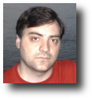
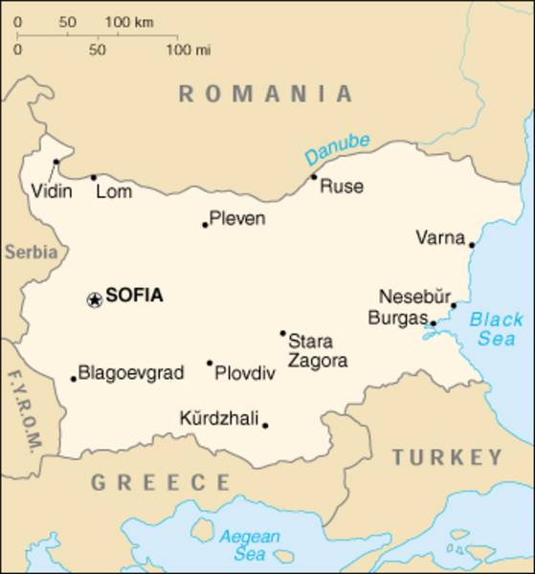



The team
Who am I?
30 years old, married, one baby :-)
Born in Lom
Living in Sofia (capital of Bulgaria)
Discovered OOo 3 years ago
Involved in OOo for 2 ½ years
Java programmer
Graduated at Technical University in Sofia
  Information technologies
Favorite colors: green and red :-)

Slide 4
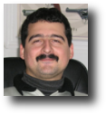
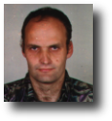
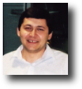
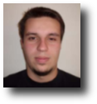

The team
Others people from the team
Michail Balabanov
This is our major expert in translation and editor. One of the authors of the Translation of GUI in Bulgarian Specification. Helped a lot to have what we have now.
Sergei Dimitrov
New member of the team. Graduated Technical University in Sofia. He has worked as teacher of information technologies. Now he is helping users of the "RINGS" system.
Radostin Radnev
Programmer and the author of the spelling, hyphenation and thesaurus dictionaries in the OpenOffice.org
Plamen Nikolov
Student in University of National and World Economy and helped in translation of OpenOffice.org 1.1.x

Slide 5
The BEGINNING
Starting localization
Internationalization of OpenOffice.org in Bulgarian
Getting some translations before (some translation of the Glossary)
Gathering people to make a team
Split the GSI file to small peaces for easy work
Making some tools to help translation

Slide 6
The BEGINNING
Native-Language Project was born
After translation of the interface finished, using of the OpenOoffice.org start to grow
Need of place to gather people using OpenOffice.org
Proposal of Bulgarian Native-Language Project dispatched
After long discussion the rules of creation of NLP changed
Bulgarian team was happy to have own NLP created on 14.10.2004.

Slide 7
Difficulties and resolves
Translation specification
  Specification of GUI translation in Bulgarian
  Dictionary of used terms
Place to store translated files
  First place was http://sourceforge.net/projects/lug-bg/
  Second place is http://sciforge.org/projects/ooo-bg
Long strings problems
  Very hard to be resolved, maybe in the future will have layouts
Place to gather people
  Web page to welcome people
  Forum to get questions of these people
  Mail lists to help work of the project

Slide 8
Future activities
Involving firms to produce and sell CDs
  Confidential Information Technologies
Introduction of OpenOffice.org 2.0
  Confidential Information Technologies has some plans to make an introduction of OpenOffice.org 2.0 when it is released.
Lectures of using of OpenOffice.org
  I hope to be done in the near future
User support for firms
  Research of IT market for OpenOffice.org support and publishing this information on the web page of our project.

Slide 9
Lessons to be learned
Never do all things alone :)
Be patient and all will come on his time
Ask people to help you and they will
Gain more people to join the team so more work to be done
Translations needs rules to be a good one
People needs a leader to remind them that there is work to be done :)
Meetings with other translation teams which will help to have equal translations of terms in different programs
Good tools to help translation process

Slide 10
Q U E S T I O N S ?

